Slide 1
Do-more Technical Training
Handouts

Slide 2
Point #1: Device-centric
Hardware or System Resource
Server
Device
Instruction
Memory

Slide 3
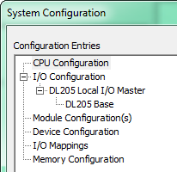
Point #2: Configuration Hierarchy
CPU Configuration
I/O Configuration
Module Configuration(s)
Device Configuration
I/O Mappings
Memory Configuration

Slide 4
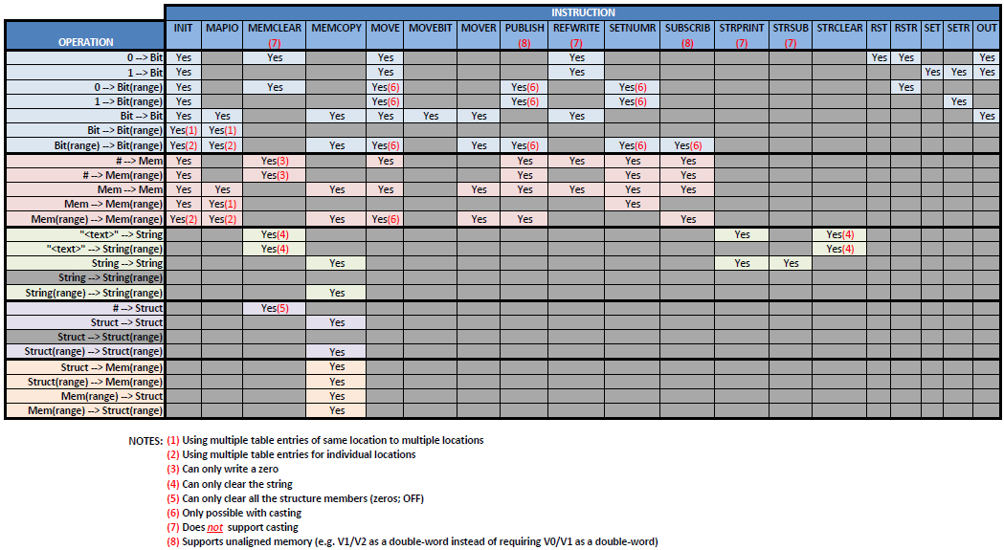
Instruction Set (Misc/Data Manipulation)
Picking the Best Instruction

Slide 5
Communications – Custom Serial
Custom Protocol | Type | Data Size | Client Instruction | Server Instruction | Server Member
Serial | Stream | Unlimited | STREAMOUT | STREAMIN | InQueue (# of bytes)
 |  |  | STREAMIN | STREAMOUT
TCP |  |  | OPENTCP | TCPLISTEN
 |  |  | STREAMOUT | STREAMIN
 |  |  | STREAMIN | STREAMOUT
UDP | Packet | 1 packet | PACKETOUT | PACKETIN | PacketAvailable (bit)

Slide 6
Communications – DirectLOGIC
# | Master CPU | Ethernet Port | Instruction | Device | Protocol
1 | Do-more | Internal | DLRX/DLWX (Module ID) | @IntEthernet | Broadcast Ethernet II
2 |  |  | DLRX/DLWX (IP Address) |  | UDP
3 |  | ECOM100 | DLRX/DLWX (Module ID) | @ECOM_001 | Broadcast Ethernet II
4 |  | ECOM100 (Peer-to-Peer) |  |  | UDP
5 | DL-PLC | ECOM100 | ECRX/ECWX (Module ID) | n/a | Broadcast Ethernet II
6 |  | ECOM100 (Peer-to-Peer) |  |  | UDP

Slide 7
Communications – DirectLOGIC
# | Slave CPU | Ethernet Port | Protocol | Device | Memory Available
1 | Do-more | Internal | Broadcast Ethernet II* | @IntEthernet | DL-memory
2 |  |  | UDP
3 |  | ECOM100 | Broadcast Ethernet II | @ECOM_001
4 |  |  | UDP
5 | DL-PLC |  | Broadcast Ethernet II | n/a | V, X, Y, C, S, T, CT, GX, GY, SP
6 |  |  | UDP
* - Currently (as of May-2016) does not work

Slide 8
Communications – Modbus TCP
# | Master CPU | Ethernet Port | Instruction | Device | Function Codes
1 | Do-more | Internal | MRX/MWX | @IntModTCPClient | 1-7, 15, 16
2 |  | ECOM100 (Modbus TCP Peer-to-Peer) | DLRX/DLWX¹ | @ECOM_001 | 1-4, 15, 16
3 | DL-PLC |  | ECRX/ECWX² | n/a
¹ Must use Client table in “ECOM100 Server Client Mapping (Do-more).PDF” file to choose correct Function Code & Modbus memory address
² Must use Client table in “ECOM100 Server Client Mapping.PDF” file to choose correct Function Code & Modbus memory address

Slide 9
Communications – Modbus TCP
# | Slave CPU | Ethernet Port | Device | Function Codes | Memory
1 | Do-more | Internal | @ModbusTCPServer | 1-7, 15, 16, 22 | M-memory
2 |  | ECOM100 | @ECOM_001 | 1-6, 15, 16 | DL-memory¹
3 | DL-PLC |  | n/a |  | C, CT, GX, GY, S, SP, T, V, X, Y & Internal ECOM100 memory²
¹ Must use Server table in “ECOM100 Server Client Mapping (Do-more).PDF” file to see where a Function Code & Modbus memory address maps into DL-memory
² Must use Server table in “ECOM100 Server Client Mapping.PDF” file to see where a Function Code & Modbus memory address maps into DL-PLC memory

Slide 10
Communications – Modbus TCP
There are actually 3 Modbus protocols
(1) Modbus RTU
Modbus RTU Telegram
Address
Function Code
Data
Checksum

Slide 11
Communications – Modbus TCP
There are actually 3 Modbus protocols
(2) Modbus TCP
TCP/IP Frame
Modbus TCP Telegram
Transaction Identifier
Protocol Identifier
Length Field
Unit ID
Function Code
Data

Slide 12
Communications – Modbus TCP
There are actually 3 Modbus protocols
(3) Modbus Over TCP
Modbus Over TCP is just a Modbus RTU Telegram encapsulated in a TCP/IP Frame
TCP/IP Frame
Modbus RTU Telegram
Address
Function Code
Data
Checksum
Do-more & ECOM100s do not natively support Modbus Over TCP
However, it can be accomplished in Do-more using a Custom TCP Device & using the CHECKSUM instruction to calculate the “Checksum” portion of the telegram

