Slide 1
Do-more Technical Training
Trainers

Slide 2
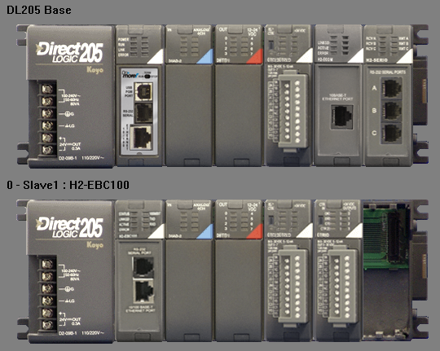
Training Station Hardware (Student)
H2-DM1E
F2-08SIM
F2-8AD4DA-2
D2-08TR
H2-ECOM100
H2-SERIO4
H2-EBC100
F2-08SIM
F2-8AD4DA-2
D2-08TR
H2-CTRIO2

Slide 3
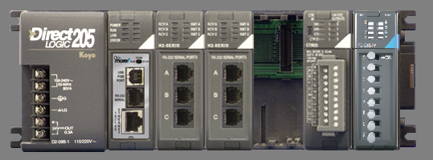
Training Station Hardware (Comm PLC)
H2-SERIO4
H2-CTRIO2
H2-DM1E
H2-SERIO4
F2-08SIM

Slide 4
Training Station Communication
Serial Comms
PLC: 10.1.1.110
EC: 10.1.1.111
EBC: 10.1.1.112
Stepper, encoder, 2 limit switches
Comm PLC: 10.1.1.200
TCP, UDP &
Serial Comms
PLC: 10.1.1.120
EC: 10.1.1.121
EBC: 10.1.1.122
Ethernet Switch
PLC: 10.1.1.130
EC: 10.1.1.131
EBC: 10.1.1.132
PLC: 10.1.1.140
EC: 10.1.1.141
EBC: 10.1.1.142
EDRV100
10.1.1.115
Raspberry Pi: 10.1.1.8
adcsmiley.tld
EDRV100
10.1.1.125
SNTP, DNS,
Email & DHCP
PLC: 10.1.1.150
EC: 10.1.1.151
EBC: 10.1.1.152
EDRV100
10.1.1.135
Links
Ethernet I/O
DL Comms
TCP & UDP
Serial
CTRIO2
SNTP, DNS, Email…
To laptops’ Ethernet Switch

