Slide 1
Do-more Technical Training
System Configuration
(Memory Configuration)

Slide 2
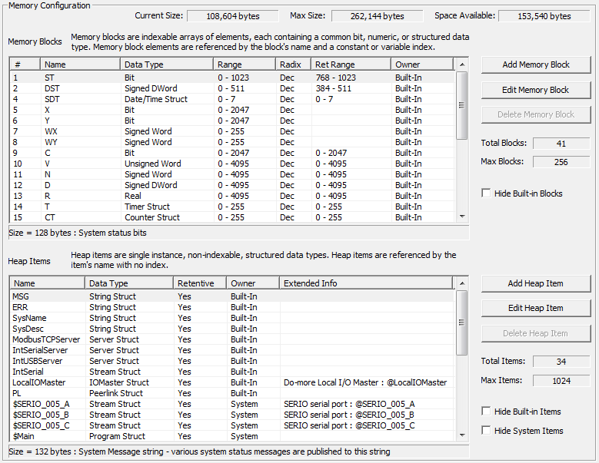
System Configuration
Memory Configuration
Memory Blocks
Add
Edit
Delete
Hide Built-ins
Heap Items
Add
Edit
Delete
Hide Built-ins
Hide System
Notes:
Launchpad: nothing new here
Project Browser:
Buttons
Control Logic Filter – Display filter
New Code Block – Create new code blocks
Execution Order – Change execution order of blocks
Status – Shows which blocks are enabled to run
Sort Code Blocks – Change display order
Sort Memory – Change display order
Control Logic
Configuration
Tools
Debug View
NOTE: Message Dump – enables dump to Do-more Logger, $EnableMsgDump (ST36)
Data View
PID Overview

Slide 3
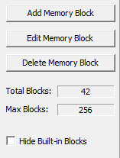
System Configuration
Memory Configuration
Memory Blocks
Indexable
(Fred0, Fred1, Fred2, etc.)
Common data type
(bits, numeric, structure)
Referenced by name & index
(Fred0, Fred[V15])
Cannot be created while editing ladders
Notes:
Launchpad: nothing new here
Project Browser:
Buttons
Control Logic Filter – Display filter
New Code Block – Create new code blocks
Execution Order – Change execution order of blocks
Status – Shows which blocks are enabled to run
Sort Code Blocks – Change display order
Sort Memory – Change display order
Control Logic
Configuration
Tools
Debug View
NOTE: Message Dump – enables dump to Do-more Logger, $EnableMsgDump (ST36)
Data View
PID Overview

Slide 4
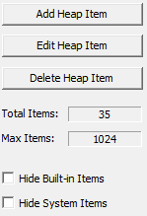
System Configuration
Memory Configuration
Heap Items (single instance)
Not Indexable
(Fred, Wilma, Barney, etc.)
Common data type
(structure only)
Referenced by name (no index)
(Fred, Wilma, Barney, etc.)
Can be created while editing ladders
NOTE: If created while editing ladders, cannot download in RUN mode because System Configuration was changed.
Notes:
Launchpad: nothing new here
Project Browser:
Buttons
Control Logic Filter – Display filter
New Code Block – Create new code blocks
Execution Order – Change execution order of blocks
Status – Shows which blocks are enabled to run
Sort Code Blocks – Change display order
Sort Memory – Change display order
Control Logic
Configuration
Tools
Debug View
NOTE: Message Dump – enables dump to Do-more Logger, $EnableMsgDump (ST36)
Data View
PID Overview

Slide 5
System Configuration
Memory Configuration
TYPE | MEMORY BLOCKS | HEAP ITEMS
Bit | Yes | No
Unsigned / Signed Byte | Yes | No
Unsigned / Signed Word | Yes | No
Signed Word | Yes | No
Real | Yes | No
Timer Struct | Yes | Yes
Counter Struct | Yes | Yes
String Struct | Yes | Yes
PID Struct | Yes | Yes
Date/Time Struct | Yes | Yes
Task Struct | Yes | Yes
Rampsoak Struct | Yes | Yes
Program Struct | Yes | Yes
DeviceRef Struct | Yes | Yes
Drum Struct | Yes | Yes
Notes:
Launchpad: nothing new here
Project Browser:
Buttons
Control Logic Filter – Display filter
New Code Block – Create new code blocks
Execution Order – Change execution order of blocks
Status – Shows which blocks are enabled to run
Sort Code Blocks – Change display order
Sort Memory – Change display order
Control Logic
Configuration
Tools
Debug View
NOTE: Message Dump – enables dump to Do-more Logger, $EnableMsgDump (ST36)
Data View
PID Overview

