Slide 1
Do-more Technical Training
System Configuration
(I/O Mapping)

Slide 2
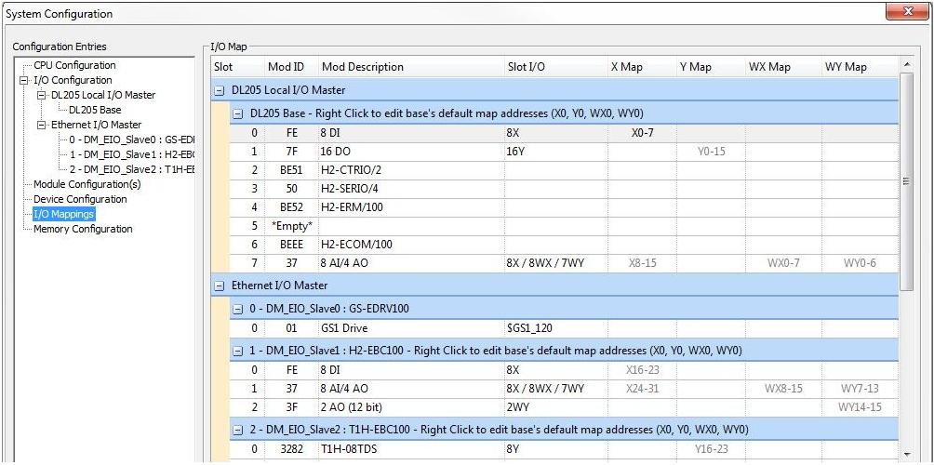
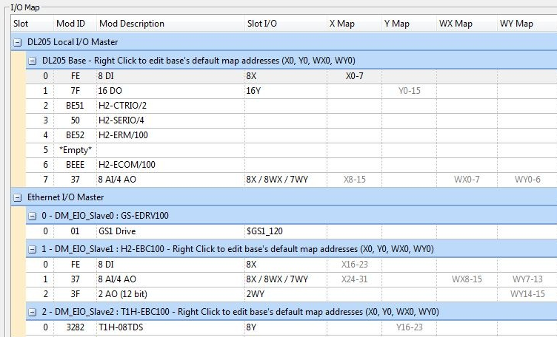
System Configuration
I/O Mapping
Grouped by I/O Master
Then by Base/Slave
Headings:
Slot
Mod ID
Mod Description
Slot I/O
X Map / Y Map / WX Map / WY Map
Notes:
Launchpad: nothing new here
Project Browser:
Buttons
Control Logic Filter – Display filter
New Code Block – Create new code blocks
Execution Order – Change execution order of blocks
Status – Shows which blocks are enabled to run
Sort Code Blocks – Change display order
Sort Memory – Change display order
Control Logic
Configuration
Tools
Debug View
NOTE: Message Dump – enables dump to Do-more Logger, $EnableMsgDump (ST36)
Data View
PID Overview

Slide 3
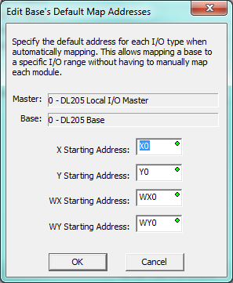
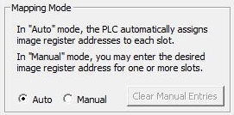
System Configuration
I/O Mapping
Decimal Addressing!
Auto – addresses are gray
PLC assigns addresses
Manual – addresses are black
User-assigned addresses
Only beginning address can be specified
Map range overlaps are red
Map values exceeding memory range are bold red
Right-click to edit base’s default map
Clear Manual Entries
WARNING
Manual configuration can change the mapping for other modules!
Notes:
Launchpad: nothing new here
Project Browser:
Buttons
Control Logic Filter – Display filter
New Code Block – Create new code blocks
Execution Order – Change execution order of blocks
Status – Shows which blocks are enabled to run
Sort Code Blocks – Change display order
Sort Memory – Change display order
Control Logic
Configuration
Tools
Debug View
NOTE: Message Dump – enables dump to Do-more Logger, $EnableMsgDump (ST36)
Data View
PID Overview

