Slide 1
Do-more Technical Training
System Configuration
(I/O Configuration)

Slide 2
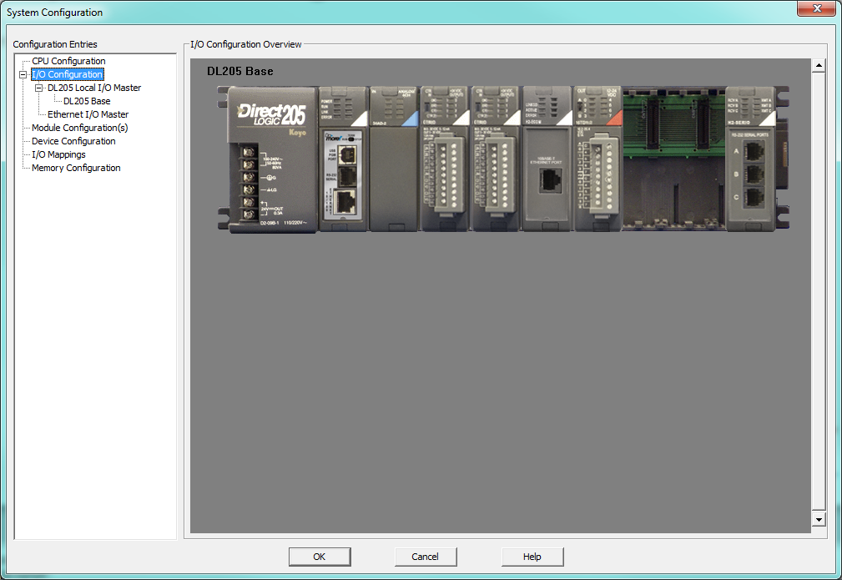
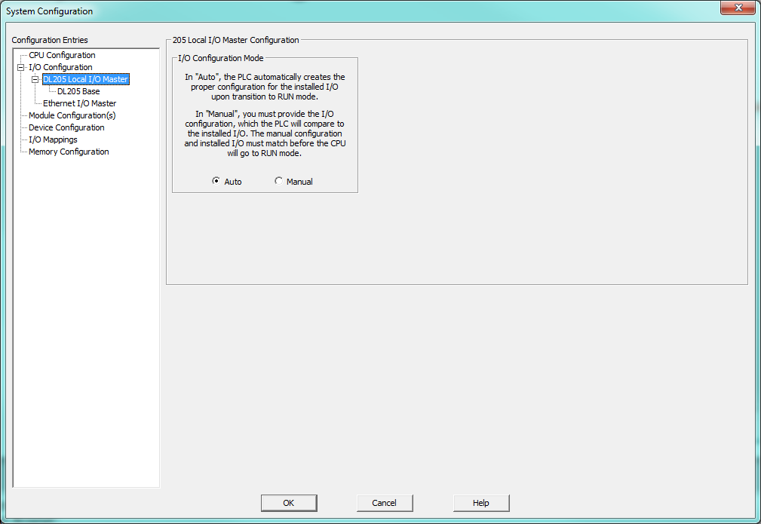
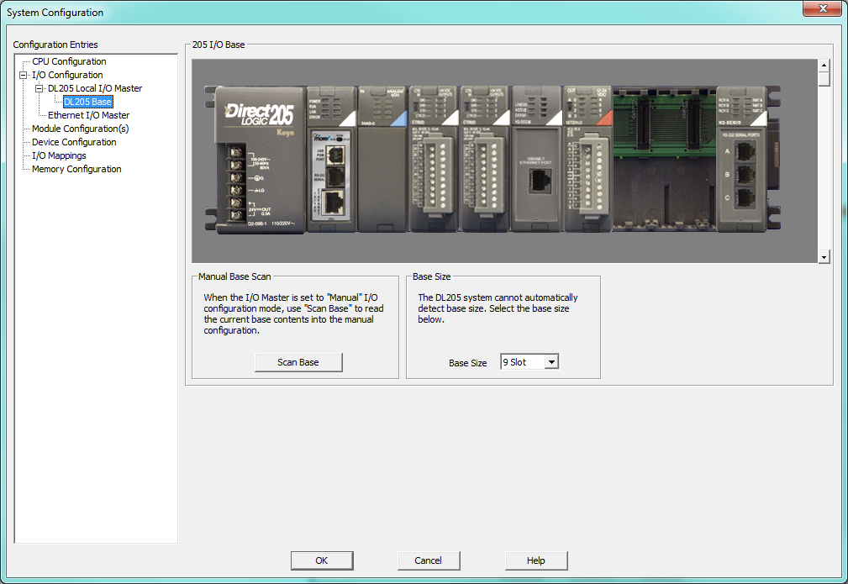
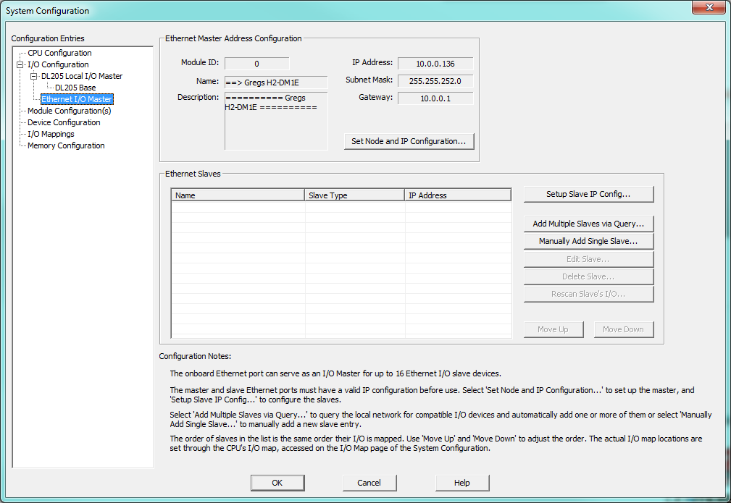
System Configuration
I/O Configuration
Overview
Local I/O Master
I/O Base
Ethernet I/O Master

Slide 3
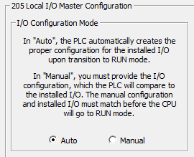
System Configuration
I/O Configuration
Local I/O Master
Auto: PLC automatically creates config for installed I/O upon transition to RUN mode
Manual: You create I/O config.
Manual config must match I/O or no RUN mode

Slide 4
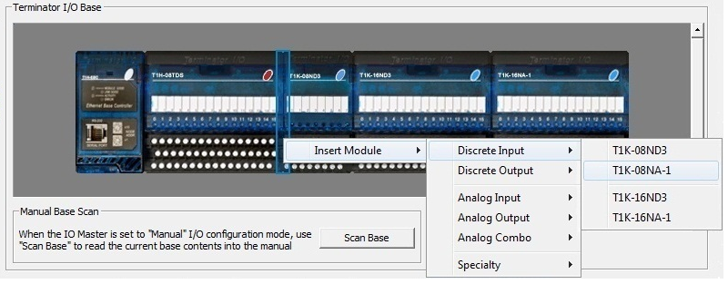
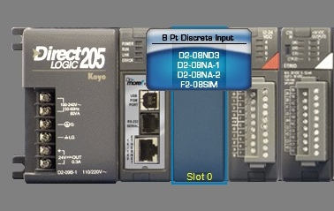
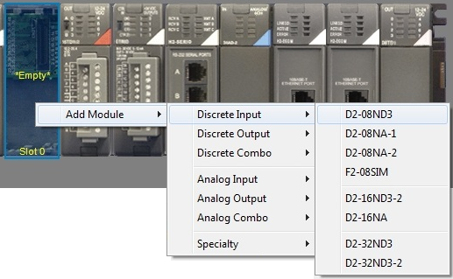
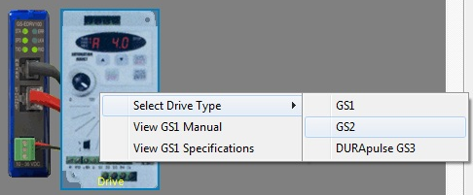
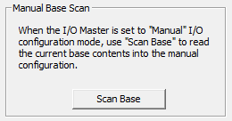
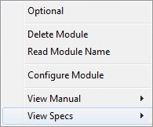
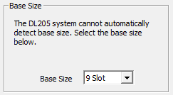
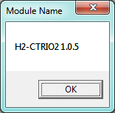
System Configuration
I/O Configuration
I/O Base
Scan Base
Base Size
Mouse hover gives info
Right-click on module
Optional – presence not necessary for RUN mode
Delete Module
Read Module Name
Configure Module
View Manual →
View Specs →
Right-click on Empty
(Terminator I/O)
(GS-EDRV)
Notes:
Have them add various modules in Manual Mode

Slide 5
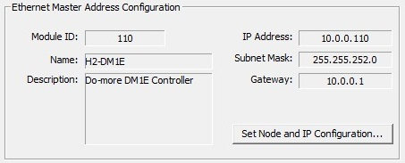
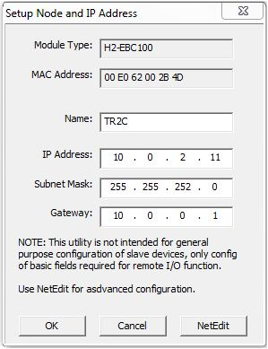
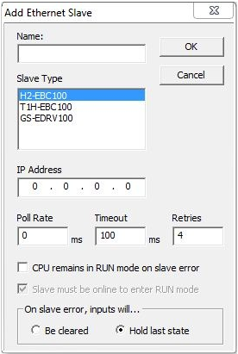
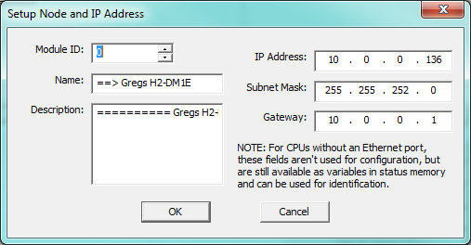
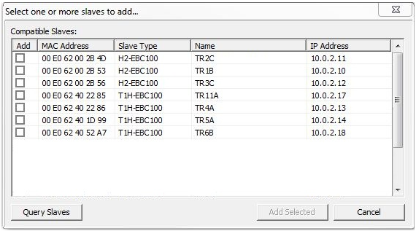
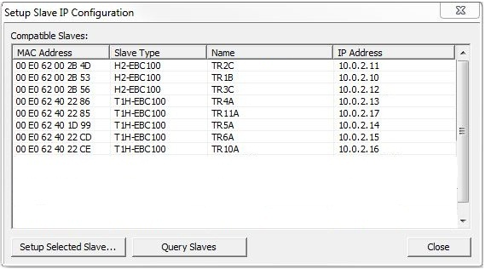
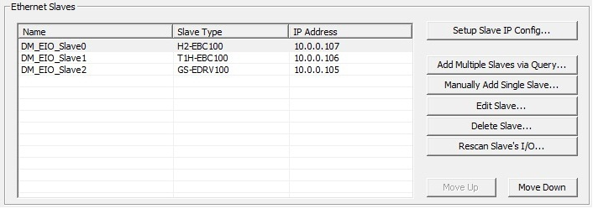
System Configuration
I/O Configuration
Ethernet I/O Master
Ethernet Master Address Configuration
Set Node and IP Configuration
Ethernet Slaves
Set Slave IP Config…
Setup Selected Slave
Query Slaves
Add Multiple Slaves via Query…
Manually Add Single Slave…
Edit Slave…
Delete Slave…
Rescan Slave’s I/O…
Move Up
Move Down
Notes:
Configure CPU for Ethernet I/O
Add EBC100 as slave

