Slide 1
Do-more Technical Training
Do-more Designer Simulator

Slide 2
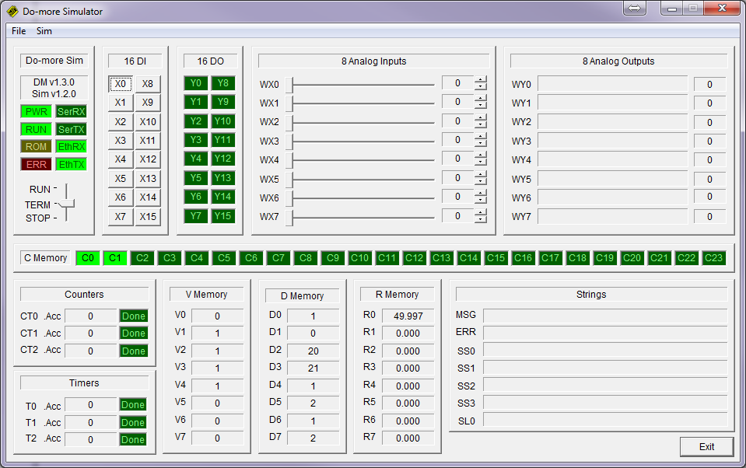
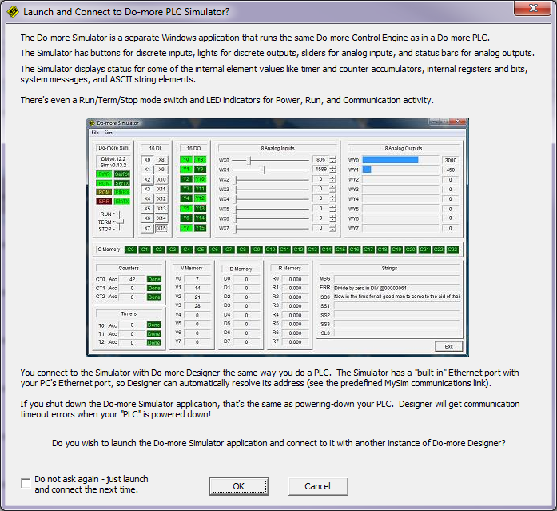
Simulator
Virtual PLC
PLC → Launch Do-more Simulator
Uses same control engine as a Do-more PLC
Components
CPU
Uses PC’s NIC
Can use PC’s COM port
Sim → Select Comm Port
16-point discrete input module
16-point discrete output module
8-channel analog input module
8-channel analog output module
Shows some key memory areas

Slide 3
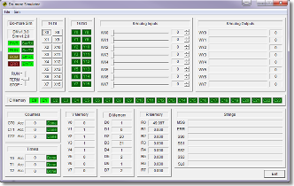
Simulator
Virtual PLC
Do-more Designer talks to the SIM like it would a real Do-more CPU
Link is preconfigured to talk over 127.0.0.1; the PC’s NIC
System Configuration & Memory Configuration can be changed
I/O Configuration is fixed
Projects are downloaded just like real CPU
If in RUN mode, executed ladder logic
Only says in RUN mode for 1 hour

Slide 4
Simulator
Virtual PLC
Discrete inputs (X0-X15)
Toggles OFF/ON on click
Disable: Sim → Enable Inputs
Discrete outputs (Y0-Y15)
Indicates OFF/ON
Analog inputs (WX0-WX7)
Click & drag slider bars
Analog outputs (WY0-WY7)
Bar indicates value
Memory status
Similar to a Data View
Pressing <Exit> button is the same as turning OFF your PLC
Do-more Designer will get a Link Error (disconnect)

Slide 5
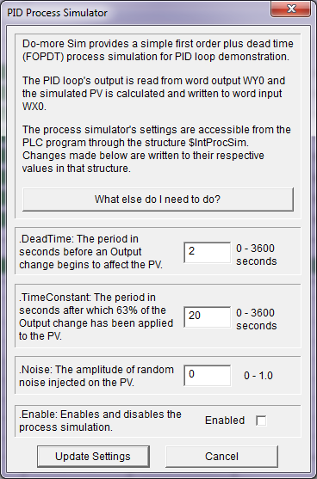
Simulator
Virtual PLC
SIM has PID Process Simulator built in
Sim → Setup PID Process Simulator
Uses 1st-order filter plus a dead-time calculation
I/O used:
WX0 as Process Variable (PV)
WX1 as Set Point (SP)
WY0 as Output (Output)
PID Process Simulator structure ($IntProcSim)
DeadTime
TimeConstant
Noise
Enable
Pressing <What else do I need to do?> button → → →

Slide 6
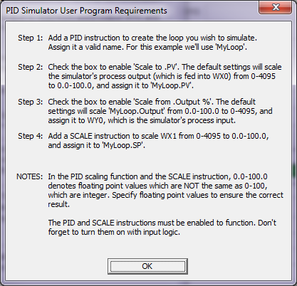
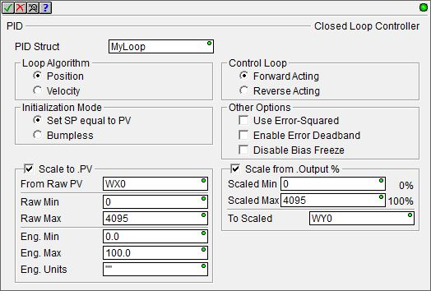
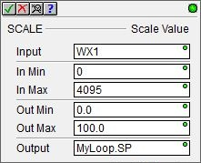
Simulator
Virtual PLC
PID instruction required
SCALE instruction required
Follow instructions

