Slide 1
Do-more Technical Training
Project Management

Slide 2
Project Management
Project File
Project Saving
Project Storage
Project Creation
Project Editing
DMD

Slide 3
Project Management
DMD
Project File
Filename: <MyProject>.DMD
Contains everything:
System Configuration
CPU Configuration
I/O Configuration
Module Configuration
Device Configuration
I/O Mappings
Memory Configuration
Ladder logic program
$Main Program
System Tasks (used)
Tasks (User)
Programs (User)
Documentation
Project Filename
Project Info
Element Documentation
Rung Comments
Title Page
*User Document
*Memory Image
Memory Image Config
Memory Image Data
*Print Options
* Not stored in the PLC

Slide 4
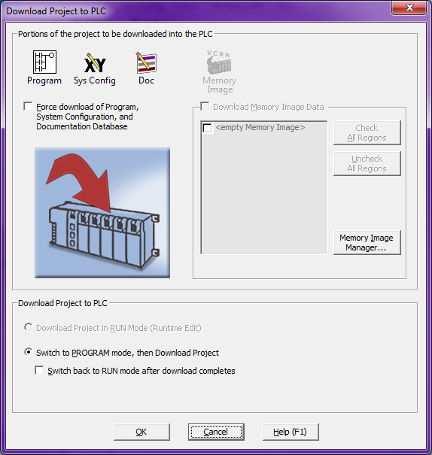
Project Management
If a Memory Image exists, it can be optionally downloaded
Project Saving
File →
Save Project
Saves everything in current filename
Save Project As…
Saves everything in different filename
Write Project to PLC
Writes what has changed of System Config, Ladders, Documentation & optionally the Memory Image
Portions are highlighted that are about to be written to the PLC
Only valid downloading options are available to choose from

Slide 5
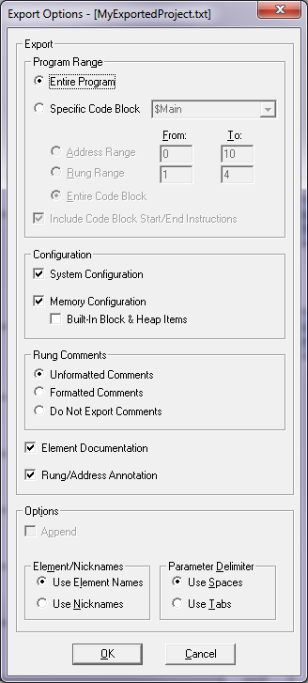
Project Management
Project Saving
File →
Export →
Project… - Creates text-only version of ladder program (mnemonics), rung comments & element documentation. Designed for backup.
Export
Program Range (Entire, Specified)
Include Code-Block Start/End instructions
Configuration (System, Memory)
Rung Comments (Unformatted, Formatted)
Include Element Documentation
Include Rung/Address Annotation
Options
Append to <filename>
Element/Nicknames (Use Element Names, Use Nicknames)
Parameter Delimiters (Use Spaces, Use Tabs)

Slide 6
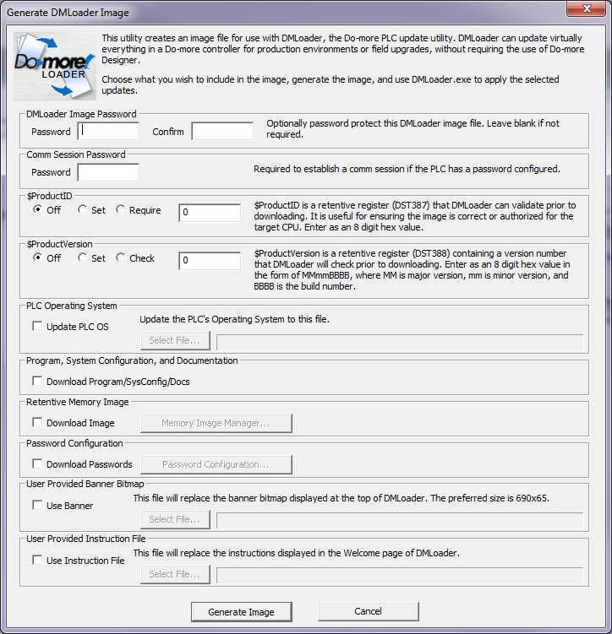
Project Management
Project Saving
File →
Export →
Generate DMLoader Image… - creates image file for DMLoader
DMLoader Image Password
Comm Session Password [if PLC has password]
$ProductID – $ProductID (DST387) useful for ensuring the image is authorized for the target PLC (8-digit hex value)
$ProductVersion - $ProductVersion (DST388), 8-digit hex: MMmmBBBB (MM: Major, mm: minor, BBBB: build)
PLC Operating System – update OS
Program, System Configuration and Documentation
Retentive Memory Image
Password Configuration
User Provided Banner Bitmap
User Provided Instruction File

Slide 7
Project Management
Project Saving
File →
Export →
Element Documentation…- Creates text-only version of element documentation. Designed for backup.
Standard Format: Element, Nickname, Extra Info, Description
Standard Format PLUS export multi-line description as multiple CSV fields
C-more™ Format: Tag Name (Nickname), Value Type, Element, Block Type, Block Name
C-more™ Format PLUS All Used Elements

Slide 8
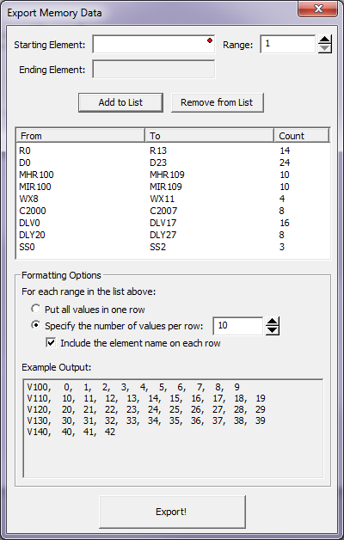
Project Management
Project Saving
File →
Export →
Memory Data…
Allows a user-defined list of memory elements to be saved into a CSV (comma-separated variable) file.

Slide 9
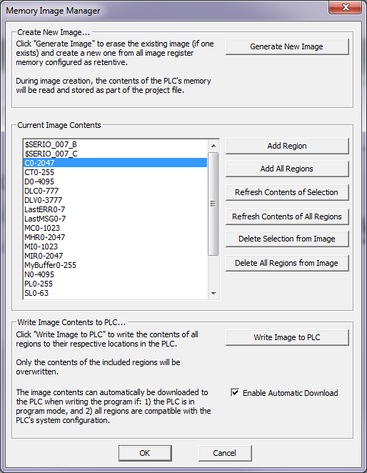
Project Management
Project Saving
Tools →
Memory Image Manager…
Snapshots retentive memory: “Generate New Image” button
Saves in project
Save only what you want
“Enable Automatic Download” – when writing to the PLC

Slide 10
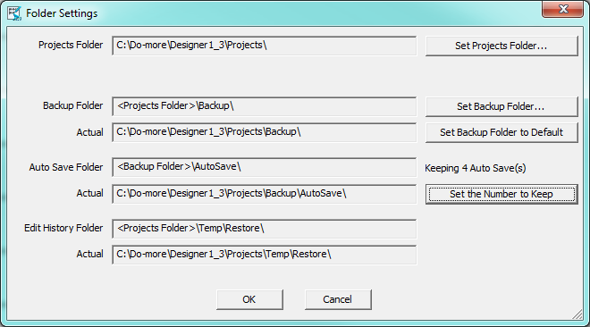
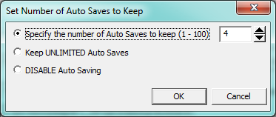
Project Management
Project Storage
File →
Manage Projects →
Folder Settings…
Projects Folder – location of all project files
Backup Folder – location of Backup files (File → Backup Project)
<Set Backup Folder to Default>
Auto Save Folder – location of AutoSave files
<Set the Number to Keep> button
Edit History Folder – locations of files created by Restore Point process (Edit → Edit History…)

Slide 11
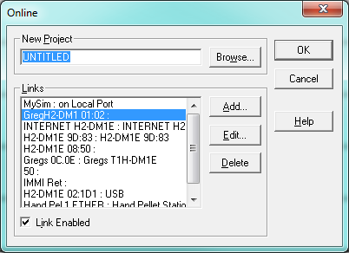
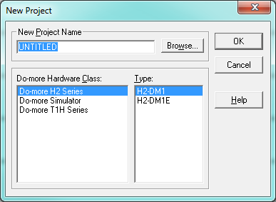
Project Management
Project Creation
File →
New Project →
Offline…
Online…

Slide 12
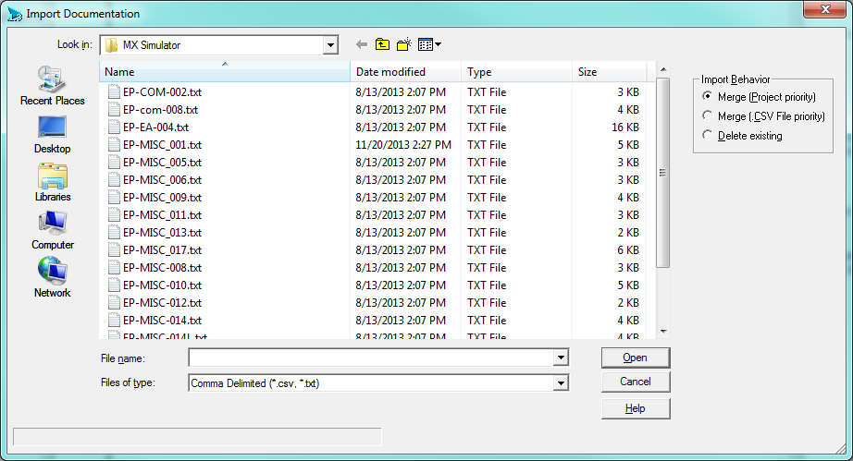
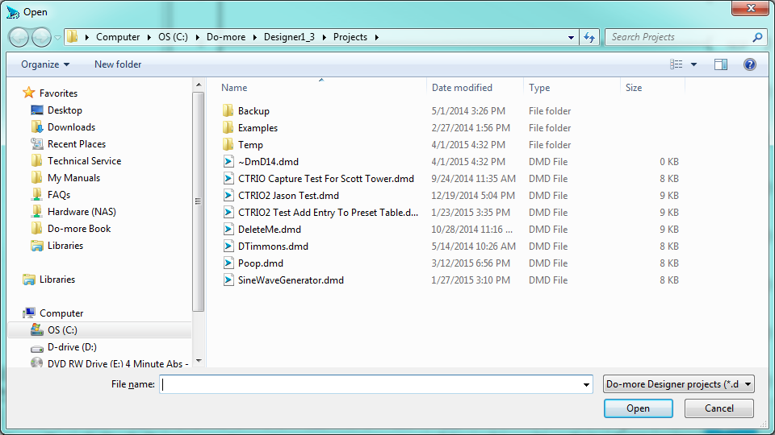
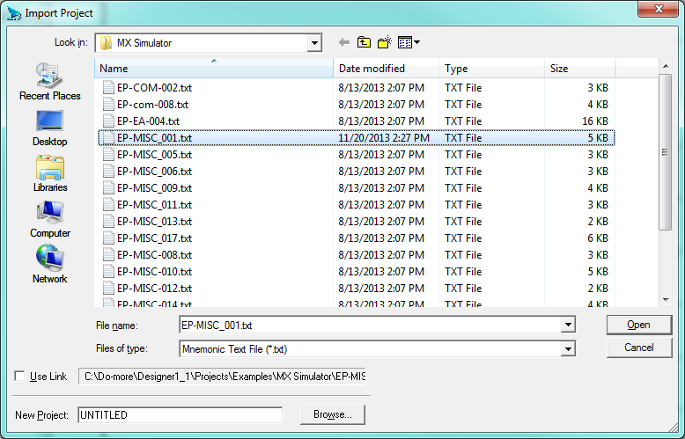
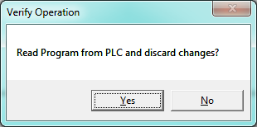
Project Management
Project Editing
File →
Open Project…
Read Project from PLC
Import →
Project…
Element Documentation…
Merge (Project priority)
Merge (.CSV File priority)
Delete existing
Memory Data… (following slides)
Migrate DirectSOFT Project… (following slides)

Slide 13
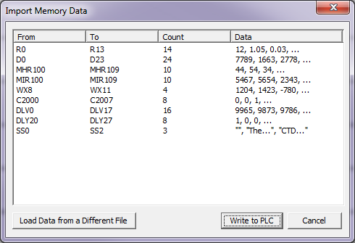
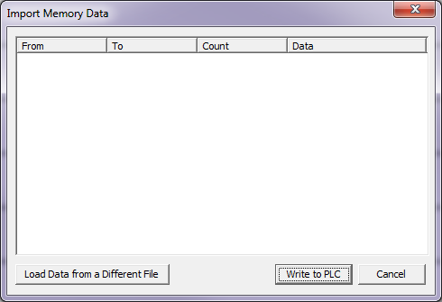
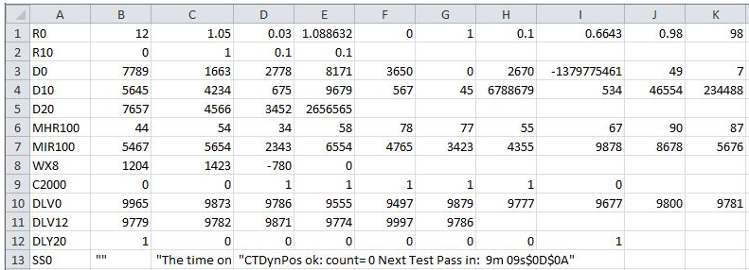
Project Management
Text:
Enclose in “”
Observe escape sequence for special characters (e.g. $)
Project Editing
File →
Import →
Memory Data…
Follow the rules
CSV File
Bit / Numeric:
Delimited by comma
Valid data for type
Start bits on byte boundary

Slide 14
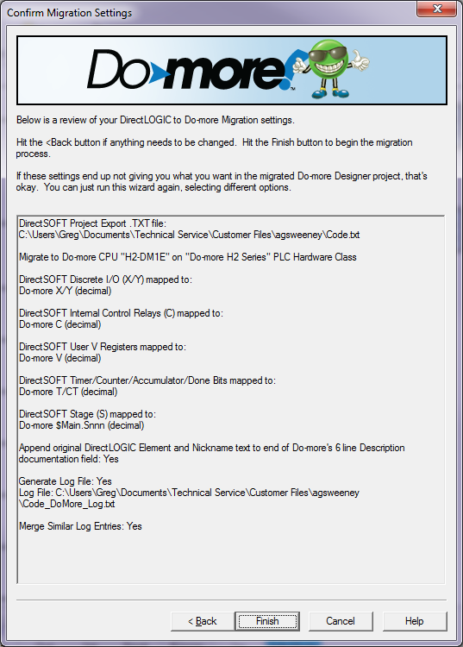
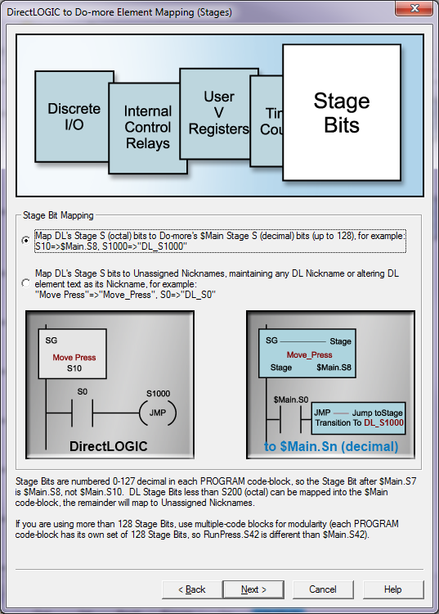
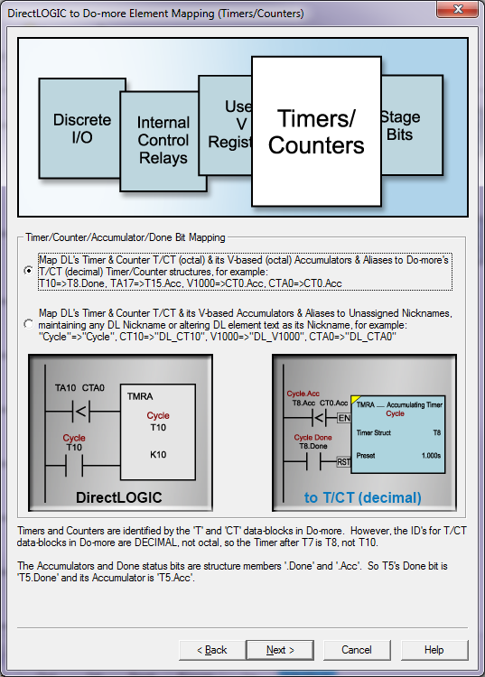
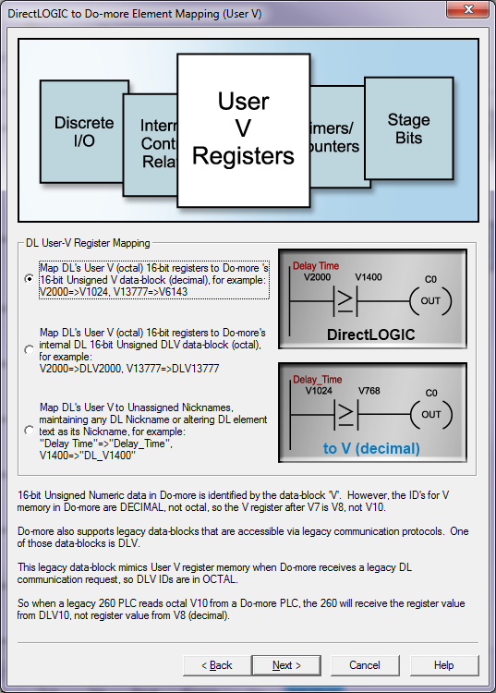
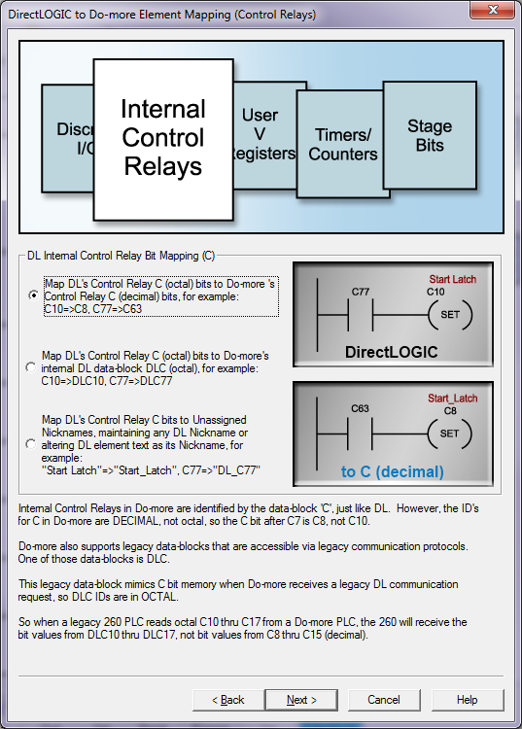
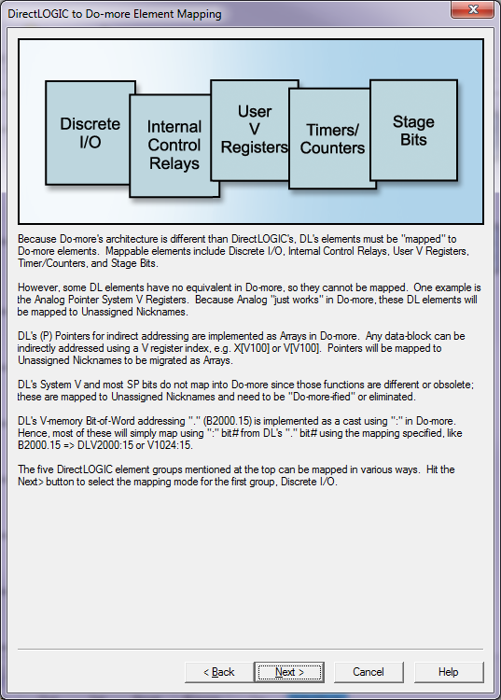
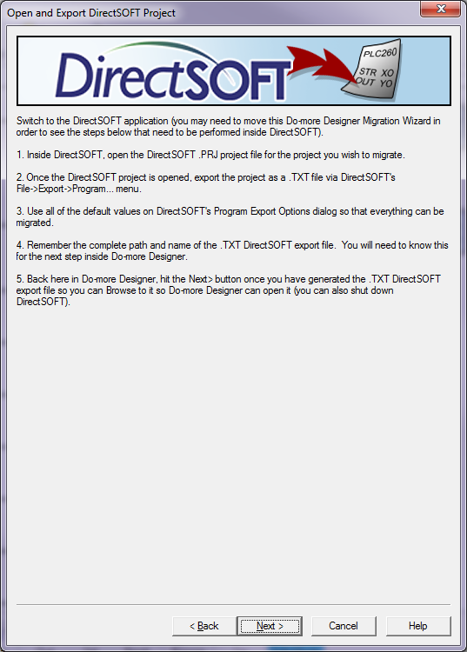
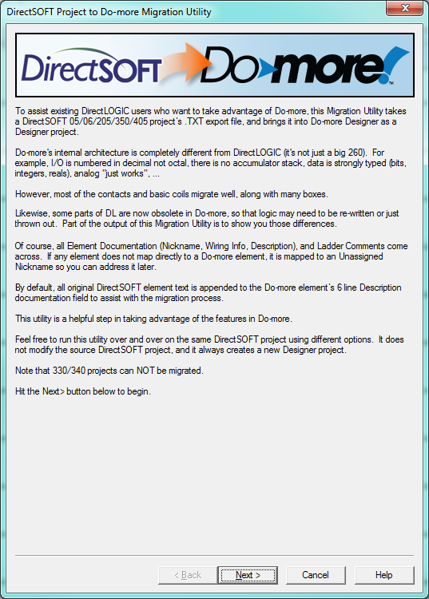
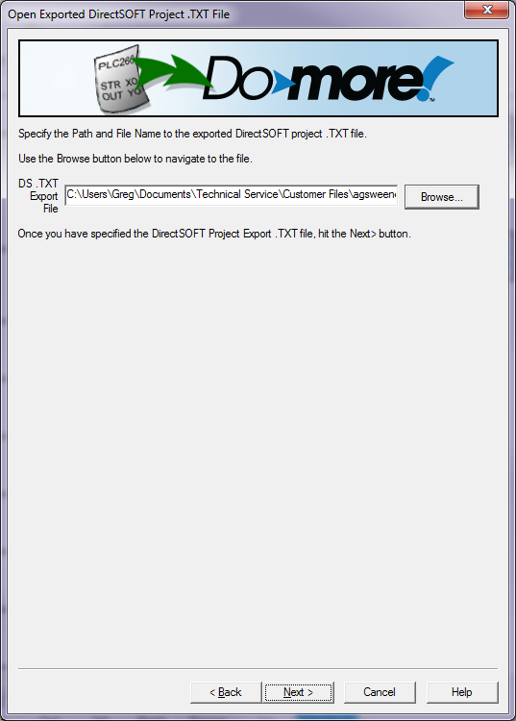
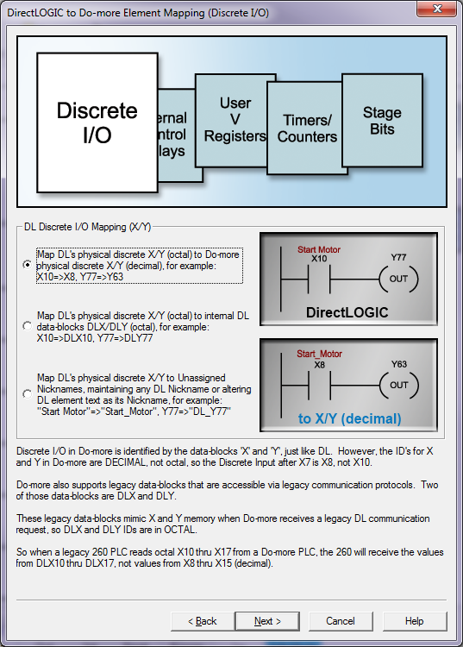
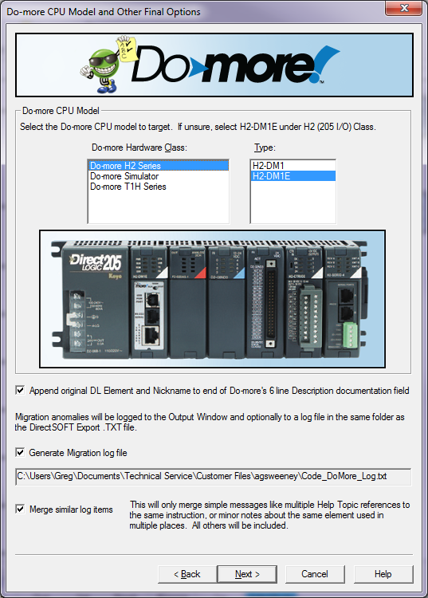
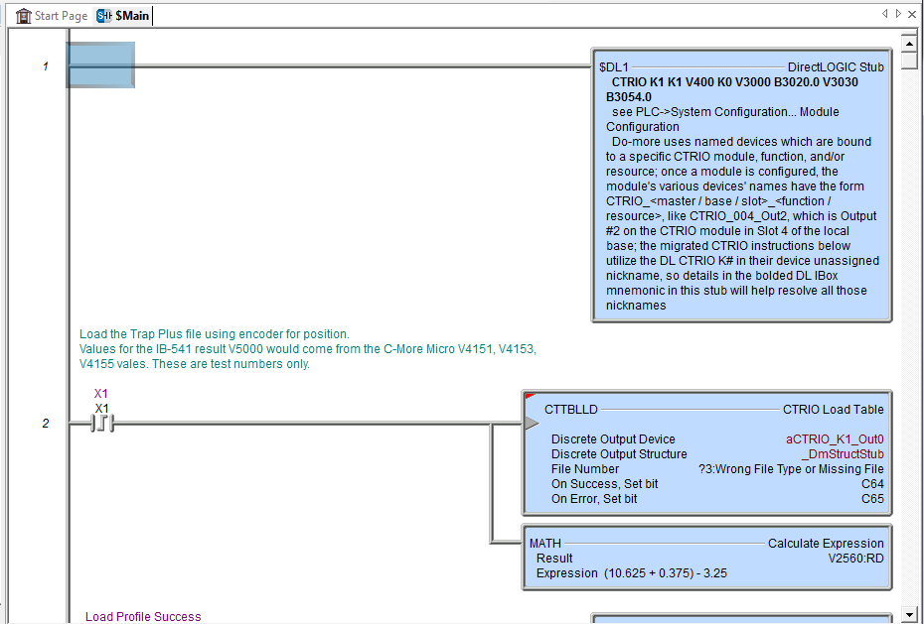
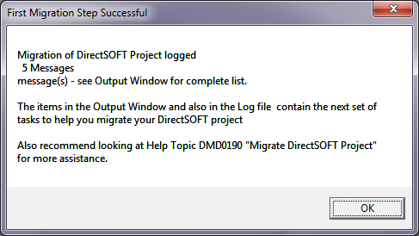
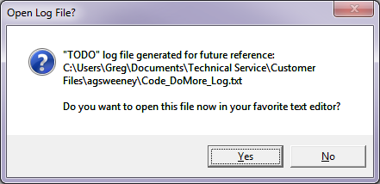
Project Management
Project Editing
File →
Import →
Migrate DirectSOFT Project…

Slide 15
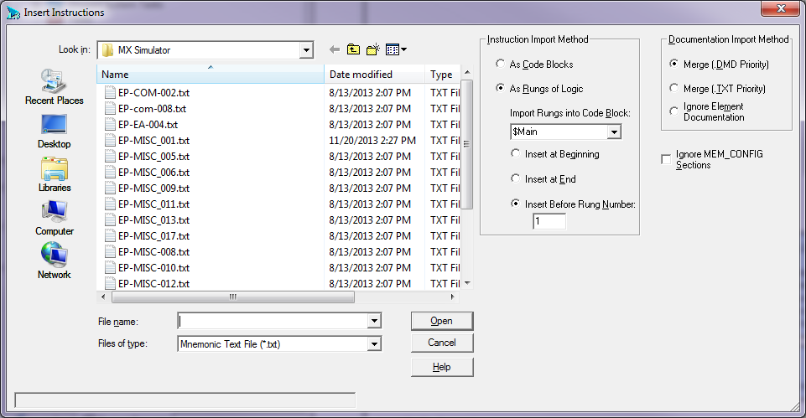
Project Management
Project Editing
Tools →
Insert Instructions From File… (text file)
Instruction Import Method
As Code Blocks: imported as new code blocks in project
As Rungs of Logic: imported as logic in existing code block
Import Rungs into Code Block: choose code block
Insert at Beginning / End / Before Rung Number
Documentation Import Method
Merge (.DMD Priority)
Merge (.TXT Priority)
Ignore Element Documentation: retains current documentation
Ignore MEM_CONFIG Sections: Disables memory configuration (Heap Items & Memory Blocks that may be required by instructions being imported)

