Slide 1
Do-more Technical Training
Programs VS Tasks

Slide 2
Programs VS Tasks
THE BASICS
Programs
Choose a Program if your application requires…
Timing, or…
Asynchronous instructions, or…
Ladder logic needing multiple scans to complete, or…
Sequential control (Stages)
Once started (RUN instruction) it runs every scan until:
Encountering an EXIT instruction
A HALT instruction in another code block is used to stop it
Tasks
Choose a Task if your application requires…
A single pass through ladder logic executing exactly one time, or…
Ladder logic that needs to execute at a specific, recurring interval
Once started (ENTASK instruction) it runs until:
Execution reaches the last rung
A HALT instruction in another code block is used to stop it (special case of looping)

Slide 3
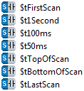
Programs VS Tasks
THE BASICS
Built-in Programs
$Main
Executed every PLC scan while in RUN mode
Built-in Tasks
$tFirstScan – only clode block that executes 1 time on STOP-to-RUN transition (before normal scanning starts)
$tLastScan – last code block that executes on RUN-to-STOP transition
$tTopOfScan – first code block to execute on each scan
$tBottomOfScan – last code block to execute on each scan
$t1Second – after all its ladder logic is executed it schedules itself to run again in 1 second
$t100ms – <ditto>… in 100ms
$t50ms - <ditto>… in 50ms
Notes:
In $tFirstScan use INIT to initialize V1000-1099 to 5555
In $t1Second use INC to increment D0
In $t100ms use INC to increment D1
In $t50ms use INC to increment D2
In $tTopOfScan use MAPIO to map X0-3 to MI1-4
In $Main use MI1 to turn ON MC1, MI2 to turn ON MC2, MI3 → MC3, MI4 → MC4
In $BottomOfScan use MAPIO to map MC1-4 to Y0-3
In $tLastScan use INIT to finalize V1000-1009 to 1111
Create Data View:
V1000-1009
MI1-4
MC1-4
D0-D2
Put in RUN mode
Notice V1000-1009 goes to 5555
Notice D0 increments every second, D1 about 10x faster, D2 even faster
Flip switches and notice Y outputs
Goto PROGRAM mode
Notice V1000-1009 goes to 1111

Slide 4
Programs VS Tasks
THE BASICS
Termination Scan
Scan which immediately follows the scan in which the Program/Task/Stage was last executed
Insures proper shutdown
Insures subsequent startup behavior
Programs:
OUT instructions are turned OFF
Timers & Counters are reset*
Stages disabled
Edge bits are turned OFF
Tasks:
OUT instructions are turned OFF
Timers & Counter are reset*
Edge bits are turned OFF
Stages:
OUT instructions are turned OFF
Timers & Counters are reset*
Edge bits are turned OFF
* UDCG “Global Up/Down Counter” & TMRAG “Global Accumulating Timer” are not reset
Notes:
Create MyProgram
Copy the code in $Main and put it in MyProgram, add X8 to conditional EXIT
Delete the code in $Main
Create a rung to RUN MyProgram with X5
Download program
Add X0-X7 to Data View
Put Project Browser in Status mode
Notice $Main, $tBottomOfScan & $tTopOfScan are all running
Notice MyProgram is not running
Verify this by flipping X0-3 and no Ys come ON
X5 = ON
Notice MyProgram is now running
Flip X0-3 and notice Ys work (leave them ON)
X7 = ON
Notice all Ys go OFF because MyProgram is exited

Slide 5
Programs VS Tasks
/E0
/E21
NOTE: This Automatic Edge-Bit Feature is not applied to Counter instructions CNT, CNTDN, UDC or UDCG. These are the ONLY exceptions.
Edge Bits
Normally hidden system-only bits
Internal use only; cannot be modified by user
Automatically added to project by Do-more Designer as edge-triggered instructions are programmed and assigned an index of zero (/E0)
Actual usable index value (e.g. “21” of “/E21”) is assigned by the Do-more PLC when project is downloaded (i.e. the PLC, not Do-more Designer, assigns them)
Holds the scan-to-scan state of edge-triggered inputs
When an edge is detected (e.g. OFF-to-ON or ON-to-OFF, depending on instruction) the associated Edge Bit is set ON for internal use
Automatic Edge Bit Feature in Stages
Edge Bits have a special use in Stages due to a desired feature
When a particular Stage is enabled, if there is an edge-triggered instruction that gets scanned in that stage, the Edge Bit for that instruction is automatically set ON if that input was ON when the Stage was enabled
Thus what would normally take a minimum of 2-3 scans of that particular Stage to detect an edge for that instruction is actually “detected” (by this feature) on the 1st scan in which that Stage is enabled
S10 Disabled
S10 Enabled
S10 Disabled
S10 Enabled
OFF-to-ON not yet seen because C0 has just now gone OFF
OFF-to-ON not yet seen because C0 was ON when S10 was enabled
1
2
3
C0 = OFF
C0 = OFF
C0 = ON
Rung not scanned
It took a minimum of 2 scans in order for S10 to “see” C0’s edge. This is normal.
But what if C0 had been ON when S10 was enabled instead of OFF as in this example?
It only takes 1 scan in order for S10 to “see” C0’s edge if C0 was ON when S10 was enabled. This is because C0’s Edge Bit is automatically set ON as a feature in Do-more
It took a minimum of 3 scans in order for S10 to “see” C0’s edge.
But this is NOT the way Do-more works!

Slide 6
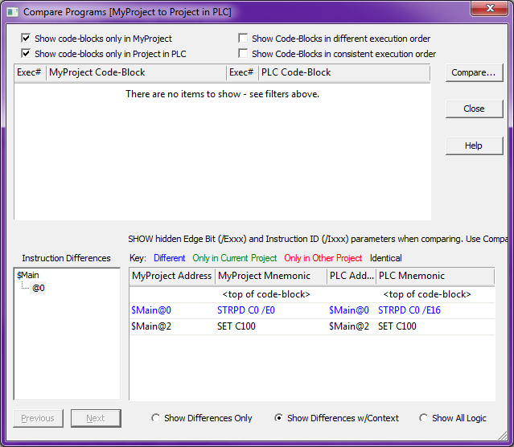
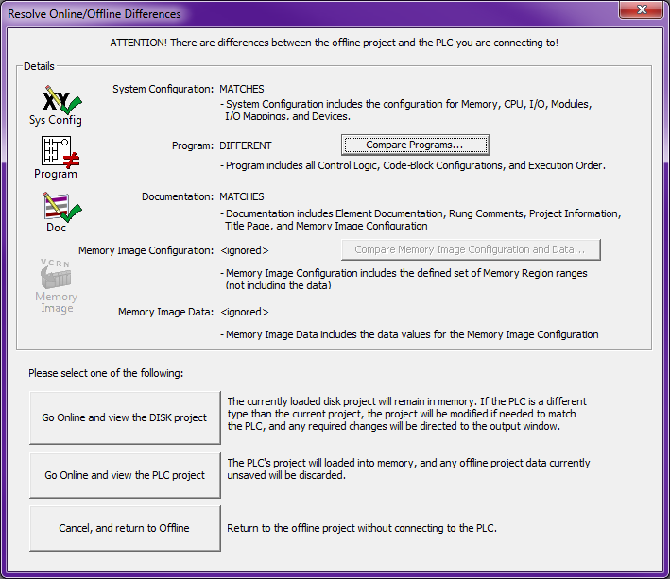
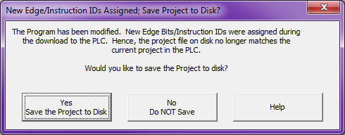
Programs VS Tasks
/E0
/E21
Edge Bits
Since indexes are assigned at download time, Do-more Designer doesn’t “know” what those are until the project is read back up
All Edge Bits in Do-more Designer originally have an index of zero (e.g. /E0)
Thus the following two interesting scenarios can occur:
(1) If a new project with edge-triggered instructions is first saved to disk and then downloaded to the PLC, a dialog will appear describing, “The Program has been modified…” when no manual modification occurred.
Solution: Save the Project to Disk.
If Project is not saved to disk then “Modified project not saved to disk – new Edge/Instruction IDs assigned during download to PLC” is displayed in the Output Window as a Warning
(2) If that project (which was not saved) is closed and then reopened online, the compare will fail.
If <Compare Programs…> is used the Edge Bit difference is shown
Solution: Go online with the PLC project and save the project to disk with the new Edge Bit index assignments

Slide 7
Programs VS Tasks
Memory Type
Structure
Programs
$Main
<Name>
Structure Members [147]
Running (bit) – ON if running
RanThis Scan (bit) – ON if ran this scan
Done (bit) – ON if completed
FirstScan (bit) – ON if executing its first scan
FirstRun (bit) – ON if still executing first full pass
DoneThisScan (bit) – ON if stopped on current scan
InstrSuspend (bit) – ON if suspended by SUSPEND instruction
DebugSuspend (bit) – ON if suspended by a debug operation
TimeSlice (dword) – microseconds allowed to loop before yielding
ScanCounter (dword) – number of scans it has run
RunCounter (dword) – number of times run to completion
S0_15 (word) – bit/stage indicating enabled/disabled status
S16_31 (word) – <ditto>
S32_47 (word) – <ditto>
S48_63 (word) – <ditto>
S64_79 (word) – <ditto>
S80_95 (word) – <ditto>
S96_111 (word) – <ditto>
S112_127 (word) – <ditto>
Sx (bit; x = 0-127) – ON if stage is enabled [128]

Slide 8
Program VS Tasks
Memory Type
Structure
Tasks
$t1Second, $t50ms, $t100ms, $tBottomOfScan, $tFirstScan, $tTopOfScan
<Name>
Structure Members [15]
Once (bit) – ON if configured to run once
Continuous (bit) – ON if configured to run continuous
Running (bit) – ON if running
RanThisScan (bit) – ON if ran this scan
Done (bit) – ON if completed
FirstScan (bit) – ON if executing its first scan
FirstRun (bit) – ON if still executing first full pass
DoneThisScan (bit) – ON if will stop on current scan
InstrSuspend (bit) – ON if suspended by SUSPEND instruction
DebugSuspend (bit) – ON if suspended by debug operation
TimeSlice (dword) – microseconds allowed to loop before yielding
Interval (dword) – how many milliseconds to delay before next run
ScanCounter (dword) – number of scans it has run
RunCounter (dword) – number of times run to completion
IntervalAcc (dword) – how many milliseconds until the next run

Slide 9
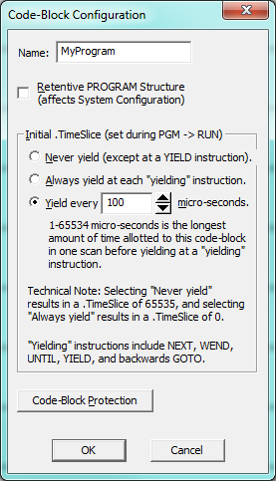
Programs VS Tasks
ADVANCED CONFIGURATION
Retentiveness
Definition: code block’s structure members maintain their values through automatic transitions to RUN
Power cycle
Restart by Watchdog event
REBOOT instruction
Automatic Program-to-Run transition:
Maintains user code block structure members marked “retentive”
Maintains System Tasks block structure members (always retentive)
Exception: $Main’s stages are reset (OFF) & initial stage is set (ON)
$PgmModeRestart (ST15) → OFF
Manual Program-to-Run transition:
Resets all code blocks structure members (even retentive!)
$PgmModeRestart (ST15) → ON
NOTE: DTDIFF “Difference Between Two Date/Times” instruction can be used with $SysShutdown (SDT1) & $SysStartup (SDT2) to determine how long PLC has not been in Run mode

Slide 10
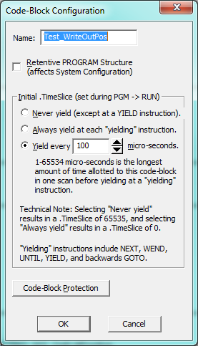
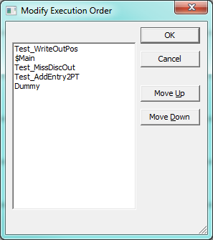
Programs VS Tasks
Enabling & Disabling
Execution Order
Yielding

Slide 11
Programs VS Tasks (Enabling & Disabling)
FEATURE | Programs | Tasks
Enabled by: | RUN | ENTASK Once on edge Power flow Continuous Interval
Disabled by: | EXIT (internally) HALT (externally) | Reaching last rung (edge ENTASK) Losing power flow HALT (externally; looping Task)
Contain Stages? | Yes | No

Slide 12
Programs VS Tasks (Enabling & Disabling)
Programs
$Main is a Program
Cannot be disabled
Runs every scan
Create MyProgram
Not being scanned
Edge triggers RUN in $Main
Now being scanned
EXIT encountered
Not being scanned
$Main
MyProgram
MyProgram

Slide 13
Programs VS Tasks (Enabling & Disabling)
FEATURE | Programs | Tasks
Enabled by: | RUN | ENTASK Once on edge Power flow Continuous Interval
Disabled by: | EXIT (internally) HALT (externally) | Reaching last rung (edge ENTASK) Losing power flow HALT (externally; looping Task)
Contain Stages? | Yes | No

Slide 14
Programs VS Tasks (Enabling & Disabling)
Programs
$Main is a Program
Cannot be disabled
Runs every scan
MyProgram created
Not being scanned
Edge triggers RUN in $Main
Now being scanned
HALT enabled
Not being scanned
$Main
MyProgram
MyProgram
Notes:
In MyProgram, remove the conditional EXIT with X7
In $Main add a conditional HALT of MyProgram with X7
Verify the same behavior

Slide 15
Programs VS Tasks (Enabling & Disabling)
FEATURE | Programs | Tasks
Enabled by: | RUN | ENTASK Once on edge Power flow Continuous Interval
Disabled by: | EXIT (internally) HALT (externally) | Reaching last rung (edge ENTASK) Losing power flow HALT (externally; looping Task)
Contain Stages? | Yes | No

Slide 16
Programs VS Tasks (Enabling & Disabling)
Tasks
$Main is a Program
Cannot be disabled
Runs every scan
Create MyTask
Not being scanned
Edge triggers ENTASK
Scans toward bottom
Bottom is reached
Not being scanned
$Main
MyTask
MyTask

Slide 17
Programs VS Tasks (Enabling & Disabling)
FEATURE | Programs | Tasks
Enabled by: | RUN | ENTASK Once on edge Power flow Continuous Interval
Disabled by: | EXIT (internally) HALT (externally) | Reaching last rung (edge ENTASK) Losing power flow HALT (externally; looping Task)
Contain Stages? | Yes | No

Slide 18
Programs VS Tasks (Enabling & Disabling)
Tasks
$Main is a Program
Cannot be disabled
Runs every scan
MyTask created
Not being scanned
Power flow to ENTASK
Now being scanned
Power flow lost
Not being scanned
$Main
MyTask
MyTask

Slide 19
Programs VS Tasks (Enabling & Disabling)
FEATURE | Programs | Tasks
Enabled by: | RUN | ENTASK Once on edge Power flow Continuous Interval
Disabled by: | EXIT (internally) HALT (externally) | Reaching last rung (edge ENTASK) Losing power flow HALT (externally; looping Task)
Contain Stages? | Yes | No

Slide 20
Programs VS Tasks (Enabling & Disabling)
Tasks
$Main is a Program
Cannot be disabled
Runs every scan
MyTask created
Not being scanned
Power flow to ENTASK
Scans to bottom
Bottom is reached
Power flow remains
500ms pass
Scans to bottom again
Bottom is reached again
Power flow lost
$Main
MyTask
MyTask

Slide 21
Programs VS Tasks (Enabling & Disabling)
FEATURE | Programs | Tasks
Enabled by: | RUN | ENTASK Once on edge Power flow Continuous Interval
Disabled by: | EXIT (internally) HALT (externally) | Reaching last rung (edge ENTASK) Losing power flow HALT (externally; looping Task)
Contain Stages? | Yes | No

Slide 22
Programs VS Tasks (Enabling & Disabling)
Tasks
$Main is a Program
Cannot be disabled
Runs every scan
MyTask created
Not being scanned
Edge triggers ENTASK
MyTask is looping
Loop time > .TimeSlice so that MyTask yields
HALT enabled
Not being scanned
$Main
MyTask
MyTask

Slide 23
Programs VS Tasks (Execution Order)
MyTask1
Create Project w/execution order
8 Examples:
(1) Program code block $Main
(2) RUN a succeeding Program
(3) RUN a preceding Program
(4) Edge-trig-enable preceding Task
(5) Edge-trig-enable succeeding Task
(6) Power-flow-enable succeeding Task
(7) Power-flow-enable preceding Task
(8) Program EXIT
$Main
MyProgram1
MyTask2
MyTask3
MyProgram2

Slide 24
Programs VS Tasks (Execution Order)
MyTask1
(1) Program code block $Main
1st scan & all subsequent scans if no other Programs or Tasks are enabled
$Main
MyProgram1
MyTask2
MyTask3
MyProgram2

Slide 25
Programs VS Tasks (Execution Order)
MyTask1
(2) RUN a succeeding Program
This scan $Main flags MyProgram2 to execute with RUN instruction.
MyProgram2 executes in the same scan because of the execution order.
Subsequent scans
$Main
MyProgram1
MyTask2
MyTask3
MyProgram2
MyProgram2

Slide 26
Programs VS Tasks (Execution Order)
MyTask1
(3) RUN a preceding Program
This scan MyProgram2 flags MyProgram1 to execute with RUN instruction.
MyProgram1 does not execute in this scan because of the execution order.
Subsequent scans
$Main
MyProgram1
MyProgram1
MyTask2
MyTask3
MyProgram2

Slide 27
Programs VS Tasks (Execution Order)
MyTask1
MyTask1
(4) Edge-trigger-enable preceding Task
This scan MyProgram1 flags MyTask1 to execute with ENTASK instruction.
MyTask1 does not execute in this scan because of the execution order.
2nd scan after being enabled MyTask1 executes to the bottom and disables itself
3rd scan after being enabled MyTask1 does not execute
Subsequent scans
$Main
MyProgram1
MyTask2
MyTask3
MyProgram2

Slide 28
Programs VS Tasks (Execution Order)
MyTask1
(5) Edge-trigger-enable succeeding Task
This scan MyProgram1 flags MyTask2 to execute with ENTASK instruction.
MyTask2 executes in this scan because of the execution order.
MyTask2 executes to the bottom and disables itself
2nd scan after being enabled MyTask2 does not execute
Subsequent scans
$Main
MyProgram1
MyTask2
MyTask2
MyTask3
MyProgram2

Slide 29
Programs VS Tasks (Execution Order)
MyTask1
(6) Power-Flow-enable succeeding Task
This scan MyProgram1 flags MyTask2 to execute with ENTASK instruction.
MyTask2 executes in this scan because of the execution order.
MyTask2 continues to execute as long as there is power flow to MyProgram1’s ENTASK
A subsequent scan MyProgram1 disables ENTASK
MyTask2 does not execute this scan because of execution order
Subsequent scans
$Main
MyProgram1
MyTask2
MyTask2
MyTask3
MyProgram2

Slide 30
Programs VS Tasks (Execution Order)
MyTask1
MyTask1
(7) Power-Flow-enable preceding Task
This scan MyProgram1 flags MyTask1 to execute with ENTASK instruction.
MyTask1 does not execute this scan because of the execution order.
2nd scan after being enabled MyTask1 executes because of execution order
MyTask1 continues to execute as long as there is power flow to MyProgram1’s ENTASK
A subsequent scan MyProgram1 disables ENTASK
The next scan after this MyTask1 does not execute.
Subsequent scans
$Main
MyProgram1
MyTask2
MyTask3
MyProgram2

Slide 31
Programs VS Tasks (Execution Order)
MyTask1
(8) Program EXIT
This scan MyProgram1 encounters an EXIT instruction and disables itself.
This scan MyProgram2 also encounters an EXIT instruction and disables itself.
2nd scan after MyProgram1 and MyProgram2 encounter EXITs they are no longer executing
Subsequent scans
$Main
MyProgram1
MyProgram1
MyTask2
MyTask3
MyProgram2
MyProgram2

Slide 32
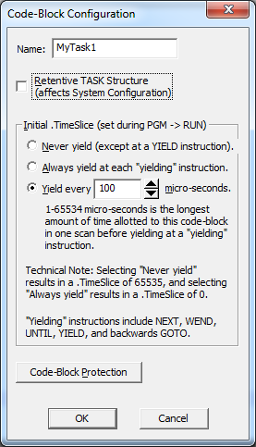
Programs VS Tasks (Yielding)
Yielding only occurs at “yielding” instructions
Yielding instructions (blue triangle):
YIELD
NEXT (w/FOR)
WEND (w/WHILE)
UNTIL (w/REPEAT)
GOTO (if backwards)
Types of yielding:
(1) Yield every x µsec (default)
(2) Never yield (except w/YIELD)
(3) Always yield

Slide 33
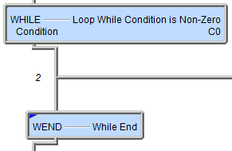
Programs VS Tasks (Yielding)
$Main
(1) Yield every 100 µsec (default)
$Main & MyProgram1 executing
$Main flags MyTask1 to execute
MyTask1 executes & reaches WEND
MyTask1 executing >= .TimeSlice?
NO. Loop back to WHILE
Loops until MyTask1 executing >= .TimeSlice
YES. WEND yields skipping over any logic below the instruction
MyProgram1 is now scanned.
Scans until WHILE/WEND is done.
NOTE: MyTask1 now skips to WEND
When WHILE/WEND completes, code below WEND is now executed
MyTask1 disables itself (bottom)
Subsequent scans
MyTask1
MyTask1
Skipped
MyProgram1
MyProgram1
Notes:
Clear PLC
Create MyTask using 100µs yielding (default)
Add WHILE X1, INC D0, WEND, INC D1 to MyTask
In $Main add X0 → ENTASK MyTask (edge-triggered)
In $tTopOfScan add MATH D2 = TICKus()
In $tBottomOfScan add MATH D3 = TICKus() – D2
Make sure X0 & X1 are OFF & D0-1 = 0
Create Data View with X0-1, D0-1, D3
Use Trend All
Download & put into RUN
Notice D3’s value hovers around 25-30 µs
X0 = ON
This enables MyTask to run once
WHILE/WEND doesn’t do anything because X1 = OFF
D1 increments to 1 for each OFF-to-ON transition of X0 showing MyTask executes the code after the WHILE/WEND but only once
Notice D3’s value doesn’t change much
X1 = ON
Nothing happens because MyTask is not executing
Toggle X0 OFF-to-ON
This enables MyTask to run
WHILE/WEND is now looping because X1 = ON
D0 is now incrementing like crazy
D1 is not incrementing at all showing the code underneath the WHILE/WEND is not executing
D3 now shows about 135 µsec showing that MyTask’s WHILE/WEND was allowed to loop for 100µs before yielding
X1 = OFF
WHILE/WEND condition is now gone (X1 = OFF)
D0 stops incrementing
D1 increments by 1 indicating after the WHILE/WEND was finished, the code underneath it was executed once
D3 returns to a value of 25-30 µs
Configure MyTask and change the Yield to 200 µs
Goto Program mode and back to Run (this is necessary to update the new TimeSlice value)
Repeat the experiment noticing the value of D3 now shows 230 µs

Slide 34
Programs VS Tasks (Yielding)
$Main
(2) Never yield (except w/YIELD)
$Main & MyProgram1 executing
$Main flags MyTask1 to execute
MyTask1 executes & reaches WEND
MyTask1 loops until WHILE/WEND is done
NOTE: WHILE condition must not be I/O or comm dependent
WARNING: If scantime > $WatchdogTimeVal (DST23) then:
CPU goes to STOP
$WatchdogTimeout (ST128) = ON
Loop completes; code below WEND is executed; scan completes
Subsequent scans
MyTask1
MyTask1
MyProgram1
MyProgram1
Notes:
Configure MyTask and change to Never Yield
Goto Program mode and back to Run (this is necessary to update the new TimeSlice value)
Repeat the experiment noticing the Do-more watchdogs
Clear Watchdog error

Slide 35
Programs VS Tasks (Yielding)
$Main
(3) Always yield
$Main & MyProgram1 executing
$Main flags MyTask1 to execute
MyTask1 executes & reaches WEND
1st time WEND is reached it does not loop to WHILE
WEND yields skipping over any logic below the instruction
Scans until WHILE/WEND is done.
MyTask1 now skips to WEND
WEND loops 1 time then yields
When WHILE/WEND completes, code below WEND is now executed
MyTask1 disables itself (bottom)
Subsequent scans
MyTask1
MyTask1
Skipped
MyProgram1
Notes:
Configure MyTask and change to Always Yield
Goto Program mode and back to Run (this is necessary to update the new TimeSlice value)
Repeat the experiment noticing D0 increments very slowly
Verify the different rate with Trend View

