Slide 1
Do-more Technical Training
Memory Types

Slide 2
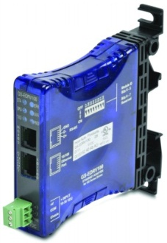
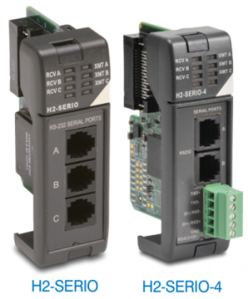
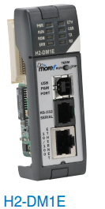
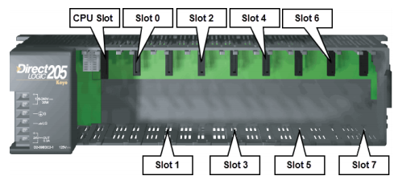
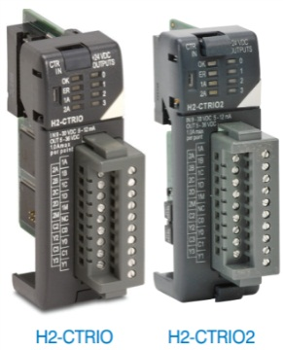
Memory Types
(1) Physical I/O
(2) System Memory
(3) User Memory

Slide 3
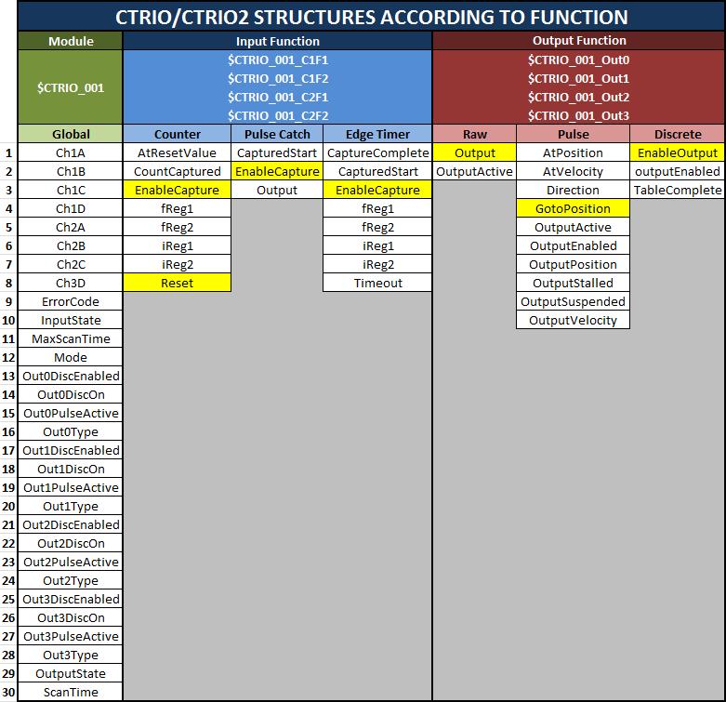
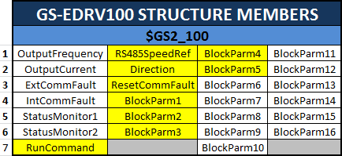
Memory Types
(1) Physical I/O
Input
Bit (X0-2047)*
Word (WX0-255)*
Output
Bit (Y0-2047)*
Word (WY0-255)*
Specialty
CTRIO/CTRIO2
Module ($CTRIO_001) [30]
Counter ($CTRIO_001_C1F1) [8]
Pulse Catch ($CTRIO_001_C1F2) [3]
Edge Timer ($CTRIO_001_C1F2) [8]
Raw Out ($CTRIO_001_Out0) [2]
Pulse Out ($CTRIO_001_Out0) [10]
Discrete Out ($CTRIO_001_Out0) [3]
SERIO/SERIO4 ($SERIO_001_A, _B, _C) [6]
GSDrive ($GS1_100) [26]
*NOTE: Adjustable size
# of structure members

Slide 4
Memory Types
(2) System Memory
Bits (ST0-1023)
Dword (DST0-511)
Structures
Date/Time (SDT0-7) [9]
I/O Masters
LocalIOMaster [4]
$EthIOMaster [68]
Peerlink (PL) [86]
Programs (<Name>) [147]
Tasks (<Name>) [15]
Servers [4]
$IntEIPServer
IntSerialServer
IntUSBServer
ModbusTCPServer
Stream [6]
IntSerial
<$Name>
Packet (<$Name>) [3]
PID (<$Name>) [19]
Ramp/Soak (<$Name>) [5]
Drum (<$Name>) [8]
String [2]
ERR
LastERR0-7
MSG
LastMSG0-7
PartNum
SerialNum
SysDesc
SysName
# of structure members

Slide 5
Memory Types
(3) User Memory¹
Bits
C0-2047
DLX0-777²
DLY0-777²
DLC0-777²
MI0-1023
MC0-1023
Word
Unsigned
V0-4095
PL0-255
DLV0-3777²
¹NOTE: Adjustable size
²NOTE: Octal address
Signed
N0-4095
MIR0-2047
MHR0-2047
Dword
Signed (D0-4095)
Real (R0-4095)
Structures
Timer (T0-255) [5]
Counter (CT0-255) [5]
Date/Time (UDT0-31) [9]
String [2]
Short (SS0-127)
Long (SL0-63)
# of structure members

Slide 6
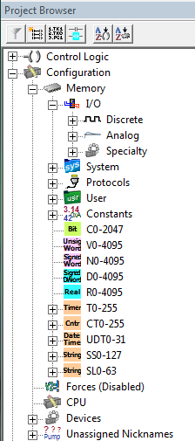
Memory Types
Project Browser →
Configuration →
Memory

Slide 7
Memory Types
Strong Typing
Every element in the PLC has a data type
(bit, real, unsigned word, timer structure, etc.)
Strong Typing PRO: Instructions know the data types
EXAMPLE:
A signed double-word (D-memory) can be compared to a real number (R-memory) without conversion to the same data type
Even constants are strongly typed
EXAMPLES:
Hexadecimal (prefix of “0x”; zero x)
Decimal (the number itself)
Octal (prefix of “0”; zero)
Real (enter a decimal point with the number; e.g. 2.0)

Slide 8
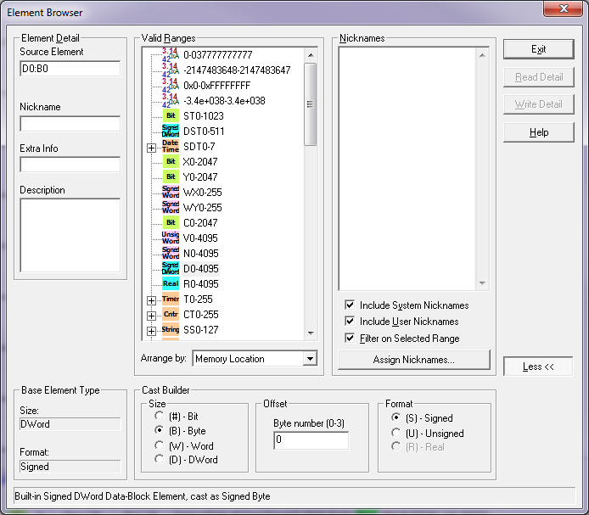
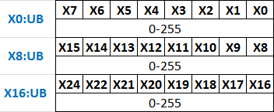
Memory Types
Casting
Strong Typing CON: Sometimes Strong Typing “gets in the way”
How to use just one bit in a V-memory location?
How to look at a group of 16 discrete inputs as a word?
How to look at 2 Modbus Holding Registers as a 32-bit Real number?
Casting operator suffix “:” (colon) is the answer:
V5:0 – look at bit 0 in V5
X0:UB – look at X0-7 as an unsigned byte
X16:UW – look at X16-31 as an unsigned word
X32:SD – look at X32-63 as signed double-word
Type boundaries must be observed (byte, word, double word):
X1:UB – invalid, but X0:UB or X8:UB are valid
More examples:
MHR10:R – look at 32-bit MHR10-11 as 32-bit real
V12:SD – look at 32-bit V12-13 as a signed double-word
V11:B0 – look at byte 0 (low byte) of V11
V11:UB1 – look at byte 1 (high byte) of V11 as an unsigned byte
Use Element Browser <F9> (Search → Element Browser) & Cast Builder Tool to help build

