Slide 1


Do-more Technical Training
Instruction Set
(Timer/Counter/Drum)

Slide 2
Instruction Set
THE BASICS
  181 instructions
    Contact (14)
    Coil/Bit Output (11)
    Analog/Process (13)
    Date/Time/Calendar (7)
    Ethernet (5)
    Hardware/Device (9)
    High Speed/CTRIO (19)
    Math (5)
    Misc/Data Manipulation (23)
    Program Control (20)
    Program-Looping (8)
    Protocol-Custom/ASCII (7)
    Protocol-Standard (10)
    String (14)
    Timer/Counter/Drum (16)

Slide 3
Instruction Set
Box Instruction
Corner
THE BASICS
  181 instructions
    In-line (100) – no flag
      Executes completely in-line on same scan
    Fully Asynchronous (48) – Red
      Dependent on shared Device’s availability
      Locks Device when executed to make it exclusive
      Unlocks Device after it is finished
      Must not terminate before it is finished
      Must wait for Success or Error indication
    Multi-scan (20) – Yellow
      Takes 2 or more scans to complete or function properly
      Depend on the status of the instruction from previous scan
      (Edge-triggering inputs normally take 2 also)
      All Timer/Counter instructions are multi-scan (except RSTCT & RSTT)
    Yielding (5) – Blue
      Can temporarily postpone operation until next scan
    Skipping (6) – Green
      Can skip forward or backward in code
    Yielding/Skipping (2) - Blue Green
      Can temporarily postpone operation until next scan and skip forward or backward in code

Slide 4
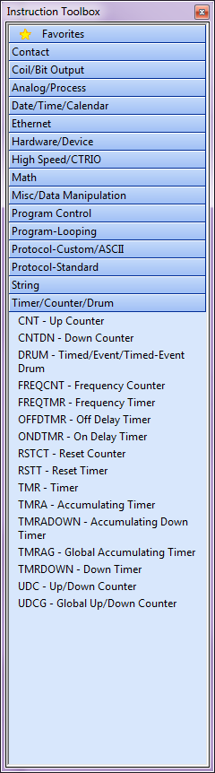
Instruction Set (Timer/Counter/Drum)
Timer/Counter/Drum
  CNT
  CNTDN
  DRUM
  FREQCNT
  FREQTMR
  OFFDTMR
  ONDTMR
  RSTCT
  RSTT
  TMR
  TMRDOWN
  TMRA
  TMRADOWN
  TMRAG
  UDC
  UDCG

Slide 5
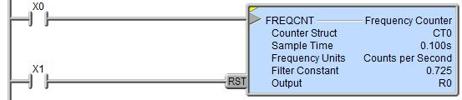
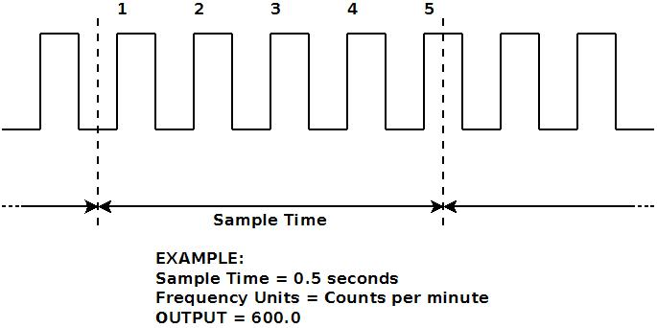
Instruction Set (Timer/Counter/Drum)
FREQCNT “Frequency Counter”
  Converts rate of series of pulses to engineering units (e.g. counting X0 pulses)
  Multiscan instruction
  (yellow triangle)
  Parameters:
    Counter Struct –
    Counter structure to be
    used
    Sample Time – how long to sample the pulses (max 2,147,483,647 ms = 596 hours, [24 days, 20 hours], 31 minutes, 23.647 seconds)
    Frequency Units: (Counts per Second, Minute or Hour)
    Filter – data smoothing; large (stable) vs small (responsive); 0.0 to 0.999999
    Scale Factor – use to convert to engineering units like gallons per second
    Output – location of result (real number)
  Input Legs:
    Top leg is the count input (edge-triggered)
    RST – resets count (Output = 0 [zero])
  Termination Scan Behavior:
    Program, Task or Stage → no longer counts
  Structure Members: not used
  Analogous to Rate calculation on a CTRIO/CTRIO2

Slide 6
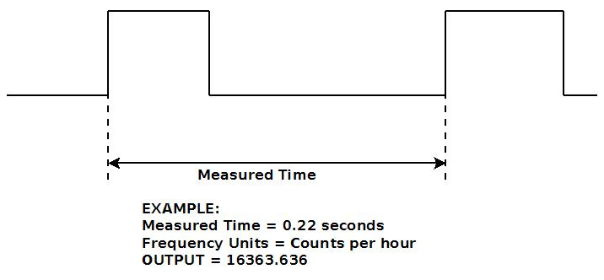
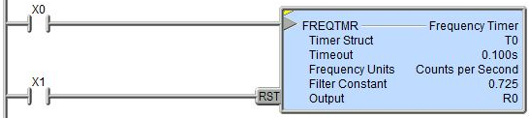
Instruction Set (Timer/Counter/Drum)
FREQTMR “Frequency Timer”
  Converts time between leading edges to engineering units
  Multiscan instruction
  (yellow triangle)
  Parameters:
    Timer Struct – Timer
    structure to be used
    Timeout – maximum
    time to wait between leading edges (max 2,147,483,647 ms = 596 hours, [24 days, 20 hours], 31 minutes, 23.647 seconds)
    Frequency Units: (Counts per Second, Minute or Hour)
    Filter – data smoothing; large (stable) vs small (responsive); 0.0 to 0.999999
    Scale Factor – use to convert to engineering units like gallons per second
    Output – location of result (real number)
  Input Legs:
    Top leg is the leading edge input
    RST – resets count (Output = 0 [zero])
  Termination Scan Behavior:
    Program, Task or Stage → no longer times
  Structure Members: not used
  Analogous to Edge Timer on CTRIO/CTRIO2

Slide 7
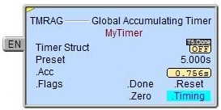
Instruction Set (Timer/Counter/Drum)
TMRAG “Global Accumulating Timer”
  Times up to a preset value
  Multiscan instruction (yellow triangle)
  Parameters:
    Timer Struct – Timer structure to be used T0-255 (default)
    Preset – time value to count up to (max 2,147,483,647 ms = 596 hours, [24 days, 20 hours], 31 minutes, 23.647 seconds)
      Constant – specified in hours, minutes, seconds, ms
      Variable – memory location value in ms
  Input Leg:
    EN = Enable
      TRUE → Timer times up
      FALSE → Timer stops timing but maintains value
  Termination Scan Behavior:
    Program, Task or Stage → Timer does not reset & maintains value but loses state
  Structure Members:
    T0.Acc – (32-bit signed value) millisecond value of current time
    T0.Done – (bit) ON when EN input leg is TRUE and T0.Acc ≥ Preset
    T0.Reset – (bit) ON if being reset by RSTT
    T0.Zero – (bit) ON when T0.Acc = zero
    T0.Timing – (bit) ON if EN input leg is TRUE

Slide 8
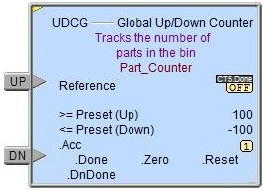
Instruction Set (Timer/Counter/Drum)
UDCG “Global Up/Down Counter”
  Counts up or down to preset value(s)
  Multiscan instruction (yellow triangle)
  Parameters:
    Reference – Counter structure to be used CT0-255 (default)
    >=Preset (Up) – count value to count up to (max 2,147,483,647), constant or variable
    <= Preset (Down) – count value to count down to
    (max -2,147,483,648), constant or variable
  Input Legs:
    UP = leading-edge-triggered counting up
    DN = leading-edge-triggered counting down
  Termination Scan Behavior:
    Program, Task or Stage → Counter does not reset
    & maintains value but loses state
  Structure Members:
    CT0.Acc – (32-bit signed value) current count
    CT0.DnDone – (bit) ON when CT0.Acc ≤ Preset (Down)
    CT0.Done – (bit) ON when CT0.Acc ≥ Preset (Up)
    CT0.Reset – (bit) ON if being reset by RSTT
    CT0.Zero – (bit) ON when CT0.Acc = zero

