Slide 1
Do-more Technical Training
Instruction Set
(String)

Slide 2
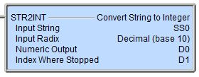
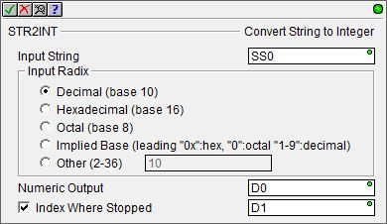
Instruction Set (String)
STR2INT “Convert String to Integer”
Converts ASCII digits to integer value
Parameters:
Input String – string to be converted
Input Radix – determines valid characters
Decimal (base 10): characters “0-9”
Hexadecimal (base 16): characters “0-F”
Octal (base 8): characters “0-7”
Implied Base: characters “0x” (hex), “0” (octal), “1-9”(decimal)
Other (2-36): e.g. 36 would validate characters “0-Z”
Numeric Output – location of converted value
Index Where Stopped – character location in string
NOTES:
If Input String is empty then Index Where Stopped = -1; ERR = “STR2INT input string is empty”
If Input String contains invalid characters then Index Where Stopped = -1; ERR = “STR2INT input string couldn’t be converted to an integer value”
SS0 | 0 | 1 | 2 | 3 | 4 | 5 | 6 | 7 | 8
 | 1 | 0
SS0 | 0 | 1 | 2 | 3 | 4 | 5 | 6 | 7 | 8
 |  |  |  | 1 | 0
SS0 | 0 | 1 | 2 | 3 | 4 | 5 | 6 | 7 | 8
 |  |  |  | 1 | F
SS0 | 0 | 1 | 2 | 3 | 4 | 5 | 6 | 7 | 8
 | @
SS0 | 0 | 1 | 2 | 3 | 4 | 5 | 6 | 7 | 8
Input Radix | Numeric Output | Index Where Stopped
Decimal | 0 | -1
Hexadecimal | 0 | -1
Octal | 0 | -1
Implied Base | 0 | -1
Other: 20 | 0 | -1
Input Radix | Numeric Output | Index Where Stopped
Decimal | 10 | 2
Hexadecimal | 16 | 2
Octal | 8 | 2
Implied Base | “Decimal” → 10 | 2
Other: 20 | 20 | 2
Input Radix | Numeric Output | Index Where Stopped
Decimal | 10 | 5
Hexadecimal | 16 | 5
Octal | 8 | 5
Implied Base | “Decimal” → 10 | 5
Other: 20 | 20 | 5
Input Radix | Numeric Output | Index Where Stopped
Decimal | 1 | 4
Hexadecimal | 31 | 5
Octal | 1 | 4
Implied Base | “Decimal” → 1 | 4
Other: 20 | 35 | 5
Input Radix | Numeric Output | Index Where Stopped
Decimal | 0 | -1
Hexadecimal | 0 | -1
Octal | 0 | -1
Implied Base | 0 | -1
Other: 20 | 0 | -1

Slide 3
Instruction Set (String)
STR2REAL “Convert String to Real”
Converts ASCII digits to real value
Parameters:
Input String – string to be converted
Numeric Output – location of converted value
Index Where Stopped – character location in string
NOTES:
Valid characters are: “0123456789.E+-”
If Input String is empty then Index Where Stopped = -1; ERR = “STR2REAL input string is empty”
If Input String contains invalid characters then Index Where Stopped = -1; ERR = “STR2REAL input string couldn’t be converted to an integer value”
SS0 | 0 | 1 | 2 | 3 | 4 | 5 | 6 | 7 | 8 | 9
 |  |  |  | - | 3 | . | 1 | 4
SS0 | 0 | 1 | 2 | 3 | 4 | 5 | 6 | 7 | 8 | 9
 |  |  |  | 1
SS0 | 0 | 1 | 2 | 3 | 4 | 5 | 6 | 7 | 8 | 9
 | + | 6 | . | 0 | 2 | E | + | 2 | 3
SS0 | 0 | 1 | 2 | 3 | 4 | 5 | 6 | 7 | 8 | 9
 |  |  |  | .
Numeric Output | Index Where Stopped
1.0 | 4
Numeric Output | Index Where Stopped
-3.14 | 8
Numeric Output | Index Where Stopped
6.02E+23 | 9
Numeric Output | Index Where Stopped
0.0 | -1

Slide 4
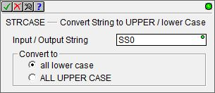
Instruction Set (String)
STRCASE “Convert String to UPPER/lower Case”
Converts all characters in a string to either upper case or lower case letters
Parameters:
Input/Output String – string to be converted
Convert to:
all lower case
ALL UPPER CASE
NOTES:
Valid characters are only alphabetic letters
If character is not alphabetic, no change occurs to that character
SS0 | a | b | c | d | ! | E | F | g | H
Low
Up
SS0 | a | b | c | d | ! | e | f | g | h
SS0 | A | B | C | D | ! | E | F | G | H

Slide 5
Instruction Set (String)
STRCLEAR “Clear Strings”
Deletes all characters from a single string or a range of strings
Parameters:
Start String – 1st (or only) string to be cleared
Number of Strings to Clear – 1 to 65535 (or variable)
NOTES:
The Status display will only show as many characters that fit in its borders (about 50 characters)

Slide 6
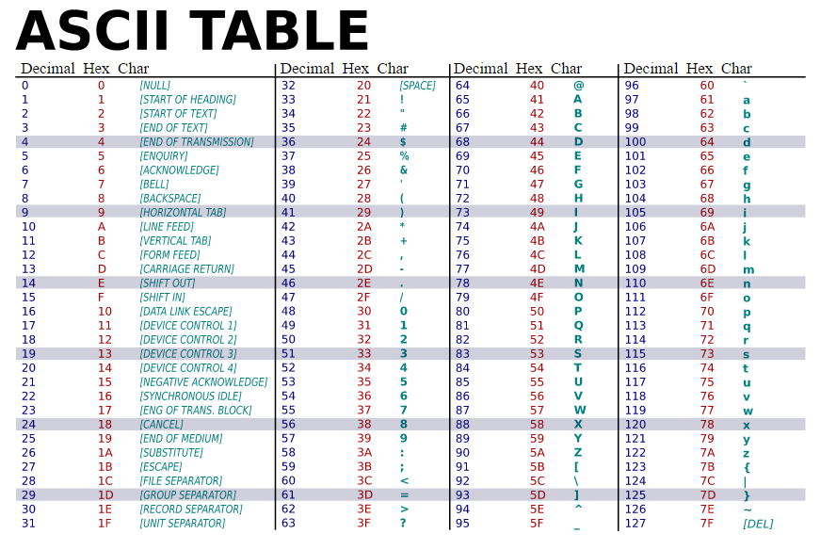
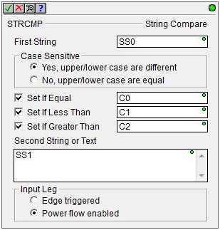
Instruction Set (String)
E = 45 hex
STRCMP “String Compare”
Compares two strings to determine if they are equal, less than or greater than
Less than & greater than values are determined by the ASCII byte values
Each byte position is compared until:
Byte values don’t match with one value > or <
End of one string reached 1st meaning it is <
End of both strings reached simultaneously meaning equality
Parameters:
First String
Case Sensitive:
Yes, upper/lower case are different
No, upper/lower case are equal
Set If Equal (optional)
Set If Less Than (optional)
Set If Greater Than (optional)
Second String or Text – the 2nd string can be a literal text in quotes
Input Leg:
Edge triggered
Power flow enabled
SS0 | a | b | c | d | ! | E | F | g | H
SS1 | a | b | c | d | ! | E | F | g | H
SS0 | a | b | c | d | ! | E | F | g | H
SS1 | a | b | c | d | ! | E
SS0 | a | b | c | d | ! | E | F | g | H
SS1 | a | b | c | d | ! | e | F
e = 65 hex
SS0’s E is < SS1’s e
Yes, upper/lower case are different
SS0 = SS1 | SS0 < SS1 | SS0 > SS1
 | YES
No, upper/lower case are equal
 |  | YES
Yes, upper/lower case are different
SS0 = SS1 | SS0 < SS1 | SS0 > SS1
YES
No, upper/lower case are equal
YES
Yes, upper/lower case are different
SS0 = SS1 | SS0 < SS1 | SS0 > SS1
 |  | YES
No, upper/lower case are equal
 |  | YES
SS0’s E & SS1’s e are equal in value & SS0 is longer

Slide 7
Instruction Set (String)
STRDELETE “Delete Substring”
Deletes characters from a string
Trailing characters are shifted to take the place of deleted ones
Parameters:
Input / Output String
Starting at Offset: 0 – 1023 (or variable)
The 1st character is 0 (zero)
Number of Characters to Delete
To delete the ! character:
Starting at Offset = 4
Number of Characters to Delete = 1
SS0 | a | b | c | d | E | F | g | H
SS0 | a | b | c | d | ! | E | F | g | H
0
1
2
3
4

Slide 8
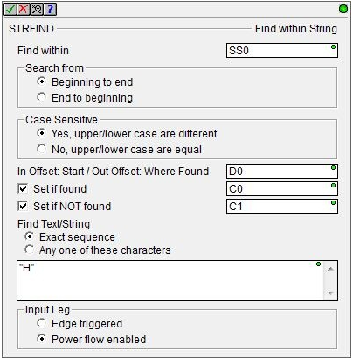
Instruction Set (String)
STRFIND “Find within String”
Search a target string for a particular string
If successful the where-found offset could be used in STRSUB, STRDELETE or STRINSERT instructions
Parameters:
Find within – string in which to search
Search from:
Beginning to end
End to beginning
Case Sensitive:
Yes, upper/lower case are different
No, upper/lower case are equal
In Offset: Start / Out Offset: Where Found – will contain -1 if nothing is found
Set if found (optional)
Set if NOT found (optional)
Find Text/String:
Exact sequence
Any one of these characters – text box
Input Leg:
Edge triggered / Power flow enabled
To find the E character:
Search from: Beginning to end
Case Sensitive: Yes
Find Text/String: Any one of these characters: “E”
SS0 | a | b | c | e | E | E | F | g | H
0
1
2
3
4

Slide 9
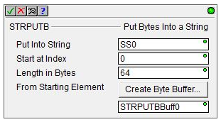
Instruction Set (String)
STRPUTB “Put Bytes Into a String”
Puts bytes of data from a specified location range into a string
Parameters:
Put Into String – string that will contain data bytes
Start at Index – 1st location in the string for the bytes
Length in Bytes – number of bytes to write into string
From Starting Element – 1st location to read bytes
<Create Byte Buffer> button – convenient way to create a Memory Block of bytes (shows up in Memory Configuration)
NOTES:
Not intended to operate on strings with ASCII text

Slide 10
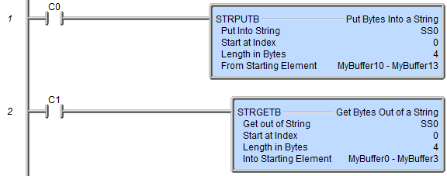
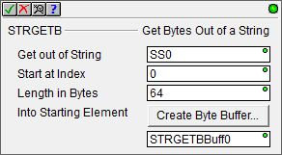
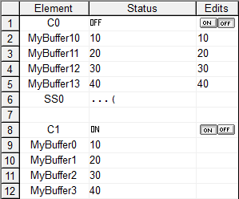
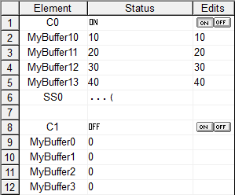
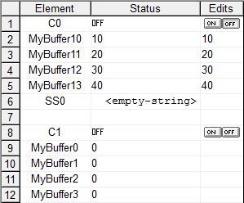
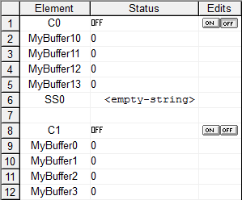
Instruction Set (String)
Values are manually written to a custom byte memory MyBuffer10-13.
STRGETB “Get Bytes Out of a String”
Extracts bytes of data out of a string & stores them in specified location
Parameters:
Get out of String – string with data bytes
Start at Index – 1st location in the string for the bytes
Length in Bytes – number of bytes to copy
Into Starting Element – 1st location to put extracted bytes
<Create Byte Buffer> button – convenient way to create a Memory Block of bytes (shows up in Memory Configuration)
NOTES:
Not intended to operate on strings with ASCII text
The STRPUTB writes the range MyBuffer10-13 into SS0
The STRGETB writes the bytes in SS0 to the range MyBuffer0-3
ASCII values of 10, 20, 30 are not displayable characters.
40 decimal ASCII is (.

Slide 11
Instruction Set (String)
STRINSERT “Insert Substring”
Inserts characters into a string
Parameters:
Insert String or Text
Into String
Starting at Offset
If > length of string, it is appended to string
If > allowable size of the Into String, then:
Text is appended to string
$OutOfRange (ST132) = ON
ERR = “Argument out of range in STRINSERT…”
The text “not ” is to be inserted into SS0 starting at offset 12.

Slide 12
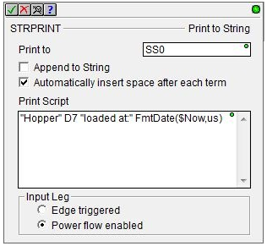
Instruction Set (String)
STRPRINT “Print to String”
Writes text & formatted data into a string
Parameters:
Print to
Append to String (optional)
Automatically insert space after each term (optional)
Print Script – text with optional embedded fields (text, control characters, strings, elements, formatting & string selection functions, raw data) – See next slide →
Input Leg – Edge triggered / Power flow enabled

Slide 13
Instruction Set (Ethernet)
STRPRINT “Print to String”
Parameters:
Print Script
String Literals – ASCII text in double quotes (e.g. “Hi!”)
Data Elements – (e.g. “The current count is” CT0.Acc)
Control Characters
$$ → $
$” → “
$L → <LF> (line feed)
$N → <CR><LF> (carriage return, line feed)
$P → <FF> (form feed)
$R → <CR> (carriage return)
$T → <TAB> (tab)
$hh → hh (any one-byte hex value)
Formatting Functions [see Do-more Designer Help Topic DMD0168]
FmtString – Sets length and/or justifies text within a string
FmtBit – Formats bits’ values as a text instead of just 0 or 1
FmtInt – Formats how an integer is represented in a string
FmtReal – Formats how real numbers are represented in a string
FmtTMR – Formats how Timer Accumulator values are represented in a string
FmtDate – Formats how a Date stamp is represented in a string
FmtTime – Formats how a Time stamp is represented in a string
Lookup – Selects a string in a list to represent a value
Raw – Places bytes of data from a data block into a string

Slide 14
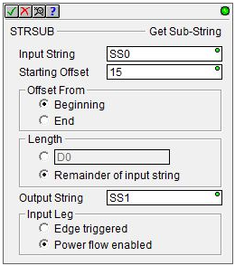
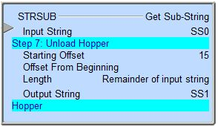
Instruction Set (String)
STRSUB “Get Sub-String”
Copies characters from one string to another
Parameters:
Input String
Starting Offset
Offset From – Beginning / End
Length – variable or Remainder of input string
Output String
Input Leg – Edge triggered / Power flow enabled

Slide 15
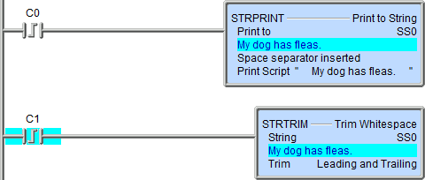
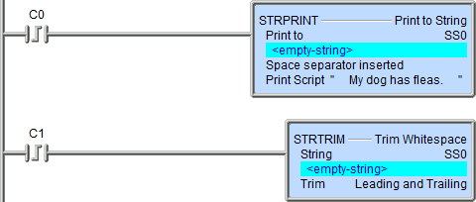
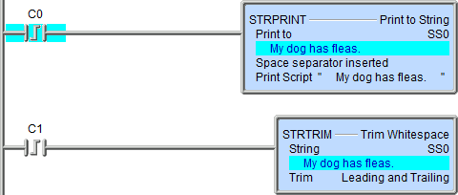
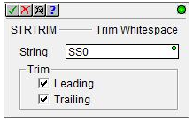
Instruction Set (String)
STRTRIM “Trim Whitespace”
Removes all whitespace characters from the beginning and/or end of a string
What is “Whitespace”? →
Space (ASCII 20 hex)
Horizontal tab <TAB> (ASCII 09 hex)
Carriage return <CR> (ASCII 0D hex)
Line feed <LF> (ASCII 0A hex)
Form feed <FF> (ASCII 0C hex)
Vertical tab <VT> (ASCII 0B hex)
Parameters:
String
Trim
Leading (optional)
Trailing (optional)

Slide 16
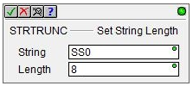
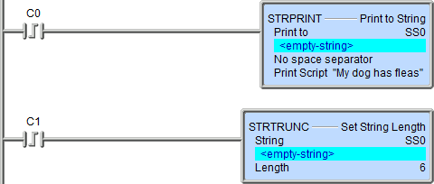
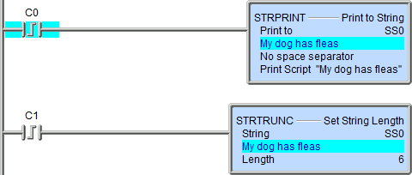
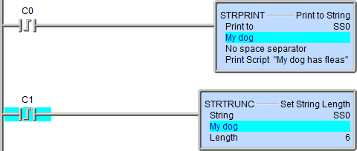
Instruction Set (String)
STRTRUNC “Set String Length”
Sets the length of a string
Parameters:
String
Length
If 0 (zero) or negative (-) clears string <empty string>
If > string’s length then string is padded with nulls (0; not spaces) to reach the specified length
If > string’s allowed length (e.g. >64 for SS, >256 for SL) then entire string is padded with nulls (0; not spaces) and…
$BufferOverflow (ST140) = ON
ERR: “Length was greater than max string length in STRTRUNC…”

