Slide 1
Do-more Technical Training
Instruction Set
(Program-Looping)

Slide 2
Instruction Set (Program-Looping)
Program-Looping (8)
BREAK
CONTINUE
FOR/NEXT
REPEAT/UNTIL
WHILE/WEND

Slide 3
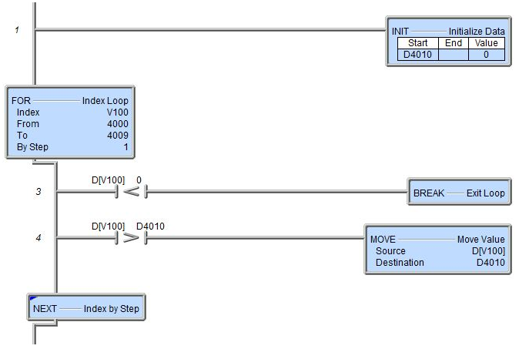
Instruction Set (Program-Looping)
Finds maximum value in D4000-4009 Stores maximum value in D4010
D4010 (maximum value) is initialized to zero
BREAK “Exit Loop”
Breaks out of FOR/NEXT, WHILE/WEND or REPEAT/UNTIL loop
Skips over instructions between BREAK and the NEXT, WEND, or UNTIL instruction
No more iterations of the loop are done
Execution continues with instruction immediately following NEXT, WEND, or UNTIL
Skipping instruction
However, if any value is found in D4000-4009 that is negative, looping is stopped
FOR/NEXT loop iterates through range V100 = 4000-4009
Maximum value is stored in D4010

Slide 4
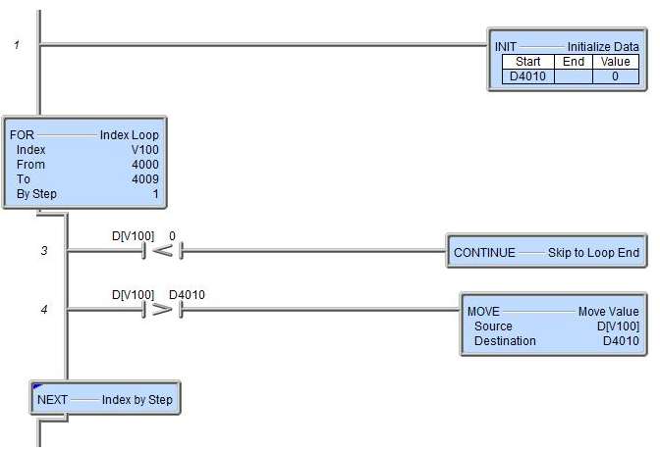
Instruction Set (Program-Looping)
Finds maximum value in D4000-4009 Stores maximum value in D4010
D4010 (maximum value) is initialized to zero
CONTINUE “Skip to Loop End”
Skips over instructions between CONTINUE and the NEXT, WEND, or UNTIL instruction
Similar to BREAK except that the loop is not terminated
Execution continues with the next iteration of the loop next time the code block is scanned
Skipping instruction
However, if any value is found in D4000-4009 that is negative, looping is continued at next iteration
FOR/NEXT loop iterates through range V100 = 4000-4009
Maximum value is stored in D4010

Slide 5
Instruction Set (Program-Looping)
FOR “Index Loop”
Designates the beginning of a loop in which instructions between FOR & NEXT are executed a predefined number of times
No limit to nesting
Unconditional
To make conditional place in Task and use ENTASK
Parameters:
Index – memory initialized to the From value and incremented by the By Step value
From – memory/constant that initializes Index
To – memory/constant that designates the last loop value
By Step – memory/constant by which Index is incremented by for each loop iteration
NEXT “Index by Step”
Designates the end of a FOR loop
Yielding instruction
Finds the maximum value in the range of D4000 - 4009

Slide 6
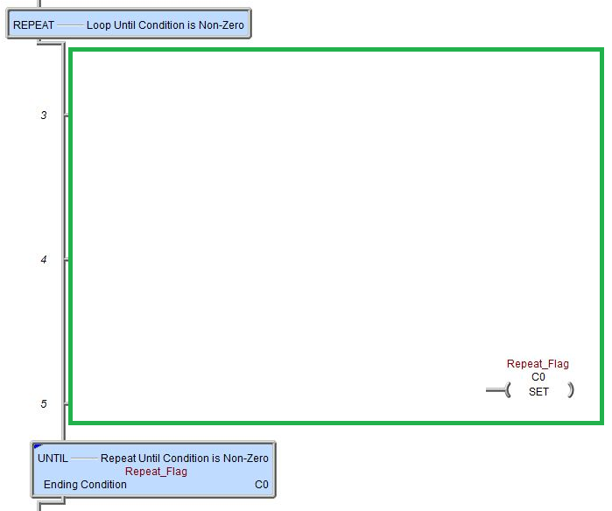
Instruction Set (Program-Looping)
REPEAT “Loop Until Condition is Non-Zero”
Designates the beginning of a loop in which instructions between REPEAT & UNTIL are executed until the ending Ending Condition is non-zero
No limit to nesting
Unconditional
To make conditional place in Task and use ENTASK
UNTIL “Repeat Until Condition is Non-Zero”
Designates the end of a REPEAT loop
Parameters:
Ending Condition – memory location that if contains a non-zero value terminates the loop
Yielding instruction
Ladder Code
Ladder Code

Slide 7
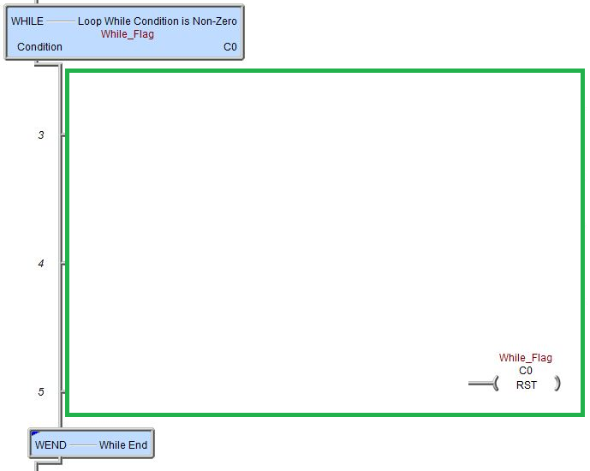
Instruction Set (Program-Looping)
WHILE “Loop While Condition is Non-Zero”
Designates the beginning of a loop in which instructions between WHILE & WEND are executed while the Condition is non-zero
Similar to REPEAT/UNTIL
No limit to nesting
Unconditional
To make conditional place in Task and use ENTASK
WEND “While End”
Designates the end of a WHILE loop
Yielding instruction
Ladder Code
Ladder Code

