Slide 1
Do-more Technical Training
Instruction Set
(Program Control)

Slide 2
Instruction Set (Program Control)
Program Control
ENTASK
EXIT
GOTO
HALT
JMP (Stage)
JMPI (Stage)
LABEL
REBOOT
RESTART
RUN
SG (Stage)
SGCONVRG (Stage)
SGDIVRG (Stage)
SGRST (Stage)
SGRSTR (Stage)
SGSET (Stage)
STOP
SUSPEND
WATCHDOG
YIELD

Slide 3
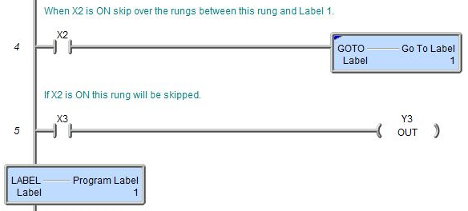
Instruction Set (Program Control)
GOTO “Go To Label”
Immediate branch to LABEL instruction
Cannot reference Labels in a different Program/Task
If inside FOR/NEXT, WHILE/WEND, or REPEAT/UNTIL loop, cannot target Labels outside that loop
Cannot target Labels in a different stage
Branching backward subjects it to yielding (blue)
LABEL “Program Label”
The target of the GOTO instruction

Slide 4
Instruction Set (Program Control)
REBOOT “Reboot PLC”
Causes CPU to perform a cold reboot (just like a power cycle)

Slide 5
Instruction Set (Program Control)
RESTART “Restart Program or Task”
Stops Program or Task then restarts it so that it begins running from the beginning
Resets Stages, clears internal flags, counters, etc.

Slide 6
Instruction Set (Program Control)
STOP “Switch to Program Mode”
Causes CPU to go to STOP (Program) Mode
Since there is no way, of course, to programmatically switch back to RUN Mode, this could be a safety concern

Slide 7
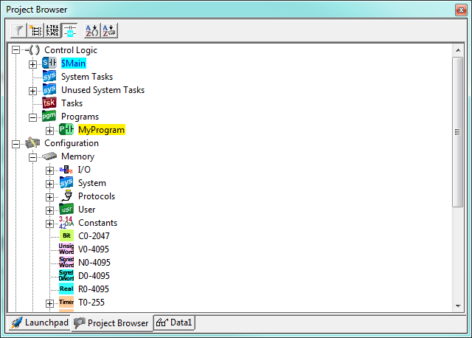
Instruction Set (Program Control)
SUSPEND “Suspend Program or Task”
Suspends the target Program or Task from running
The current state of all ladder logic in target is maintained
.InstrSuspend = ON
Name of target is shown in yellow
Cannot suspend itself

Slide 8
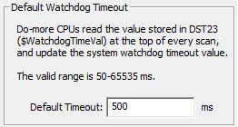
Instruction Set (Program Control)
WATCHDOG “Force Watchdog Error”
Generates a software or hardware watchdog error
Used to verify emergency shutdown
Parameters:
Fire Software Watchdog
CPU goes to STOP (Program) Mode
Acts like scantime > $WatchdogTimeVal (DST23)
Fire Hardware Watchdog
Depends on setup of $DisableHwWdog (ST25) & $HwWatchdogMode (ST24)
If input logic is retentive & Mode switch is in RUN or TERM, CPU will execute Force Watchdog Error instruction continuously.
Place Mode switch in STOP to break out of this

Slide 9
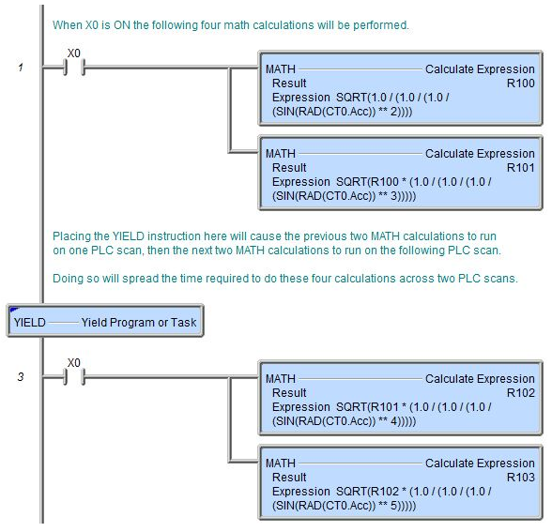
Instruction Set (Program Control)
YIELD “Yield Program or Task”
Stops execution of current Program or Task & passes control to next code block in the execution order
Yields (blue triangle) regardless of value in .TimeSlice
Code block continues at instruction directly below upon next execution
Used so scantime can be controlled
E.g. Program normally takes long time to complete
Inserting YIELDs in the code breaks it up
1st scan
2nd scan
Notes:
Clear PLC
Create MyProgram
Add $On → 4 MATHs, R100 = SQRT(1.0 / (1.0 / (1.0 / (SIN(RAD(R0))**2))))
To $Main, add X0 → RUN MyProgram
To $tTopOfScan add MATH D2 = TICKus()
To $tBottomOfScan add MATH D3 = TICKus() – D2
Create Data View: X0, D3, R0
Write a value to R0 (for the MATH in MyProgram, so it won’t generate a divide-by-zero)
Download & put into RUN
X0 = ON
Notice the value of D3 in µs
Edit MyProgram and put a YIELD in between the 4 MATHs (2 above, 2 below)
Download, notice the smaller D3
Edit MyProgram and put 2 more YIELDs for all 4 MATHs
Download, notice the smaller D3

Slide 10
Stage Programming
Introduction to sequencing
Ladder logic
Pros:
Very good at controlling concurrent processes
Cons:
Not good at controlling sequential processes
Not good at event-driven sequences
Programs get filled with numerous interlocking bits
Difficult to debug
Difficult to modify
All logic impacts scantime

Slide 11
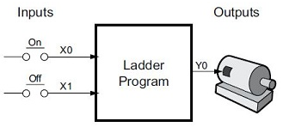
Stage Programming
Ladder Program
States of Y0
OFF
ON
Initially Y0 = OFF
X0 causes Y0 to transition to ON state
X1 causes Y0 to transition to OFF state

Slide 12
Stage Programming
State Diagram
States of Y0
OFF
ON
Initially Y0 = OFF
X0 causes Y0 to transition to ON state
X1 causes Y0 to transition to OFF state
X0
OFF
OFF
ON
Y0
ON
X1

Slide 13
Stage Programming
Sequence Diagram
States of Y0
OFF
ON
Initially Y0 = OFF
X0 causes Y0 to transition to ON state
X1 causes Y0 to transition to OFF state

Slide 14
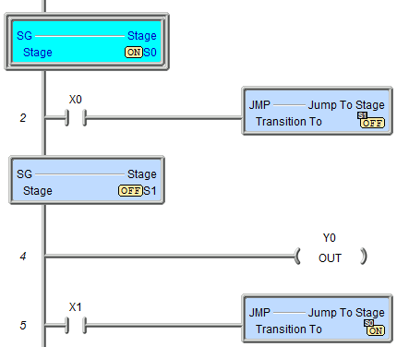
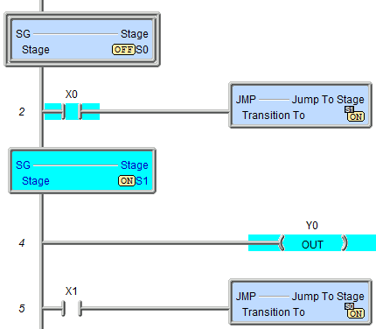
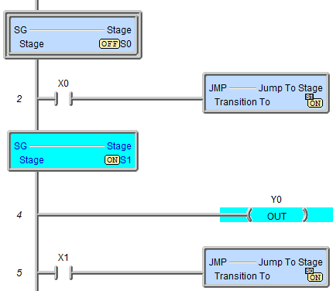
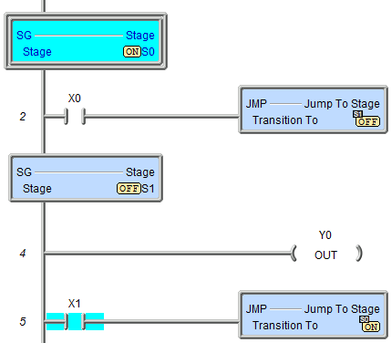
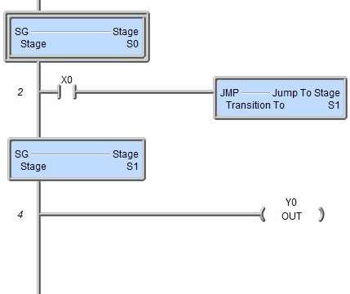
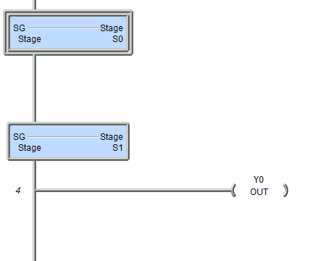
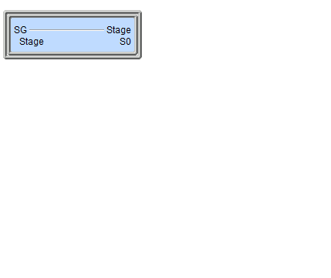
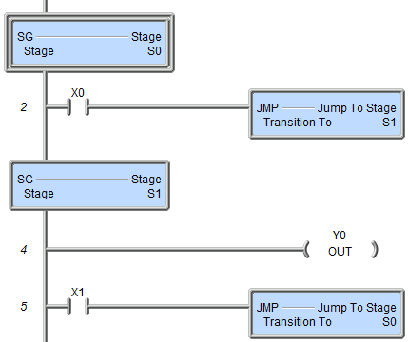
Stage Programming
Stage Program
States of Y0
OFF
ON
Initially Y0 = OFF
X0 causes Y0 to transition to ON state
X1 causes Y0 to transition to OFF state

Slide 15
Stage Programming
Numbering
Tasks do not have Stages
Programs can have 128 Stages (SG; S0-S127) each
Stage number does not determine sequence
The Initial Stage is the first one (very top)
Enabling/Disabling
Enabled Stages are executed each PLC scan
When a Stage is enabled/scanned the first time it artificially generates an “edge” for all the edge-triggered instructions by setting Edge bits for each bit in the Stage that is already ON when the Stage was enabled*
Disabled Stages are not scanned
A disabled Stage runs a “Termination Scan” immediately following the scan in which it was disabled
*Exception: Bits associated with Counter instructions

Slide 16
Stage Programming
/E0
/E21
NOTE: This Automatic Edge-Bit Feature is not applied to Counter instructions CNT, CNTDN, UDC or UDCG. These are the ONLY exceptions.
Edge Bits
Normally hidden system-only bits
Internal use only; cannot be modified by user
Automatically added to project by Do-more Designer as edge-triggered instructions are programmed and assigned an index of zero (/E0)
Actual usable index value (e.g. “21” of “/E21”) is assigned by the Do-more PLC when project is downloaded (i.e. the PLC, not Do-more Designer, assigns them)
Holds the scan-to-scan state of edge-triggered inputs
When an edge is detected (e.g. OFF-to-ON or ON-to-OFF, depending on instruction) the associated Edge Bit is set ON for internal use
Automatic Edge Bit Feature in Stages
Edge Bits have a special use in Stages due to a desired feature
When a particular Stage is enabled, if there is an edge-triggered instruction that gets scanned in that stage, the Edge Bit for that instruction is automatically set ON if that input was ON when the Stage was enabled
Thus what would normally take a minimum of 2-3 scans of that particular Stage to detect an edge for that instruction is actually “detected” (by this feature) on the 1st scan in which that Stage is enabled
S10 Disabled
S10 Enabled
S10 Disabled
S10 Enabled
OFF-to-ON not yet seen because C0 has just now gone OFF
OFF-to-ON not yet seen because C0 was ON when S10 was enabled
1
2
3
C0 = OFF
C0 = OFF
C0 = ON
Rung not scanned
It took a minimum of 2 scans in order for S10 to “see” C0’s edge. This is normal.
But what if C0 had been ON when S10 was enabled instead of OFF as in this example?
It only takes 1 scan in order for S10 to “see” C0’s edge if C0 was ON when S10 was enabled. This is because C0’s Edge Bit is automatically set ON as a feature in Do-more
It took a minimum of 3 scans in order for S10 to “see” C0’s edge.
But this is NOT the way Do-more works!

Slide 17
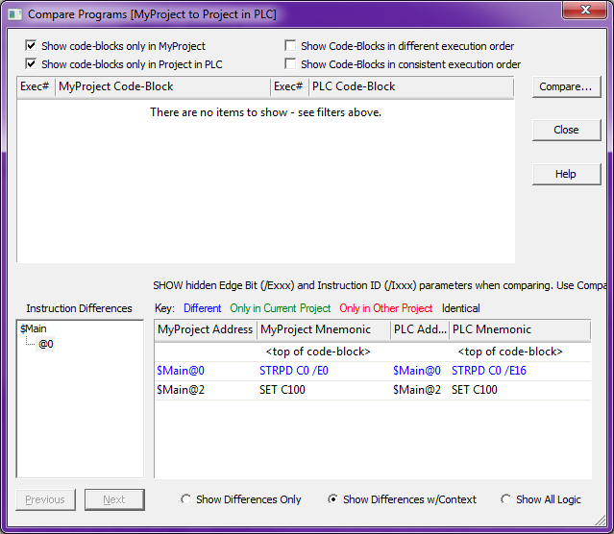
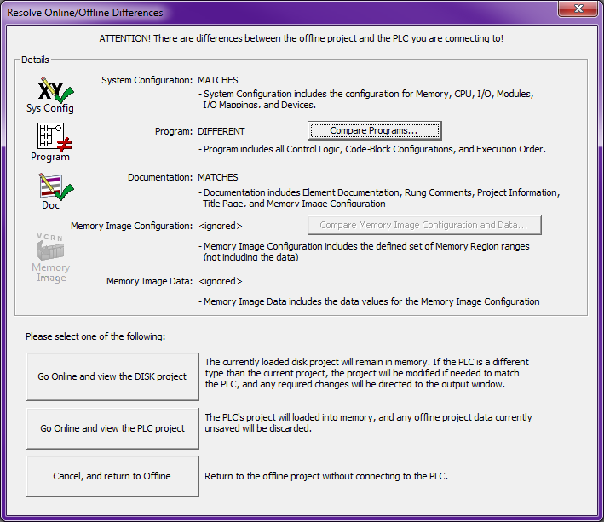
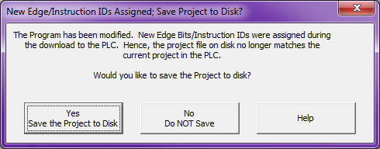
Stage Programming
/E0
/E21
Edge Bits
Since indexes are assigned at download time, Do-more Designer doesn’t “know” what those are until the project is read back up
All Edge Bits in Do-more Designer originally have an index of zero (e.g. /E0)
Thus the following two interesting scenarios can occur:
(1) If a new project with edge-triggered instructions is first saved to disk and then downloaded to the PLC, a dialog will appear describing, “The Program has been modified…” when no manual modification occurred.
Solution: Save the Project to Disk.
If Project is not saved to disk then “Modified project not saved to disk – new Edge/Instruction IDs assigned during download to PLC” is displayed in the Output Window as a Warning
(2) If that project (which was not saved) is closed and then reopened online, the compare will fail.
If <Compare Programs…> is used the Edge Bit difference is shown
Solution: Go online with the PLC project and save the project to disk with the new Edge Bit index assignments

Slide 18
Stage Programming
Termination Scan
Scan which immediately follows the scan in which the Stage was last executed
Insures proper shutdown
Insures subsequent startup behavior
What happens?
OUT instructions are turned OFF
Timers & Counters are reset*
Edge bits are turned OFF
*UDCG “Global Up/Down Counter” not reset
*TMRAG “Global Accumulating Timer” not reset

Slide 19
Stage Programming
Enabling:
When the Stage is the target of:
(1) JMP “Jump To Stage”
(2) JMPI “Indexed Jump”
(3) SGSET “Enable Stage”
(4) SGDIVRG “Jump to Multiple Stages”
(5) SGCONVRG “Converge Multiple Stages to SG”
Disabling:
When the Stage is:
The source of:
(1) JMP “Jump To Stage”
(2) JMPI “Indexed Jump”
(4) SGDIVRG “Jump to Multiple Stages”
(5) SGCONVRG “Converge Multiple Stages to SG”
The target of:
(6) SGRST “Disable Stage”
(7) SGRSTR “Disable Range of Stages”

Slide 20
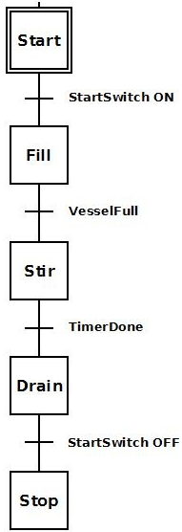
Stage Programming
JMP “Jump To Stage”
Disables Stage in which it is contained & enables the “jump-to” Stage
Parameters:
Transition To – target Stage to “jump” to
NOTES:
Does not “jump” immediately
Code between the JMP and end of the Stage is still scanned / executed
Cannot “jump” to Stages in other Programs

Slide 21
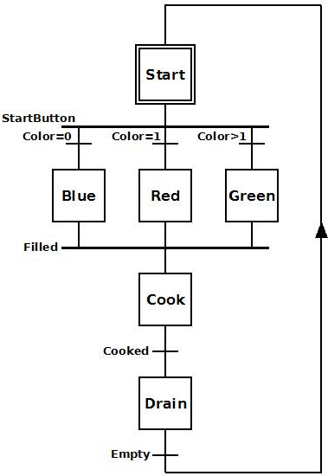
Stage Programming
JMPI “Indexed Jump”
Disables Stage in which it is contained & enables the “jump-to” Stage based on an Index
Parameters:
Index – memory location of index value
First Stage – 1st Stage in range for index = 0
Last/Exception Stage – Stage to “jump” to if index is out of range
NOTES:
Does not “jump” immediately
Code between the JMPI and end of the Stage is still scanned / executed
Cannot “jump” to Stages in other Programs

Slide 22
Stage Programming
SGSET “Enable Stage”
Enables target Stage
Parameters:
Stage – target Stage to enable
NOTES:
Does not disable Stage containing SGSET
Cannot enable Stages in other Programs

Slide 23
Stage Programming
SGRST “Disable Stage”
Disables target Stage
Parameters:
Stage – target Stage to disable
NOTES:
If it disables itself, code between the SGRST & end of the Stage is still scanned / executed
Cannot disable Stages in other Programs

Slide 24
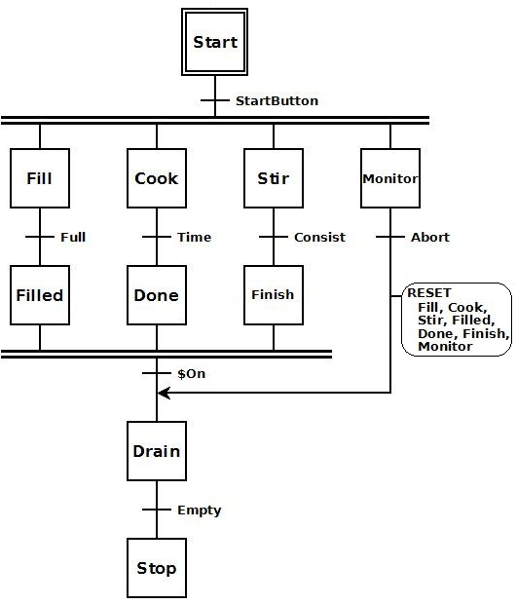
Stage Programming
SGRSTR “Disable Range of Stages”
Disables a range of Stages
Parameters:
Start Stage – 1st Stage in range to disable
End Stage – last Stage in range to disable
NOTES:
If it disables itself, code between the SGRSTR & end of the Stage is still scanned / executed
Cannot disable Stages in other Programs

Slide 25
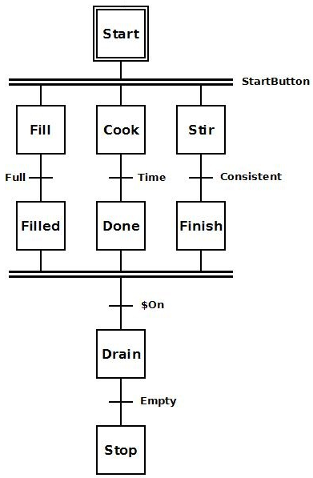
Stage Programming
SGDIVRG “Jump to Multiple Stages”
Disables Stage in which it is contained & enables all Stages listed
Parameters:
Transition To – list of Stages to enable
NOTES:
Cannot disable Stages in other Programs

Slide 26
Stage Programming
SGCONVRG “Converge Multiple Stages to SG”
Disables listed Stages & enables target Stage based on condition
Parameters:
Stage – target Stage to be enabled
From Stages – list of Stages to be disabled when condition is true
Then converge when – condition causing the convergence
NOTES:
Cannot use Stages in other Programs

Slide 27
Stage Programming
Design Stage Program
X1 is the Drill Head’s start position
X2 is the Drill Head’s drill position
Y0 drives the Drill Head out
Drill Head
UP
DN
Y1 spins the drill
Y2 extends the drill bit
Y3 determines direction of Drill Head
X3 is the drill bit’s position
X0 starts the Drill Operation

Slide 28
Stage Programming
Design Stage Program
Inputs:
X0: Start drilling operation
X1: Drill Head in start position
X2: Drill Head in drilling position
X3: Drill bit is down
Outputs:
Y0: Traverse motor
Y1: Drill bit motor
Y2: Extend drill bit
Y3: Traverse direction

Slide 29
Stage Programming
Design Stage Program
How do we naturally think about it?
We think of it as a sequence (stage)
Wait for operator to press START button to begin drilling operation
When START button is pressed, drill head traverses to drilling position
When drilling position is reached, drill spins up
After drill spins up, drilling operation is performed
After drilling operation is performed, drill is retracted & turned off
After drill is retracted, drill head is retrieved back to starting position
Is ladders the best option? Probably not.
Could possibly be done with DRUM instruction because it is discrete I/O and timers that are used
But if anything else is done during each stage of the sequence, a DRUM instruction could not be utilized

Slide 30
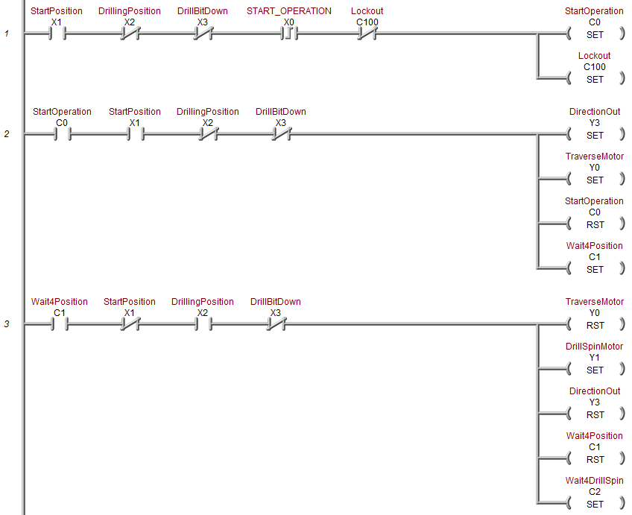
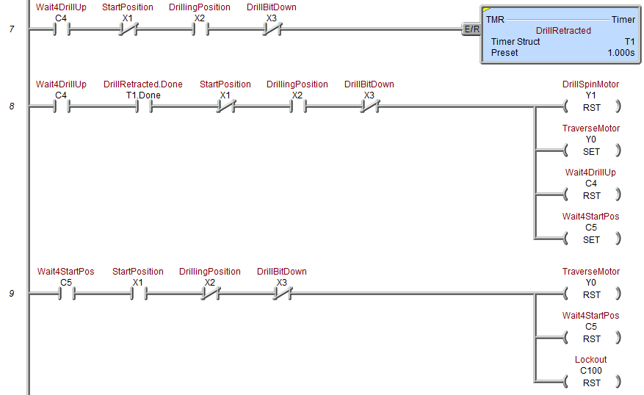
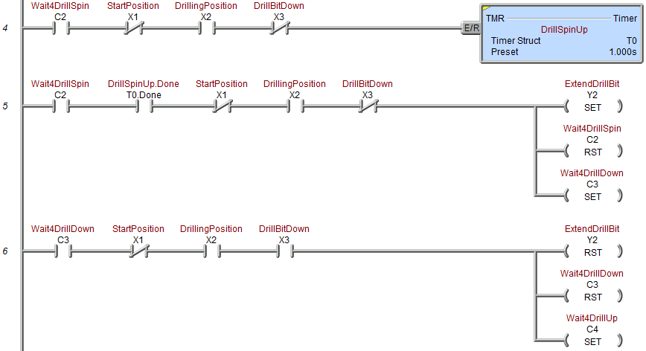
Stage Programming
Design Stage Program (Ladders)
Interlocking C-bits are necessary to sequence the Ladder Logic

Slide 31
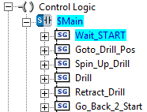
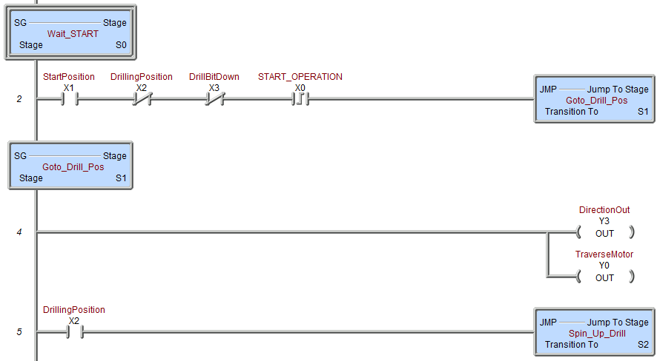
Stage Programming
Design Stage Program (Stage)
Initial Stage
Interlocking C-bits are not necessary
Jumps to “Goto Drill Position”
When the jump occurs both the DirectionOut and Traverse Motor automatically turn OFF
Sets Direction for “out” and turns traverse motor ON
When drilling position is reached, jumps to spin up the drill
Waits for: - Drill head in start position
Drill head not in drilling position
Drill bit is not down
- Operator to press START

Slide 32
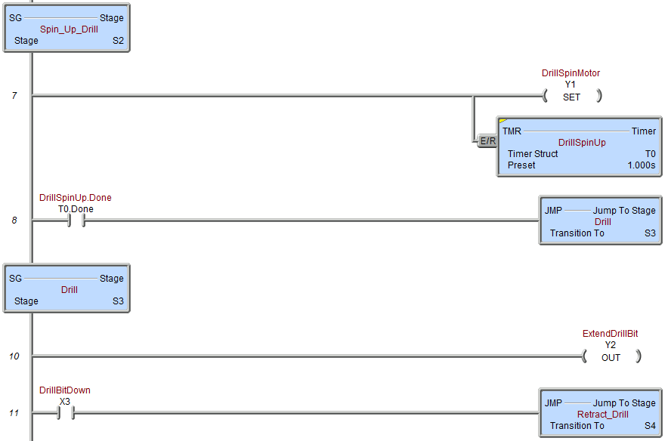
Stage Programming
Design Stage Program (Stage)
Drill motor is turned ON & allowed to spin up for 1 second
When drill has spun up for 1 second, jumps to “Drill”
When jump occurs the drill motor is left spinning because a SET was used (instead of an OUT)
Drill bit is extended to do the drilling operation
When drill bit has reached down position, jumps to “retract the drill bit”
When jump occurs the extend drill bit mechanism automatically turns OFF

Slide 33
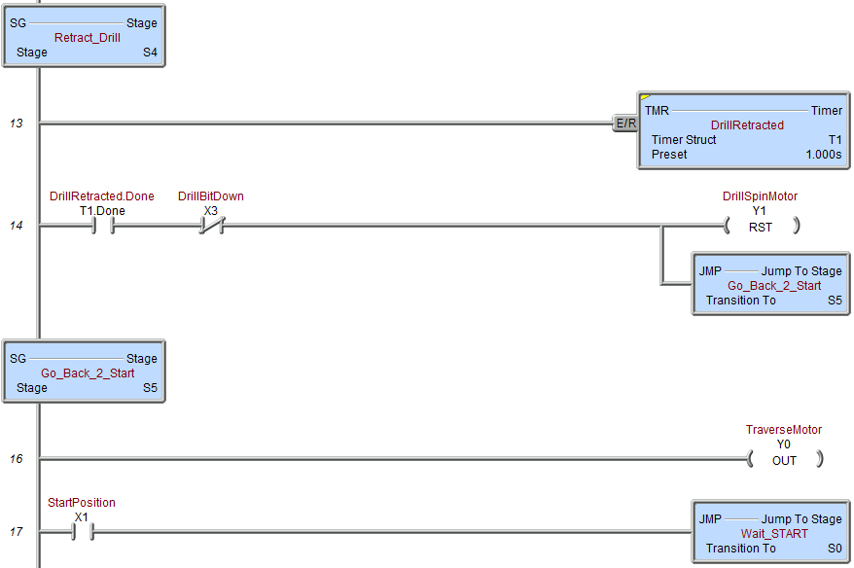
Stage Programming
Design Stage Program (Stage)
Drill bit is allowed time to retract for 1 second
When drill bit is no longer down & 1 second has passed, drill motor is turned OFF
Time to retrieve the Drill Head & start over
Traverse motor is turned ON to retrieve Drill Head back to start position
When Drill Head reaches start position, jump is made back to START
When jump occurs the traverse motor is automatically shut OFF

