Slide 1
Do-more Technical Training
Instruction Set
(Misc/Data Manipulation)

Slide 2
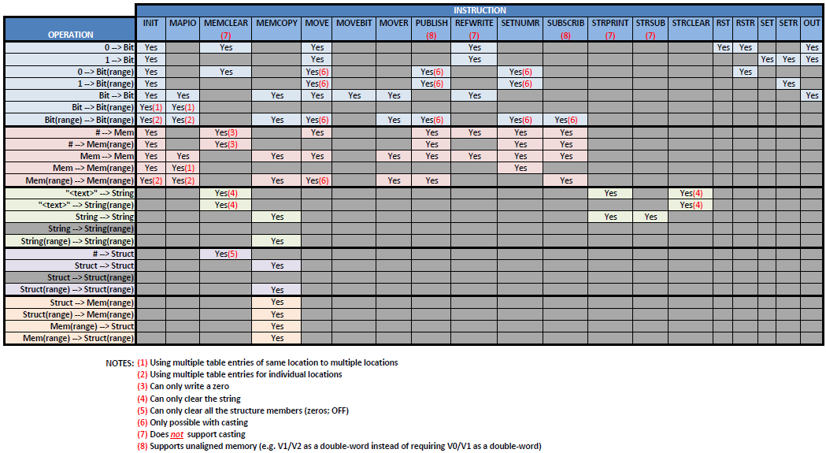
Instruction Set (Misc/Data Manipulation)
Picking the Best Instruction

Slide 3
Instruction Set (Misc/Data Manipulation)
BCDTO “BCD To Integer/Real”
Converts BCD to integer or real
Parameters:
BCD Input – location of BCD value
Output – location of converted value
NOTES:
If BCD Input does not contain valid BCD:
$OutOfRange (ST132) = ON
ERR = “Digit greater than 9 in BCDTO…”

Slide 4
Instruction Set (Misc/Data Manipulation)
TOBCD “Integer/Real To BCD”
Converts integer or real to BCD
Parameters:
Input – location of integer or real number
BCD Output – location of converted BCD value
NOTES:
Only integer portion of real number is converted
Negative values cannot be converted
BCD Output = 0 (zero)

Slide 5
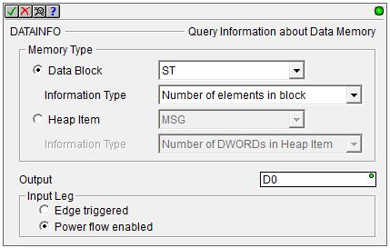
Instruction Set (Misc/Data Manipulation)
Schema ID | Description | Schema ID | Description
1 | BIT | 265 | File
2 | Unsigned BYTE | 266 | Program
3 | Signed BYTE | 267 | Device Reference
4 | Unsigned WORD
5 | Signed WORD | 268 | CTRIO
6 | Signed DWORD | 269 | CTRIO Counter
7 | REAL | 270 | CTRIO Timer
 |  | 271 | CTRIO Pulse Catch
256 | Timer | 272 | CTRIO Pulse
257 | Counter | 273 | CTRIO Discrete
258 | String | 274 | CTRIO Raw
259 | PID
260 | Clock | 275 | Drum
261 | Task | 276 | Stream
262 | Peerlink | 277 | Server
263 | RampSoak | 278 | Packet
264 | Reserved | 279 | Process Simulator
DATAINFO “Query Information about Data memory”
Reads the size or Schema ID of a Data Block or Heap Item
Parameters:
Memory Type:
Data Block – a list of all Data Blocks configured
Information Type:
Number of Elements in Block
Number of BYTEs in Block
Number of BITs in Block
Data Type ID (Schema ID)
Heap Item – a list of all Heap Items configured
Information Type:
Number of DWORDs in Heap Item
Data Type ID (Schema ID)
Output – location of read value
Input Leg
Edge triggered
Power flow enabled

Slide 6
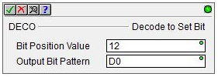
Instruction Set (Misc/Data Manipulation)
DECO “Decode to Set Bit”
Sets a bit (ON) at specified bit position & resets all other bits (OFF)
Parameters:
Bit Position Value – location of bit
Output Bit Pattern – element containing bit
NOTES:
If Bit Position Value > 31:
Output Bit Pattern = 0 (zero)
$OutOfRange (ST132) = ON
“Bit Position Value” = 12
D0 = 0110_0000_0001_0100_0000_0000_0010_1111
D0 = 0000_0000_0000_0000_0001_0000_0000_0000

Slide 7
Instruction Set (Misc/Data Manipulation)
ENCO “Encode Bit Position”
Locates the 1st bit that is ON in memory location
Parameters:
Bit Pattern – memory location (up to 32 bits)
Output Bit Position Value – bit position number
NOTES:
If >1 bit is ON, the least significant one is encoded
If no bits are ON, Output Bit Position Value:
Signed Dword, Signed Word, Real → -1
Unsigned Word → 65535
Unsigned Byte → 255
D0 = 0000_0011_1000_0010_0000_0000_0000_0000
These bits are ignored
D1 = 17
D1 = 0

Slide 8
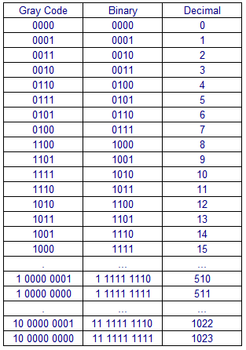
Instruction Set (Misc/Data Manipulation)
GRAY “Gray Code to Integer”
Converts 16-bit Gray code value to integer
Parameters:
Input Value – location to be converted
Output Value – location of conversion

Slide 9
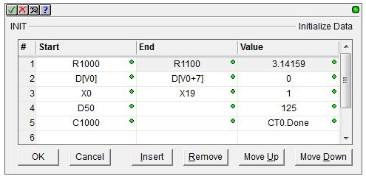
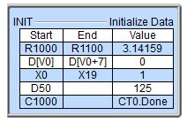
Instruction Set (Misc/Data Manipulation)
INIT “Initialize Data”
Sets each element to specified value
Parameters:
Start – location of 1st element in range to be initialized
End (optional) – location of last element in range to be initialized
Value – initialization value
Editing buttons:
OK – saves & closes editor
Cancel – discards changes & closes editor
Insert – inserts empty row before current row
Remove – deletes current row
Move Up – moves current row up
Move Down – moves current row down
NOTES:
Can have up to 50 rows

Slide 10
Instruction Set (Misc/Data Manipulation)
ISCLEAR “Is Structure Cleared”
Checks if all the members of a particular structure are at their initialized values
E.g. Is a string empty?
Parameters:
Structure – the structure to check
Set if clear – bit to set ON if structure is clear

Slide 11
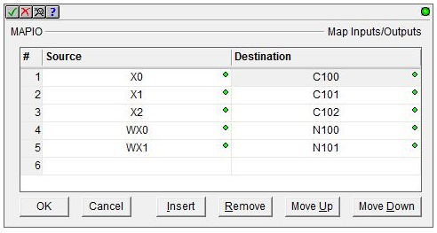
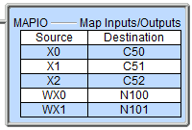
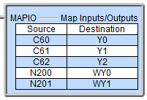
Instruction Set (Misc/Data Manipulation)
MAPIO “Map Inputs/Outputs”
Intended to map real-world I/O to elements & vice versa
Parameters:
Source – input location
Destination – output location
Editing buttons:
OK - saves & closes editor
Cancel – discards changes & closes editor
Insert – inserts empty row before current row
Remove – deletes current row
Move Up – moves current row up
Move Down – moves current row down
NOTES:
Typically a pair of MAPIO instructions:
(1) Map real-world inputs → memory
(2) Map memory → real-world outputs
Typically use of $tTopOfScan & $tBottomOfScan task code blocks would be used
$tTopOfScan
$tBottomOfScan

Slide 12
Instruction Set (Misc/Data Manipulation)
MEMCLEAR “Clear Memory”
Clears a range of memory
Parameters:
Start Struct/Numeric – 1st element in range to be cleared
Number of Elements – number of elements to be cleared

Slide 13
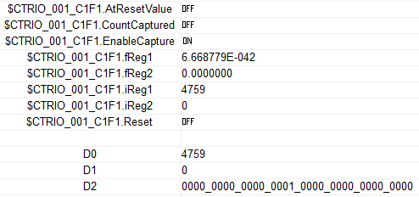
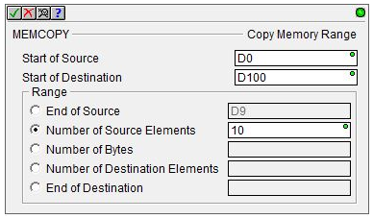
Instruction Set (Misc/Data Manipulation)
MEMCOPY “Copy Memory Range”
Copies bytes from one range of memory locations to another without regard to the format of the data
Parameters:
Start of Source – location of 1st data byte to be copied
Start of Destination – location of 1st data byte in destination
Range – five ways to specify the range
(1) End of Source – calculates # of bytes of by last location in source
(2) Number of Source Elements – calculates # of bytes by elements in source
(3) Number of Bytes – specifies # of bytes
(4) Number of Destination Elements – calculates # of bytes by elements in destination
(5) End of Destination – calculates # of bytes by last element in destination
NOTES:
Can be used to copy structures

Slide 14
Instruction Set (Misc/Data Manipulation)
MOVE “Move Value”
Copies single source value to a single destination
Parameters:
Source – value to be copied (constant or variable)
Destination – location to receive data
NOTES:
Copies a structure member, but not entire structures
If Source & Destination are different types, data conversion is automatically done
If Source and Destination are different sizes, data may be truncated
D0 = 70000
V0 = 0
V0 = 4464
CT0.Acc = 451
V0 = 0
V0 = 451
R0 = 1.234E+08
D1 = 123400000
D1 = 0

Slide 15
Instruction Set (Misc/Data Manipulation)
MOVEBIT “Move Single Bit”
Copies single bit state to a single destination
Parameters:
Source Bit – bit to be copied
Destination – location to receive state
NOTES:
Can copy a bit structure member

Slide 16
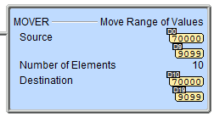
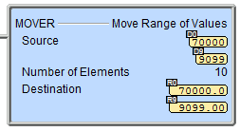
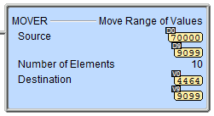
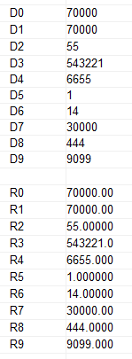
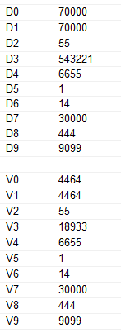
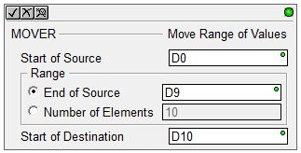
Instruction Set (Misc/Data Manipulation)
MOVER “Move Range of Values”
Copies a range of values to a range of destinations
Parameters:
Start of Source – location of 1st value to be copied
Range – defines the extent of the range
End of source – end of the source range
Number of Elements – size of the range
Start of Destination – location of 1st destination in range
NOTES:
Cannot copy structures or their members
If Source & Destination are different types, data conversion is automatically done
If Source and Destination are different sizes, data may be truncated

Slide 17
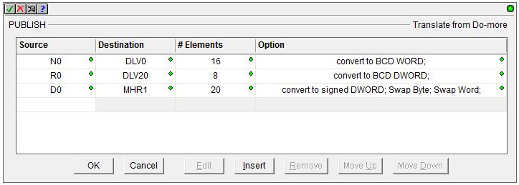
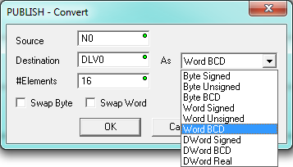
Instruction Set (Misc/Data Manipulation)
PUBLISH “Translate from Do-more”
Copies & converts ranges of data from Do-more memory to a data format to be used by external source
Parameters:
Source – 1st location to be translated
Destination – 1st output location
As – defines format conversion
# Elements – defines size of range
Swap Byte – check if needed
Swap Word – check if needed
Editing buttons:
OK - saves & closes editor
Cancel – discards changes & closes editor
Edit – edit the current row
Insert – inserts empty row before current row
Remove – deletes current row
Move Up – moves current row up
Move Down – moves current row down

Slide 18
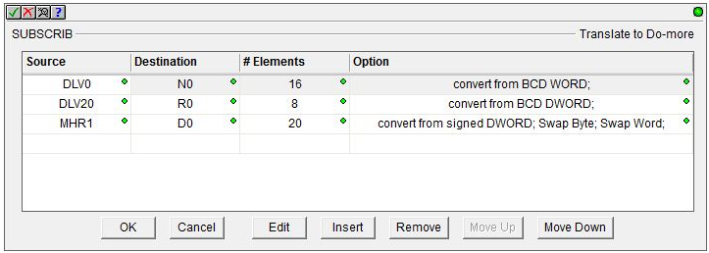
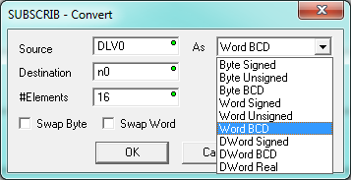
Instruction Set (Misc/Data Manipulation)
SUBSCRIB “Translate to Do-more”
Copies & converts ranges of data used by an external source to Do-more memory
Parameters:
Source – 1st location to be translated
Destination – 1st output location
As – defines format conversion
# Elements – defines size of range
Swap Byte – check if needed
Swap Word – check if needed
Editing buttons:
OK - saves & closes editor
Cancel – discards changes & closes editor
Edit – edit the current row
Insert – inserts empty row before current row
Remove – deletes current row
Move Up – moves current row up
Move Down – moves current row down

Slide 19
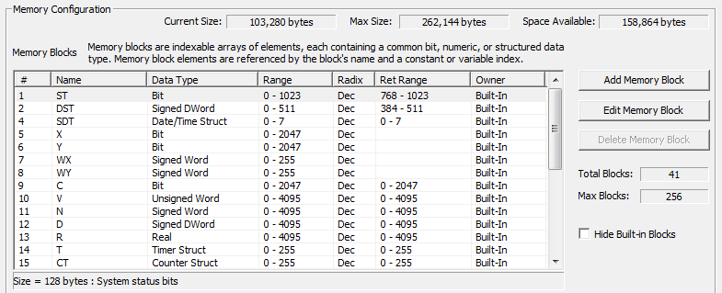
Instruction Set (Misc/Data Manipulation)
REFWRITE “Write Value Indirectly”
Writes value to location by indirect addressing
Parameters:
Value – value to be written
Reference Type – memory block type
See in Memory Configuration
For others, see Help file
Reference ID – index number of the memory block

Slide 20
Instruction Set (Misc/Data Manipulation)
ROTL “Rotate Left”
Rotates bits in location a specified number of bit locations to the left
Parameters:
Input/Output – location of bits
Number of Bits – how many bit locations to shift
NOTES:
Most significant bits are looped back to least significant bits
# of shifts = 0
# of shifts = 2
# of shifts = 3
# of shifts = 4
# of shifts = 1
D0 = 0100_0000_1000_0010_0000_0000_0000_0000
D0 = 0000_0010_0000_1000_0000_0000_0000_0001
D0 = 0000_0100_0001_0000_0000_0000_0000_0010
D0 = 0000_1000_0010_0000_0000_0000_0000_0100
D0 = 1000_0001_0000_0100_0000_0000_0000_0000

Slide 21
Instruction Set (Misc/Data Manipulation)
ROTR “Rotate Right”
Rotates bits in location a specified number of bit locations to the right
Parameters:
Input/Output – location of bits
Number of Bits – how many bit locations to shift
NOTES:
Least significant bits are looped back to most significant bits
# of shifts = 0
# of shifts = 2
# of shifts = 3
# of shifts = 4
# of shifts = 1
D0 = 0000_1000_0010_0000_0000_0000_0000_0100
D0 = 0000_0100_0001_0000_0000_0000_0000_0010
D0 = 0000_0010_0000_1000_0000_0000_0000_0001
D0 = 0100_0000_1000_0010_0000_0000_0000_0000
D0 = 1000_0001_0000_0100_0000_0000_0000_0000

Slide 22
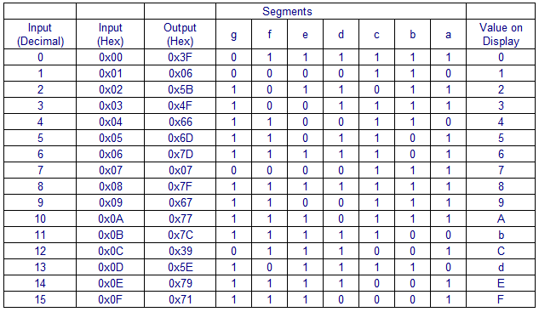
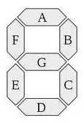
Instruction Set (Misc/Data Manipulation)
SEG “Hex/BCD to 7 Segment Display”
Converts 4-digit hex value to 7-segment display
Parameters:
4 Digit Hex/BCD Value – location to be converted
4x8 Bit a-g Output – location of converted value

Slide 23
Instruction Set (Misc/Data Manipulation)
SETNUMR “Set Numeric Range”
Sets a range of locations to the same value
Parameters:
Start – 1st location of range to be set
End – last location of range to be set
Value – value to be written to range

Slide 24
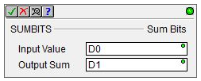
Instruction Set (Misc/Data Manipulation)
SUMBITS “Sum Bits”
Counts number of bits in a location that are ON
Parameters:
Input Value – location of bits
Output Sum – value containing number of bits that are ON
D0 = 0100_0000_1000_0010_0000_0000_0000_0000
3
2
1
D1 = 0
D1 = 3

Slide 25
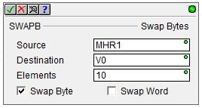
Instruction Set (Misc/Data Manipulation)
SWAPB “Swap Bytes”
Swaps bytes and/or words in a range of locations
Parameters:
Source – 1st location to be converted
Destination – 1st location of converted value
Elements – number of Source locations
Swap Byte – check if needed
Swap Word – check if needed
NOTES:
Source & Destination don’t have to be same type
Swap Byte, V0 → V100
V0 (hex) | V100 (hex)
1234 | 3412
5678 | 7856
ABCD | CDAB
Swap Byte, D0 → D100
D0 (hex) | D100 (hex)
12345678 | 34127856
90ABCDEF | AB90EFCD
Swap Word, D0 → D100
D0 (hex) | D100 (hex)
12345678 | 56781234
90ABCDEF | CDEF90AB
Swap Byte & Word, D0 → D100
D0 (hex) | D100 (hex)
12345678 | 78563412
90ABCDEF | EFCDAB90

