Slide 1
Do-more Technical Training
Instruction Set
(Math)

Slide 2
Instruction Set (Math)
DEC “Decrement”
Decrements the value in location by 1 every scan as long as it has Power Flow
Parameters:
Element – location to decrement
NOTES:
Real numbers can also be used

Slide 3
Instruction Set (Math)
INC “Increment”
Increments the value in location by 1 every scan as long as it has Power Flow
Parameters:
Element – location to decrement
NOTES:
Real numbers can also be used

Slide 4
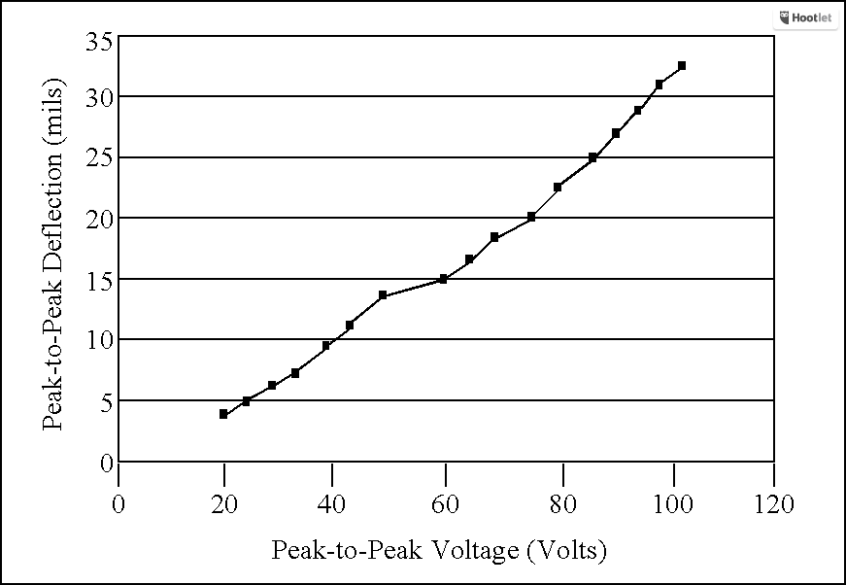
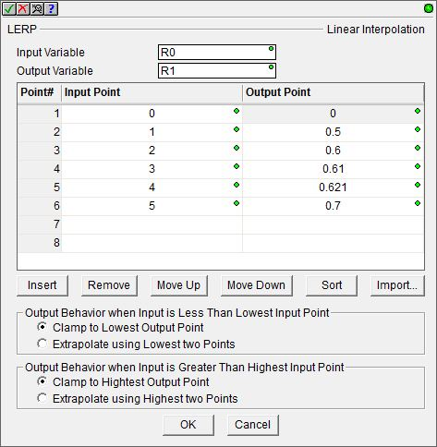
Instruction Set (Math)
Extrapolate using Highest two Points
Clamp to Highest Output Point
LERP “Linear Interpolation”
Uses a table of 2 to 50 input / output data pairs to generate an output by interpolation & extrapolation
Parameters:
Input Variable – input location
Output Variable – generated output location
Output Behavior when Input is Less Than Lowest Input Point
Clamp to Lowest Output Point
Extrapolate using Lowest two Points
Output Behavior when Input in Greater Than Highest Input Point
Clamp to Highest Output Point
Extrapolate using Highest two Points
Editing Buttons
Insert – inserts row before current row
Remove – deletes current row
Move Up – moves current row up
Move Down – moves current row down
Sort – orders table by increasing value of the “Input Point” column
Import – imports data pairs to fill the table from a CSV file
Individual Data Point
Individual Data Point
Linear Interpolation between data points
x

Slide 5
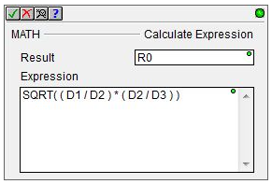
Instruction Set (Math)
MATH “Calculate Expression”
Performs complex math in spreadsheet-formula fashion
8 levels of nested parentheses
Traditional math precedence:
Parentheses →
Exponents (roots)→
Multiplication/Division →
Addition/Subtraction
“Please Excuse My Dear Aunt Sally”
Uses 32-bit math (promotion of bytes, words, dwords)
Integer math unless reals are involved, then promotion to real math occurs

Slide 6
Instruction Set (Math)
MATH “Calculate Expression”
Arithmetic Operators | Description | Example
+ | Add | D0 + D1
– | Subtract | D0 – D1
* | Multiply | D0 * D1
/ | Divide | D0 / D1
% | Modulus/Remainder | D0 % D1
** | Raise to Power | D0 ** D1
- | Negate | -D0
+
D0 | 15
D1 | 7
D10 | 22
-
D0 | 15
D1 | 7
D10 | 8
*
D0 | 15
D1 | 7
D10 | 105
/
D0 | 15
D1 | 7
D10 | 2
%
D0 | 15
D1 | 7
D10 | 1
**
D0 | 15
D1 | 7
D10 | 170859376
-
D0 | 15
D10 | -15

Slide 7
Instruction Set (Math)
MATH “Calculate Expression”
Binary/Bit-wise Operators | Description | Example
& | Bit-wise AND | D0 & 0x7FFF
| | Bit-wise OR | D0 | 0xFFFF
^ | Bit-wise XOR | D0 ^ D1
~ | Bit-wise Invert | ~D0
<< | Shift Left | D0 << 1
>> | Shift Right | D0 >> 1
>>> | Unsigned Shift Right | D0 >>> 1
&
D0 | 15 (1111)
D1 | 7 (0111)
D10 | 7 (0111)
|
D0 | 15 (1111)
D1 | 7 (0111)
D10 | 15 (1111)
^
D0 | 15 (1111)
D1 | 7 (0111)
D10 | 8 (1000)
~
D0 | 15 (0000 000F hex)
D10 | -16 (FFFF FFF0 hex)
<<
D0 | 15 (1111)
D1 | 7
D10 | 1920 (0111 1000 0000)
>>
D0 | 15 (1111)
D1 | 7
D10 | 0
NOTE: Bit positions that have been vacated by the shift are filled with the sign bit
>>>
D0 | 15 (1111)
D1 | 7
D10 | 0
NOTE: Bit positions that have been vacated by the shift are filled with 0 (zero)

Slide 8
Instruction Set (Math)
MATH “Calculate Expression”
Logical Operators | Description | Example
&& | Logical AND | X0 && X1
|| | Logical OR | X0 || X1
! | Logical NOT | !X0
< | Less Than | D0 < D1
<= | Less Than or Equal To | D0 <= D1
== | Equal To | D0 == D1
!= | Not Equal To | D0 != D1
>= | Greater Than or Equal To | D0 >= D1
> | Greater Than | D0 > D1
&&
D0 | 15
D1 | 7
D10 | 1
NOTE: Are both D0 & D1 non-zero? Yes: D10=1 No: D10=0
||
D0 | 15
D1 | 7
D10 | 1
NOTE: Is either D0 or D1 non-zero? Yes: D10=1 No: D10=0
>=
D0 | 15
D1 | 7
D10 | 1
!
D0 | 15
D10 | 0
NOTE: Is D0 = 0 (zero)? Yes: D10 = 1
No: D10 = 0 (zero)
>
D0 | 15
D1 | 7
D10 | 1
<
D0 | 15
D1 | 7
D10 | 0
<=
D0 | 15
D1 | 7
D10 | 0
==
D0 | 15
D1 | 7
D10 | 0
!=
D0 | 15
D1 | 7
D10 | 1

Slide 9
Instruction Set (Math)
MATH “Calculate Expression”
Common Functions | Description | Example
ABS | Absolute Value | ABS(D0)
MAX | Maximum Between 2 Expressions | MAX(D0,D1)
MIN | Minimum Between 2 Expressions | MIN(D0,D1)
MIN
D0 | 15
D1 | 7
D10 | 7
MAX
D0 | 15
D1 | 7
D10 | 15
ABS
D0 | 15
D10 | 15

Slide 10
Instruction Set (Math)
MATH “Calculate Expression”
Real Functions | Description | Example
E | Euler’s Constant e | E()
FRAC | Fractional Portion of Real Number | FRAC(R0)
LN | Natural Log | LN(R0)
LOG | Log Base 10 | LOG(R0)
PI | Returns pi Π (3.14159) | PI()
ROUND | Round Real to Nearest Whole # | ROUND(R0)
SQRT | Square Root | SQRT(R0)
TOINT | Convert to Integer | TOINT(R0)
TOREAL | Convert to Real | TOREAL(D0)
TRUNC | Truncate Real to Whole # | TRUNC(R0)
E
R10 | 2.718282
FRAC
R0 | 1.234567
R10 | 0.2345670
LN
R0 | 1.234567
R10 | 0.2107203
LOG
R0 | 1.234567
R10 | 0.09151468
TOREAL
D0 | 15
R10 | 15.00000
PI
R10 | 3.141593
TRUNC
R0 | 1.234567
R10 | 1.000000
ROUND
R0 | 1.234567
R10 | 1.000000
SQRT
R0 | 1.234567
R10 | 1.111111
TOINT
R0 | 1.234567
D10 | 1

Slide 11
Instruction Set (Math)
MATH “Calculate Expression”
Trig Functions | Description | Example | Result: R10 R0 = 1.234567
ACOS | Arccosine in Radians | ACOS(R0) | ST132 ($OutOfRange) ON Valid Range: -1.0 to +1.0
ASIN | Arcsine in Radians | ASIN(R0) | ST132 ($OutOfRange) ON Valid Range: -1.0 to +1.0
ATAN | Arctangent in Radians | ATAN(R0) | R10 = 0.8899872
COS | Cosine of Radian Angle | COS(R0) | R10 = 0.3299299
DEG | Covert Radians to Degrees | DEG(R0) | R10 = 70.73548
RAD | Convert Degrees to Radians | RAD(R0) | R10 = 0.02154726
SIN | Sine of Radian Angle | SIN(R0) | R10 = 0.9440054
TAN | Tangent of Radian Angle | TAN(R0) | R10 = 2.861231

Slide 12
Instruction Set (Math)
MATH “Calculate Expression”
AVGR(R0,10) R10 = 1.603000
R0 | 1.200000
R1 | 1.300000
R2 | 2.000000
R3 | 2.100000
R4 | 1.270000
R5 | 1.350000
R6 | 1.750000
R7 | 1.660000
R8 | 1.500000
R9 | 1.900000
MAXR(R0,10) R10 = 2.100000
R0 | 1.200000
R1 | 1.300000
R2 | 2.000000
R3 | 2.100000
R4 | 1.270000
R5 | 1.350000
R6 | 1.750000
R7 | 1.660000
R8 | 1.500000
R9 | 1.900000
MINR(R0,10) R10 = 1.200000
R0 | 1.200000
R1 | 1.300000
R2 | 2.000000
R3 | 2.100000
R4 | 1.270000
R5 | 1.350000
R6 | 1.750000
R7 | 1.660000
R8 | 1.500000
R9 | 1.900000
STDEVPR(R0,10) R10 = 0.3261577
R0 | 1.200000
R1 | 1.300000
R2 | 2.000000
R3 | 2.100000
R4 | 1.270000
R5 | 1.350000
R6 | 1.750000
R7 | 1.660000
R8 | 1.500000
R9 | 1.900000
STDEVR(R0,10) R10 = 0.3094204
R0 | 1.200000
R1 | 1.300000
R2 | 2.000000
R3 | 2.100000
R4 | 1.270000
R5 | 1.350000
R6 | 1.750000
R7 | 1.660000
R8 | 1.500000
R9 | 1.900000
SUMR(R0,10) R10 = 16.03000
R0 | 1.200000
R1 | 1.300000
R2 | 2.000000
R3 | 2.100000
R4 | 1.270000
R5 | 1.350000
R6 | 1.750000
R7 | 1.660000
R8 | 1.500000
R9 | 1.900000
Statistical Functions | Description | Example
AVGR | Average of Range of Values | AVGR(R0,10)
MAXR | Maximum Value Across Range | MAXR(R0,10)
MINR | Minimum Value Across Range | MINR(R0,10)
RANDINT | Random Integer (0 – 2147483647) | RANDINT()
RANDREAL | Random Real (0.0 – 1.0) | RANDREAL()
STDEVPR | Population Standard Deviation of Range | STDEVPR(R0,8)
STDEVR | Sample Standard Deviation of Range | STDEVR(R0,8)
SUMR | Sum of Range | SUMR(R0,10)
RANDINT & RANDREAL are seeded from the RANDSEED instruction

Slide 13
Instruction Set (Math)
MATH “Calculate Expression”
CountIfEQ(1.35,R0,10) D10 = 1
R0 | 1.200000
R1 | 1.300000
R2 | 2.000000
R3 | 2.100000
R4 | 1.270000
R5 | 1.350000
R6 | 1.750000
R7 | 1.660000
R8 | 1.500000
R9 | 1.900000
Conditional Functions | Description | Example
CountIfEQ | Count If Equal | COUNTIFEQ(1.35,R0,10)
CountIfNE | Count If Not Equal | COUNTIFNE(1.35,R0,10)
CountIfGE | Count If Greater Than Or Equal | COUNTIFGE(1.35,R0,10)
CountIfGT | Count If Greater Than | COUNTIFGT(1.35,R0,10)
CountIfLE | Count If Less Than Or Equal | COUNTIFLE(1.35,R0,10)
CountIfLT | Count If Less Than | COUNTIFLT(1.35,R0,10)
IF | If / Else Expression | IF(C7,D0,D1)
SumIfEQ | Sum If Equal | SUMIFEQ(1.35,R0,10)
SumIfNE | Sum If Not Equal | SUMIFNE(1.35,R0,10)
SumIfGE | Sum If Greater Than Or Equal | SUMIFGE(1.35,R0,10)
SumIfGT | Sum If Greater Than | SUMIFGT(1.35,R0,10)
SumIfLE | Sum If Less Than Or Equal | SUMIFLE(1.35,R0,10)
SumIfLT | Sum If Less Than | SUMIFLT(1.35,R0,10)
CountIfNE(1.35,R0,10) D10 = 9
R0 | 1.200000
R1 | 1.300000
R2 | 2.000000
R3 | 2.100000
R4 | 1.270000
R5 | 1.350000
R6 | 1.750000
R7 | 1.660000
R8 | 1.500000
R9 | 1.900000
CountIfGE(1.35,R0,10) D10 = 7
R0 | 1.200000
R1 | 1.300000
R2 | 2.000000
R3 | 2.100000
R4 | 1.270000
R5 | 1.350000
R6 | 1.750000
R7 | 1.660000
R8 | 1.500000
R9 | 1.900000
CountIfGT(1.35,R0,10) D10 = 6
R0 | 1.200000
R1 | 1.300000
R2 | 2.000000
R3 | 2.100000
R4 | 1.270000
R5 | 1.350000
R6 | 1.750000
R7 | 1.660000
R8 | 1.500000
R9 | 1.900000
CountIfLE(1.35,R0,10) D10 = 4
R0 | 1.200000
R1 | 1.300000
R2 | 2.000000
R3 | 2.100000
R4 | 1.270000
R5 | 1.350000
R6 | 1.750000
R7 | 1.660000
R8 | 1.500000
R9 | 1.900000
CountIfLT(1.35,R0,10) D10 = 3
R0 | 1.200000
R1 | 1.300000
R2 | 2.000000
R3 | 2.100000
R4 | 1.270000
R5 | 1.350000
R6 | 1.750000
R7 | 1.660000
R8 | 1.500000
R9 | 1.900000
SumIfEQ(1.35,R0,10) R10 = 1.350000
R0 | 1.200000
R1 | 1.300000
R2 | 2.000000
R3 | 2.100000
R4 | 1.270000
R5 | 1.350000
R6 | 1.750000
R7 | 1.660000
R8 | 1.500000
R9 | 1.900000
SumIfNE(1.35,R0,10) R10 = 14.68000
R0 | 1.200000
R1 | 1.300000
R2 | 2.000000
R3 | 2.100000
R4 | 1.270000
R5 | 1.350000
R6 | 1.750000
R7 | 1.660000
R8 | 1.500000
R9 | 1.900000
SumIfGE(1.35,R0,10) R10 = 12.26000
R0 | 1.200000
R1 | 1.300000
R2 | 2.000000
R3 | 2.100000
R4 | 1.270000
R5 | 1.350000
R6 | 1.750000
R7 | 1.660000
R8 | 1.500000
R9 | 1.900000
SumIfGT(1.35,R0,10) R10 = 10.91000
R0 | 1.200000
R1 | 1.300000
R2 | 2.000000
R3 | 2.100000
R4 | 1.270000
R5 | 1.350000
R6 | 1.750000
R7 | 1.660000
R8 | 1.500000
R9 | 1.900000
SumIfLE(1.35,R0,10) R10 = 5.120000
R0 | 1.200000
R1 | 1.300000
R2 | 2.000000
R3 | 2.100000
R4 | 1.270000
R5 | 1.350000
R6 | 1.750000
R7 | 1.660000
R8 | 1.500000
R9 | 1.900000
SumIfLT(1.35,R0,10) R10 = 3.770000
R0 | 1.200000
R1 | 1.300000
R2 | 2.000000
R3 | 2.100000
R4 | 1.270000
R5 | 1.350000
R6 | 1.750000
R7 | 1.660000
R8 | 1.500000
R9 | 1.900000
If C7 = ON Then D10 = D0 Else D10 = D1

Slide 14
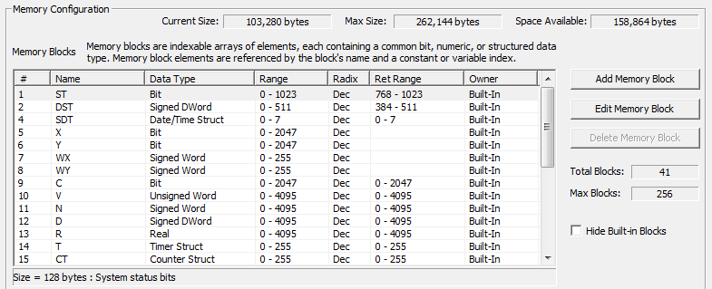
Instruction Set (Math)
MATH “Calculate Expression”
Time Functions | Description | Example
NOW | Get Date/Time 32-bit Integer (1970 Epoch) | NOW()
TICKms | Get Millisecond System Timer Value | TICKms()
TICKus | Get Microsecond System Timer Value | TICKus()
D[(V10*16)+V11] D10 = 19473
V10 | 2
V11 | 5
D37 | 19473
NOW() Returns the number of seconds since 1970
REF(p1,p2) similar to REFWRITE “Write Value Indirectly” instruction
Memory Functions | Description | Example
REF | Read Value Indirectly | REF(D0,V0)
[] | Array Index Expression | D[(V10*16)+V11]
REF(p1,p2) p1: Memory Block Type
(see in Memory Configuration)
p2: Index

Slide 15
Instruction Set (Math)
RANDSEED “Random Number Seed”
Sets a seed value that will be used by the RANDINT() “Generate Random Integer” and RANDREAL() “Generate Random Real” functions inside the MATH “Calculate Expression” instruction
Parameters:
Seed – location of seed number

