Slide 1


Do-more Technical Training
Instruction Set
(Introduction)

Slide 2
Instruction Set (Introduction)
THE BASICS
  181 instructions
    Contact (14)
    Coil/Bit Output (11)
    Analog/Process (13)
    Date/Time/Calendar (7)
    Ethernet (5)
    Hardware/Device (9)
    High Speed/CTRIO (19)
    Math (5)
    Misc/Data Manipulation (23)
    Program Control (20)
    Program-Looping (8)
    Protocol-Custom/ASCII (7)
    Protocol-Standard (10)
    String (14)
    Timer/Counter/Drum (16)

Slide 3
Instruction Set (Introduction)
Box Instruction
Corner
THE BASICS
  181 instructions
    In-line (100) – no flag
      Executes completely in-line on same scan
    Fully Asynchronous (48) – Red
      Dependent on shared Device’s availability
      Locks Device when executed to make it exclusive
      Unlocks Device after it is finished
      Must not terminate before it is finished
      Must wait for Success or Error indication
    Multi-scan (20) – Yellow
      Takes 2 or more scans to complete or function properly
      Depend on the status of the instruction from previous scan
      (Edge-triggering inputs normally take 2 also)
    Yielding (5) – Blue
      Can temporarily postpone operation until next scan
    Skipping (6) – Green
      Can skip forward or backward in code
    Yielding/Skipping (2) - Blue Green
      Can temporarily postpone operation until next scan and skip forward or backward in code

Slide 4
Instruction Set (Introduction)
THE BASICS
  181 instructions
    Auto/Manual – ON: automatic mode
    Data – ON: value of 1 available to instruction
    CTRIO: Direction – ON: clockwise
    Down – OFF-to-ON: count down
    Enable – ON: enabled
    Enable/Reset – ON: enabled; OFF: reset
    CTRIO2: Forward – ON: generate clockwise pulses
    Jog – OFF-to-ON: advance to next step
    Pause – ON: stop execution; maintain status data
    Reset – ON: stop execution; reset status data
    DRUM: Run – ON: timer running; events active
    CTRIO2: Reverse – ON: generate counter-clockwise pulses
    CTRIO: Suspend – ON: stop generating pulses
    Up – OFF-to-ON: count up
    Edge Trigger – OFF-to-ON transition required

Slide 5
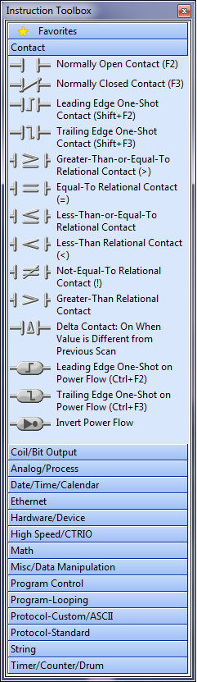
Instruction Set (Introduction)
Contact (14)
  Normally Open Contact
  Normally Closed Contact
  Leading Edge One-Shot Contact
  Trailing Edge One-Shot Contact
  Greater-Than-or-Equal-To Relational Contact
  Equal-To Relational Contact
  Less-Than-or-Equal-To Relational Contact
  Less-Than Relational Contact
  Not-Equal-To Relational Contact
  Greater-Than Relational Contact
  Delta Contact
  Leading Edge One-Shot on Power Flow
  Trailing Edge One-Shot on Power Flow
  Invert Power Flow

Slide 6
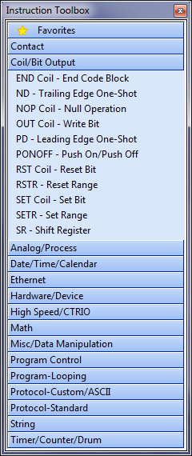
Instruction Set (Introduction)
Coil/Bit Output (11)
  END coil – End Code Block
  ND – Trailing Edge One-Shot
  NOP coil – Null Operation
  OUT coil – Write Bit
  PD – Leading Edge One-Shot
  PONOFF – PushOn/Push Off
  RST coil – Reset Bit
  RSTR – Reset Range
  SET coil – Set Bit
  SETR – Set Range
  SR – Shift Register

Slide 7
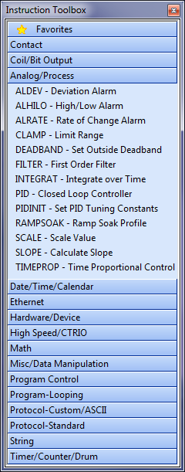
Instruction Set (Intro)
Analog/Process (13)
  ALDEV – Deviation Alarm
  ALHILO – High/Low Alarm
  ALRATE – Rate of Change Alarm
  CLAMP – Limit Range
  DEADBAND – Set Outside Deadband
  FILTER – First Order Filter
  INTEGRAT – Integrate over Time
  PID – Closed Loop Controller
  PIDINIT – Set PID Tuning Constants
  RAMPSOAK – Ramp Soak Profile
  SCALE – Scale Value
  SLOPE – Calculate Slope
  TIMEPROP – Time Proportional Control

Slide 8
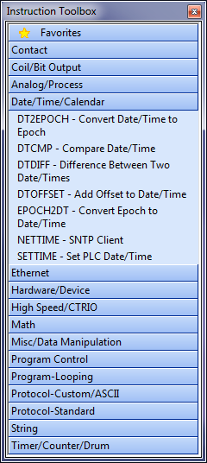
Instruction Set (Introduction)
Date/Time/Calendar (7)
  DT2EPOCH – Convert Date/Time to
  Epoch
  DTCMP – Compare Date/Time
  DTDIFF – Difference Between Two
  Date/Times
  DTOFFSET – Add Offset to Date/Time
  EPOCH2DT – Convert Epoch to
  Date/Time
  NETTIME – SNTP Client
  SETTIME – Set PLC Date/Time

Slide 9
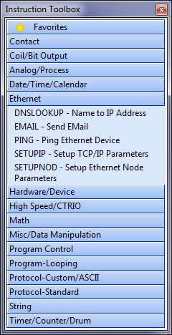
Instruction Set (Introduction)
Ethernet (5)
  DNSLOOKUP – Name to IP
  Address
  EMAIL – Send EMail
  PING – Ping Ethernet Device
  SETUPIP – Setup TCP/IP
  Parameters
  SETUPNOD – Setup Ethernet Node
  Parameters

Slide 10
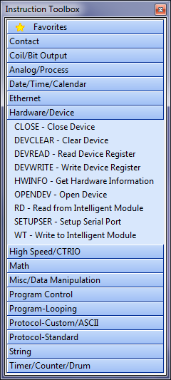
Instruction Set (Introduction)
Hardware/Device (9)
  CLOSE – Close Device
  DEVCLEAR – Clear Device
  DEVREAD – Read Device Register
  DEVWRITE – Write Device Register
  HWINFO – Get Hardware Information
  OPENDEV – Open Device
  RD – Read from Intelligent Module
  SETUPSER – Setup Serial Port
  WT – Write to Intelligent Module

Slide 11
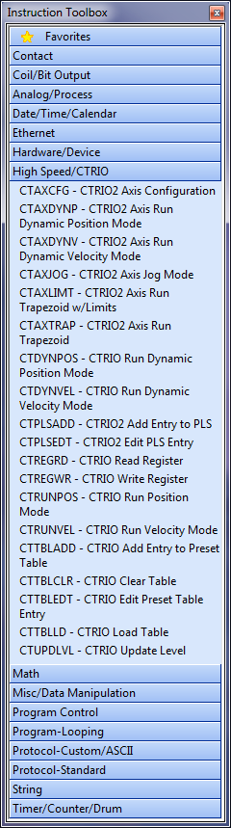
Instruction Set (Introduction)
High Speed/CTRIO (19)
  CTAXCFG – CTRIO2 Axis Configuration
  CTAXDYNP – CTRIO2 Axis Run Dynamic Position Mode
  CTAXDYNV – CTRIO2 Axis Run Dynamic Velocity Mode
  CTAXJOG – CTRIO2 Axis Jog Mode
  CTAXLIMT – CTRIO2 Axis Run Trapezoid w/Limits
  CTAXTRAP – CTRIO2 Axis Run Trapezoid
  CTDYNPOS – CTRIO Run Dynamic Position Mode
  CTDYNVEL – CTRIO Run Dynamic Velocity Mode
  CTPLSADD – CTRIO2 Add Entry to PLS
  CTPLSEDT – CTRIO2 Edit PLS Entry
  CTREGRD – CTRIO Read Register
  CTREGWR – CTRIO Write Register
  CTRUNPOS – CTRIO Run Position Mode
  CTRUNVEL – CTRIO Run Velocity Mode
  CTTBLADD – CTRIO Add Entry to Preset Table
  CTTBLCLR – CTRIO Clear Table
  CTTBLEDT – CTRIO Edit Preset Table Entry
  CTTBLLD – CTRIO Load Table
  CTUPDLVL – CTRIO Update Level

Slide 12
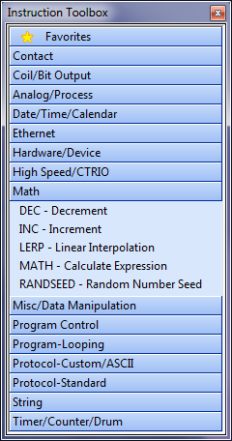
Instruction Set (Introduction)
Math (5)
  DEC - Decrement
  INC - Increment
  LERP – Linear Interpolation
  MATH – Calculate Expression
  RANDSEED – Random Number
  Seed

Slide 13
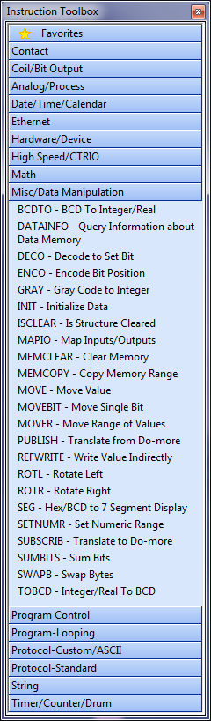
Instruction Set (Introduction)
Misc/Data Manipulation (22)
  BCDTO – BCD To Integer/Real
  DATAINFO – Query Information about Data Memory
  DECO – Decode to Set Bit
  ENCO – Encode Bit Position
  GRAY – Gray Code to Integer
  INIT – Initialize Data
  ISCLEAR – Is Structure Cleared
  MAPIO – Map Inputs/Outputs
  MEMCLEAR – Clear Memory
  MOVE – Move Value
  MOVEBIT – Move Single Bit
  MOVER – Move Range of Values
  PUBLISH – Translate from Do-more
  REFWRITE – Write Value Indirectly
  ROTL – Rotate Left
  ROTR – Rotate Right
  SEG – Hex/BCD to 7 Segment Display
  SETNUMR – Set Numeric Range
  SUBSCRIB – Translate to Do-more
  SUMBITS – Sum Bits
  SWAPB – Swap Bytes
  TOBCD – Integer/Real to BCD

Slide 14
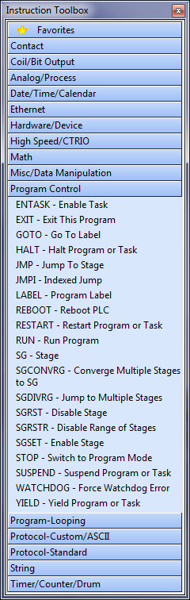
Instruction Set (Intro)
Program Control (20)
  ENTASK – Enable Task
  EXIT – Exit This Program
  GOTO – Go To Label
  HALT – Halt Program or Task
  JMP – Jump To Stage
  JMPI – Indexed Jump
  LABEL – Program Label
  REBOOT – Reboot PLC
  RESTART – Restart Program or Task
  RUN – Run Program
  SG - Stage
  SGCONVRG – Converge Multiple Stages to SG
  SGDIVRG – Jump to Multiple Stages
  SGRST – Disable Stage
  SGRSTR – Disable Range of Stages
  SGSET – Enable Stage
  STOP – Switch to Program Mode
  SUSPEND – Suspend Program or Task
  WATCHDOG – Force Watchdog Error
  YIELD – Yield Program or Task

Slide 15
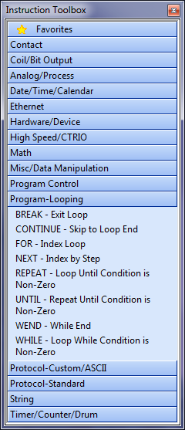
Instruction Set (Introduction)
Program-Looping (8)
  BREAK – Exit Loop
  CONTINUE – Skip to Loop End
  FOR – Index Loop
  NEXT – Index by Step
  REPEAT – Loop Until Condition is
  Non-Zero
  UNTIL – Repeat Until Condition is
  Non-Zero
  WHILE – Loop While Condition is
  Non-Zero
  WEND – While End

Slide 16
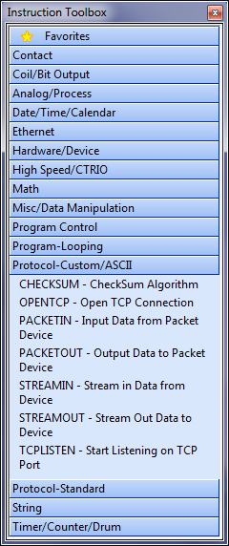
Instruction Set (Introduction)
Protocol-Custom/ASCII (7)
  CHECKSUM – CheckSum Algorithm
  OPENTCP – Open TCP Connection
  PACKETIN – Input Data from Packet Device
  PACKETOUT – Output Data to Packet Device
  STREAMIN – Stream in Data from Device
  STREAMOUT – Stream Out Data to Device
  TCPLISTEN – Start Listening on TCP Port

Slide 17
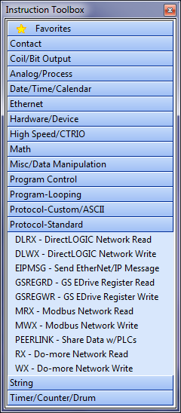
Instruction Set (Introduction)
Protocol-Standard (10)
  DLRX – DirectLOGIC Network Read
  DLWX – DirectLOGIC Network Write
  EIPMSG – Send EtherNet/IP Message
  GSREGRD – GS EDrive Register Read
  GSREGWR – GS EDrive Register Write
  MRX – Modbus Network Read
  MWX – Modbus Network Write
  PEERLINK – Share Data w/PLCs
  RX – Do-more Network Read
  WX – Do-more Network Write

Slide 18
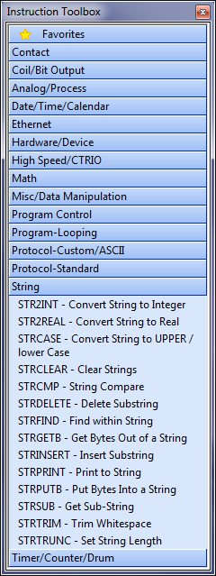
Instruction Set (Intro)
String (14)
  STR2INT – Convert String to Integer
  STR2REAL – Convert String to Real
  STRCASE – Convert String to UPPER / lower
  Case
  STRCLEAR – Clear Strings
  STRCMP – String Compare
  STRDELETE – Delete Substring
  STRFIND – Find within String
  STRGETB – Get Bytes Out of a String
  STRINSERT – Insert Substring
  STRPRINT – Print to String
  STRPUTB – Put Bytes Into a String
  STRSUB – Get Sub-String
  STRTRIM – Trim Whitespace
  STRTRUNC – Set String Length

Slide 19
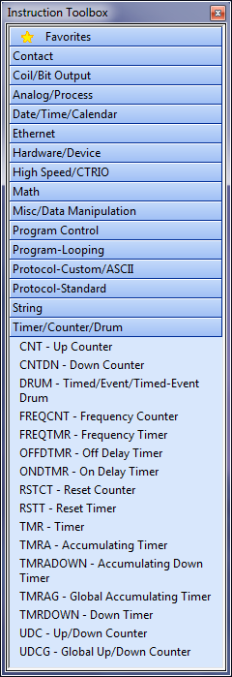
Instruction Set (Intro)
Timer/Counter/Drum (16)
  CNT – Up Counter
  CNTDN – Down Counter
  DRUM – Timed/Event/Timed-Event Drum
  FREQCNT – Frequency Counter
  FREQTMR – Frequency Timer
  OFFDTMR – Off Delay Timer
  ONDTMR – On Delay Timer
  RSTCT – Reset Counter
  RSTT – Reset Timer
  TMR – Timer
  TMRA – Accumulating Timer
  TMRADOWN – Accumulating Down Timer
  TMRAG – Global Accumulating Timer
  TMRDOWN – Down Timer
  UDC – Up/Down Counter
  UDCG – Global Up/Down Counter

