Slide 1


Do-more Technical Training
Instruction Set
(Coil/Bit Output)

Slide 2
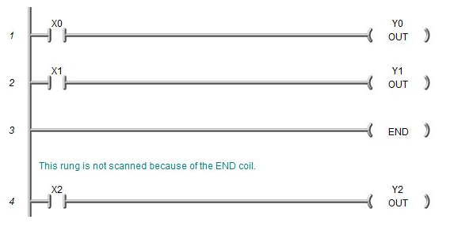
Instruction Set (Coil/Bit Output)
END
  Unconditional (no input logic allowed)
  Optional (not required for Programs or Tasks)
  Good for debugging code
Skipped

Slide 3
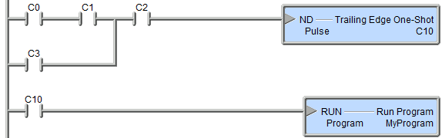



Instruction Set (Coil/Bit Output)
ND “Trailing Edge One-Shot”
  Every trainling edge will turn ON a bit for one scan
  Parameters:
    Pulse – location of one-shot bit
  NOTES:
    Use “Trailing Edge Powerflow Modifier” to generate a one-shot event for multiple output instructions. Saves from using a bit location.

Slide 4

Instruction Set (Coil/Bit Output)
OUT (Output)
  Reflects the status of the input logic
  Input logic must remain true for output to stay ON
  Avoid using multiple OUTs that
  reference the same discrete memory
  location (last OUT will always win)
  Avoid referencing the same discrete memory location with OUT that is referenced with SET & RST instructions
  If in a Program, Task or Stage, the OUT will be turned OFF when those code blocks are disabled

Slide 5
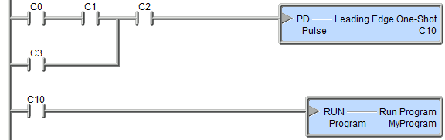



Instruction Set (Coil/Bit Output)
PD “Leading Edge One-Shot”
  Every leading edge will turn ON a bit for one scan
  Parameters:
    Pulse – location of one-shot bit
  NOTES:
    Use “Leading Edge Powerflow Modifier” to generate a one-shot event for multiple output instructions. Saves from using a bit location.

Slide 6

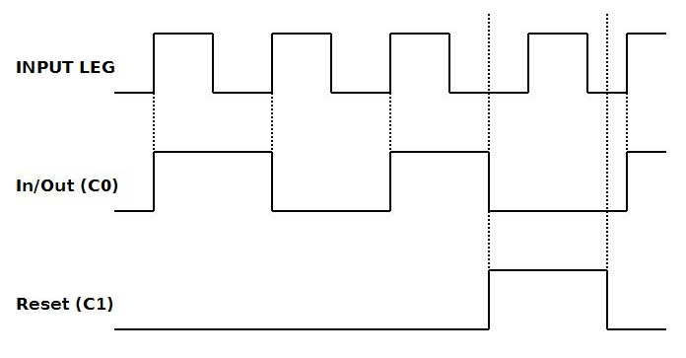
Instruction Set (Coil/Bit Output)
PONOFF “Push On/Push Off”
  Each leading edge toggles a bit
    If In/Out bit is ON, turns OFF
    If In/Out bit is OFF, turns ON
  Parameters:
    In/Out – bit to toggle
    Reset – (optional) if ON, resets (OFF) In/Out bit

Slide 7

Instruction Set (Coil/Bit Output)
RST (Reset)
  Can only turn discrete memory location OFF
  Input logic does not have to remain true for output to stay OFF
  Usually used in conjunction with SET
  instruction to turn the same discrete
  memory location ON
  It is common to use multiple RSTs to the same discrete memory location
  Avoid referencing the same discrete memory location with RST that is referenced with OUT

Slide 8

Instruction Set (Coil/Bit Output)
RSTR “Reset Range”
  Resets (turns OFF) a range of bit locations
  Parameters:
    Start – 1st location of range to be reset
    End – last location of range to be reset

Slide 9

Instruction Set (Coil/Bit Output)
SET
  Can only turn discrete memory location ON
  Input logic does not have to remain true for output to stay ON
  Usually used in conjunction with RST
  instruction to turn the same discrete
  memory location OFF
  It is common to use multiple SETs to the same discrete memory location
  Avoid referencing the same discrete memory location with SET that is referenced with OUT

Slide 10

Instruction Set (Coil/Bit Output)
SETR “Set Range”
  Sets (turns ON) a range of bit locations
  Parameters:
    Start – 1st location of range to be set
    End – last location of range to be set

Slide 11
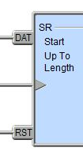

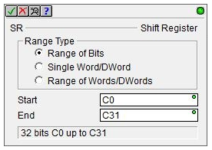
Instruction Set (Coil/Bit Output)
SR “Shift Register”
  Shifts data bits through a range of bit locations
  Parameters:
    Range Type:
      Range of Bits – min 8 bits, max 2048 bits, multiples of 8 bits, 8-bit boundary
      Single Word/Dword – bits always shift up (e.g. D0:0 → D0:31)
      Range of Words/Dwords – max 128 words / 64 dwords,
    Start – 1st location in range
    End – last location in range
  Input Legs:
    DAT – data signal
    Clock – leading-edge trigger
    RST – resets all bits to zero
  NOTES:
    Direction of shift for Range of Bits & Range of Words/Dwords is determined by Start & End
Shift Register Range of Bits (C0-C31)
C31 | 0 | 0 | 0 | 0 | 0 | 0 | 0 | 0 | C24
C23 | 0 | 0 | 0 | 0 | 0 | 0 | 0 | 0 | C16
C15 | 0 | 0 | 0 | 0 | 0 | 0 | 0 | 0 | C8
C7 | 0 | 0 | 0 | 0 | 0 | 0 | 0 | 1 | C0
Shift Register Range of Bits (C0-C31)
C31 | 0 | 0 | 0 | 0 | 0 | 0 | 0 | 0 | C24
C23 | 0 | 0 | 0 | 0 | 0 | 0 | 0 | 0 | C16
C15 | 0 | 0 | 0 | 0 | 0 | 0 | 0 | 0 | C8
C7 | 0 | 0 | 0 | 0 | 0 | 0 | 1 | 1 | C0
Shift Register Range of Bits (C0-C31)
C31 | 0 | 0 | 0 | 0 | 0 | 0 | 0 | 0 | C24
C23 | 0 | 0 | 0 | 0 | 0 | 0 | 0 | 0 | C16
C15 | 0 | 0 | 0 | 0 | 0 | 0 | 0 | 0 | C8
C7 | 0 | 0 | 0 | 0 | 0 | 1 | 1 | 0 | C0
Shift Register Range of Bits (C0-C31)
C31 | 0 | 0 | 0 | 0 | 0 | 0 | 0 | 0 | C24
C23 | 0 | 0 | 0 | 0 | 0 | 0 | 0 | 0 | C16
C15 | 0 | 0 | 0 | 0 | 0 | 0 | 0 | 0 | C8
C7 | 0 | 0 | 0 | 0 | 1 | 1 | 0 | 0 | C0
Shift Register Range of Bits (C0-C31)
C31 | 0 | 0 | 0 | 0 | 0 | 0 | 0 | 0 | C24
C23 | 0 | 0 | 0 | 0 | 0 | 0 | 0 | 0 | C16
C15 | 0 | 0 | 0 | 0 | 0 | 0 | 0 | 0 | C8
C7 | 0 | 0 | 0 | 1 | 1 | 0 | 0 | 1 | C0
Shift Register Range of Bits (C0-C31)
C31 | 0 | 0 | 0 | 0 | 0 | 0 | 0 | 0 | C24
C23 | 0 | 0 | 0 | 0 | 0 | 0 | 0 | 0 | C16
C15 | 0 | 0 | 0 | 0 | 0 | 0 | 0 | 0 | C8
C7 | 0 | 0 | 0 | 0 | 0 | 0 | 0 | 0 | C0
DAT
0
DAT
1
ETC…

