Slide 1
Do-more Technical Training
Instruction Set (Analog/Process)

Slide 2
Instruction Set
THE BASICS
181 instructions
Contact (14)
Coil/Bit Output (11)
Analog/Process (13)
Date/Time/Calendar (7)
Ethernet (5)
Hardware/Device (9)
High Speed/CTRIO (19)
Math (5)
Misc/Data Manipulation (23)
Program Control (20)
Program-Looping (8)
Protocol-Custom/ASCII (7)
Protocol-Standard (10)
String (14)
Timer/Counter/Drum (16)

Slide 3
Instruction Set
THE BASICS
181 instructions
In-line (100) – no flag
Executes completely in-line on same scan
Fully Asynchronous (48) – Red
Dependent on shared Device’s availability
Locks Device when executed to make it exclusive
Unlocks Device after it is finished
Must not terminate before it is finished
Must wait for Success or Error indication
Multi-scan (20) – Yellow
Takes 2 or more scans to complete or function properly
Depend on the status of the instruction from previous scan
(Edge-triggering inputs normally take 2 also)
ALRATE, FILTER, INTEGRAT, PID, RAMPSOAK, SLOPE, TIMEPROP
Yielding (5) – Blue
Can temporarily postpone operation until next scan
Skipping (6) – Green
Can skip forward or backward in code
Yielding/Skipping (2) - Blue Green
Can temporarily postpone operation until next scan and skip forward or backward in code
Box Instruction
Corner

Slide 4
Instruction Set (Analog/Process)
Analog/Process
ALDEV
ALHILO
ALRATE
CLAMP
DEADBAND
FILTER
INTEGRAT
PID
PIDINIT
RAMPSOAK
SCALE
SLOPE
TIMEPROP

Slide 5
Instruction Set (Analog/Process)
Utilizes Tinker-Toy™ approach
Other things use common PID controls (Alarms, Ramp/Soak profiles, Filters, Clamping, Deadband, etc.)
Modular, interchangeable, independent, & run-time configurable
Using multiple Ramp/Soak profiles for same PID (recipes)
Easier to troubleshoot
Filter issue? Deadband too tight? Too wide? Ramp rate in Ramp/Soak too steep? Too slow?
Right-click on instruction & select Trend Instruction

Slide 6
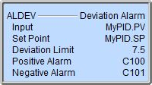
Instruction Set (Analog/Process)
ALDEV “Deviation Alarm”
Sets alarm bits if the input deviates from a set point by more than a limit value
Parameters:
Input – location of the monitored value
Set Point – data value from which the deviation is compared
Deviation Limit – maximum allowable deviation from the Set Point before an alarm is set
Positive Alarm (optional) – bit that is set ON if Input > Set Point + Deviation Limit
Negative Alarm (optional) – bit that is set ON if Input < Set Point – Deviation Limit

Slide 7
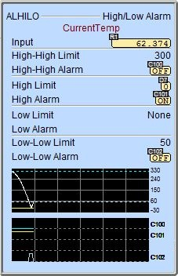
Instruction Set (Analog/Process)
ALHILO “High/Low Alarm”
Sets various alarm bits based on values
Parameters:
Input – location of the monitored value
High-High Limit – data value for high-high alarm
High-High Alarm – high-high alarm bit
High Limit – data value for high alarm
High Alarm – high alarm bit
Low Limit – data value for low alarm
Low Alarm – low alarm bit
Low-Low Limit – data value for low-low alarm
Low-Low Alarm – low-low alarm bit
NOTES:
All alarm pairs (value/bit) are optional
Alarms are inclusive
Alarm values must be consecutive order

Slide 8
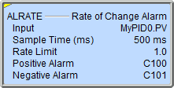
Instruction Set (Analog/Process)
ALRATE “Rate of Change Alarm”
Sets alarm bits if the input changes at rate faster than a limit value
Multiscan instruction (yellow triangle)
Parameters:
Input – location of the monitored value
Sample Time – the period (ms) between samples of the Input
Rate Limit – maximum allowable change of the Input value from one sample time to the next
Positive Alarm (optional) – bit that is set ON if Input value has increased by more than the Rate Limit since last sample time
Negative Alarm (optional) – bit that is set ON if Input value has decreased by more than the Rate Limit since last sample time

Slide 9
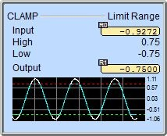
Instruction Set (Analog/Process)
CLAMP “Limit Range”
Constrains a memory location’s highest/lowest value
Parameters:
Input – location of the monitored value
High – maximum allowable value for Input
Low – minimum allowable value for Input
Output – location to stored the clamped value

Slide 10
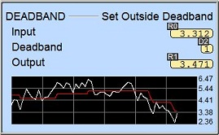
Instruction Set (Analog/Process)
DEADBAND “Set Outside Deadband”
Generates an output value only when the input value differs by the deadband value
Parameters:
Input – location of the monitored value
Deadband – minimum change in Input before generating the Output
Output – location of the new value
NOTES:
Deadband value is applied equally above & below

Slide 11
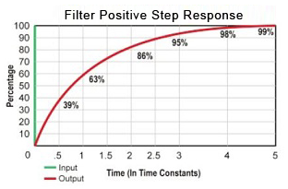
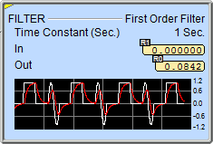
Instruction Set (Analog/Process)
FILTER “First Order Filter”
Performs continuous first-order low-pass filtering on input value like a capacitor charging formula:
$Out=(In−Out)× \left( 1−e^{−\frac{t}{τ}} \right)$
where:
t = time
τ = tau; the time constant
e = natural number; 2.71828
Thus:
In 1 time constant Out would be about 63% of In
In 2 time constants Out would be about 86% of In
In 3 time constants Out would be about 95% of In
In 4 time constants Out would be about 98% of In
In 5 time constants Out would be about 99% of In
Multiscan instruction (yellow triangle)
Parameters:
Time Constant – τ in the above equation (in seconds)
In – location of value to be filtered
Output – location of filtered value

Slide 12
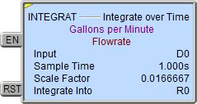
Instruction Set (Analog/Process)
INTEGRAT “Integrate over Time”
Accumulates a value at a time interval:
$$IntInto=IntInto+\left(In\right)\left(ScaleF\right)\left(STime\right)$$
$$R0=R0+\left(D0\right)\left(0.016667\right)\left(1.0\right)$$
Where R0 is calculated once every Sample Time
Multiscan instruction (yellow triangle)
Parameters:
Input – location of data value to integrate
Sample Time – time interval for the integration
Constant – hours, minutes, seconds, milliseconds
Variable – location of time in milliseconds
Scale Factor – constant value or location of variable value that will be multiplied to the Input
Integrate Into – location of integral value
Input Leg:
EN = Enables integration
RST = Resets Integrate Into to zero; stops integration

Slide 13
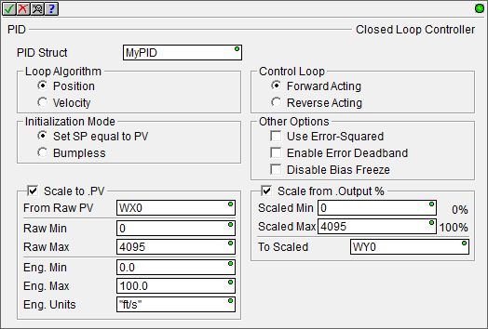
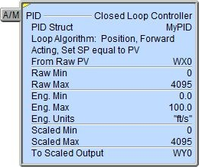
Instruction Set (Analog/Process)
PID “Closed Loop Controller”
Proportional, integral & derivative control algorithm
Multiscan instruction (yellow triangle)
Parameters:
PID Struct
Loop Algorithm:
Position
Velocity
Initialization Mode:
Set SP equal to PV
Bumpless

Slide 14
Instruction Set (Analog/Process)
PID “Closed Loop Controller”
Parameters (cont’):
Scale to .PV
From Raw PV, Raw Min, Raw Max
Eng. Min, Eng. Max, Eng. Units
Control Loop
Forward, Reverse
Other Options
Use Error-Squared – less responsive but responds faster with a large error
Enable Error Deadband – PV more immune to noise
Disable Bias Freeze – bias keeps changing even if Output go out of range
Scale from .Output %
Scaled Min (0%)
Scaled Max (100%)
To Scaled

Slide 15
Instruction Set (Analog/Process)
PID “Closed Loop Controller”
Input Leg:
A/M – Automatic / Manual
Structure (PID)
<PIDName>: User PID Structure
PID Structure Members (19)
AutoTuneComp | Gain | Reset
AutoTuning | LastError | SampleTime
AutoTuningErr | Mode | SP
Bias | Output | Tune
DGainLmt | PV | TunedParms
ErrorDB | RanThisScan | TuningAlg
--- | Rate | ---

Slide 16
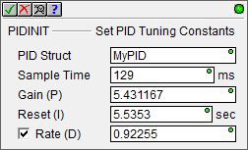
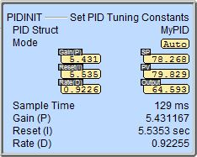
Instruction Set (Analog/Process)
PIDINIT “Set PID Tuning Constants”
Initializes the runtime parameters of a PID loop
Parameters:
PID Struct – which PID
Sample Time – milliseconds
Gain (P)
RESET (I)
Rate (D) – optional

Slide 17
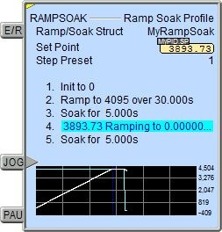
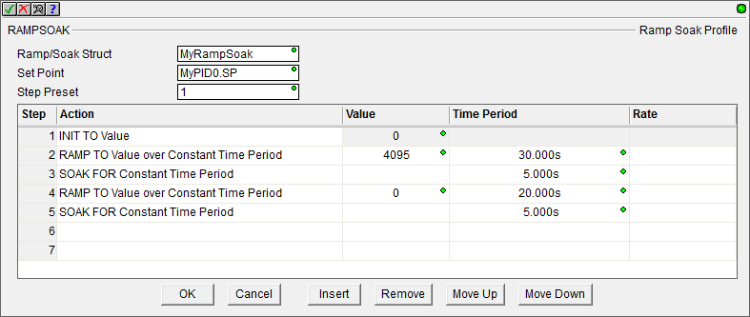
Instruction Set (Analog/Process)
RAMPSOAK “Ramp Soak Profile”
Moves a set point through sets of values at prescribed time intervals
Multiscan instruction (yellow triangle)
Parameters:
Ramp/Soak Struct
Set Point
Step Preset – which step to begin with
Action / Value / Time Period / Rate
INIT TO Value
SOAK for Constant (or Variable) Time Period
RAMP to Value
Over Constant (or Variable) Time Period
At Rate (per Second, Minute or Hour)
ADJUST BY Value
Over Constant (or Variable) Time Period
At Rate (per Second, Minute or Hour)
Editing buttons:
OK, Cancel, Insert, Remove, Move Up, Move Down

Slide 18
Instruction Set (Analog/Process)
RAMPSOAK “Ramp Soak Profile”
Input legs:
E/R – Enable/Reset
JOG – (edge triggered) moves to next step
PAU – freezes execution
Structure (Ramp/Soak)
<RampSoakName>: User Ramp/Soak Structure
NOTES:
Can have up to 50 rows
RampSoak Structure Members (5)
Done | StepTarget | TimeLeft
Step | StepTime | ---

Slide 19
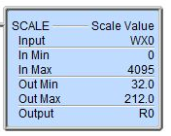
Instruction Set (Analog/Process)
SCALE “Scale Value”
Converts value to engineering units
Parameters:
Input – location to be scaled
In Min – minimum value of Input
In Max – maximum value of Input
Out Min – minimum value of Output
Out Max – maximum value of Output
Output – location of scaled value

Slide 20
Instruction Set (Analog/Process)
SLOPE “Calculate Slope”
Calculates the slope of the line between two points where y is the change in the input value and x is the sample time:
$$\frac{Input2−Input1}{SampleTime}$$
Multiscan instruction (yellow triangle)
Parameters:
Input – location of value to measure slope
Sample Time – time between samples
Slope – location of slope value

Slide 21
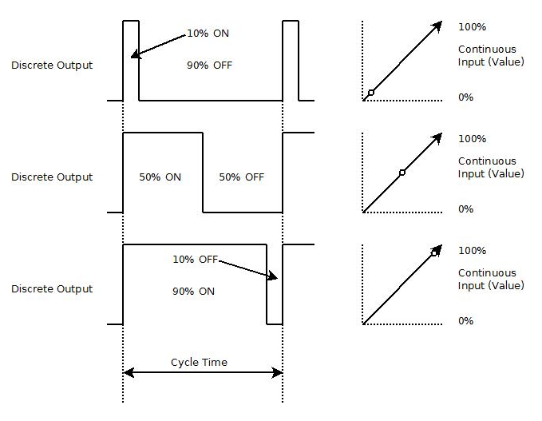
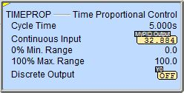
Instruction Set (Analog/Process)
TIMEPROP “Time Proportional Control”
Converts a control output (0-100%) to a pulse-width modulation discrete output control
$ON=CycleTime×\frac{ContinuousInput −0\%MinRange}{100\%MaxRange −0\%MinRange}$
Multiscan instruction (yellow triangle)
Parameters:
Cycle Time – time period
Continuous Input – location of input value
0% Min. Range – minimum value
100% Max. Range – maximum value
Discrete Output – output to be cycled

Slide 22
Instruction Set (Analog/Process)
Process Control Utilities
PID Overview
PID View
Auto-tune Process
PID Process Simulator

Slide 23
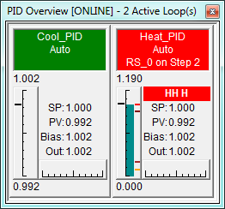
Instruction Set (Analog/Process)
PID Overview
PID ref
Mode
Ramp/Soak
Colors
Green – Auto
Normal – Manual
Yellow – Auto-tune
Red – Alarm
PV vertical graph
SP marker
SP, PV, Bias & Output values
Output horizontal graph
Alarm markers
Notes:
Launchpad: nothing new here
Project Browser:
Buttons
Control Logic Filter – Display filter
New Code Block – Create new code blocks
Execution Order – Change execution order of blocks
Status – Shows which blocks are enabled to run
Sort Code Blocks – Change display order
Sort Memory – Change display order
Control Logic
Configuration
Tools
Debug View
NOTE: Message Dump – enables dump to Do-more Logger, $EnableMsgDump (ST36)
Data View
PID Overview

Slide 24
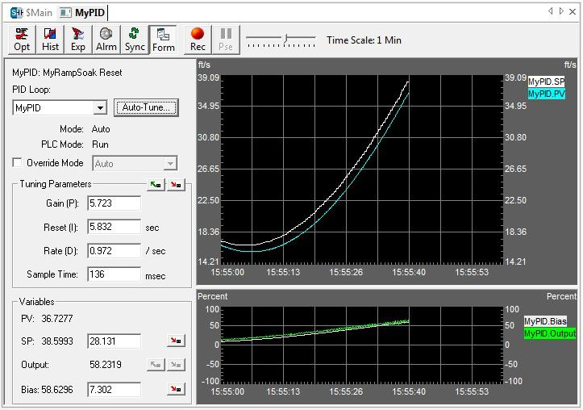
Instruction Set (Analog/Process)
PID View
Configuration, tuning & monitoring
3 panes
Data form
PV / SP trend
Output / Bias trend
Notes:
Launchpad: nothing new here
Project Browser:
Buttons
Control Logic Filter – Display filter
New Code Block – Create new code blocks
Execution Order – Change execution order of blocks
Status – Shows which blocks are enabled to run
Sort Code Blocks – Change display order
Sort Memory – Change display order
Control Logic
Configuration
Tools
Debug View
NOTE: Message Dump – enables dump to Do-more Logger, $EnableMsgDump (ST36)
Data View
PID Overview

Slide 25
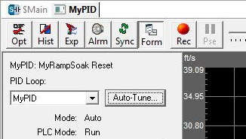
Instruction Set (Analog/Process)
Auto-tune Process
Sets optimal values for P, I & D to get ideal response from control system
Manipulates the PID’s output then measures the rate of change, overshoot and response of the process variable
Uses Ziegler-Nichols methodology
Press <Auto-Tune…> button →
NOTE: 1st make sure process is relatively stable
Steps:
Choose which variables to tune
Choose tuning algorithm
Decide what to do with newly-tuned PID
Do something with new tuning constants

Slide 26
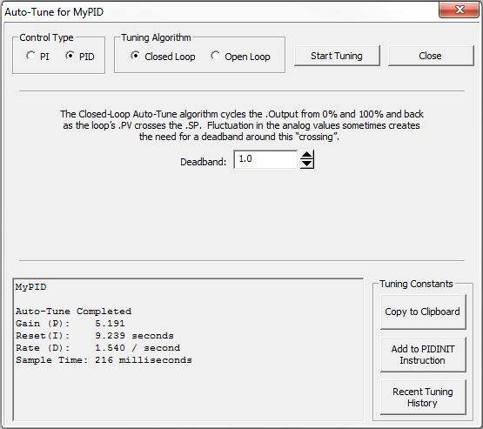
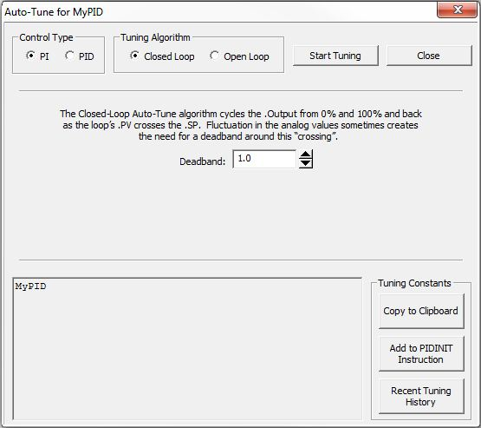
Instruction Set (Analog/Process)
Auto-tune Process (cont’)
Choose which variables are to be Auto-Tuned (Control Type)
Choose which type of tuning algorithm to be used (Tuning Algorithm)
Closed Loop – cycles Output from 0% to 100% & back as PV crosses SP (3 times)
Choose Deadband around this crossing if necessary
Press <Start Tuning> button… Auto-tune happens…

Slide 27
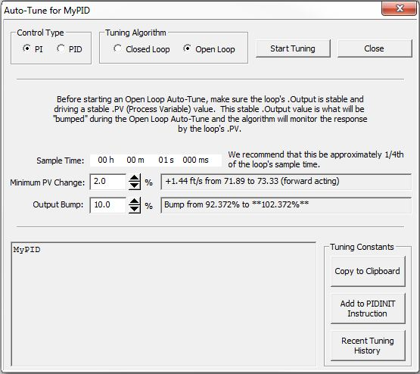
Instruction Set (Analog/Process)
Auto-tune Process
Choose which type of tuning algorithm to be used (Tuning Algorithm)
Open Loop – Output is bumped & response is measured by the change in PV
Set Sample Time to 25% of loop’s sample time
Set Minimum PV Change
Set Output Bump size
Press <Start Tuning>… Auto-tune happens…

Slide 28
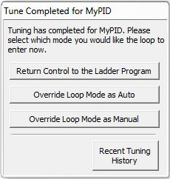
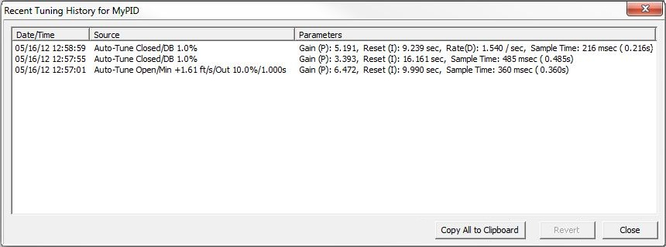
Instruction Set (Analog/Process)
Auto-tune Process (cont’)
Decide what to do with the newly-tuned PID
Return Control to the Ladder Program
Override Loop Mode as Auto
Override Loop Mode as Manual
Recent Tuning History

Slide 29
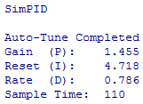
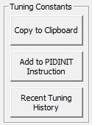
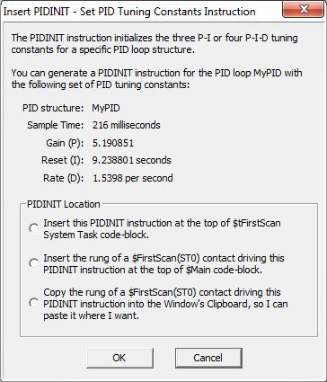
Instruction Set (Analog/Process)
Auto-tune Process (cont’)
Do something with your newly calculated PID constants
Copy to Clipboard
Add to PIDINIT Instruction
Recent Tuning History

Slide 30
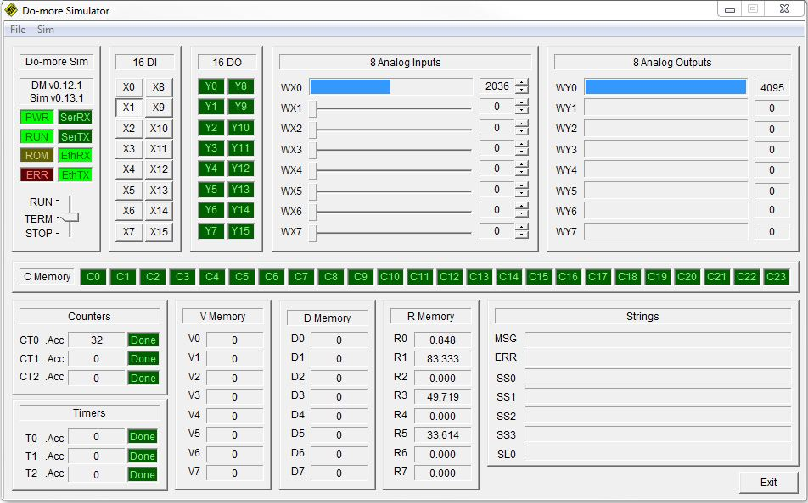
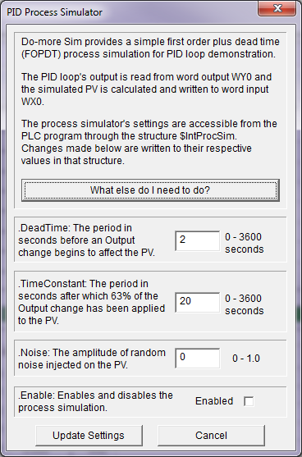
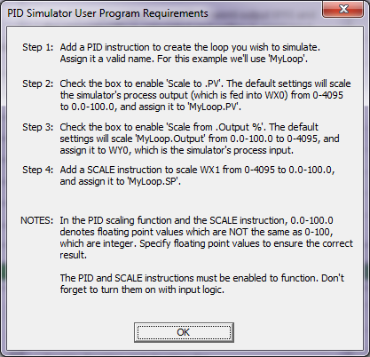
Instruction Set (Analog/Process)
PID Process Simulator
Do-more Designer has a Virtual PLC (SIM)
Sim → Setup PID Process Simulator

