Slide 1


Do-more Technical Training
Documentation

Slide 2
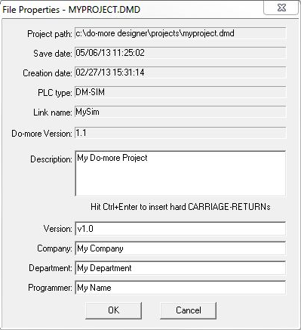
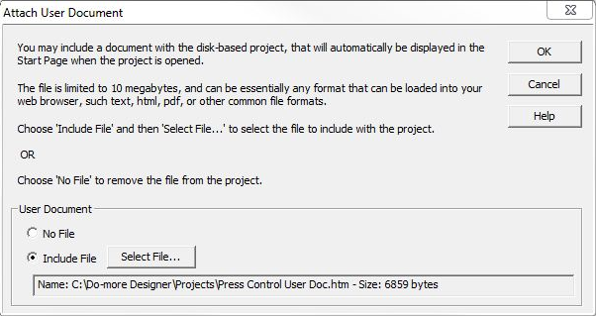
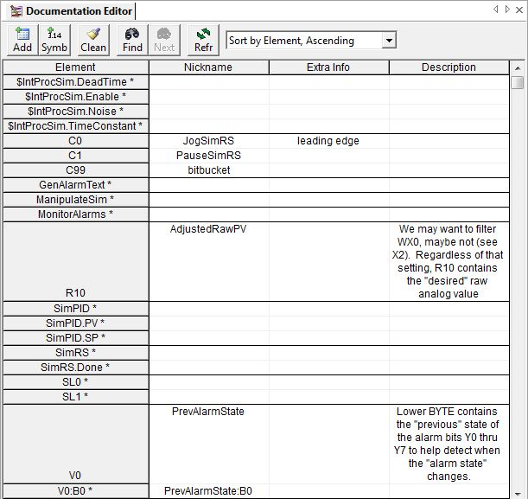
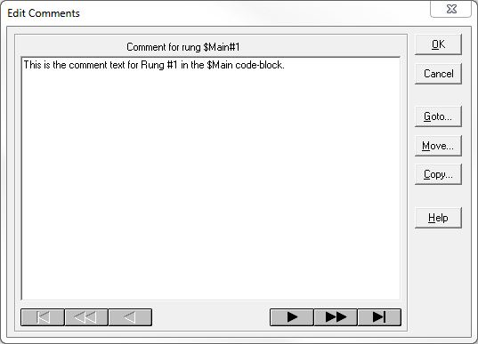
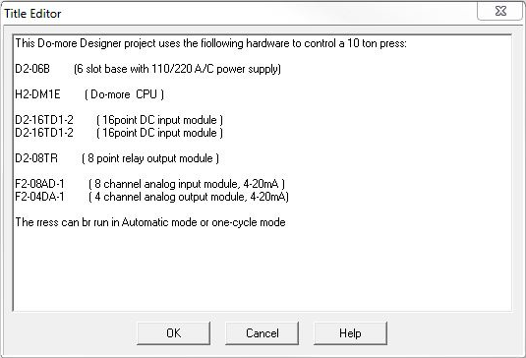
Documentation
(1) Element Documentation
  Nickname
  Extra Info
  Description
(2) Rung Comments
(3) Title Page
(4) Project Properties Page
(5) *User Document
* Not stored in the PLC

Slide 3
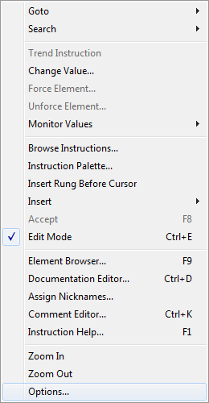

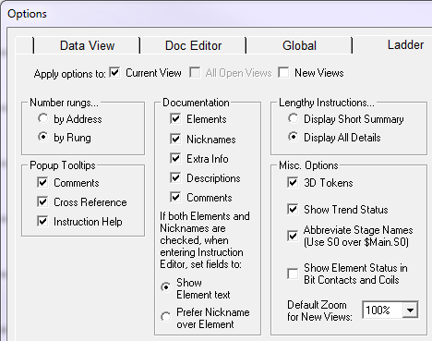
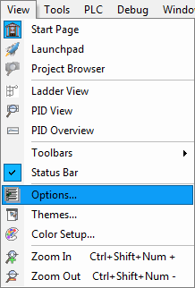
Documentation
Displaying in Ladder View
  View → Options
  Press <Options> button
  Right-click in Ladder View,
  select “Options”

Slide 4
Documentation
Element Documentation (pieces)
  Saved to the disk automatically upon change
  Saved to PLC when “Write PLC” is performed
  Nicknames – alternate name for Element
    1 to 16 characters
    Must begin with alpha-character (“a-z” or “A-Z”) or underscore (“_”)
    All other characters can be alpha-numeric (i.e. including “0-9”) or underscores
    No spaces
    No punctuation
  Extra Info – e.g. panel wiring info, etc.
    1 to 16 characters
    Any character can be alphabet (“a-z” or “A-Z”), numeric (“0-9”), punctuation or arithmetic operator
  Description – e.g. detailed description
    1 to 132 characters
    Any characters same as Extra Info

Slide 5
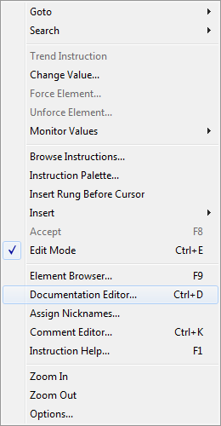
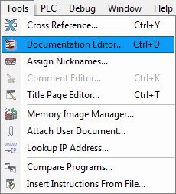

Documentation
(1) Element Documentation (edit)
  Tools → Documentation Editor…
  Press <CTRL> + D
  Press <Documentation> button
  Right-click in Ladder View,
  select “Documentation Editor…”

Slide 6
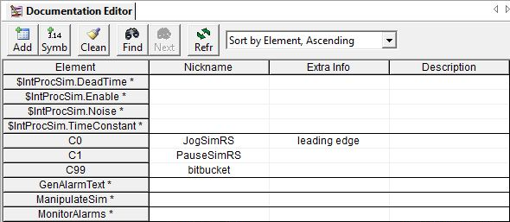
Documentation
(1) Element Documentation (columns)
  Element
    Asterisk (*) means:
      Element is used but
      has no documentation
      Element was used in
      current edit session
        May or may not exist currently
        Elements not used will disappear when project is closed
      Element is “Unreferenced…”, and only has a Nickname in the project
    Can also be a “Symbolic Const”

Slide 7
Documentation
(1) Element Documentation (columns)
  Nickname
    For symbolic
    constants, the
    Nickname given
    is shown (e.g. PI)
  Extra Info
    For symbolic constants, it will show the value
  Description
    If longer than column width, line breaks are inserted
    Manual line breaks can be inserted with <CTRL> + <Enter>

Slide 8

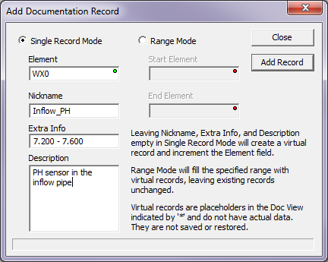
Documentation
(1) Element Documentation (buttons)
  <Add>
    Elements already
    have a record, so…
    Add is mainly used to create
    documentation records for
    Elements not yet existing in
    Ladder Logic
    Single Record Mode –
    Enter fields then
    press <Add Record> button
    Range Mode – creates
    records for a range of
    Elements
      Any Elements in the range that already have documentation will not be changed
      Provides a means to create records that can subsequently be edited

Slide 9

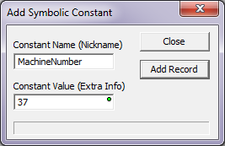
Documentation
(1) Element Documentation (buttons)
  <Symb> – adds a
  Symbolic Constant not
  already being used in the Ladder
  Logic
    Enter the fields & press <Add Record> button
      Notice:
        Constant’s Name shows up in the Nickname field
        Constant’s Value shows up in the Extra Info field

Slide 10
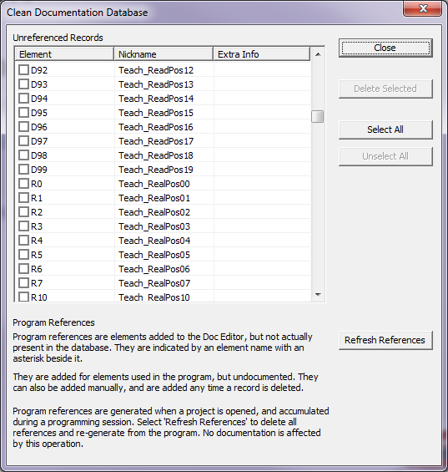

Documentation
(1) Element Documentation (buttons)
  <Clean> – removes
  records for Elements &
  Symbolic Constants that
  are not currently used
  in Ladder Logic
    Select Element(s) &
    press <Delete Selected>
    button

Slide 11

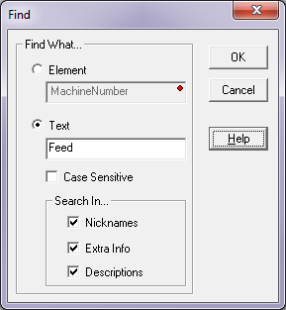

Documentation
(1) Element Documentation (buttons)
  <Find> – search Element
  Documentation records
    Choose Element or Text
    Check Case Sensitivity
    Choose where to search
    Press <OK> button
    <Next> button will now be
    available
  <Next> - searches for next occurrence

Slide 12
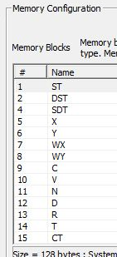
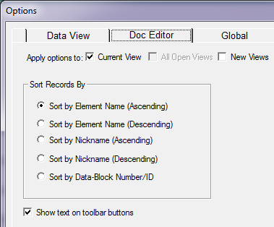

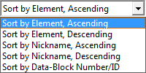
Documentation
(1) Element Documentation (buttons)
  <Refr> – refresh display
  Sort by:
    Element
      Ascending
      Descending
    Nickname
      Ascending
      Descending
    Data-Block Number/ID – same order as the left column in Memory Configuration
  Default sort option can be set in View → Options → Doc Editor tab

Slide 13
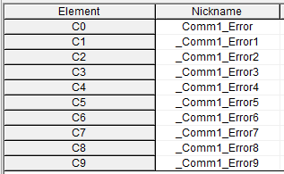
Documentation
(1) Element Documentation (Cut/Copy/Paste)
  Conventional keys supported:
    Cut – <CTRL> + X
    Copy – <CTRL> + C
    Paste – <CTRL> + V
  Selection:
    Entire row – click on Element
    Individual text – double-click on text
    Range of rows – click & drag on Element
  NOTE: Since Nicknames must be unique,
  an underscore (“_”) will be prepended & an incremented number (“1”, “2”, “3”, etc.) will be appended to pasted Nicknames
C0 was copied to C1-C9

Slide 14
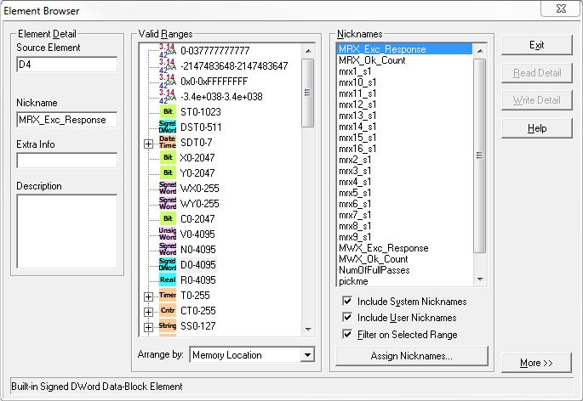
Documentation
(1) Element Documentation (Element Browser)
  The Element Documentation Editor is the primary tool for creating/editing Element Documentation
  But Element Browser can be used as well
    Search → Element Browser
    <F9> key
    (1) Enter Source Element,
    Nickname, Extra Info,
    Description
    (2) Press <Write Detail>
    button
    Use <Read Detail> button to reset the test if need be

Slide 15
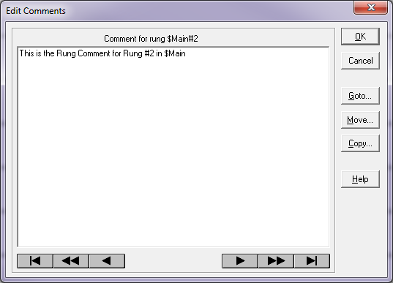

Documentation
(2) Rung Comments
  Each Rung can have a text comment
    20 lines of text
    Maximum 2400
    characters
    Number of
    characters/line
    dependent on font
    Any printable
    ASCII character
  Tools → Comment
  Editor
  <CTRL> + K
  Double-clicking in
  Rung Comment area
  in Ladder View
  Double-clicking on existing Rung Comment

Slide 16
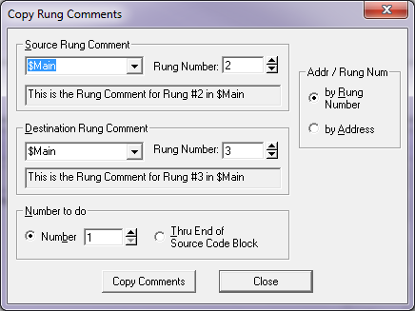

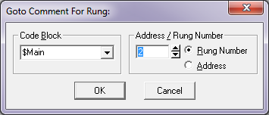
Documentation
(2) Rung Comments
  Buttons:
    1st Rung
    Back 5 Rungs
    Back 1 Rung,
    <PageUp>
    Forward 1 Rung,
    <PageDown>
    Forward 5 Rungs
    Last Rung
    <Goto…>
    <Move…>
    <Copy…>

Slide 17
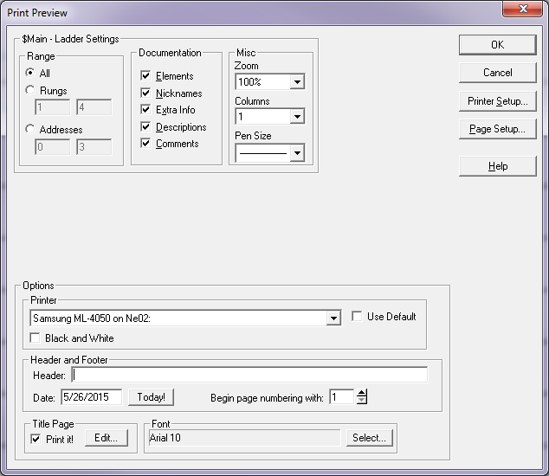
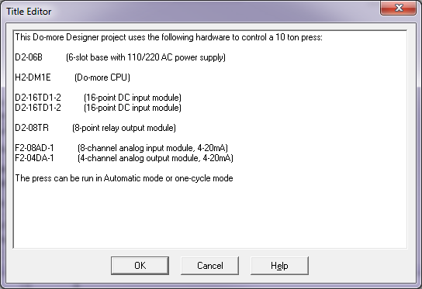

Documentation
(3) Title Page
  Document a general description of entire project & is, by default, the 1st page printed for Project
    20 lines of text
    Maximum 2400
    characters
    Number of
    characters/line
    dependent on font
    Any printable
    ASCII character
  Tools → Title Page
  Editor…
  <CTRL> + T
  <Edit…> in Print,
  Print All, or Print
  Preview dialogs

Slide 18
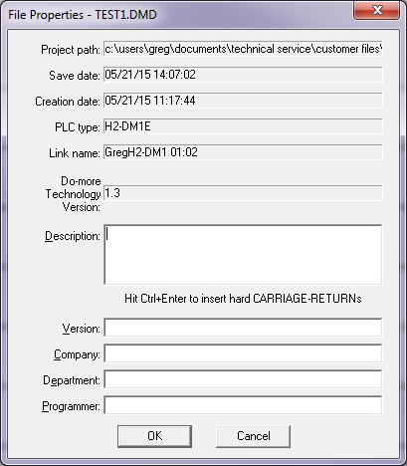

Documentation
(4) Project Properties Page
  Document information
  about Project (i.e. version
  numbers & changes since
  its creation)
  Displayed on Title Page
  Editor pulled up 1st time
  Project is saved to disk
  File → Properties

Slide 19

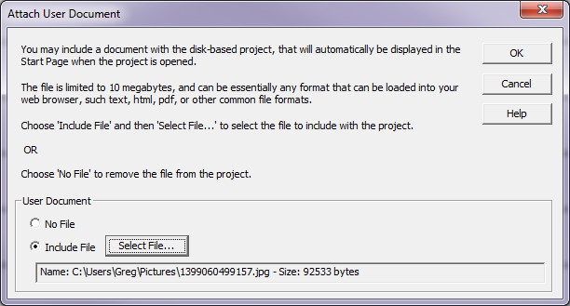
Documentation
(5) User Document
  Attached to the Project
  Displays as the Start Page
  Any file type that can be displayed in a web browser
  Maximum size:
  10 Mbytes
  Not stored in CPU
  Tools → Attach
  User Document…

Slide 20

Documentation

