Slide 1
Do-more Technical Training
The Do-more Way

Slide 2
Do-more Architecture
Hardware or System Resource
Servers are similar to Devices but run in the background
Servers (like Devices) interface directly to the PLC’s hardware or System Resources
Do-more PLCs are “device-centric”
Devices interface directly to the PLC’s hardware & system resources, handling low-level issues like protocols, handshaking, memory allocation, status flags & communication buffer management
Server
Devices provide a uniform interface to the hardware for the instructions
Devices also provide a uniform interface to the hardware for the memory
Devices are interfaces that provide access to Do-more resources
Device
Most instructions do not use Devices but interface directly to memory
With a few exceptions, Servers do not normally interface with instructions
Servers (like Devices) also provide a uniform interface to the hardware for the memory
Instruction
Memory

Slide 3
Advantages of Device-Centricism
Provides a level of abstraction
Reduces complexity when interfacing to the PLC’s system resources (e.g. hardware)
Increases efficiency in handling complex functions
Provides a uniform programming interface even if the hardware is different
Provides a uniform interface to memory so it is impossible to have memory mapping issues
Provides clearly-named memory structures that give access to the particular device’s features & functions
Handles the hardware asynchronously for the programmer
Think of the standard interfaces to a computer (mouse, keyboard, monitor), or a phone (touch screen, swipe, long press), etc. These interfaces are generic even though providing access to very different hardware.

Slide 4
Do-more Devices
Three types:
(1) Built-in⁽¹⁾ – exist by default
@DMLogger
@IntEIPClient
@IntEthDMPPClient
@IntEthernet
@IntModTCPClient
@IntSerial
@LocalIOMaster
@UserLog
(2) System-created – created by system as user modifies CPU Configuration or adds modules to system
@IntSerModbusClient⁽¹⁾
@IntEIPServer⁽¹⁾
@EthIOMaster⁽¹⁾
@CTRIO_xxx⁽²⁾
@CTRIO_xxx_CyFz⁽²⁾
@CTRIO_xxx_Outy⁽²⁾
@ECOM_xxx⁽²⁾
@ERM⁽²⁾
@GSEDRV100⁽²⁾
@SERIO_xxx_y⁽²⁾
(3) User-created – created manually by the user⁽²⁾
@EtherNetIPClient
@ModbusTCPClient
@SMTPClient
@TCPClient
@TCPServer
@UDPConnection
(1) Name of Device(s) cannot be changed
(2) Name given upon creation (changeable)

Slide 5
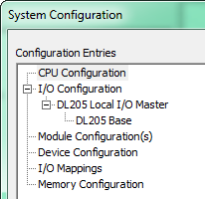
Do-more Configuration Hierarchy
CPU Configuration
I/O Configuration
Module Configuration(s)
Device Configuration
I/O Mappings
Memory Configuration
The order is on purpose!
The order is on purpose!

Slide 6
(1) CPU Configuration Ethernet Port: Can handle many simultaneous Devices/Servers/Functions
@IntEthernet
Peerlink
Function
DomoreServer
2ndInt EthServer
DLServer
Ethernet Port
@EthIOMaster
Ethernet IP Server
@SMTPClient
@TCPClient
ModbusTCP Server

Slide 7
(1) CPU Configuration Serial Port: Only does one Configuration
Do-more Programming Configuration:
Baud rate
Data bits
Stop bits
Parity
Transmit control
RTS control
Modbus RTU Client (Master) Configuration:
Timeout
Retries
Inter-packet Delay
Baud rate
Data bits
Stop bits
Parity
Transmit control
RTS control
Serial Port
K-Sequence Server Configuration:
Station
Baud rate
Data bits
Stop bits
Parity
Transmit control
RTS control
@IntSerial
General Purpose Configuration:
Baud rate
Data bits
Stop bits
Parity
Transmit control
RTS control
Modbus RTU Server (Slave) Configuration:
Unit ID
Baud rate
Data bits
Stop bits
Parity
Transmit control
RTS control

Slide 8
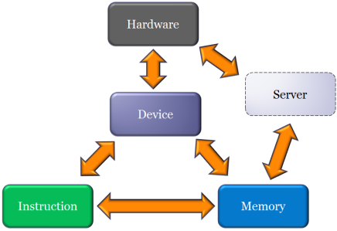
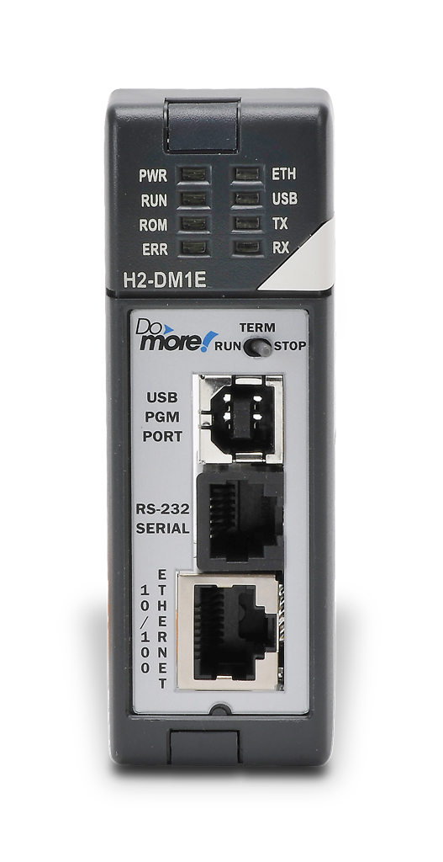
(1) CPU Configuration (Default)
Uses Internal Ethernet Port
The following are not manually configurable
All use the @IntEthernet Device
Do-more Server
Allows access to all Do-more memory
Do-more Designer uses this
DL Server
Allows access to DL-memory
SNTP “Simple Network Time Protocol”
Used by NETTIME instruction to set CPU time
ICMP “Internet Control Message Protocol”
Responds to external “pings”
Used by PING instruction to find an IP address
DNS “Domain Name System” Protocol
Used by DNSLOOKUP instruction to find IP address
Peerlink Function
Used by PEERLINK instruction for easy comms
Allows access to PL-memory blocks (16 blocks of 16 words)
Allows access to PL memory structure

Slide 9
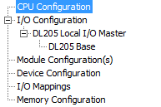
Do-more Architecture (1) CPU Configuration – Do-more Server
Internal Ethernet Port
Do-more Server interfaces directly to the Internal Ethernet Port
Do-more Server runs in the background
Do-more Server on @IntEthernet
Do-more Server provides a uniform interface to the hardware for all the PLC’s memory
All PLC Memory

Slide 10
Do-more Architecture (1) CPU Configuration – DL Server (K-seq)
Internal Ethernet Port
DL Server interfaces directly to the Internal Ethernet Port
DL Server runs in the background
DL Server on @IntEthernet
DL Server provides a uniform interface to the hardware for DL memory
DL-Memory

Slide 11
Do-more Architecture (1) CPU Configuration – SNTP “Simple Network Time Protocol”
Internal Ethernet Port
@IntEthernet Device interfaces directly to the Internal Ethernet Port handling the SNTP “Simple Network Time Protocol”
@IntEthernet Device provides interface to the hardware for the NETTIME instruction
@IntEthernet Device provides access to Internal Ethernet Port
@IntEthernet
NETTIME instruction uses Do-more memory for parameters
NETTIME
Do-more Memory

Slide 12
Do-more Architecture (1) CPU Configuration – ICMP “Internet Control Message Protocol”
Internal Ethernet Port
@IntEthernet Device interfaces directly to the Internal Ethernet Port handling the ICMP “Internet Control Message Protocol” & responding to external ICMP “pings”
@IntEthernet Device provides interface to the hardware for the PING instruction
@IntEthernet
PING instruction uses Do-more memory for parameters
PING
Do-more Memory

Slide 13
Do-more Architecture (1) CPU Configuration – DNS “Domain Name System” Protocol
Internal Ethernet Port
@IntEthernet Device interfaces directly to the Internal Ethernet Port handling the DNS “Domain Name System” protocol
@IntEthernet Device provides interface to the hardware for the DNSLOOKUP instruction
@IntEthernet
DNSLOOKUP instruction uses Do-more memory for parameters
DNSLOOKUP
Do-more Memory

Slide 14
Do-more Architecture (1) CPU Configuration – Peerlink Function
Internal Ethernet Port
@IntEthernet Device interfaces directly to the Internal Ethernet Port handling the Peerlink Protocol
@IntEthernet Device provides interface to the hardware for the PEERLINK instruction
@IntEthernet Device provides a uniform interface to the hardware for PL Memory
@IntEthernet
PEERLINK
PL Blocks PL Structure

Slide 15
(1) CPU Configuration (Manual)
TimeSync Configuration (@IntEthernet)
Allows access to:
SDT0 ($Now) system date/time structure
ST23 ($TimeSynced) system bit
Internal Ethernet Port (@IntEthernet)
Configure IP settings
Enable Secondary Ethernet Connection
Allows access to all Do-more memory over a different UDP Port Number
Do-more Designer uses this
(By default, DLRX/DLWX instructions can be used)
Modbus/TCP Server Configuration (@ModbusTCPServer)
Allows access to M-memory
Uses ModbusTCPServer memory structure
Ethernet/IP Explicit Message Server (@IntEIPServer)
Allows access to up to 8 configured Do-more memory blocks
Uses $IntEIPServer memory structure

Slide 16
Do-more Architecture (1) CPU Configuration – TimeSync Configuration
Internal Ethernet Port
TimeSync Configuration:
Client
Server
Alternate
Update Interval
@IntEthernet Device interfaces directly to the Internal Ethernet Port handling the Time Sync Protocol
@IntEthernet Device provides a uniform interface to the hardware for System Clock Memory
@IntEthernet
SDT0 ($Now) ST23 ($TimeSynced)

Slide 17
Do-more Architecture (1) CPU Configuration – IP Configuration
Internal Ethernet Port
IP Configuration:
Module ID
Name
Description
IP Address
Subnet Mask
Gateway
@IntEthernet Device interfaces directly to the Internal Ethernet Port handling all Ethernet telegrams
@IntEthernet

Slide 18
Do-more Architecture (1) CPU Configuration – Secondary Ethernet Connection
Internal Ethernet Port
Do-more Server interfaces directly to the Internal Ethernet Port
Do-more Server runs in the background
Do-more Server on @IntEthernet
Secondary Ethernet Connection:
Enable
UDP Port Number
Do-more Server provides a uniform interface to the hardware for all the PLC’s memory
All PLC Memory

Slide 19
Do-more Architecture (1) CPU Configuration – DL Client (K-seq)
Internal Ethernet Port
@IntEthernet Device interfaces directly to the Internal Ethernet Port handling the hidden background DL Client’s K-seq protocol
@IntEthernet Device provides interface to the hardware for the DLRX/DLWX instructions
@IntEthernet
DLRX/DLWX instructions use Do-more memory for parameters
DLRX
DLWX
Do-more Memory

Slide 20
Do-more Architecture (1) CPU Configuration – Modbus TCP Server (Slave)
Internal Ethernet Port
ModbusTCP Server runs in the background but is visible & configurable
Modbus TCP Server interfaces directly to the Internal Ethernet Port
@ModbusTCPServer
Modbus TCP Server Configuration:
Enable
Maximum Concurrent Sessions
Client Inactivity Timeout
TCP Port Number
Modbus TCP Server provides a uniform interface to the hardware for M-memory & the Server’s Structure
M-Memory
$ModbusTCPServer

Slide 21
Do-more Architecture (1) CPU Configuration – EtherNet/IP Explicit Message Server
Internal Ethernet Port
EtherNet/IP Explicit Message Server runs in the background but is visible & configurable
EtherNet/IP Explicit Message Server interfaces directly to the Internal Ethernet Port
@IntEIPServer
EtherNet/IP Explicit Message Server Configuration:
Enable
Maximum Concurrent Sessions
Client Inactivity Timeout
TCP Port Number
Device Name
Block1-8
EtherNet/IP Explicit Message Server provides a uniform interface to the hardware for Block1-8 & the Server’s Structure
Block1-8
$IntEIPServer

Slide 22
(1) CPU Configuration (Manual)
Serial Port Mode (@IntSerial)
Do-more Programming
Allows access to all Do-more memory
Uses $IntSerialServer memory structure
K-sequence Server
Allows access to DL-memory
Uses $IntSerialServer memory structure
Modbus RTU Server (Slave)
Allows access to M-memory
Uses $IntSerialServer memory structure
Modbus RTU Client (Master) (@IntSerModbusClient)
Used by MRX/MWX instructions
General Purpose
Used by STREAMIN/STREAMOUT instructions
Uses $IntSerial memory structure
Default Watchdog Timeout
Uses:
ST13 ($WatchdogReboot) system bit
ST24 ($HwWatchdogMode) system bit
ST25 ($DisableHwWdog) system bit
ST37 ($DisableSwWdog) system bit
ST128 ($WatchdogTimeout) system bit
DST23 ($WatchdogTimeVal) system double word
DST385 ($WatchdogReboots) system double word
Used by WATCHDOG instruction

Slide 23
Do-more Architecture (1) CPU Configuration – Do-more Programming
Internal Serial Port
Do-more Server interfaces directly to the Internal Serial Port
Do-more Server runs in the background
Do-more Server on @IntSerial
Serial Port Settings:
Baud Rate
Data Bits
Stop Bits
Parity
Transmit Control
RTS Control
Do-more Server provides a uniform interface to the hardware for all the PLC’s memory
All PLC Memory
$IntSerialServer

Slide 24
Do-more Architecture (1) CPU Configuration – DL Server (K-seq)
Internal Serial Port
DL Server interfaces directly to the Internal Serial Port
DL Server runs in the background
DL Server on @IntSerial
Serial Port Settings:
Station
Baud Rate
Data Bits
Stop Bits
Parity
Transmit Control
RTS Control
DL Server provides a uniform interface to the hardware for DL memory & $IntSerialServer
DL-Memory
$IntSerialServer

Slide 25
Do-more Architecture (1) CPU Configuration – Modbus RTU Server (Slave)
Internal Serial Port
Modbus RTU Server runs in the background but is visible & configurable
Modbus RTU Server interfaces directly to the Internal Serial Port
Modbus RTU Server on @IntSerial
Modbus RTU Server Settings:
Unit ID
Baud Rate
Data Bits
Stop Bits
Parity
Transmit Control
RTS Control
Modbus RTU Server provides a uniform interface to the hardware for M-memory & the Server’s Structure
M-Memory
$IntSerialServer

Slide 26
Do-more Architecture (1) CPU Configuration – Modbus RTU Client (Master)
Internal Serial Port
Modbus RTU Client Configuration:
Timeout
Retries
Inter-packet Delay
Baud rate
Data bits
Stop bits
Parity
Transmit control
RTS control
@IntSerModbusClient Device interfaces directly to the Internal Serial Port handling the Modbus RTU protocol
@IntSerModbusClient Device provides interface to the hardware for the MRX/MWX instructions
@IntSerModbusClient
MRX/MWX instructions use Do-more memory for parameters
MRX
MWX
Do-more Memory

Slide 27
Do-more Architecture (1) CPU Configuration – General Purpose
Internal Serial Port
Serial Port Settings:
Baud rate
Data bits
Stop bits
Parity
Transmit control
RTS control
@IntSerial Device interfaces directly to the Internal Serial Port handling the general purpose comms
@IntSerial Device provides interface to the hardware for the STREAMIN/STREAMOUT instructions
@IntSerial Device provides a uniform interface to the hardware for the IntSerial Structure
@IntSerial
STREAMIN/STREAMOUT instructions use Do-more memory for parameters
STREAMIN
STREAMOUT
Do-more Memory
IntSerial Structure

Slide 28
Do-more Architecture (1) CPU Configuration – Watchdog Function
Do-more CPU
Watchdog Function interfaces directly to the Do-more CPU
Watchdog Function runs in the background but is configurable
Watchdog Function
Default Watchdog Settings:
Default Timeout
Watchdog Function provides a uniform interface for the WATCHDOG instruction
Watchdog Function provides a uniform interface to the hardware for Watchdog-related System memory
WATCHDOG
Watchdog-related System Memory
(e.g. ST128, DST23)

Slide 29
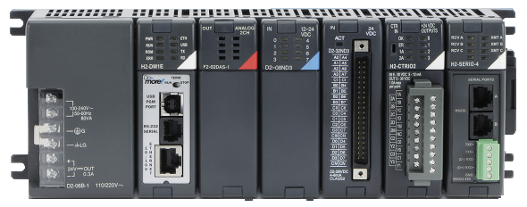
(2) I/O Configuration
DL205 Local Master (@LocalIOMaster)
Allows Auto/Manual Configuration of I/O
Allows access to I/O memory
Uses LocalIOMaster memory structure
Ethernet I/O Master (@EthIOMaster)
Controls up to 16 EBC100 slaves
Allows access to I/O memory
Uses $EthIOMaster memory structure

Slide 30
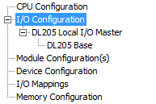
Do-more Architecture (2) I/O Configuration – Local I/O Master
Backplane w/Modules
Local I/O Master Configuration:
Auto
Manual
@LocalIOMaster Device interfaces directly to the Backplane handling the module communications
@LocalIOMaster Device provides interface to the hardware for smart-module Devices & their instructions
@LocalIOMaster Device provides a uniform interface to the hardware for the I/O memory & LocalIOMaster Structure
@LocalIOMaster
Instructions use Do-more & I/O memory for parameters
Smart-Module Instructions
I/O Memory
Do-more Memory
LocalIOMaster Structure

Slide 31
Do-more Architecture (2) I/O Configuration – Ethernet I/O Master
Internal Ethernet Port
Ethernet I/O Master Configuration:
EBC100 Slaves & their I/O Configurations
@EthIOMaster Device interfaces directly to the Internal Ethernet port handling the EBC100 Slave module communications
@EthIOMaster Device provides a uniform interface to the hardware for the I/O memory & $EthIOMaster Structure
@EthIOMaster
Instructions use Do-more & I/O memory for parameters
Instructions
I/O Memory
Do-more Memory
$EthIOMaster

Slide 32
(3) Module Configuration
CTRIO/CTRIO2 (@CTRIO_001)
Creates @CTRIO_001 device that uses $CTRIO_001 memory structure
Creates various memory structures as module is configured (e.g. $CTRIO_001_C1F1)
Used by all CTxxxxxx & RD/WT instructions
ECOM/ECOM100 (@ECOM_002)
Allows access to DL-memory
Can be used by DLRX/DLWX & RD/WT instructions
ERM/ERM100 (e.g. @ERM_003)
Allows access to Do-more memory or DL-memory
Can be used by DLRX & RD/WT instructions
F2-8AD4DA-x
Allows configuration of resolution, track & hold, input/output ranges
GS Drive (e.g. @MyGSDrive)
Uses $MyGSDrive memory structure
Used by GSREGRD/GSREGWR instructions

Slide 33
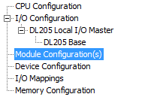
Do-more Architecture (3) Module Configuration – CTRIO2 Module
CTRIO2 Module
The @CTRIO_001 Device is automatically created when a CTRIO2 module is plugged into an I/O Master’s base
@CTRIO_001 Device interfaces directly to the CTRIO2 via the I/O Master handling the CTRIO2 module communications
@CTRIO_001 Device provides interface to the hardware for the CTREGRD & CTREGWR instructions
@CTRIO_001 Device provides a uniform interface to the hardware for the $CTRIO_001 Structure
@CTRIO_001
Instructions use Do-more memory for parameters
CTREGRD
CTREGWR
$CTRIO_001
Do-more Memory

Slide 34
Do-more Architecture (3) Module Configuration – CTRIO Input Functions
CTRIO2 Input Functions
The @CTRIO_001_C1F1 Device is automatically created if the CTRIO2 module is configured with an Input Function
@CTRIO_001_C1F1 Device interfaces directly to the CTRIO2 via the I/O Master handling the CTRIO2 module communications for input functions (counter, timer, pulse catch)
@CTRIO_001_C1F1 Device provides a uniform interface to the hardware for the $CTRIO_001_C1F1 Structure
@CTRIO_001_C1F1
Instructions use Do-more memory for parameters
Instructions
$CTRIO_001_C1F1
Do-more Memory

Slide 35
Do-more Architecture (3) Module Configuration – CTRIO Output Functions
CTRIO2 Output Functions
The @CTRIO_001_Out2 Device is automatically created if the CTRIO2 module is configured with an Output Function
@CTRIO_001_Out2 Device interfaces directly to the CTRIO2 via the I/O Master handling the CTRIO2 module communications for output functions (raw output, discrete output, pulse output)
@CTRIO_001_Out2 Device provides interface to the output functions of the CTRIO2 for all the CTRIO instructions
@CTRIO_001_Out2 Device provides a uniform interface to the hardware for the $CTRIO_001_Out2 Structure
@CTRIO_001_Out2
Instructions use Do-more memory for parameters
CTRIO Instructions
$CTRIO_001_Out2
Do-more Memory

Slide 36
Do-more Architecture (3) Module Configuration – ECOM100 Module
Must use NetEdit3 to Configure:
IP network parameters
Peer-to-peer table
Email, etc.
ECOM100 Module
The @ECOM_001 Device is automatically created when an ECOM100 module is plugged into an I/O Master’s base
@ECOM_001 Device interfaces directly to the ECOM100 via the @LocalIOMaster handling the ECOM100 module communications
@ECOM_001 Device provides interface to the ECOM100 for the DLRX/DLWX instructions
@ECOM_001 Device provides a uniform interface to the ECOM100 for DL-Memory
@ECOM_001
DLRX/DLWX use Do-more memory for parameters
DLRX
DLWX
DL-Memory
Do-more Memory

Slide 37
Do-more Architecture (3) Module Configuration – ERM100 Module
Must use ERM Workbench to Configure:
EBC100 Slaves & their I/O Configurations
ERM100 Module
The @ERM_001 Device is automatically created when an ERM100 module is plugged into an I/O Master’s base
@ERM_001 Device interfaces directly to the ERM100 via the @LocalIOMaster handling the ERM100 module communications
@ERM_001 Device provides interface to the ERM100 for the DLRX, RD/WT instructions
@ERM_001 Device provides a uniform interface to the ERM100 for Do-more Memory
@ERM_001
DLRX, RD/WT instructions use Do-more memory for parameters
DLRX
RD/WT
Do-more Memory

Slide 38
Do-more Architecture (3) Module Configuration – F2-8AD4DA-x Analog Combo Module
Module Settings:
Enable channel
Resolution
Track & hold
Input/Output range
F2-8AD4DA-x Module
A Module Configuration is automatically created when an F2-8AD4DA-x module is plugged into an I/O Master’s base
The I/O Master Device interfaces directly to the F2-8AD4DA-x module handling the module communications & allowing the settings to be written on power-up
The I/O Master Device provides a uniform interface to the F2-8AD4DA-x module by mapping its I/O to I/O memory
I/O Master Device
The instructions have access to the mapped I/O memory of the F2-8AD4DA-x module
Instructions
I/O Memory

Slide 39
Do-more Architecture (3) Module Configuration – GS-EDRV100 Module
GS-EDRV100 Module
The @GS2_100 Device is automatically created when a GS-EDRV100 module is configured as a slave to an Ethernet I/O Master
@GS2_100 Device interfaces directly to the GS-EDRV100 module via the Ethernet I/O Master handling the GS-EDRV100 module communications
@GS2_100 Device provides interface to the hardware for the GSREGRD & GSREGWR instructions
@GS2_100 Device provides a uniform interface to the GS-EDRV100 for the $GS2_100 Structure
@GS2_100
Instructions use Do-more memory for parameters
GSREGRD
GSREGWR
$GS2_100
Do-more Memory

Slide 40
(3) Module Configuration
SERIO/SERIO4 (@SERIO_004_A, _B, _C)
Do-more Programming
Allows access to all Do-more memory
Uses $SERIO_004_A, _B, _C memory structure
K-sequence Server
Allows access to DL-memory
Uses $SERIO_004_A, _B, _C memory structure
Modbus RTU Server (Slave)
Allows access to M-memory
Uses $SERIO_004_A, _B, _C memory structure
Modbus RTU Client (Master)
Used by MRX/MWX instructions
General Purpose
Used by STREAMIN/STREAMOUT instructions
Uses $SERIO_004_A, _B, _C memory structure
Terminator Analog Output
Allows configuration of enable, output type/range

Slide 41
Do-more Architecture (3) Module Configuration – Do-more Programming
SERIO/SERIO4 Module
The @SERIO_001_A Device is automatically created when a SERIO/SERIO4 module’s Port A is configured as “Do-more Programming”
Do-more Server interfaces directly to the SERIO/SERIO4 Module via the @LocalIOMaster Device
Do-more Server runs in the background
Do-more Server on @SERIO_001_A
Serial Port Settings:
Baud Rate
Data Bits
Stop Bits
Parity
Transmit Control
RTS Control
Do-more Server provides a uniform interface to the SERIO/SERIO4 Module for all the PLC’s memory & $SERIO_001_A Structure
All PLC Memory
$SERIO_001_A

Slide 42
Do-more Architecture (3) Module Configuration – DL Server (K-seq)
SERIO/SERIO4 Module
The @SERIO_001_A Device is automatically created when a SERIO/SERIO4 module’s Port A is configured as “K-Sequencer Server”
DL Server interfaces directly to the SERIO/SERIO4 Module via the @LocalIOMaster
DL Server runs in the background
DL Server on @SERIO_001_A
Serial Port Settings:
Station
Baud Rate
Data Bits
Stop Bits
Parity
Transmit Control
RTS Control
DL Server provides a uniform interface to the SERIO/SERIO4 Module for DL memory & $SERIO_001_A
DL-Memory
$SERIO_001_A

Slide 43
Do-more Architecture (3) Module Configuration – Modbus RTU Server (Slave)
SERIO/SERIO4 Module
The @SERIO_001_A Device is automatically created when a SERIO/SERIO4 module’s Port A is configured as “Modbus RTU Server (Slave)”
Modbus RTU Server interfaces directly to the SERIO/SERIO4 Module via the @LocalIOMaster
Modbus RTU Server runs in the background but is visible & configurable
Modbus RTU Server on @SERIO_001_A
Modbus RTU Server Settings:
Unit ID
Baud Rate
Data Bits
Stop Bits
Parity
Transmit Control
RTS Control
Modbus RTU Server provides a uniform interface to the SERIO/SERIO4 Module for M-memory & $SERIO_001_A
M-Memory
$SERIO_001_A

Slide 44
Do-more Architecture (3) Module Configuration – Modbus RTU Client (Master)
SERIO/SERIO4 Module
The @SERIO_001_A Device is automatically created when a SERIO/SERIO4 module’s Port A is configured as “Modbus RTU Client (Master)”
Modbus RTU Client Configuration:
Timeout
Retries
Inter-packet Delay
Baud rate
Data bits
Stop bits
Parity
Transmit control
RTS control
@SERIO_001_A Device interfaces directly to the SERIO/SERIO4 Module handling the Modbus RTU protocol
@SERIO_001_A Device provides interface to the SERIO/SERIO4 Module for the MRX/MWX instructions
@SERIO_001_A
MRX/MWX instructions use Do-more memory for parameters
MRX
MWX
Do-more Memory

Slide 45
Do-more Architecture (3) Module Configuration – General Purpose
SERIO/SERIO4 Module
The @SERIO_001_A Device is automatically created when a SERIO/SERIO4 module’s Port A is configured as “General Purpose”
Serial Port Settings:
Baud rate
Data bits
Stop bits
Parity
Transmit control
RTS control
@SERIO_001_A Device interfaces directly to the SERIO/SERIO4 Module handling the general purpose comms
@SERIO_001_A Device provides interface to the SERIO/SERIO4 Module for the STREAMIN/STREAMOUT instructions
@SERIO_001_A Device provides a uniform interface to the SERIO/SERIO4 Module for the $SERIO_001_A Structure
@SERIO_001_A
STREAMIN/STREAMOUT instructions use Do-more memory for parameters
STREAMIN
STREAMOUT
$SERIO_001_A
Do-more Memory

Slide 46
Do-more Architecture (3) Module Configuration – T1F-16DA-x Analog Output Module
Module Settings:
Enable channel
Output range type
Output range (voltage)
Output range (current)
T1F-16DA-x Module
A Module Configuration is automatically created when a T1F-16DA-x module is plugged into an I/O Master’s base
The I/O Master Device interfaces directly to the T1F-16DA-x module handling the module communications & allowing the settings to be written on power-up
The I/O Master Device provides a uniform interface to the T1F-16DA-x module by mapping its I/O to I/O memory
I/O Master Device
The instructions have access to the mapped I/O of the T1F-16DA-x module
Instructions
I/O Memory

Slide 47
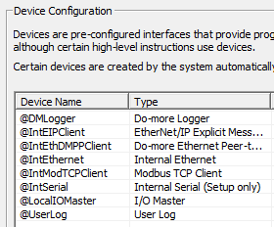
(4) Device Configuration
System Devices
Do-more Logger (@DMLogger)
Used by STREAMOUT instruction
EtherNet/IP Explicit Message Client (@IntEIPClient)
Used by EIPMSG instruction
Do-more Ethernet Peer-to-Peer Client (@IntEthDMPPClient)
Used by RX/WX instructions
Modbus TCP Client (@IntModTCPClient)
Used by MRX/MWX instructions
User Log (@UserLog)
Used by STREAMOUT instruction
DL Client (@IntEthernet)
Used by DLRX/DLWX instructions

Slide 48
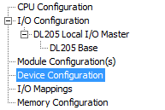
Do-more Architecture (4) Device Configuration – Do-more Logger
Internal Ethernet Port
@DMLogger Device interfaces directly to the Internal Ethernet Port handling the broadcasts to Do-more Logger App
@DMLogger Device provides interface to the Internal Ethernet Port for the STREAMOUT instruction
@DMLogger
The STREAMOUT instruction uses Do-more memory for parameters
STREAMOUT
Do-more Memory

Slide 49
Do-more Architecture (4) Device Configuration – EtherNet/IP Explicit Message Client (Master)
Internal Ethernet Port
@IntEIPClient Device interfaces directly to the Internal Ethernet Port handling the EtherNet/IP Explicit Message protocol
@IntEIPClient Device provides interface to the Internal Ethernet Port for the EIPMSG instruction
@IntEIPClient
The EIPMSG instruction uses Do-more memory for parameters
EIPMSG
Do-more Memory

Slide 50
Do-more Architecture (4) Device Configuration – Do-more Peer-to-peer Client
NOTE: The Do-more Point-to-Point Server portion is handled by the Do-more Server (see above)
Internal Ethernet Port
@IntEthDMPPClient Device interfaces directly to the Internal Ethernet Port handling the Do-more Point-to-Point protocol
@IntEthDMPPClient Device provides interface to the Internal Ethernet Port for the RX/WX instructions
@IntEthDMPPClient
The RX/WX instructions use Do-more memory for parameters
RX
WX
Do-more Memory

Slide 51
Do-more Architecture (4) Device Configuration – Modbus TCP Client (Master)
Internal Ethernet Port
Modbus TCP Client Configuration:
Timeout
Retries
Inactivity Timeout
@IntModTCPClient Device interfaces directly to the Internal Ethernet Port handling the Modbus TCP protocol
@IntModTCPClient Device provides interface to the Internal Ethernet Port for the MRX/MWX instructions
@IntModTCPClient
MRX/MWX instructions use Do-more memory for parameters
MRX
MWX
Do-more Memory

Slide 52
Do-more Architecture (4) Device Configuration – User Log
Internal User Event Log
@UserLog Device interfaces directly to the Internal User Event Log handling the data being written there
@UserLog Device provides interface to the Internal User Event Log for the STREAMOUT instruction
@UserLog
The STREAMOUT instruction uses Do-more memory for parameters
STREAMOUT
Do-more Memory

Slide 53
Do-more Architecture (4) Device Configuration – DL Client (K-seq)
Internal Ethernet Port
@IntEthernet Device interfaces directly to the Internal Ethernet Port handling the DL (K-seq) communications
@IntEthernet Device provides interface to the Internal Ethernet Port for the DLRX/DLWX instructions
@IntEthernet
DLRX/DLWX use Do-more memory for parameters
DLRX
DLWX
Do-more Memory

Slide 54
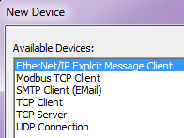
(4) Device Configuration
User Devices
EtherNet/IP Explicit Message Client (e.g. @MyEIPClient)
Used by EIPMSG instruction
Modbus TCP Client (e.g. @MyModTCPClient)
Used by MRX/MWX instructions
SMTP Client (e.g. @MySMTPClient)
Used by EMAIL instruction
TCP Client (e.g. @MyTCPClient)
Uses $MyTCPClient memory structure
Used by OPENTCP, STREAMIN/STREAMOUT instructions
TCP Server (e.g. @MyTCPServer)
Uses $MyTCPServer memory structure
Used by TCPLISTEN, STREAMIN/STREAMOUT instructions
UDP Connection (e.g. @MyUDPConnect)
Uses $MyUDPConnect memory structure
Used by PACKETIN/PACKETOUT instructions

Slide 55
Do-more Architecture (4) Device Configuration – Extra EtherNet/IP Explicit Message Client
Internal Ethernet Port
@MyEIPClient Device interfaces directly to the Internal Ethernet Port handling the EtherNet/IP Explicit Message protocol
@MyEIPClient Device provides interface to the Internal Ethernet Port for the EIPMSG instruction
@MyEIPClient
The EIPMSG instruction uses Do-more memory for parameters
EIPMSG
Do-more Memory

Slide 56
Do-more Architecture (4) Device Configuration – Extra Modbus TCP Client (Master)
Internal Ethernet Port
Modbus TCP Client Configuration:
Timeout
Retries
Inactivity Timeout
@MyModTCPClient Device interfaces directly to the Internal Ethernet Port handling the Modbus TCP protocol
@MyModTCPClient Device provides interface to the Internal Ethernet Port for the MRX/MWX instructions
@MyModTCPClient
MRX/MWX instructions use Do-more memory for parameters
MRX
MWX
Do-more Memory

Slide 57
Do-more Architecture (4) Device Configuration – SMTP Client (Email)
Internal Ethernet Port
SMTP Client Configuration:
SMTP Server IP Address
SMTP Server Port
Timeout
‘From’ Email Address
Authentication
@MySMTPClient Device interfaces directly to the Internal Ethernet Port handling the SMTP protocol
@MySMTPClient Device provides interface to the Internal Ethernet Port for the EMAIL instructions
@MySMTPClient
EMAIL instructions use Do-more memory for parameters
EMAIL
Do-more Memory

Slide 58
Do-more Architecture (4) Device Configuration – TCP Client
Internal Ethernet Port
@MyTCPClient Device interfaces directly to the Internal Ethernet Port handling TCP protocol
@MyTCPClient Device provides interface to the Internal Ethernet Port for the OPENTCP, STREAMIN & STREAMOUT instructions
@MyTCPClient Device provides a uniform interface to the Internal Ethernet Port for the $MyTCPClient Structure
@MyTCPClient
OPENTCP, STREAMIN & STREAMOUT instructions use Do-more memory for parameters
OPENTCP
STREAMIN
STREAMOUT
$MyTCPClient
Do-more Memory

Slide 59
Do-more Architecture (4) Device Configuration – TCP Server
Internal Ethernet Port
TCP Server Configuration:
TCP Port Number
@MyTCPServer Device interfaces directly to the Internal Ethernet Port handling the TCP protocol
@MyTCPServer Device provides interface to the Internal Ethernet Port for the TCPLISTEN, STREAMIN & STREAMOUT instructions
@MyTCPServer Device provides a uniform interface to the Internal Ethernet Port for the $MyTCPServer Structure
@MyTCPServer
TCPLISTEN, STREAMIN & STREAMOUT instructions use Do-more memory for parameters
TCPLISTEN
STREAMIN
STREAMOUT
$MyTCPServer
Do-more Memory

Slide 60
Do-more Architecture (4) Device Configuration – UDP Connection
Internal Ethernet Port
UDP Server Configuration:
UDP Port Number
@MyUDP Device interfaces directly to the Internal Ethernet Port handling the UDP protocol
@MyUDP Device provides interface to the Internal Ethernet Port for the PACKETIN & PACKETOUT instructions
@MyUDP Device provides a uniform interface to the Internal Ethernet Port for the $MyUDP Structure
@MyUDP
PACKETIN & PACKETOUT instructions use Do-more memory for parameters
PACKETIN
PACKETOUT
$MyUDP
Do-more Memory

Slide 61
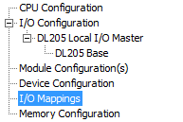
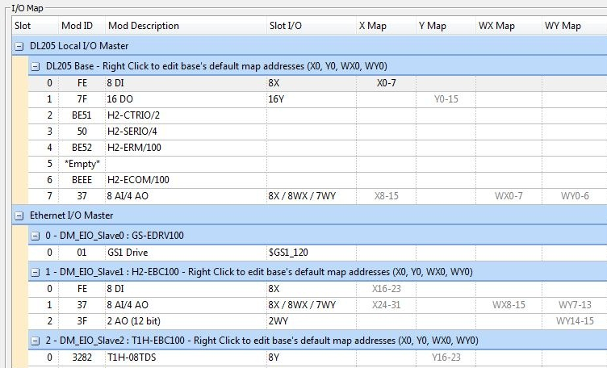
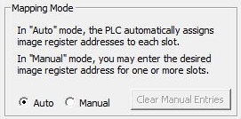
(5) I/O Mappings
Auto mode automatically assigns X/Y/WX/WY addressing in sequential order
Addresses are shown in gray
Manual mode allows editing of the start address for each module
Addresses are shown in black
Address overlaps show in red
Addresses exceeding memory range are bold red
A base’s default map can be changed

Slide 62
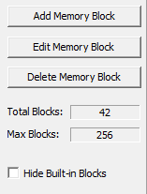
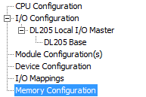
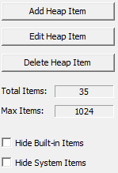
(6) Memory Configuration
Memory Blocks
Indexable
E.g. Fred0, Fred1, Fred2, etc.
Common data type
E.g. bits, numeric, structure
Referenced by name & index
E.g. Fred0, Fred[V15]
Cannot be created while editing ladders
Heap Items (single instance)
Not indexable
E.g. Fred, Wilma, Barney, etc.
Common data type
Structure only
Referenced by name (no index)
E.g. Fred, Wilma, Barney, etc.
Can be created while editing ladders
NOTE: Cannot download in RUN mode (System Configuration changed)

Slide 63
Point #1: Device-centric
Hardware or System Resource
Server
Device
Instruction
Memory

Slide 64
Point #2: Configuration Hierarchy
CPU Configuration
I/O Configuration
Module Configuration(s)
Device Configuration
I/O Mappings
Memory Configuration

