Slide 1
Do-more Technical Training
Designer Links

Slide 2
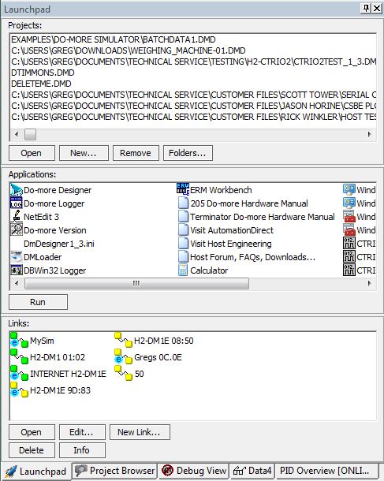
Programming Environment
Utilities
Launchpad
Links
New Link… – create a new link
Ethernet
Serial
USB
Uses HID (Human Interface Devices (no driver required)
Modem

Slide 3
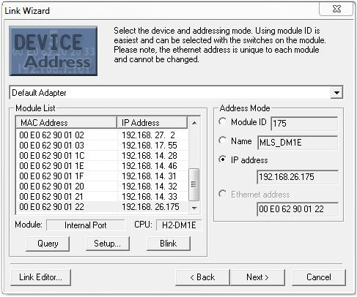
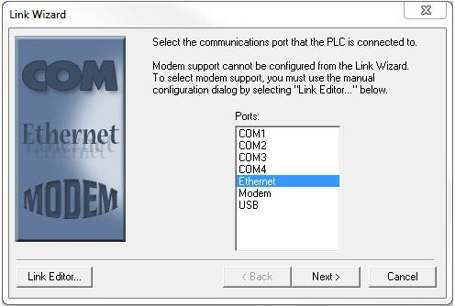
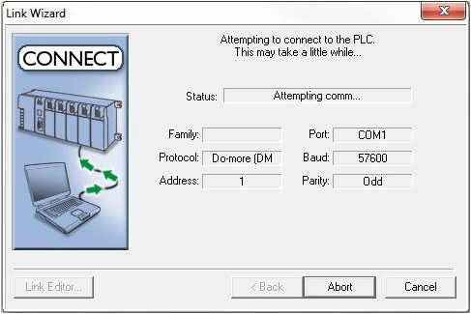
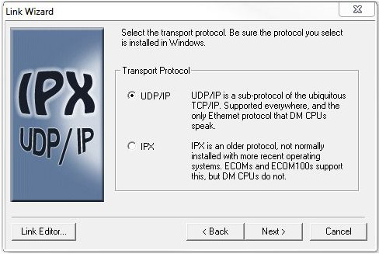
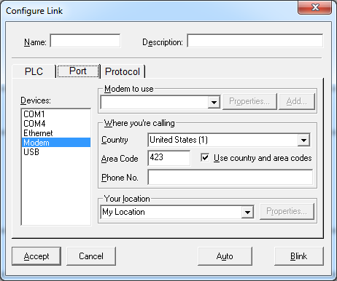
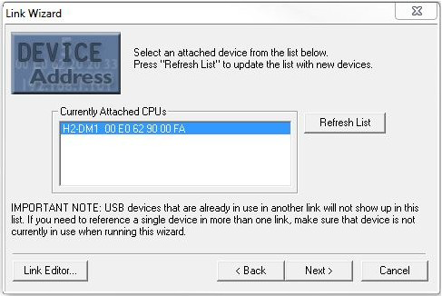
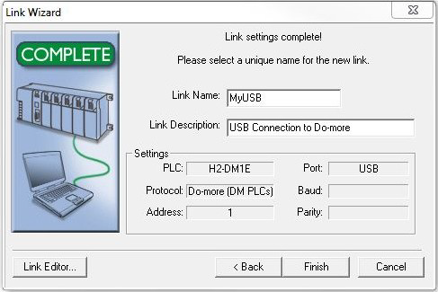
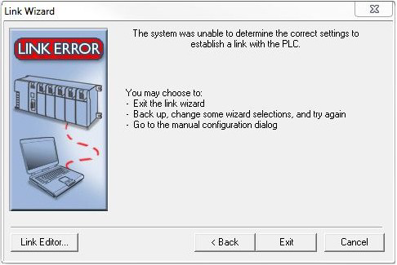
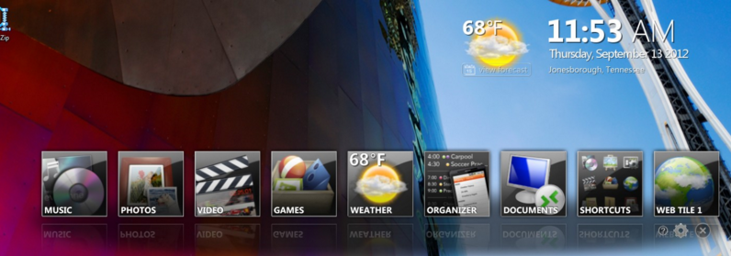
Programming Environment
See Do-more FAQ0025
Utilities
Launchpad
Links
→ Link Wizard
COM1, COM2, etc
Ethernet
UDP/IP
IPX
Pic’-a-NIC
Modem
USB
The DELL Stage Issue

