Slide 1
Do-more Technical Training
Designer Basics

Slide 2
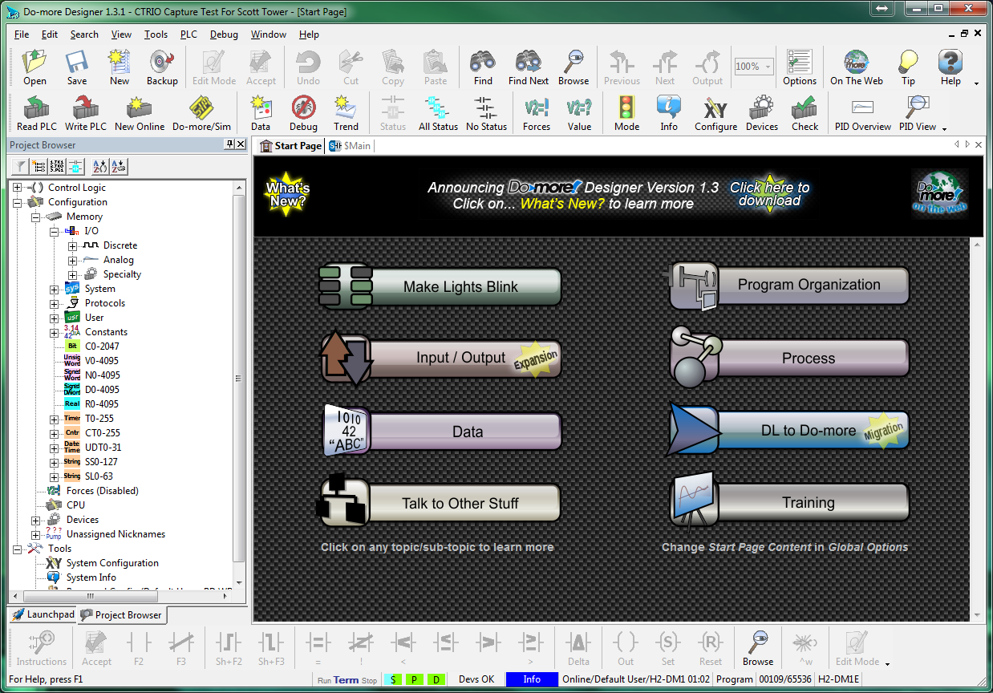
Programming Environment
Toolbar
Utilities
Tabs
Status

Slide 3
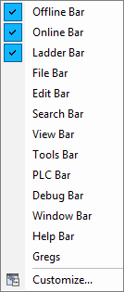
Programming Environment
Toolbars
Offline
Online
Ladder
File
Edit
Search
View
Tools
PLC
Debug
Window
Help

Slide 4
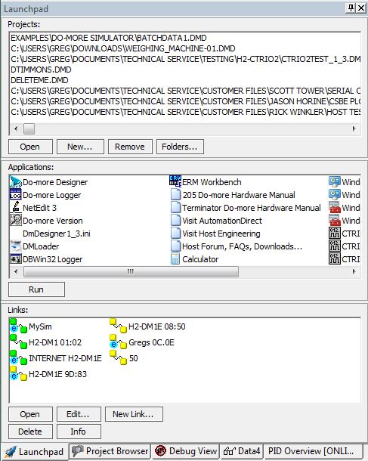
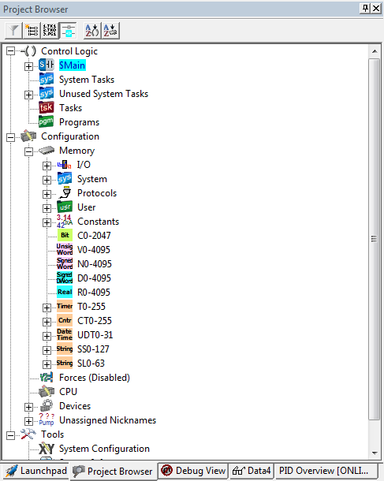
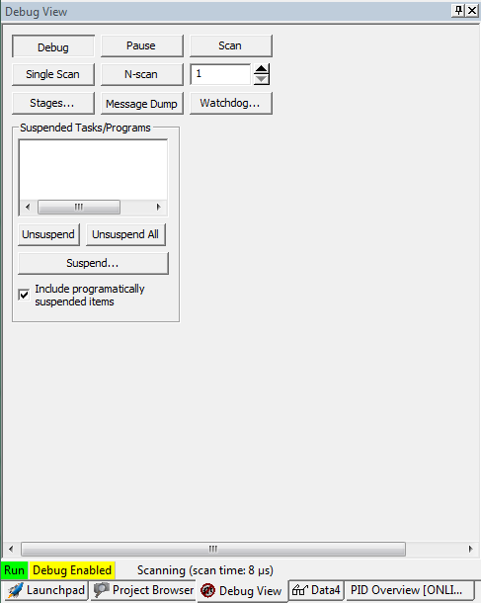
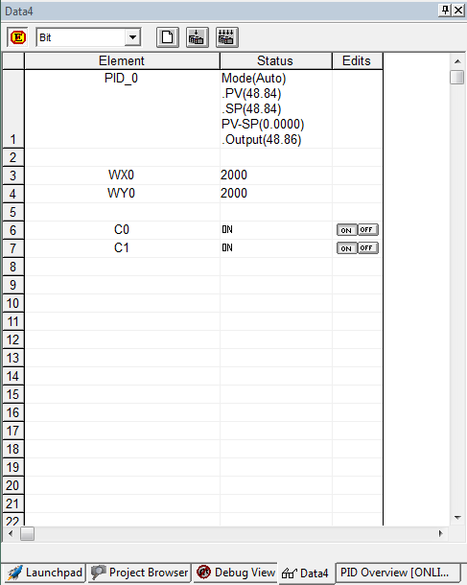
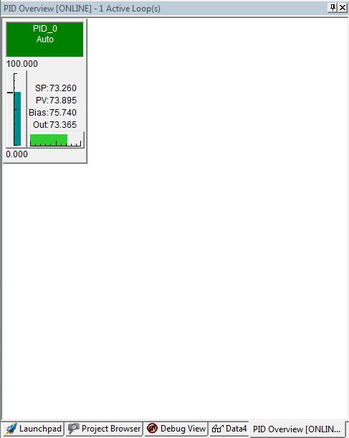
Programming Environment
Utilities
Launchpad
Project Browser
Debug View
Data View
PID Overview

Slide 5
Programming Environment
Utilities
Launchpad
Projects
Applications
Links

Slide 6
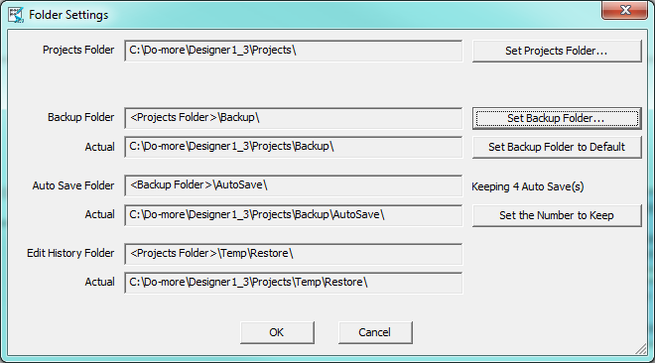
Programming Environment
Utilities
Launchpad
Projects
Remove – Removes project from list and/or from disk
Folders – Change project folder locations

Slide 7
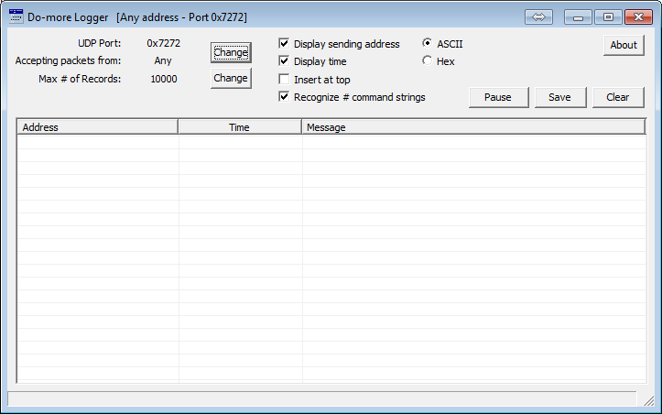
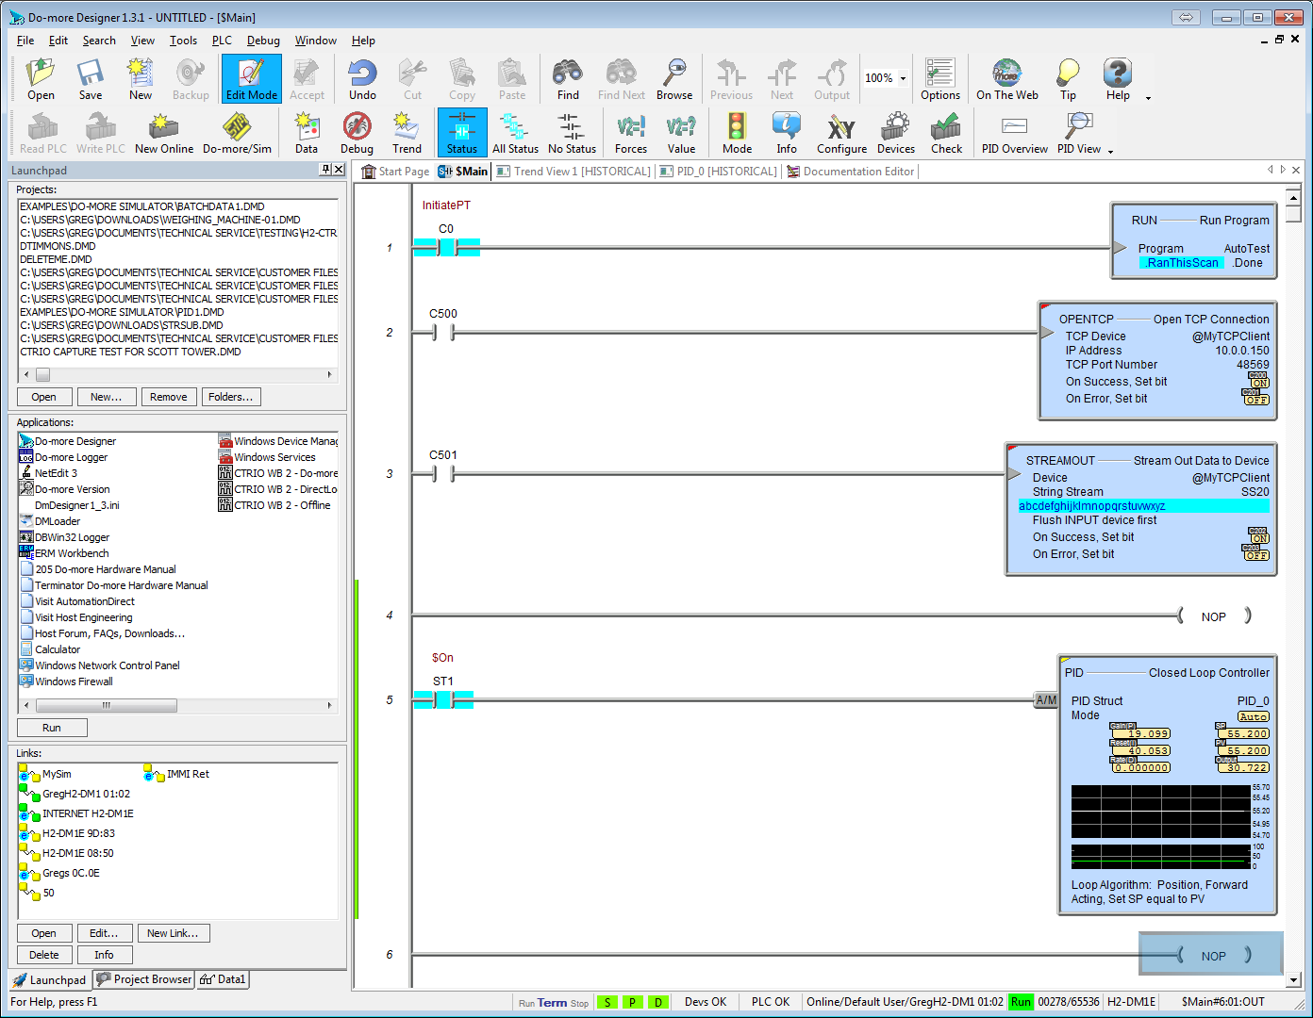
Programming Environment
Utilities
Launchpad
Applications
Do-more Designer
Do-more Logger

Slide 8
Programming Environment
Utilities
Launchpad
Applications
Do-more Designer
Do-more Logger
Displays debug & status messages received from Do-more CPU w/ Ethernet port.
Packets are sent to UDP Port # 7272(hex)
$EnableMsgDump (ST36) = ON to enable
Very handy for troubleshooting EMAIL

Slide 9
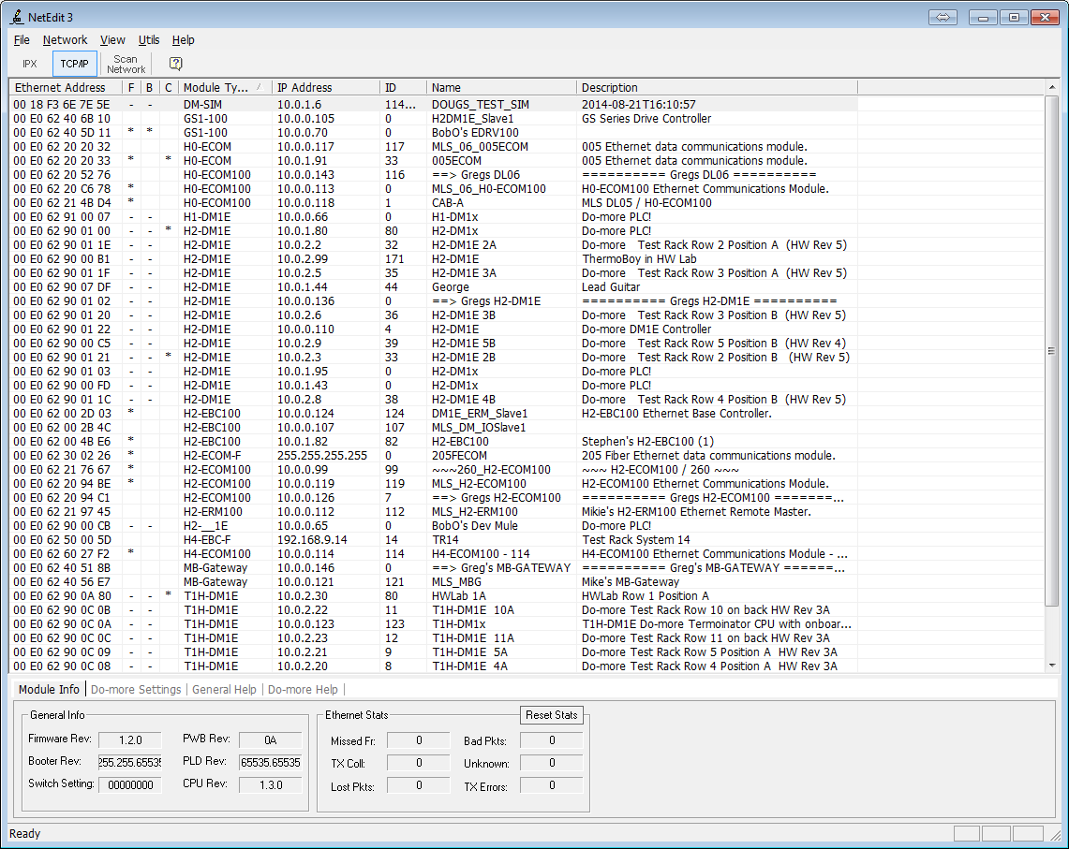
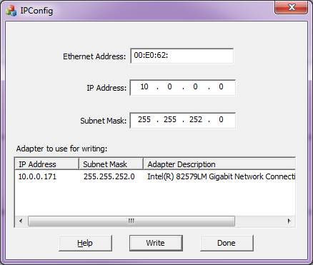
Programming Environment
Utilities
Launchpad
Applications
Do-more Designer
Do-more Logger
NetEdit3
IPConfig
Recover missing Ethernet device (NetEdit can’t see; IPX unavail)
(1) Select Adapter at bottom
(2) Get MAC address from device’s label
(3) Enter MAC address in “Ethernet Address”
(4) Enter “IP Address” you want missing device to have (must be on PC’s subnet)
(5) “Subnet Mask” got set when Adapter was selected (but you can change it)
(6) Press <Write> button → “Cool! Found device!” or “Sorry! Unable to find device!”

Slide 10
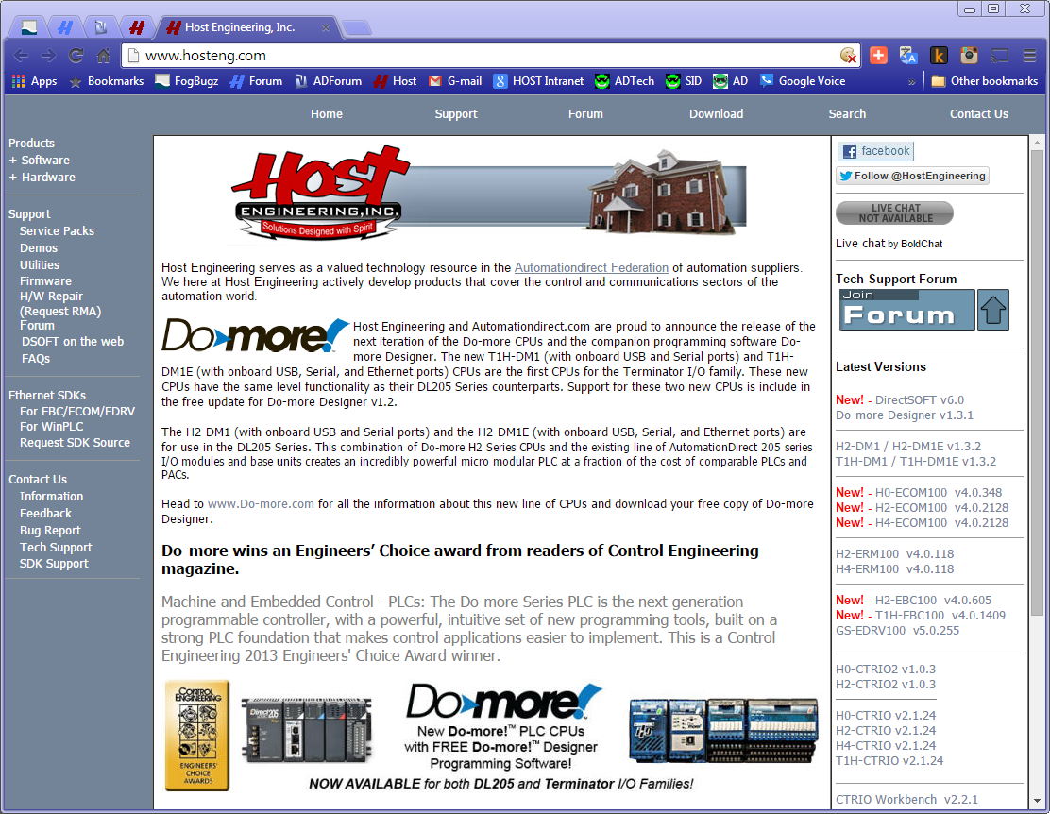
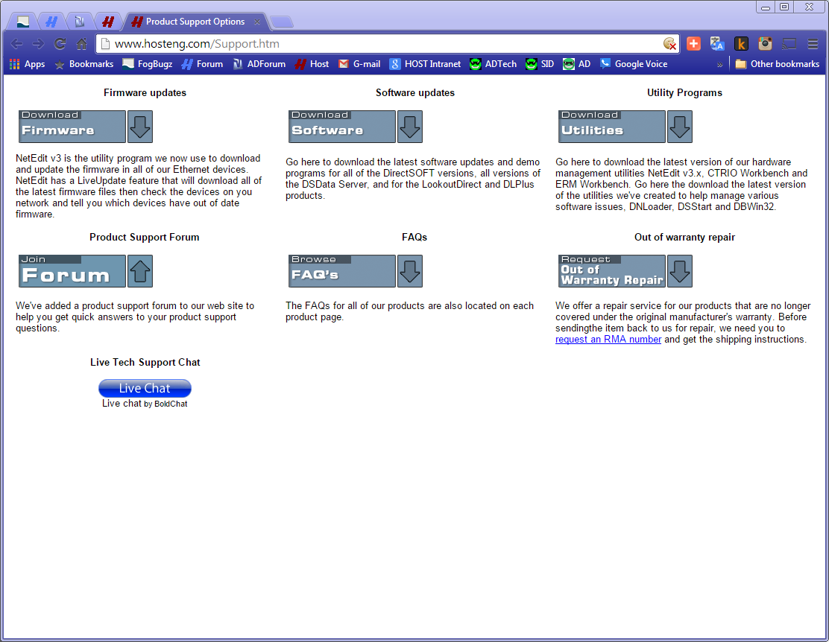
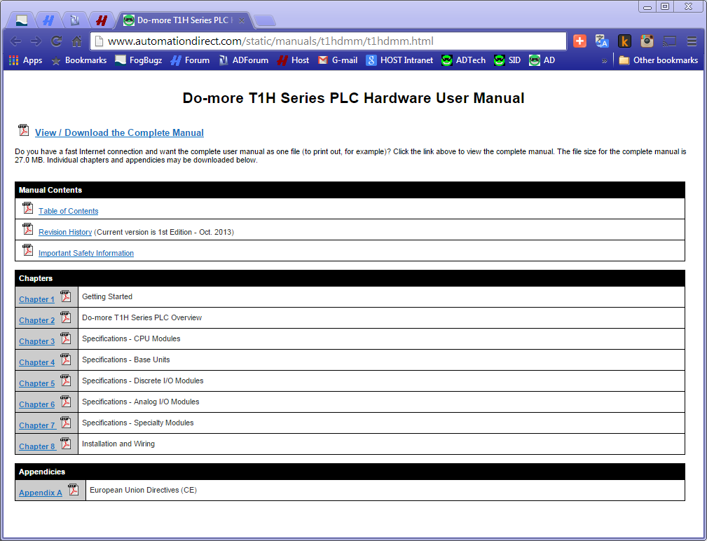
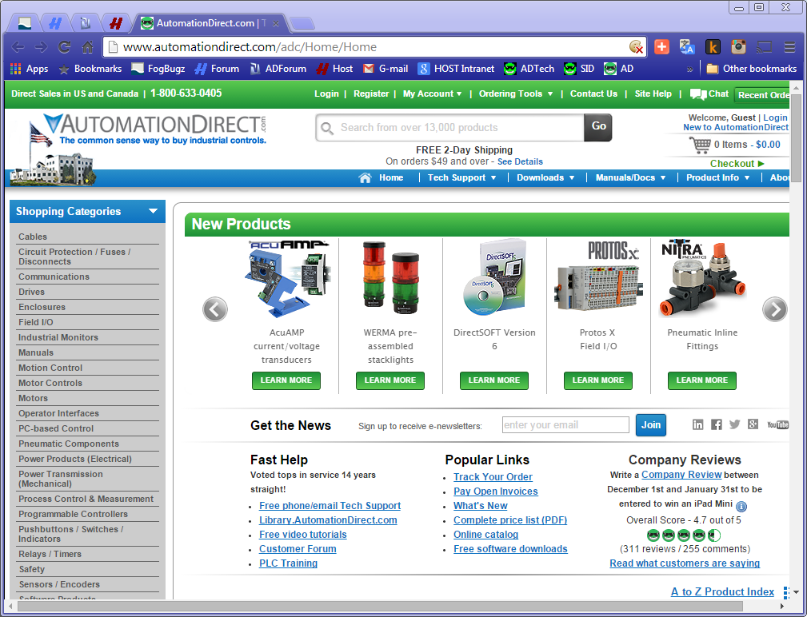
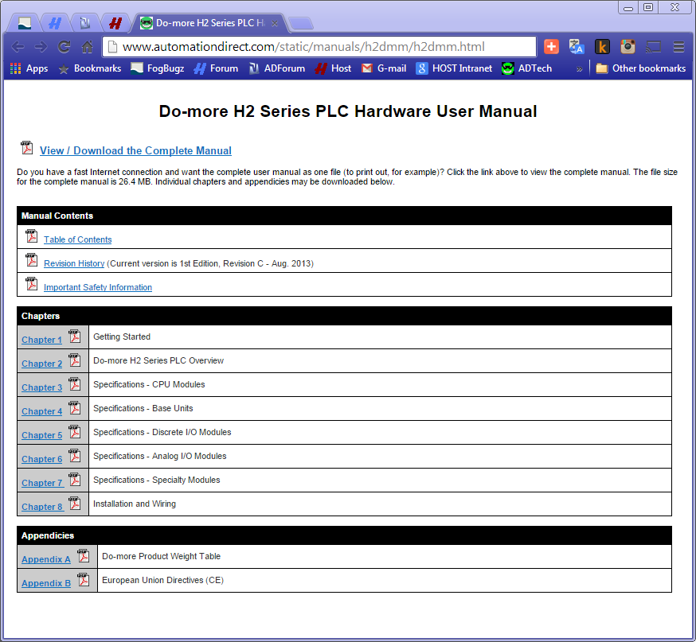
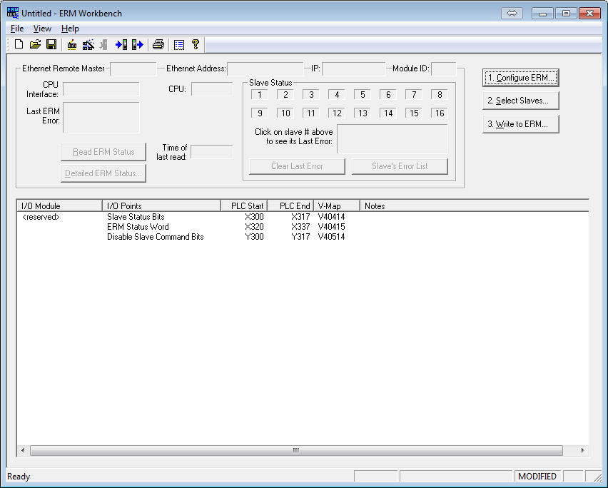
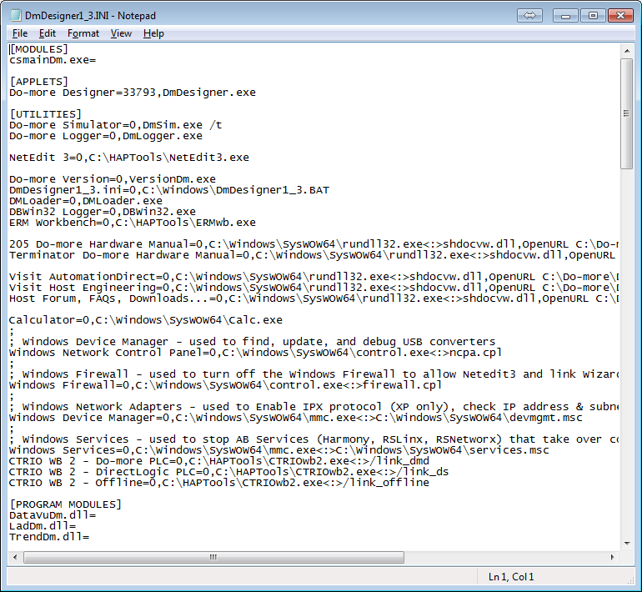
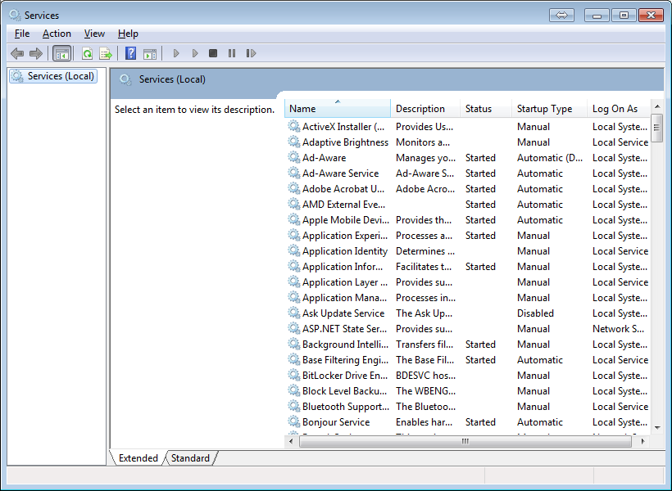
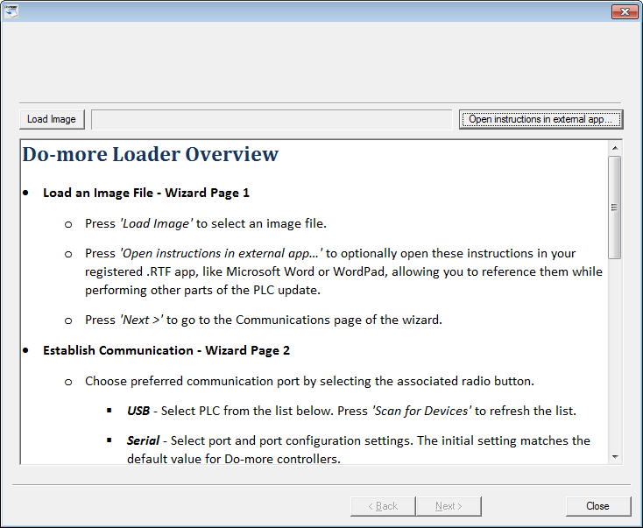
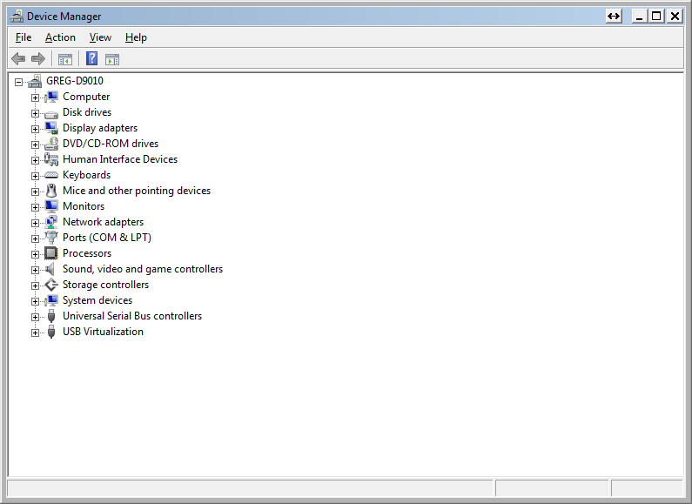
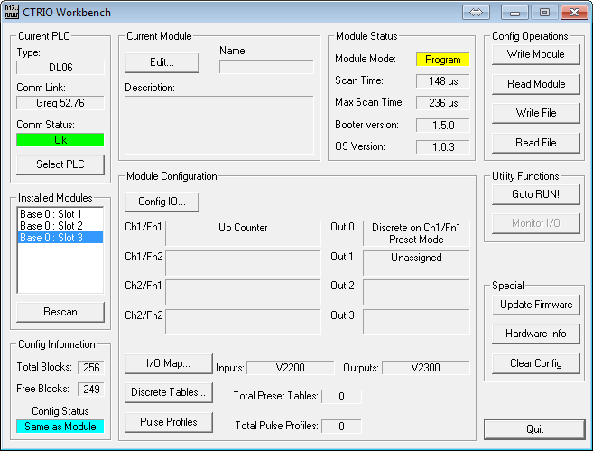
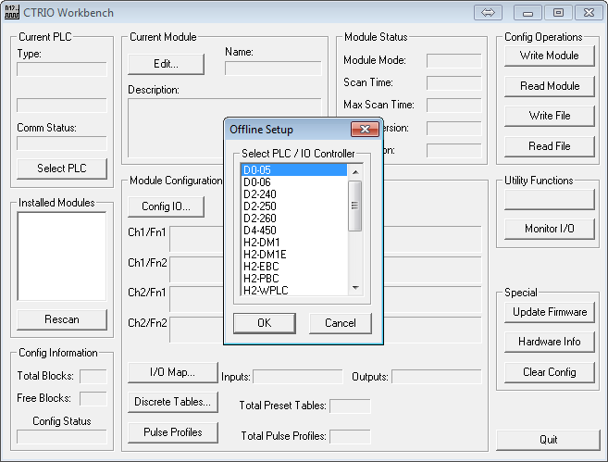
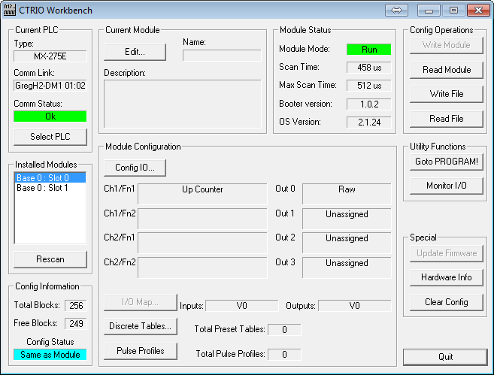
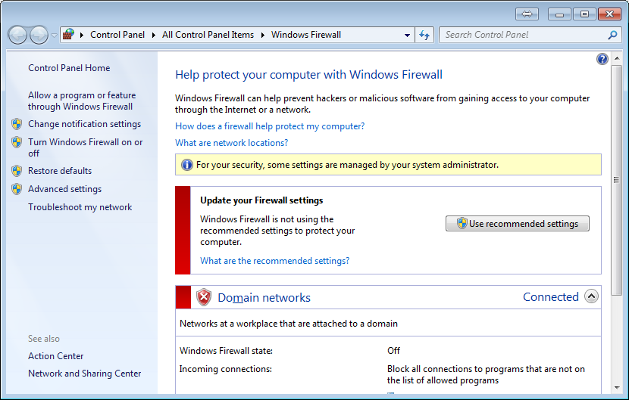
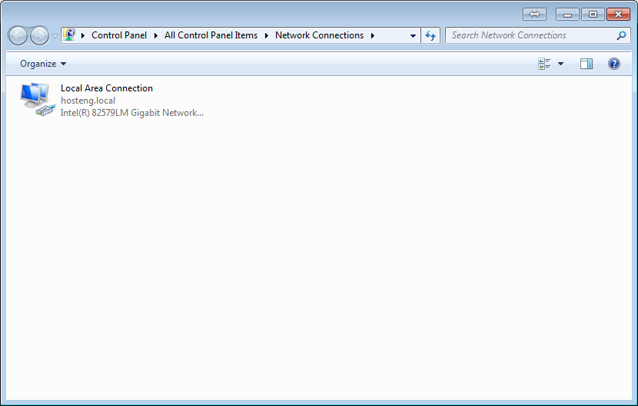
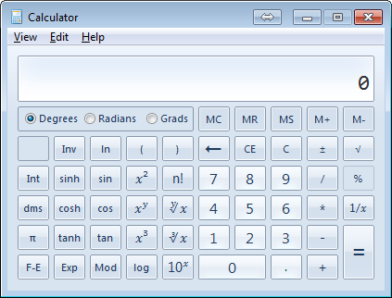
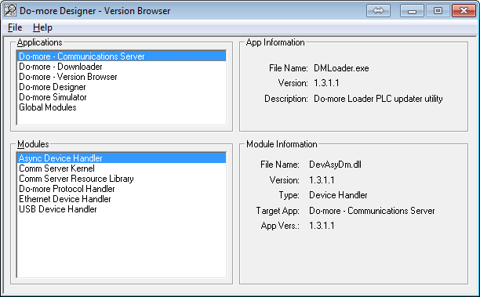
Programming Environment
Utilities
Launchpad
Applications
Do-more Designer
Do-more Logger
NetEdit3
IPConfig
Do-more Version
DmDesigner1_3.ini
DMLoader
DBWin32Logger
ERM Workbench
205 Do-more Hardware Manual
Terminator Do-more Manual
Visit AutomationDirect
Visit Host Engineering
Host Forum, FAQs, Downloads…
Calculator
Windows Network Control Panel
Windows Firewall
Windows Device Manager
Windows Services
CTRIO WB 2 – Do-more PLC
CTRIO WB 2 – DirectcLogic PLC
CTRIO WB 2 – Offline

Slide 11
Programming Environment
Utilities
Project Browser
Control Logic
Configuration
- Control Logic Filter
- New Code Block
- Execution Order
- Status
- Sort Code Blocks
- Sort Memory

Slide 12
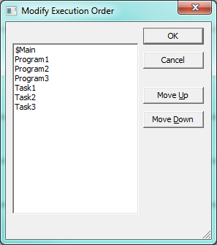
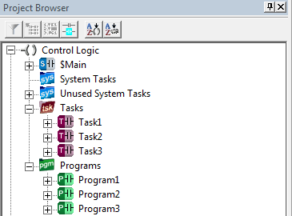
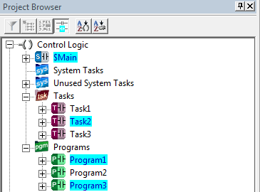
Programming Environment
Utilities
Project Browser
BUTTONS
- Execution Order
- Status

Slide 13
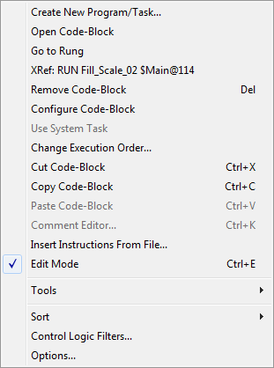
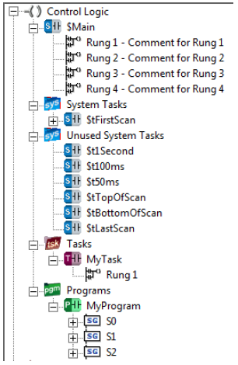
Programming Environment
Utilities
Project Browser
Control Logic
Shows all Programs & Tasks
Programs expand to show Rungs & Stages
Tasks expand to show Rungs
Shows first line of Comment
Double-click opens code block in Ladder View
When in Edit Mode, right-click on code block allows many functions (e.g. create, remove, etc.)

Slide 14
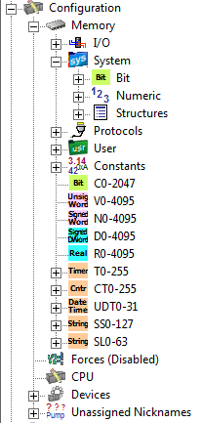
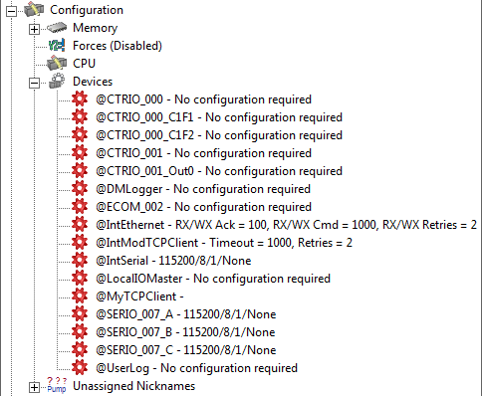
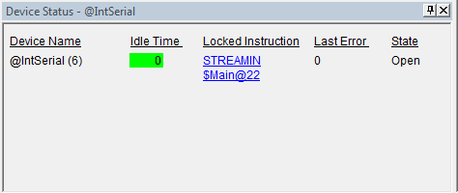
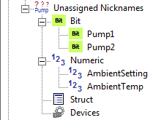
Programming Environment
Utilities
Project Browser
Configuration: lists Data Blocks, Heap Items & Devices
Memory – all memory types in System Configuration
Devices – all system-created & user-created Devices in System Configuration, e.g.
@CTRIO_001_C1F1
@IntEthernet
@IntModTCPClient
Unassigned Nicknames – any Nicknames not yet assigned to actual memory
Notes:
Have them open the Memory section
Do System Configuration and configure the internal serial port to “General Purpose”
Enter a STREAMIN (with Network Timeout set to 10 seconds)
Enable STREAMIN (pull up the Device Status) to show the hotlink

Slide 15
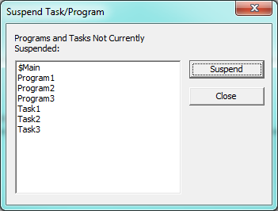
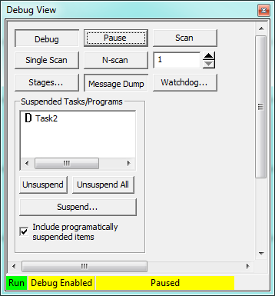
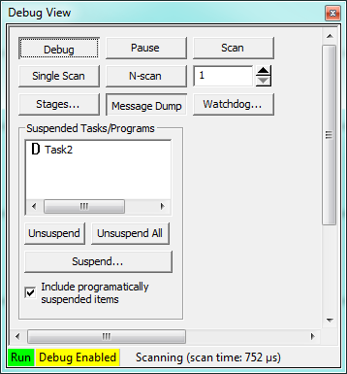
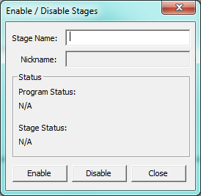
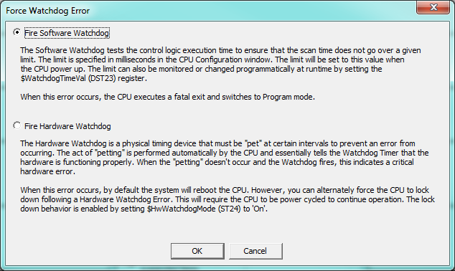
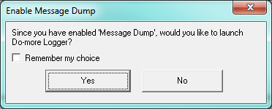
Programming Environment
Utilities
Debug View
Debug – enable
Pause – stops scan
Scan – starts scan
Single Scan – runs one scan then pauses
N-Scan – runs # of scans then pauses
Stages – enable/disable
Message Dump – enable to Do-more Logger app; sets $EnableMsgDump (ST36) = ON
Watchdog… - test hardware or software watchdog
Unsuspend, Unsuspend All, Suspend… - manually for Program or Task
Notes:
Enter INC D0
Put D0 in Data View to watch it increment
Put $EnableDebug (ST33) in Data View
Pull up Debug → Debug View
Notice you can turn ST33 ON or OFF in Data View or in Debug View
Turn it ON
<Pause> … D0 stops incrementing
<Scan> … D0 increments again
<Pause> … D0 stops incrementing
<Single Scan> … D0 increments once
Enter 10 into the N-scan variable
<N-scan> … D0 increments 10 times
Create MyTask task
Program INC D1
Back in $Main, enter C0 to ENTASK “MyTask” (power flow, not edge)
C0 = ON … D1 increments
Debug mode
<Pause> … D0 & D1 stop incrementing
<Single Scan> … D0 & D1 increment by 1
<Scan> … D0 & D1 incrementing
<Suspend…> MyTask … D1 stops incrementing (D0 keeps incrementing), MyTask is listed as suspended
In Project Browser, MyTask (with status ON) shows yellow
Select MyTask in Debug View, <Unsuspend> … D0 & D1 both incrementing
Exit Debug

Slide 16
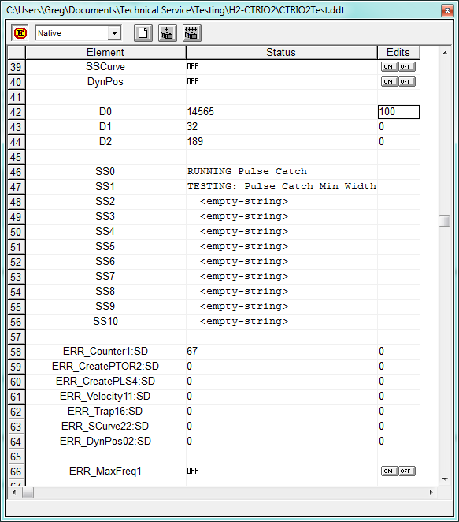
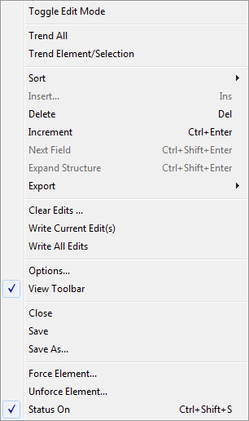
Programming Environment
Utilities
Data View
Right-click

Slide 17
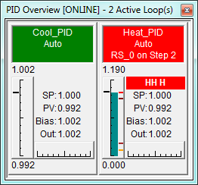
Programming Environment
Utilities
PID Overview

Slide 18
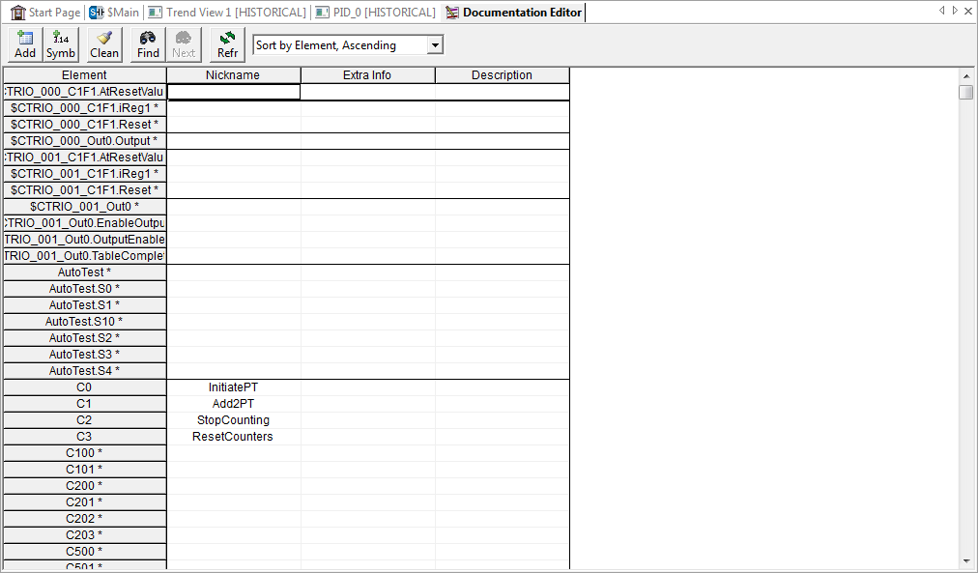
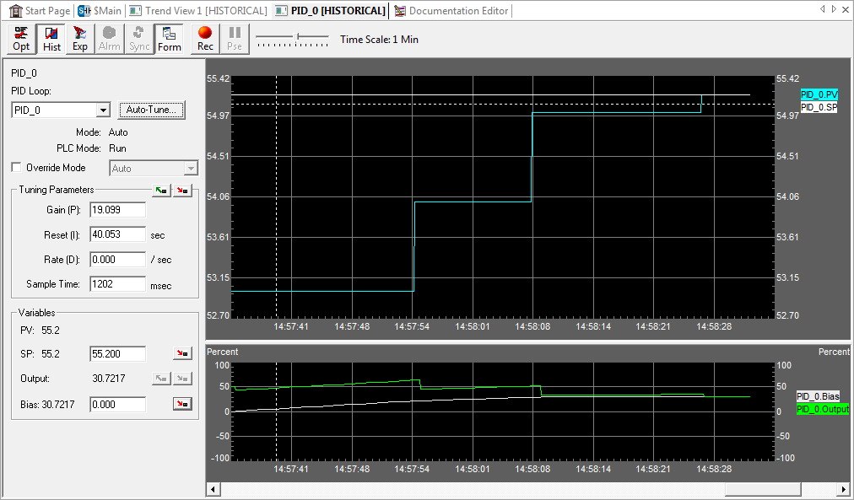
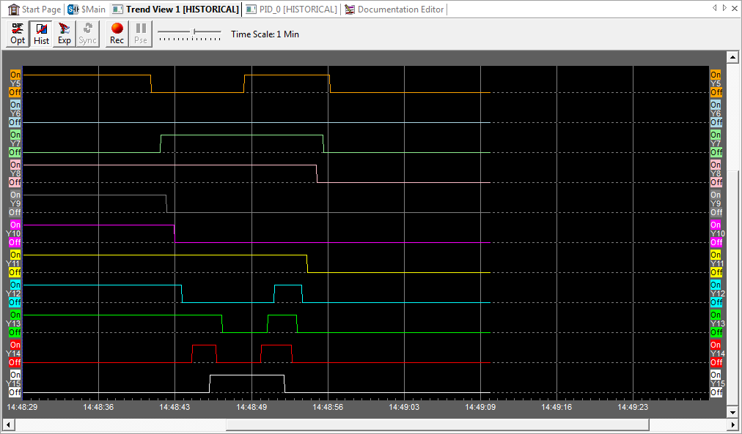
Programming Environment
Tabs
Top
Start Page
Ladder Views
Trend Views
PID Views
Documentation Editor
Bottom (dock/float)
Cross Reference View
Output Window

Slide 19
Programming Environment
Tabs
Top
Start Page (Global)
Customizable

Slide 20
Programming Environment
Tabs
Top
Ladder View
Individual tabs
Re-orderable tabs
Scroll (arrows/wheel)
Search → Find (CTRL-F)
Search → Goto (CTRL-G)
View → Options → Ladder
Hover Element (Xref w/links)
Hover Instruction (Help w/links)
View → Themes…
View → Color Setup…
Split screen bar
Window → New Window, Cascade, Tile Horizontally, Tile Vertically, Arrange Icons
Window → Default Layout (Recover!)
View → Zoom In / Zoom Out (buttons / toolbar)

Slide 21
Programming Environment
Tabs
Top
Ladder View
Status bar
Project Differences (hover)
S = System Configuration
P = Program
D = Documentation
Colors
Green: not saved to disk
Cyan: not saved to PLC
Program Usage
Used / Available
Click for System Information
Cursor Location
<CodeBlock>#<Rung>:<Row>:<Column>

Slide 22
Programming Environment
Tabs
Top
Trend View
Logging / Historical
Panes:
Discrete
Integers / Real
Crosshair cursor
Click for snapshot
Zoom: CTRL + wheel
Buttons:
Opt – Trend View Options
Hist – Toggle historical mode
Exp – Export range of data points
Sync – Synchronize time
Rec – Record data to a file
Pse – Pause recording
Time Scale slider (500ms to 1 hour)
Notes:
Have them program a RAMPSOAK and use a system toggle bit (i.e. ST4 ($1second))
Pull up Data View with pertinent parameters
Right-click on Data View and select Trend All
Play with various things in Trend View

Slide 23
Programming Environment
Tabs
Top
PID View
Configuration, tuning & monitoring
3 panes
Data form
PV / SP trend
Output / Bias trend

Slide 24
Programming Environment
Tabs
Top
Documentation Editor
Saved in the PLC
PLC → System Information → Memory Usage box shows Max Documentation & Documentation Used
Displays only used
Element: program element
(*) no documentation
Nickname: 16 characters
Extra Info: 16 characters
Description: 132 characters
CTRL-Enter manual line break
Buttons:
Add Record
Add Sym Const – e.g. PI = 3.14159
Clean Database – remove records not being used
Find
Find Again

Slide 25
Programming Environment
Tabs
Bottom
Dockable / Floatable
Cross Reference View
Tools → Cross Reference… or CTRL-Y
Modes:
(1) Xref mode
(2) Usage mode

Slide 26
Programming Environment
Tabs
Bottom
Dockable / Floatable
Cross Reference View
Modes:
(1) Xref mode
Element
Extended Info – Structure member / Casting
Access Type – Input, Output, In/Out
Address - <CodeBlock>@<Address>
Instruction
Parameter Info – Instruction’s parameter
Double-click places cursor

Slide 27
Programming Environment
Tabs
Bottom
Dockable / Floatable
Cross Reference View
Modes:
(1) Xref mode
Buttons
Follow Ladder Cursor
Point Scope – Ladder View cursor itself
Instruction Scope – Ladder View instruction
Rung Scope – Ladder View rung
Block Scope – Ladder View code block
Full Scope – Entire project
Include Bits
Include Numerics
Include Structures
Include Devices
Include Inputs
Include Outputs
Expand – include range entries (e.g. SETR “C100 thru C120”)
Sort order – Element, Nickname, Data-Block/Number ID

Slide 28
Programming Environment
Tabs
Bottom
Dockable / Floatable
Cross Reference View
Modes:
(2) Usage mode
Buttons
Follow Ladder Cursor
Reverse Usage
Field Size 8
Field Size 10
Field Size 16
X = explicit use
[ = start range
] = end range
– = inside range

Slide 29
Programming Environment
Tabs
Bottom
Dockable / Floatable
Output Window
Displays errors, warnings & info
Can be activated by:
Edit → Accept
PLC → Program Check
File → Import
Search → Replace…
Changes to System Configuration
After PID Auto-tune
Connecting to PLC
Filter Buttons: Error, Warning, Message

Slide 30
Programming Environment
Status Bar
FUNCTION | POSSIBLE VALUES | APPEARANCE
Writing to PLC | N/A
PLC writing ROM | N/A
PLC Mode Switch | Run, Term, Stop
Force status | Forces, Forces Suspended
Project/PLC sync | System (S), Program (P), Documentation (D)
Device status | Devs OK, Device Error
PLC status | PLC OK, Info, Warning, Error
Session status | Online-Offline/<user>/<link>
PLC mode | Run, Program
Memory usage | Program: <current>/<total>
PLC type | e.g. H2-DM1E
Cursor position | <CodeBlock>#<Rung>:<Row>:<Column>

