Slide 1
Do-more Technical Training
Communication
(Time Sync)

Slide 2
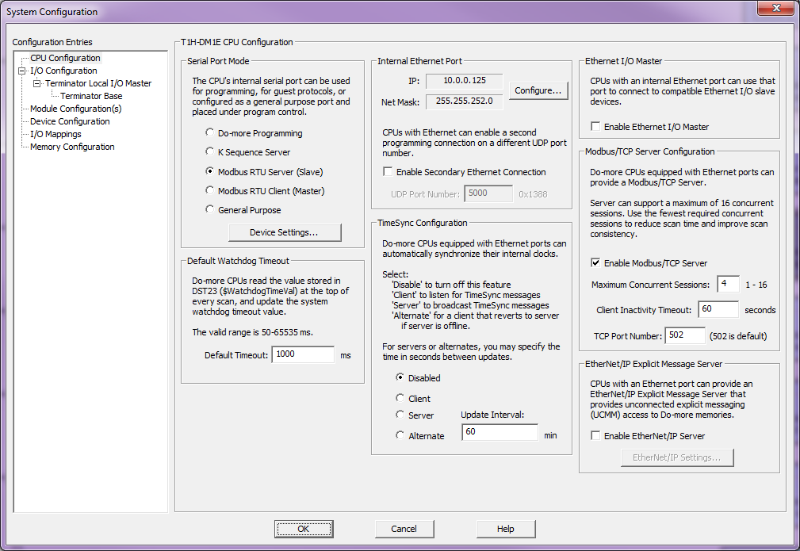
Communication (Time Sync)
CPU Configuration
TimeSync Configuration
Notes:
Launchpad: nothing new here
Project Browser:
Buttons
Control Logic Filter – Display filter
New Code Block – Create new code blocks
Execution Order – Change execution order of blocks
Status – Shows which blocks are enabled to run
Sort Code Blocks – Change display order
Sort Memory – Change display order
Control Logic
Configuration
Tools
Debug View
NOTE: Message Dump – enables dump to Do-more Logger, $EnableMsgDump (ST36)
Data View
PID Overview

Slide 3
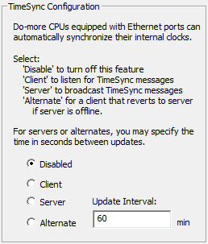
Communication (Time Sync)
TimeSync Configuration
Automatic time sync network
1 server
1 or more alternate server(s)
1 or more client(s)
TCP/IP broadcast (network domain)
Disabled: default
Client:
Listens for server’s time-sync packet
If heard →
$TimeSynced (ST23) = ON
Sets real-time clock
Keeps listening (times down from Update Interval)
If Update Interval times out →
$TimeSynced (ST23) = OFF
Keeps listening (times down from Update Interval)
Server: transmits 3 time-sync packets (5 second intervals) every Update Interval)
Alternate:
Normally a Client
If Update Interval times out + 15 seconds →
Becomes the new Server
Update Interval: 0 – 32,767 minutes (22 days)
Notes:
Launchpad: nothing new here
Project Browser:
Buttons
Control Logic Filter – Display filter
New Code Block – Create new code blocks
Execution Order – Change execution order of blocks
Status – Shows which blocks are enabled to run
Sort Code Blocks – Change display order
Sort Memory – Change display order
Control Logic
Configuration
Tools
Debug View
NOTE: Message Dump – enables dump to Do-more Logger, $EnableMsgDump (ST36)
Data View
PID Overview

Slide 4
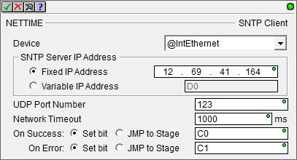
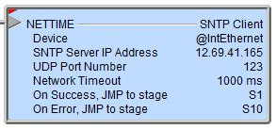
Onboard Clock
Automatic Setting:
NETTIME “SNTP Client” instruction
Retrieves date/time from an SNTP (Simple Network Time Protocol) Server & stored in $UTC (DST21)
Parameters:
Device – onboard Ethernet port
SNTP Server IP Address
Fixed IP Address – IP address of SNTP Server
Variable IP Address – (32-bit word) variable IP address of SNTP Server commonly obtained by DNSLOOKUP “Name to IP Address” instruction
UDP Port Number – SNTP Protocol default is 123
Network Timeout – 1 to 65.535 seconds
On Success, On Error – Action to take
Instruction is leading-edge triggered
NOTE: NTP protocol is not supported
Notes:
* Program NETTIME using Richard’s SNTP server IP address (10.1.1.8)

Slide 5
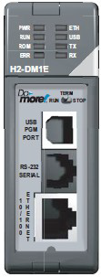
Communication (Time Sync)
Update Interval timesout (60 seconds)
Server
TimeSync
Broadcast
Client 1
Client 2
1 Server
Repeats 2 more times at 5-sec intervals
15-Feb-2016
2:02:23 PM
$TimeSynced = OFF
15-Feb-2016
2:02:23 PM
$TimeSynced = OFF
15-Feb-2016
2:01:01 PM
$TimeSynced = OFF
15-Feb-2016
2:01:15 PM
$TimeSynced = OFF
15-Feb-2016
2:02:38 PM
$TimeSynced = ON
15-Feb-2016
2:02:38 PM
$TimeSynced = ON
15-Feb-2016
2:02:38 PM
$TimeSynced = OFF
15-Feb-2016
2:02:38 PM
$TimeSynced = OFF
15-Feb-2016
2:01:23 PM
$TimeSynced = ON
15-Feb-2016
2:01:23 PM
$TimeSynced = ON
15-Feb-2016
2:01:23 PM
Repeats 2 more times at 5-sec intervals
Update Interval timesout (60 seconds)
Server drops offline for some reason
Update Interval timesout (60 seconds)
Alt
15 seconds more pass
Client 3
Update
Time
1 Alternate Server
15-Feb-2016
2:02:23 PM
$TimeSynced = OFF
15-Feb-2016
2:01:20 PM
$TimeSynced = OFF
TimeSync
Broadcast
15-Feb-2016
2:02:38 PM
$TimeSynced = ON
15-Feb-2016
2:02:38 PM
$TimeSynced = OFF
15-Feb-2016
2:01:23 PM
$TimeSynced = ON
15-Feb-2016
2:02:23 PM
$TimeSynced = OFF
15-Feb-2016
2:01:21 PM
$TimeSynced = OFF
15-Feb-2016
2:02:38 PM
$TimeSynced = OFF
15-Feb-2016
2:01:23 PM
$TimeSynced = ON
Update Interval timesout (60 seconds)
Update
Time
15-Feb-2016
2:02:38 PM
Notes:
Launchpad: nothing new here
Project Browser:
Buttons
Control Logic Filter – Display filter
New Code Block – Create new code blocks
Execution Order – Change execution order of blocks
Status – Shows which blocks are enabled to run
Sort Code Blocks – Change display order
Sort Memory – Change display order
Control Logic
Configuration
Tools
Debug View
NOTE: Message Dump – enables dump to Do-more Logger, $EnableMsgDump (ST36)
Data View
PID Overview

