Slide 1
Do-more Technical Training
Communications
(PEERLINK)

Slide 2
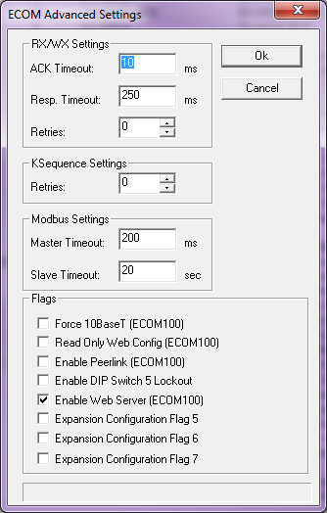
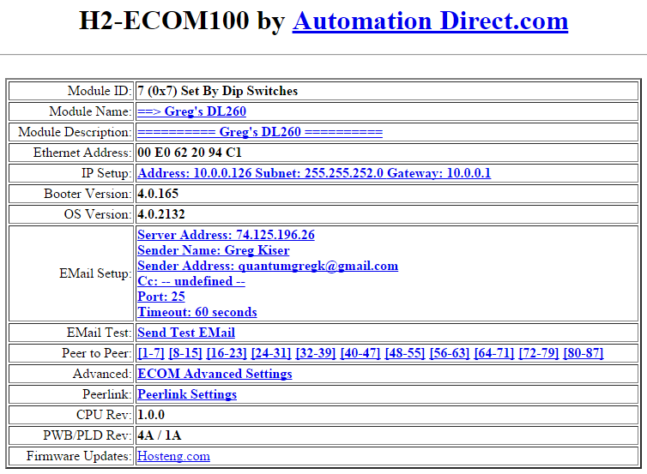
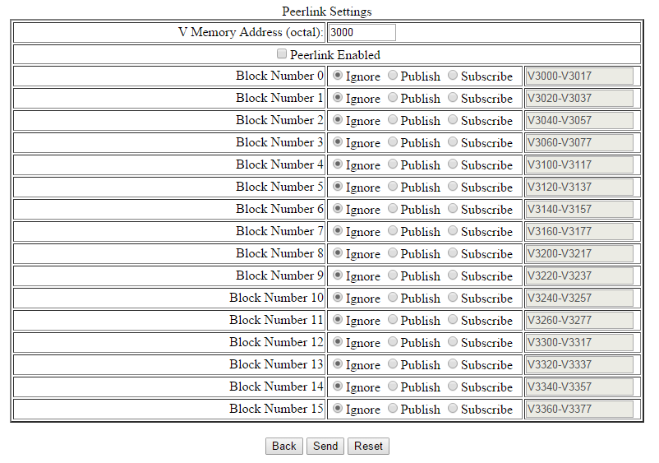
Communications – PEERLINK
Peerlink communications network
Data-sharing of 16 blocks of 16 words each
Uses broadcasts at a rate of 10Hz
Network can consist of:
EASY! Do-more PLC w/built-in Ethernet port
Uses only one PEERLINK instruction in $Main
Utilizes built-in PL-memory (PL0-255)
DL-PLC w/ECOM100
Peerlink configured via ECOM100’s web server (not NetEdit)
Peerlink blocks mapped to V-memory as configured
Do-more PLC w/ECOM100 (not recommended)
Does NOT use PEERLINK instruction
Peerlink configured via ECOM100’s web server
Peerlink blocks mapped to DLV-memory as configured
Must turn the ECOM100’s Web Server ON using NetEdit3
Notes:
- Use Internet Explorer and log into ECOM100 and show the Peerlink Configuration

Slide 3
Communications – PEERLINK
Peerlink communications network
Concepts:
Publish – analogous to send / write
Subscribe – analogous to receive / read
These terms have nothing to do with the PUBLISH & SUBSCRIB instructions
Blocks (256 unsigned 16-bit words):
Block0: PL0-15 Block8: PL128-143
Block1: PL16-31 Block9: PL144-159
Block2: PL32-47 Block10: PL160-175
Block3: PL48-63 Block11: PL176-191
Block4: PL64-79 Block12: PL192-207
Block5: PL80-95 Block13: PL208-223
Block6: PL96-111 Block14: PL224-239
Block7: PL112-127 Block15: PL240-255

Slide 4
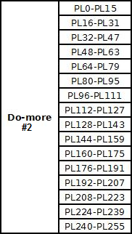
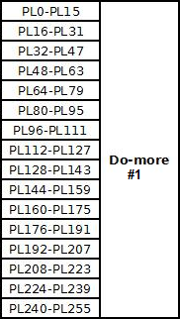
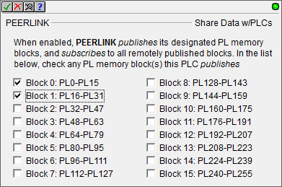
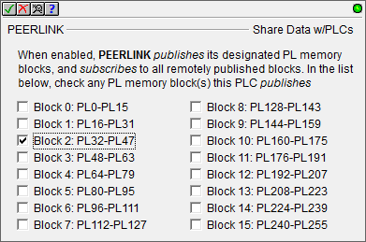
Communications – PEERLINK
Peerlink communications network
Do-more #1 publishes Block #2
Do-more #2 hears & puts data in its Block #2
Do-more #2 publishes Blocks #0 & #1
Do-more #1 hears & puts data in its Blocks #0 & #1

Slide 5
Communications – PEERLINK
PEERLINK “Share Data w/PLCs”
Fully asynchronous (red triangle)
Parameters:
Blocks – check which blocks to publish
Input Leg:
ON → Publishes at 10 Hz; listens for other blocks
OFF → No publishing; no listening
PL: Peerlink Header Structure (next slide)

Slide 6
Communications – PEERLINK
PEERLINK “Share Data w/PLCs”
PL: Peerlink Header Structure
B0Act-B15Act (bit)
ON: Block publishing or receiving
OFF:
Block not published
Block published; PEERLINK OFF
Block published; PLC in Program
Active (word) – 16 Active bits; 1/Block
B0Err-B15Err (bit)
ON: Configuration error (>1 device publishing Block)
OFF: No error
Error (word) – 16 Error bits; 1/Block
B0Updated-B15Updated (bit)
ON: New data for Block this scan
OFF: No data change since last scan
Updated (word) – 16 Update bits; 1/Block
MyBlocks (word) – 16 Publishing bits; 1/Block
B0Inh-B15Inh (bit)
ON: prevents updating of Block
OFF: allows updating of Block
Inhibit (word) – 16 Inhibit bits; 1/Block
Enabled (bit) – PEERLINK publishing
B0Rate-B15Rate (word) – transfers per second

Slide 7
Communications – PEERLINK
PEERLINK “Share Data w/PLCs”
Status:
Offline – input leg OFF
Subscribe Only – not configured to publish any blocks
Connecting… - input leg coming ON; gathering data for nodes (1-2 seconds)
Disconnecting… - input leg going OFF; closing connections (1-2 seconds)

Slide 8
Communications – PEERLINK
PEERLINK “Share Data w/PLCs”
Status:
Green background: normal speed (>7 pkts/sec). Blocks 0, 1, 3, 5, 6 & 15
Yellow background: slow speed (4-7 pkts/sec). Block 2
Red background: very slow speed (<3 pkts/sec). Block 4
No highlight & grayed #: no packets publishing to this Block. Blocks 7, 9, 10, 11, 12, 13 & 14
Bold box outline: Blocks published by this PEERLINK instruction. Block 0
Any highlight w/Grayed #: updates to this block are inhibited. Blocks 3 & 5
PEERLINK publishing the Block, Inhibit prevents publishing of that Block
PEERLINK listening to Block, Inhibit prevents that Block from being updated
Red Circle w/Slash: more than one device on the Peerlink network is publishing to this block (configuration error). Block 8

Slide 9
Communications – PEERLINK
Peerlink Publishing
Peerlink Subscribing
Do-more CPU
Do-more CPU
PL0-255
PEERLINK
Peerlink Device
UDP
Peerlink Device
PEERLINK
PL0-255
Peerlink Publishing
Peerlink Subscribing
Do-more CPU
E
C
O
M
1
0
0
Do-more CPU
PL0-255
Peerlink Config
Peerlink Device
UDP
@ECOM_001
DLV
PEERLINK
Peerlink Publishing
Peerlink Subscribing
In this case a PEERLINK instruction is not necessary because the ECOM100 is subscribing and writing to “V” (i.e. DLV)
Do-more CPU
E
C
O
M
1
0
0
DL-CPU
PL0-255
Peerlink Config
Peerlink Device
UDP
V-memory
PEERLINK

Slide 10
Communications – PEERLINK
Peerlink Publishing
Peerlink Subscribing
Do-more CPU
E
C
O
M
1
0
0
Do-more CPU
Peerlink Config
PEERLINK
DLV
@ECOM_001
UDP
Peerlink Device
PL0-255
Peerlink Publishing
Peerlink Subscribing
Do-more CPU
In all these cases a PEERLINK instruction is not necessary for publishing because the ECOM100 is doing that itself
E
C
O
M
1
0
0
E
C
O
M
1
0
0
Do-more CPU
Peerlink Config
Peerlink Config
DLV
DL Server
UDP
@ECOM_001
DLV
Peerlink Publishing
Peerlink Subscribing
In this case a PEERLINK instruction is not necessary because the ECOM100 is subscribing and writing to “V” (i.e. DLV)
Do-more CPU
E
C
O
M
1
0
0
E
C
O
M
1
0
0
DL-CPU
Peerlink Config
Peerlink Config
DLV
DL Server
UDP
V-memory

Slide 11
Communications – PEERLINK
Peerlink Publishing
Peerlink Subscribing
DL-CPU
E
C
O
M
1
0
0
Do-more CPU
Peerlink Config
PEERLINK
V-memory
UDP
Peerlink Device
PL0-255
Peerlink Publishing
Peerlink Subscribing
DL-CPU
E
C
O
M
1
0
0
E
C
O
M
1
0
0
Do-more CPU
Peerlink Config
Peerlink Config
V-memory
UDP
@ECOM_001
DLV
Peerlink Publishing
Peerlink Subscribing
In this case a PEERLINK instruction is not necessary because the ECOM100 is subscribing and writing to “V” (i.e. DLV)
DL-CPU
E
C
O
M
1
0
0
E
C
O
M
1
0
0
DL-CPU
Peerlink Config
Peerlink Config
V-memory
UDP
V-memory

Slide 12
Communications – PEERLINK
# | Publishing or Subscribing CPU | Ethernet Port | Instruction | Device | Memory
1 | Do-more | Internal | PEERLINK | @IntEthernet | PL0-255
2 |  | ECOM100 (Peerlink Config) | None | @ECOM_001 | DLV
3 | DL-PLC |  |  | n/a | V

Slide 13
Communications – PEERLINK
Write a changing value to your PL
Block0 PL0
Block3 PL48
Block1 PL16
Block4 PL64
Block2 PL32

