Slide 1


Do-more Technical Training
Communications
(Modbus TCP)

Slide 2
Communications – Modbus TCP
Modbus TCP Server (Slave)
  (1) Do-more built-in Ethernet port
  (2) Do-more w/ECOM100
Modbus TCP Client (Master)
  (3) Do-more built-in Ethernet port
  (4) Do-more w/ECOM100
Client (Master)
Server (Slave) #1

Slide 3
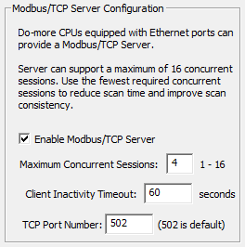
Communications – Modbus TCP
Do-more SLAVE
Modbus TCP Server (Slave)
  (1) Do-more built-in Ethernet port
    Modbus TCP Server Device exists & is enabled by default (see CPU Configuration)
      Use CPU Configuration → Modbus/TCP Server Configuration to change parameters as desired
        Maximum Concurrent Sessions: 1-16 (default 4)
          Up to 16 Clients (Masters) can talk to the Do-more.
          The 17th one will be unable to connect
        Client Inactivity Timeout: 1-65,535 seconds
          If Do-more hasn’t heard from one of his Clients
          (Masters) in this time period, Do-more will do a TCP
          disconnect
        TCP Port Number: default 502
    Serves up M-memory to the Modbus TCP Client
      Modbus Inputs 0-1023 → MI0-1023*
      Modbus Coils 0-1023 → MC0-1023*
      Modbus Input Registers 0-2047 → MIR0-2047*
      Modbus Holding Registers 0-2047 → MHR0-2047*
      *Range is expandable via Memory Configuration

Slide 4
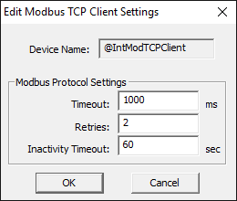
Communications – Modbus TCP
Do-more MASTER
Modbus TCP Client (Master)
  (3) Do-more built-in Ethernet port
    One Modbus TCP Client Device (@IntModTCPClient) exists by default
      Use Device Configuration to change
      parameters as desired
        Timeout: milliseconds (ms) to wait
        for Server (Slave) to respond
        Retries: how many times to retry comm
        Inactivity Timeout: seconds to keep
        TCP connection alive due to inactivity
        (no MRX/MWX being executed) before
        doing a TCP disconnect from the Server
        (Slave)
    Use MRX (Read) & MWX (Write)
    instructions
      Multiple MRX/MWX instructions can be used to same Server (Slave)
    If >1 Server (Slave), create a Modbus TCP Client Device for each one (explained in a few minutes)…

Slide 5
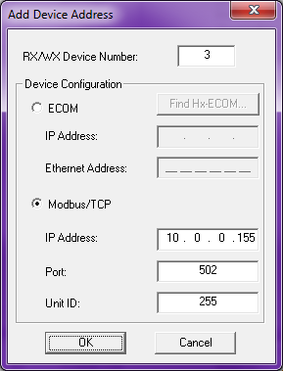
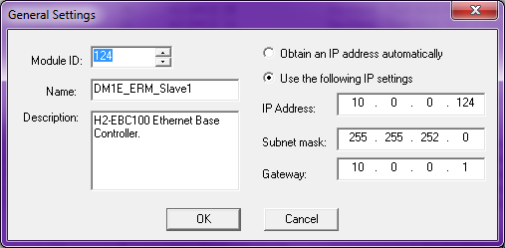
Communications – Modbus TCP
DL-PLC w/ECOM100 MASTER
DL & ECOM100 History Lesson
  Remember the New Advancements?:
    ECOM100 invented that runs at
    100Mbps & supports Modbus TCP
    (Client & Server) requiring TCP/IP
    to be supported:
      IP address, subnet mask & gateway
      address
      Also, peer-to-peer must be used to
      select Modbus TCP
    New Problem: How to further select Modbus Function Code & register address?

Slide 6
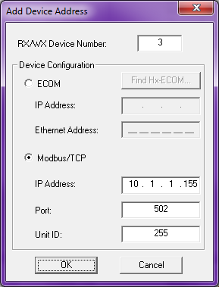
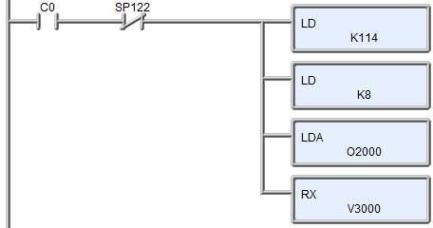
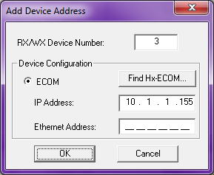
Communications – Modbus TCP
DL-PLC w/ECOM100 MASTER
DL & ECOM100 History Lesson
  Original Requirements:
    Module ID (a number from 0-90) is the only means to address the communication partner
      Solved with peer-to-peer table
  New Requirements:
    How to select Modbus TCP?
      SOLUTION: A 2nd peer-to-peer selection
    How to select Modbus FC?
    How to select register address?
    These last two are solved with mapping
Converts Module ID (“RX/WX Device Number”) to an IP Address
Not only converts Module ID (“RX/WX Device Number”) to an IP Address but also selects Modbus TCP protocol

Slide 7
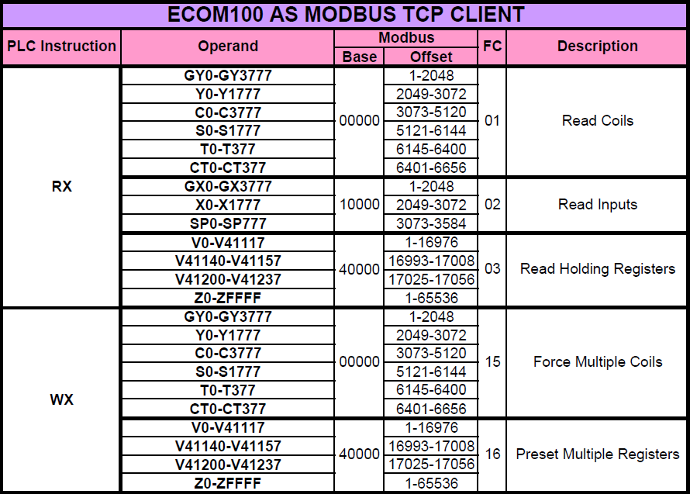
Communications – Modbus TCP
DL-PLC w/ECOM100 MASTER
DL & ECOM100 History Lesson
  Modbus TCP Client Mapping:
    Uses RX/WX operand to select both the Modbus FC & the register address

Slide 8
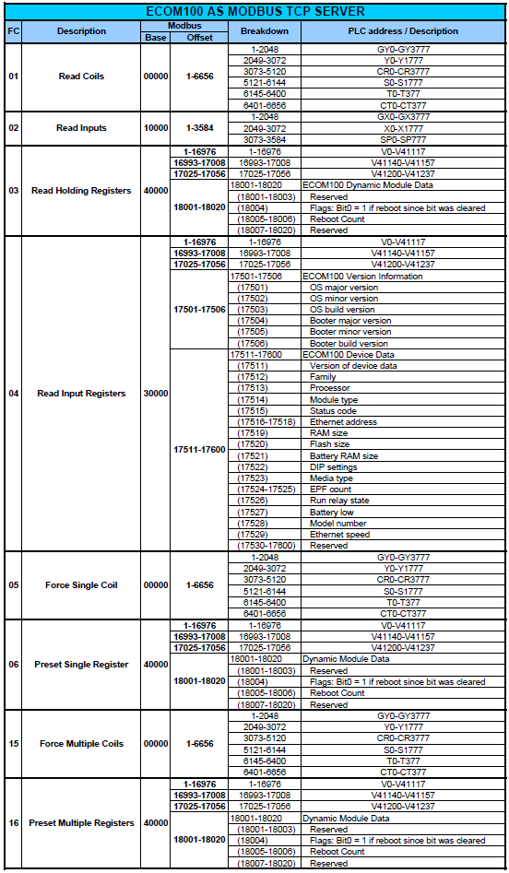
Communications –
Modbus TCP
DL-PLC w/ECOM100 SLAVE
DL & ECOM100 History
Lesson
  Modbus TCP Server
  Mapping:
    Responds to the Modbus FCs
    as shown
    Notice, however, FC03 &
    FC04 both serve up DL-PLC’s
    V-memory
      This is not usually a problem
      for 3rd-party Modbus TCP
      Clients, but…

Slide 9
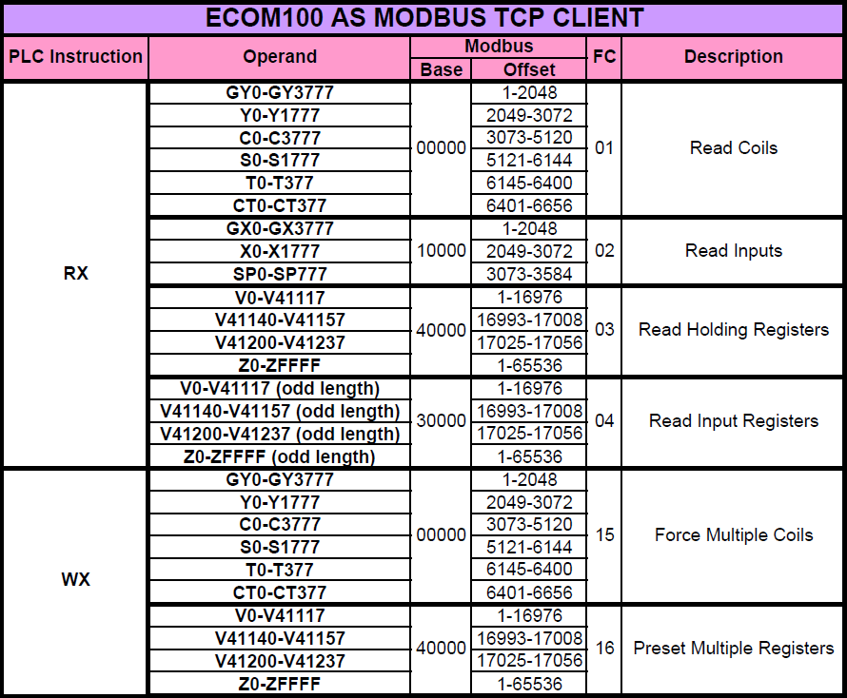
Communications – Modbus TCP
DL-PLC w/ECOM100 MASTER
DL & ECOM100 History Lesson
  New Problem:
    Modbus TCP Client mapping doesn’t allow the ability to address Modbus Input Registers!
    SOLUTION: Use an odd length designation to change from using Holding Registers to using Input Registers
      Why this works: the length parameter is always an even number because it designates bytes and all Modbus registers are words (2 bytes)
IR?

Slide 10
Communications – Modbus TCP
DL-PLC w/ECOM100 SLAVE/MASTER
DL & ECOM100 History Lesson
  All previous maps were for DL PLCs using ECOM100s
  Can ECOM100 be used to do Modbus TCP while in a Do-more PLC base?... Yes… however…
    To an ECOM100 as any kind of server in a Do-more PLC, only DL-memory is available
    So the server mapping chart is further restricted
      As Modbus TCP Server:
        FC01 “Read Coils”, FC05 “Force Single Coil” & FC15 “Force Multiple Coils” only access DLY0-1777 & DLC0-3777
        FC02 “Read Inputs” only accesses DLX0-1777
        FC03 “Read Holding Registers”, FC06 “Preset Single Register” & FC16 “Preset Multiple Registers” only access DLV0-7777
        FC04 “Read Input Registers” also only accesses DLV0-7777
    As Modbus TCP Client:
      Must use DLRX/DLWX (not MRX/MWX!) with
      proper parameter

Slide 11
Communications – Modbus TCP
Do-more w/ECOM100 SLAVE
Modbus TCP Server (Slave)
  (2) Do-more with ECOM100
    Do-more’s Modbus TCP Server is not utilized
    A Modbus TCP Server exists & is enabled in the ECOM100
    Modbus I/O mapping from ECOM100 will go to DL-memory
      Modbus Inputs:
        2049-3072 → DLY0-1777*
        3073-5120 → DLC0-3777*
      Modbus Coils:
        2049-3072 → DLX0-1777*
      Modbus Input Registers:**
        1-4096 → DLV0-7777*
        17,501-17,506 → Internal ECOM100 Version Info (ECOM manual)
        17,511-17,600 → Internal ECOM100 Device Data (ECOM manual)
      Modbus Holding Registers:**
        1-4096 → DLV0-7777*
        18,001-18020 → Internal ECOM100 Dynamic Mod Data (ECOM manual)
      * These ranges are larger than the default.
      Use Memory Configuration to enlarge them if needed
      ** Notice both Input & Output Registers address DLV

Slide 12
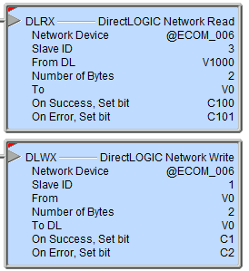
Communications – Modbus TCP
Do-more w/ECOM100 MASTER
Modbus TCP Client (Master)
  (4) Do-more with ECOM100
    Do-more’s Modbus TCP Client is not utilized
    A Modbus TCP Client exists & is enabled in the ECOM100
      Must configure a Peer-to-peer table and select Modbus TCP
    Must use DLRX/DLWX instructions with the proper From DL/To DL parameters
    DLRX with From DL parameter will select the following:
      FC01 “Read Coils” (Coils 1-6656):
        GY0-3777 → 1-2048
        Y0-1777 → 2049-3072
        C0-3777 → 3073-5120
        S0-1777 → 5121-6144
        T0-377 → 6145-6400
        CT0-377 → 6401-6656
      FC02 “Read Inputs” (Inputs 1-3584):
        GX0-3777 → 1-2048
        X0-1777 → 2049-3072
        SP0-777 → 3073-3584
      FC03 “Read Holding Registers” (HRs 1-17056):
        V0-41237 → 1-17056
      FC04 “Read Input Registers” (IRs 1-17056):
        V0-41237 → 1-17056*
    DLWX with To DL parameter will select the following:
      FC15 “Force Multiple Coils”: Same mapping as FC01 “Read Coils” above
      FC16 “Preset Multiple Registers”: Same mapping as FC03 “Read Holding Registers” above
      *To select this one requires the use of an odd number for the Number of Bytes parameter

Slide 13
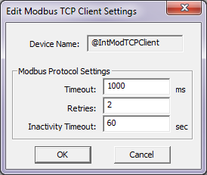
Communications – Modbus TCP
Do-more MASTER
@IntModTCPClient (Master)
DO-MORE PLC
MRX/MWX #1
Modbus TCP Server (Slave) #1
SYN
Establish TCP Connection #1 over Port #502
TCP Connection #1 Established
TCP Connection #1 Established
SYN, ACK
ACK
If Server does not respond in 15 seconds (not configurable) the MRX/MWX instruction errors out
Modbus Request
Modbus Protocol Exchange
ACK
If Server does not respond in Timeout period it Retries the number of times specified before MRX/MWX instruction errors out
Modbus Response
ACK

Slide 14
Communications – Modbus TCP
Do-more MASTER
@IntModTCPClient (Master)
DO-MORE PLC
After TCP Connection is established, if an MRX/MWX is not executed within Inactivity Timeout setting, the TCP Connection is closed
Modbus TCP Server (Slave) #1
TCP Connection #1 Established
TCP Connection #1 Established
MRX/MWX #1
Modbus Request
Modbus Protocol Exchange
ACK
Modbus Response
ACK

Slide 15
Communications – Modbus TCP
Do-more MASTER
@IntModTCPClient (Master)
DO-MORE PLC
Modbus TCP Server (Slave) #1
TCP Connection #1 Established
TCP Connection #1 Established
MRX/MWX #1
Modbus Request
Modbus Protocol Exchange
ACK
Modbus Response
ACK

Slide 16
Communications – Modbus TCP
Do-more MASTER
@IntModTCPClient (Master)
DO-MORE PLC
MRX/MWX #2
Modbus TCP Server (Slave) #1
FIN, ACK
TCP Connection #1 Established
TCP Connection #1 Established
Close TCP Connection #1
FIN, ACK
ACK
2nd Server (Slave) is added, but still using just one Modbus TCP Client in Do-more
TCP Connection to Server (Slave) #1 is still established
Modbus TCP Server (Slave) #2
SYN
Establish TCP Connection #2 over Port #502
TCP Connection #2 Established
TCP Connection #2 Established
SYN, ACK
ACK

Slide 17
Communications – Modbus TCP
Do-more MASTER
@IntModTCPClient (Master)
DO-MORE PLC
MRX/MWX #2
Modbus TCP Server (Slave) #1
Modbus Request
Modbus TCP Server (Slave) #2
TCP Connection #2 Established
ACK
TCP Connection #2 Established
Modbus Response
ACK

Slide 18
Communications – Modbus TCP
Do-more MASTER
@IntModTCPClient (Master)
@MyModTCPClient (Master)
DO-MORE PLC
MRX/MWX #1
Modbus TCP Server (Slave) #1
Modbus Request
SYN
Establish TCP Connection #1 over Port #502
ACK
TCP Connection #1 Established
TCP Connection #1 Established
SYN, ACK
Modbus Response
ACK
ACK
Modbus TCP Server (Slave) #2
2nd Modbus TCP Client is created to service the 2nd Server (Slave) #2

Slide 19
Communications – Modbus TCP
Do-more MASTER
@IntModTCPClient (Master)
@MyModTCPClient (Master)
DO-MORE PLC
Multiple MRXs & MWXs possible
Modbus TCP Server (Slave) #1
TCP Connection #1 Established
MRX/MWX #1
TCP Connection #1 Established
MRX/MWX #1
No disconnect & reconnect (management) of the TCP Connections is necessary
MRX/MWX #1
MRX/MWX #2
Modbus TCP Server (Slave) #2
Modbus Request
Establish TCP Connection #2 over Port #502
SYN
MRX/MWX #2
TCP Connection #2 Established
ACK
TCP Connection #2 Established
MRX/MWX #2
SYN, ACK
Modbus Response
MRX/MWX #2
ACK
ACK

Slide 20
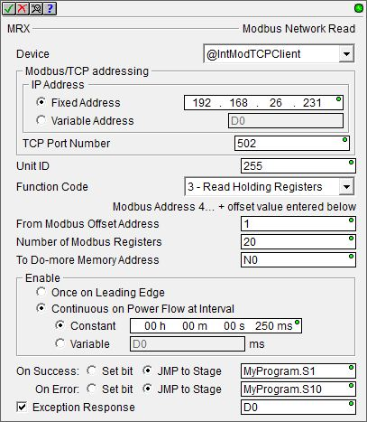
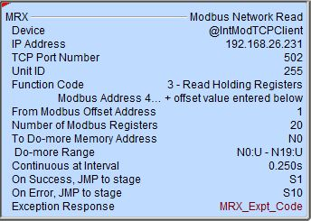
Communications – Modbus TCP
Do-more MASTER
MRX “Modbus Network Read”
  Reads data from a Modbus (TCP or RTU) Server
  Fully asynchronous instruction (red triangle)
  Parameters:
    Device – Modbus TCP Client Device name
    Modbus/TCP addressing
      IP Address
        Fixed Address
        Variable Address
      TCP Port Number – default 502
    Unit ID – default 255 (most Slaves ignore)
    Function Code
      1 (Read Coil)
      2 (Read Discrete Inputs)
      3 (Read Holding Registers)
      4 (Read Input Registers)
      7 (Read Exception Status
    From Modbus Offset Address
    Number of Modbus… “Coils”, “Discrete Inputs”, “Registers”
    To Do-more Memory Address – where received data is stored

Slide 21
Communications – Modbus TCP
Do-more MASTER
MRX “Modbus Network Read”
  Parameters:
    Enable
      Once on Leading Edge
      Continuous on Power Flow
      at Interval – executes
      multiple times based on the
      Interval configured
        Constant
        Variable
    On Success: Set bit or JMP to
    Stage
    On Error: Set bit or JMP to
    Stage
    Exception Response (optional)

Slide 22
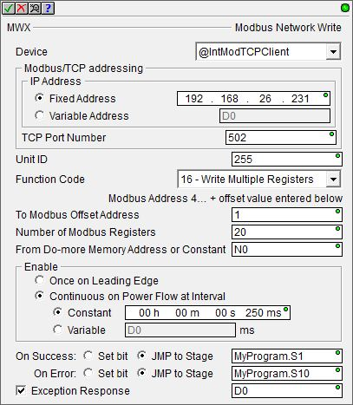
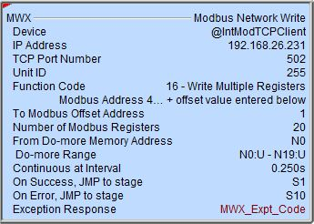
Communications – Modbus TCP
Do-more MASTER
MWX “Modbus Network Write”
  Writes data to a Modbus (TCP or RTU) Server
  Fully asynchronous instruction (red triangle)
  Parameters:
    Device – Modbus TCP Client Device name
    Modbus/TCP addressing
      IP Address
        Fixed Address
        Variable Address
      TCP Port Number – default 502
    Unit ID – default 255 (most Slaves ignore)
    Function Code
      5 (Write Single Coil)
      6 (Write Single Register)
      15 (Write Multiple Coils)
      16 (Write Multiple Registers)
    To Modbus Offset Address
    Number of Modbus… “Coils”, “Registers”
    From Do-more Memory Address – where data to be written is stored

Slide 23
Communications – Modbus TCP
Do-more MASTER
MWX “Modbus Network Write”
  Parameters:
    Enable
      Once on Leading Edge
      Continuous on Power Flow
      at Interval – executes
      multiple times based on the
      Interval configured
        Constant
        Variable
    On Success: Set bit or JMP to
    Stage
    On Error: Set bit or JMP to
    Stage
    Exception Response (optional)

Slide 24
Communications – Modbus TCP
Modbus TCP Client (Master)
Modbus TCP Server (Slave)
Do-more CPU
Do-more CPU
MC
MI
MIR
MHR
MRX
MWX
@IntModTCPClient
@ModbusTCPServer
Modbus TCP Client (Master)
Modbus TCP Server (Slave)
Do-more CPU
ECOM100
Do-more CPU
DLC
DLX
DLY
DLV
MRX
MWX
@IntModTCPClient
DL Server

Slide 25
Communications – Modbus TCP
Modbus TCP Client (Master)
Modbus TCP Server (Slave)
Do-more CPU
E
C
O
M
1
0
0
Do-more CPU
Modbus
Peer
to
peer
MC
MI
MIR
MHR
DLRX
DLWX
@ECOM_001
@ModbusTCPServer
Modbus TCP Client (Master)
Modbus TCP Server (Slave)
Do-more CPU
E
C
O
M
1
0
0
ECOM100
Do-more CPU
Modbus
Peer
to
peer
DLC
DLX
DLY
DLV
DLRX
DLWX
@ECOM_001
DL Server

Slide 26
Communications – Modbus TCP
# | Master CPU | Ethernet Port | Instruction | Device | Function Codes
1 | Do-more | Internal | MRX/MWX | @IntModTCPClient | 1-7, 15, 16
2 |  | ECOM100 (Modbus TCP Peer-to-Peer) | DLRX/DLWX¹ | @ECOM_001 | 1-4, 15, 16
3 | DL-PLC |  | ECRX/ECWX² | n/a
¹ Must use Client table in “ECOM100 Server Client Mapping (Do-more).PDF” file
to choose correct Function Code & Modbus memory address
² Must use Client table in “ECOM100 Server Client Mapping.PDF” file to choose
correct Function Code & Modbus memory address

Slide 27
Communications – Modbus TCP
# | Slave CPU | Ethernet Port | Device | Function Codes | Memory
1 | Do-more | Internal | @ModbusTCPServer | 1-7, 15, 16, 22 | M-memory
2 |  | ECOM100 | @ECOM_001 | 1-6, 15, 16 | DL-memory¹
3 | DL-PLC |  | n/a |  | C, CT, GX, GY, S, SP, T, V, X, Y & Internal ECOM100 memory²
¹ Must use Server table in “ECOM100 Server Client Mapping (Do-more).PDF” file
to see where a Function Code & Modbus memory address maps into DL-memory
² Must use Server table in “ECOM100 Server Client Mapping.PDF” file to see where
a Function Code & Modbus memory address maps into DL-PLC memory

Slide 28
Communications – Modbus TCP
There are actually 3 Modbus protocols
  (1) Modbus RTU
  (2) Modbus TCP
  (3) Modbus Over TCP
Modbus Over TCP is just a Modbus RTU Telegram encapsulated in a TCP/IP Frame
TCP/IP Frame
TCP/IP Frame
Modbus RTU Telegram
Modbus RTU Telegram
Modbus TCP Telegram
Transaction Identifier
Protocol Identifier
Length Field
Unit ID
Address
Address
Function Code
Function Code
Data
Data
Checksum
Checksum
Do-more & ECOM100s do not natively support Modbus Over TCP
However, it can be accomplished in Do-more using a Custom TCP Device & using the CHECKSUM instruction to calculate the “Checksum” portion of the telegram

