Slide 1
Do-more Technical Training
Communications
(Modbus RTU)

Slide 2
Communications – Modbus RTU
Client (Master)
Server (Slave) #1
Modbus RTU Server (Slave)
(1) Do-more built-in serial port
(2) Do-more w/SERIO
Modbus RTU Client (Master)
(3) Do-more built-in serial port
(4) Do-more w/SERIO

Slide 3
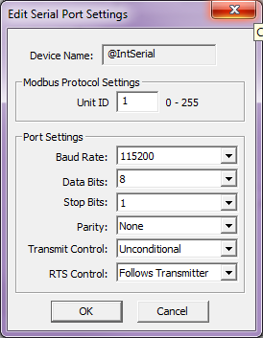
Communications – Modbus RTU
Modbus RTU Server (Slave)
(1) Do-more built-in serial port
Modbus RTU Server (Slave) must be configured
Use CPU Configuration → Serial Port Mode and select “Modbus RTU Server (Slave)”
Use <Device Settings> button to change parameters as desired
Configuration creates IntSerialServer structure with members:
ActiveSessions – (unsigned byte) Not used
LastError – (unsigned byte) Error code of last failed transaction
Errors – (unsigned word) Number of failed transactions
Transactions – (signed double-word) Number of successful transactions
Function Codes Supported:
1-7, 15, 16, 22
Serves up M-memory to the Modbus RTU Client (Master)
Modbus Inputs 0-1023 → MI0-1023*
Modbus Coils 0-1023 → MC0-1023*
Modbus Input Registers 0-2047 → MIR0-2047*
Modbus Holding Registers 0-2047 → MHR0-2047*
*Range is expandable via Memory Configuration

Slide 4
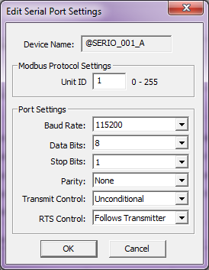
Communications – Modbus RTU
Modbus RTU Server (Slave)
(2) Do-more CPU with local SERIO/4 module
Modbus RTU Server (Slave) must be configured
Use Module Configuration(s), double-click on SERIO/SERIO4 module
Select “Modbus RTU Server (Slave)” for the port you want to use
Use <Device Settings> button for any of the 3 ports to change parameters as desired
Configuration creates, e.g. $SERIO_001_A structure with members:
ActiveSessions – (unsigned byte) Not used
LastError – (unsigned byte) Error code of last failed transaction
Errors – (unsigned word) Number of failed transactions
Transactions – (signed double-word) Number of successful transactions
Function Codes supported:
1-7, 15, 16, 22
Serves up M-memory to the Modbus RTU Client (Master)
Modbus Inputs 0-1023 → MI0-1023*
Modbus Coils 0-1023 → MC0-1023*
Modbus Input Registers 0-2047 → MIR0-2047*
Modbus Holding Registers 0-2047 → MHR0-2047*
*Range is expandable via Memory Configuration

Slide 5
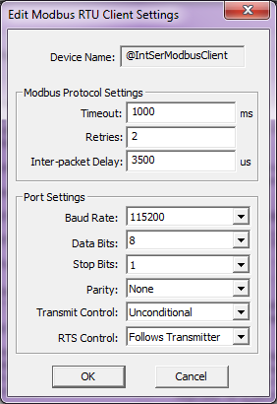
Communications – Modbus RTU
Modbus RTU Client (Master)
(3) Do-more built-in serial port
Modbus RTU Client (Master) must be configured
Use CPU Configuration → Serial Port Mode and select “Modbus RTU Client (Master)”
Use <Device Settings> button to change parameters as desired
Timeout: milliseconds (ms) to wait for Server (Slave) to respond
Retries: how many times to retry comm
Inter-packet Delay: time between packets
This should be at least 3.5 character times
(3.5 * (#BitsPerCharacter/Baud))*1,000,000
Use MRX (Read) & MWX (Write) instructions
Multiple MRX/MWX instructions can be used to same Server (Slave)
@IntSerModbusClient (Master)
Server (Slave) #1
Server (Slave) #2

Slide 6
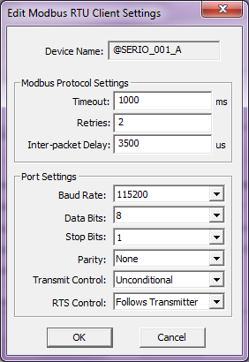
Communications – Modbus RTU
Modbus RTU Client (Master)
(4) Do-more CPU with local SERIO/4 module
Modbus RTU Client (Master) must be configured
Use Module Configuration(s), double-click on SERIO/SERIO4 module
Select “Modbus RTU Server (Slave)” for the port you want to use
Use <Device Settings> button for any of the 3 ports to change parameters as desired
Timeout: milliseconds (ms) to wait for Server (Slave) to respond
Retries: how many times to retry comm
Inter-packet Delay: time between packets
This should be at least 3.5 character times
(3.5 * (#BitsPerCharacter/Baud))*1,000,000
Use MRX (Read) & MWX (Write) instructions
Multiple MRX/MWX instructions can be used to same Server (Slave)

Slide 7
Communications – Modbus RTU
@IntSerModbusClient Client (Master)
MRX/MWX to 1
@IntSerial
Server (Slave) #1
Modbus Request
ACK
Modbus Response
ACK
If Server does not respond in Timeout period it Retries the number of times specified before MRX/MWX instruction errors out

Slide 8
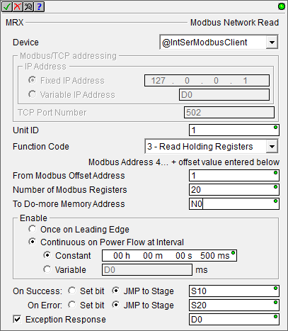
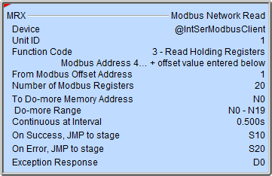
Communications – Modbus RTU
MRX “Modbus Network Read”
Reads data from a Modbus (TCP or RTU) Server
Fully asynchronous instruction (red triangle)
Parameters:
Device – Modbus RTU Client Device name
Unit ID – default 1
Function Code
1 (Read Coil)
2 (Read Discrete Inputs)
3 (Read Holding Registers)
4 (Read Input Registers)
7 (Read Exception Status
From Modbus Offset Address
Number of Modbus… “Coils”, “Discrete Inputs”, “Registers”
To Do-more Memory Address – where received data is stored

Slide 9
Communications – Modbus RTU
MRX “Modbus Network Read”
Parameters:
Enable
Once on Leading Edge
Continuous on Power Flow at Interval – executes multiple times based on the Interval configured
Constant
Variable
On Success: Set bit or JMP to Stage
On Error: Set bit or JMP to Stage
Exception Response (optional)

Slide 10
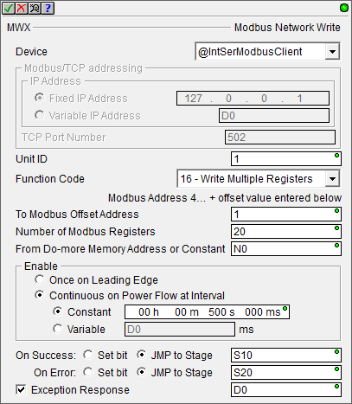
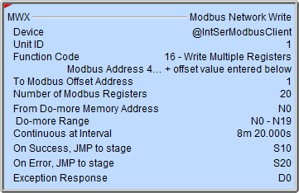
Communications – Modbus RTU
MWX “Modbus Network Write”
Writes data to a Modbus (TCP or RTU) Server
Fully asynchronous instruction (red triangle)
Parameters:
Device – Modbus RTU Client Device name
Unit ID – default 1
Function Code
5 (Write Single Coil)
6 (Write Single Register)
15 (Write Multiple Coils)
16 (Write Multiple Registers)
To Modbus Offset Address
Number of Modbus… “Coils”, “Registers”
From Do-more Memory Address – where data to be written is stored

Slide 11
Communications – Modbus RTU
MWX “Modbus Network Write”
Parameters:
Enable
Once on Leading Edge
Continuous on Power Flow at Interval – executes multiple times based on the Interval configured
Constant
Variable
On Success: Set bit or JMP to Stage
On Error: Set bit or JMP to Stage
Exception Response (optional)

Slide 12
Communications – Modbus RTU
Modbus RTU Client (Master)
Modbus RTU Server (Slave)
Do-more CPU
Do-more CPU
MC
MI
MIR
MHR
MRX
MWX
@IntSerModbusClient
@IntSerial
Modbus RTU Client (Master)
Modbus RTU Server (Slave)
Do-more CPU
SERIO/4
SERIO/4
Do-more CPU
MC
MI
MIR
MHR
MRX
MWX
@SERIO_001_A
@SERIO_001_A

