Slide 1
Do-more Technical Training
Communications
(GS-EDRV100)

Slide 2
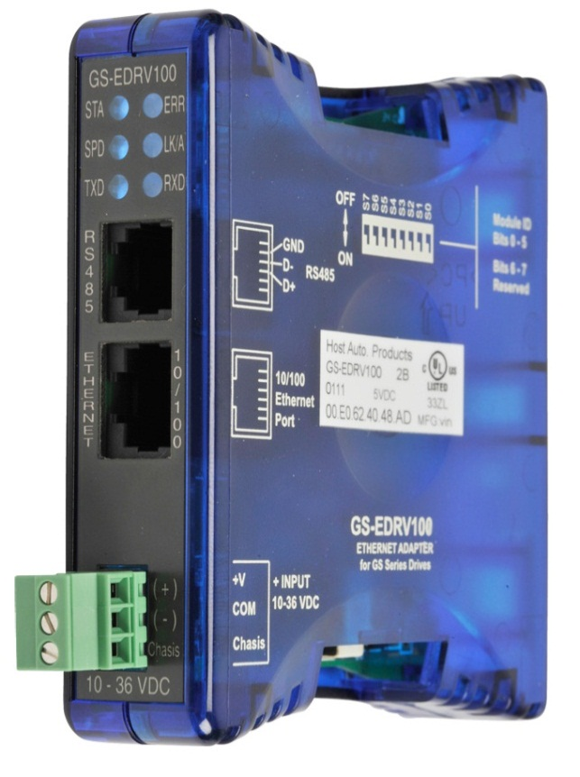
Communications – GS-EDRV100
Use as slave with Do-more Ethernet I/O
Serially connects to drive
Works with:
GS1
GS2
GS3/DURAPulse
LEDs
STA – connected to drive
SPD – 100Mbps Ethernet
TXD – serial send
ERR – fatal error
LK/A – link / activity Ethernet
RXD – serial receive
Dipswitches set Module ID
Use NetEdit or Do-more Designer to set IP parameters

Slide 3
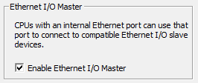
Communications – GS-EDRV100
System Configuration → CPU Configuration
Check “Enable Ethernet I/O Master”
Under I/O Configuration, click on the new “Ethernet I/O Master” that showed up

Slide 4
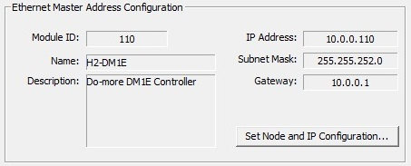
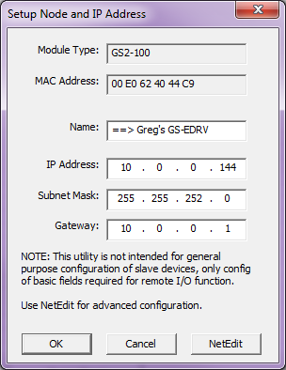
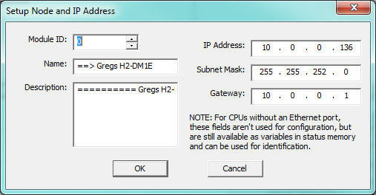
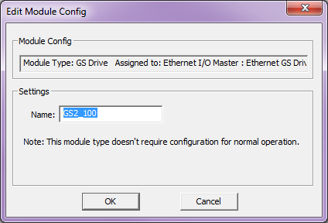
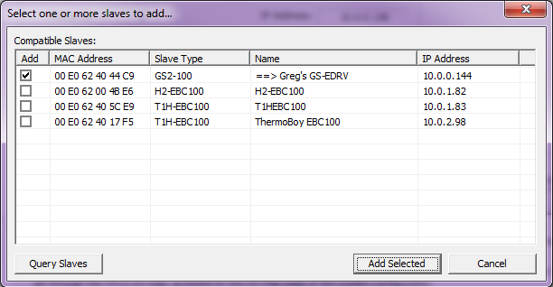
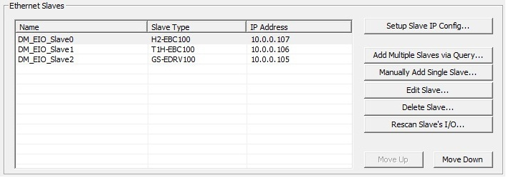
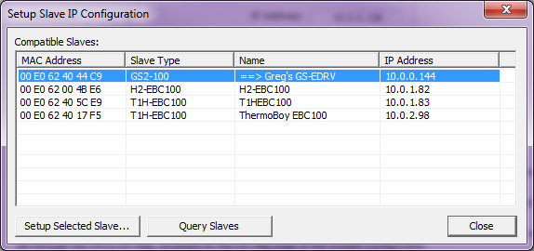
Communications – GS-EDRV100
I/O Configuration
Ethernet I/O Master
Ethernet Master Address Configuration
Set Node and IP Configuration
Ethernet Slaves
Set Slave IP Config…
Setup Selected Slave
Query Slaves
Add Multiple Slaves via Query…
Adds Module Configuration
Adds Device that uses a Structure
Notes:
Configure Ethernet I/O with your EBC100 slave

Slide 5
Communications – GS-EDRV100
$GS2_100 Structure Members
OutputFrequency (word)
OutputCurrent (word)
ExtCommFault (bit): drive serial
IntCommFault (bit): Ethernet
StatusMonitor1 (word): 2100 hex mem in drive
StatusMonitor2 (word): 2101 hex mem in drive
RunCommand (word): P9.27; 1 = Run; 0 = Stop
RS485SpeedRef (word): P9.26; set speed
Direction (bit): P9.28; ON = forward
ResetCommFault (bit): turn ON to reset fault
BlockParm1-5 (word): P9.11-.15; user-defined write value
BlockParm6-15 (word): P9.16-.25; user-defined read value

Slide 6
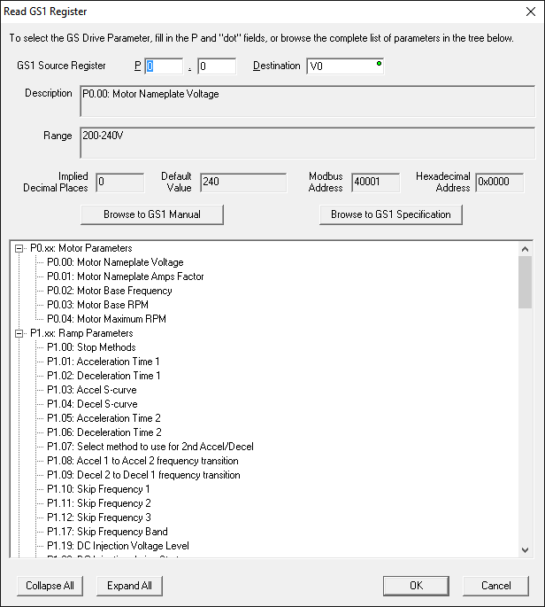
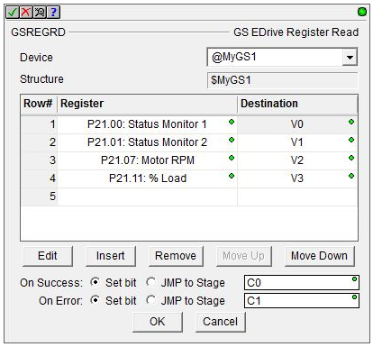
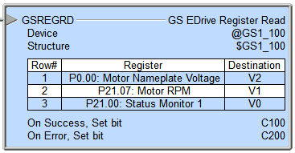
Communications – GS-EDRV100
GSREGRD “GS EDrive Register Read”
Reads data from GS-EDRV100 (up to 50 read operations)
Fully asynchronous
Parameters:
Device – GS-EDRV100
Structure – structure being used
Register – drive register to read from
Press the <Insert> button to pull up all the selections
Destination – where the read value is stored
On Success / On Error: Set bit or JMP to Stage

Slide 7
Communications – GS-EDRV100
GSREGWR “GS EDrive Register Write”
Writes data to GS-EDRV100 (up to 50 write operations)
Fully asynchronous
Parameters:
Device – GS-EDRV100
Structure – structure being used
Source – where write value originates
Register – drive register to write to
Press the <Insert> button to pull up all the selections
On Success / On Error: Set bit or JMP to Stage

