Slide 1


Do-more Technical Training
Communications
(EtherNet/IP)

Slide 2
Communications – EtherNet/IP
EtherNet/IP Explicit Message Server (Slave)
  Do-more built-in Ethernet port
EtherNet/IP Explicit Message Client (Master)
  Do-more built-in Ethernet port
Client (Master)
Server (Slave)

Slide 3
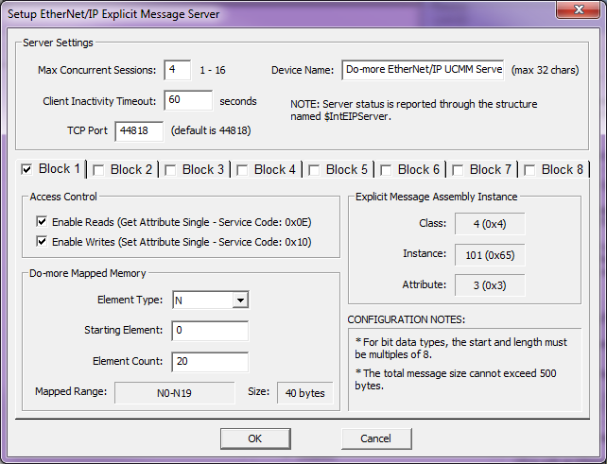
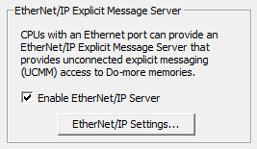
Communications – EtherNet/IP
EtherNet/IP Explicit Message Server (Slave)
  Do-more built-in Ethernet port
    EtherNet/IP Explicit Message Server (Slave) must be enabled & configured
      Use CPU Configuration → EtherNet/IP Explicit Message Server, check the “Enable EtherNet/IP Server” box
      Use <EtherNet/IP Settings…> button to change parameters as desired
      Configuration creates $IntEIPServer structure with members:
        ActiveSessions – (unsigned byte) # of concurrent open connections
        LastError – (unsigned byte) error code of last failed transaction
        Errors – (unsigned word) # of failed transactions
        Transactions – (signed double-word) # of successful transactions
    Serves up the Blocks as defined
    Can have up to 16 Clients (Masters); default = 4
    EtherNet/IP uses TCP so TCP session must be established
Configure up to 8 Blocks
Default TCP Parameters
These 4 parameters are vitally important & must be matched by the Client
These 4 parameters are vitally important & must be matched by the Client

Slide 4
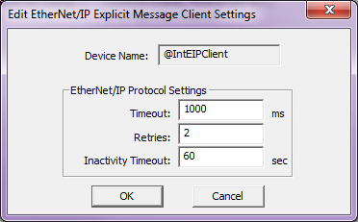
Communications – EtherNet/IP
EtherNet/IP Explicit Message Client (Master)
  Do-more built-in Ethernet port
    One EtherNet/IP Explicit Message Client Device (@IntEIPClient) exists by default
      Use Device Configuration to change
      parameters as desired
        Timeout: milliseconds (ms) to wait for
        Server (Slave) to respond
        Retries: how many times to retry comm
        Inactivity Timeout: seconds to keep TCP
        connection alive due to inactivity (no
        EIPMSG being executed) before doing a TCP
        disconnect from the Server (Slave)
    Use EIPMSG instruction
      Multiple EIPMSG instructions can be used to
      same Server (Slave)
    If >1 Server (Slave), it is more efficient to create an EtherNet/IP Explicit Message Client Device for each one (see Modbus TCP slides for the detailed reason why)
@IntEIPClient (Master)
Server (Slave)
@IntEIPClient (Master)
Server (Slave) #1
@MyEIPClient (Master)
Server (Slave) #2

Slide 5
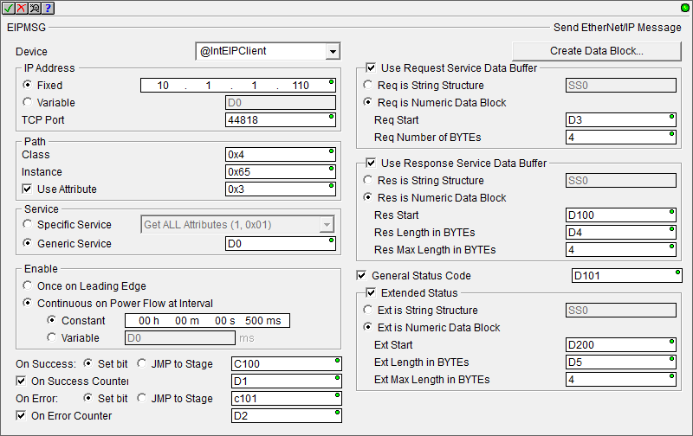
Communications – EtherNet/IP
EIPMSG “Send EtherNet/IP Message”
  Reads/writes data from/to an EtherNet/IP Explicit Message Server (Slave)
  Fully asynchronous instruction
  Parameters:
    Device – EtherNet/IP Explicit
    Message Client Device name
    IP Address – Fixed or Variable; TCP
    Port (44818 default)
    Path – Class, Instance, Attribute
    Service
      Specific Service:
        Get Attribute (14, 0x0E) – read
        Set Attribute (16, 0x10) – write
        Get ALL Attributes (1, 0x01) – read
        Set ALL Attributes (2, 0x02) – write
      Generic Service: any other service
      not named above
    Enable – (self explanatory)
    On Success/On Error – (ditto)
    Use Request Service Data Buffer – gets selected automatically if setting an attribute (writing); length must match
    Use Response Service Data Buffer – gets selected automatically if getting an attribute (reading)
    Generic Status Code – this is defined by the EtherNet/IP server’s documentation
    Extended Status – use this if necessary

Slide 6
Communications – EtherNet/IP
EtherNet/IP Client (Master)
EtherNet/IP Server (Slave)
Do-more CPU
Do-more CPU
EIPMSG
@IntEIPClient
@IntEIPServer
Blocks 1-8

Slide 7

Communications – EtherNet/IP
Define Block1 in Do-more CPU
Define Block1 in SIM on your PC
Use EIPMSG instruction in CPU to write to SIM
Use EIPMSG instruction in CPU to read from SIM
Use EIPMSG instruction in SIM to write to CPU
Use EIPMSG instruction in SIM to read from CPU
Do-more
10.1.1.110
SIM
10.1.1.200
EIPMSG
N10 → Block1
EIPMSG
D10 → Block1

