Slide 1
Do-more Technical Training
Communications
(Ethernet I/O)

Slide 2
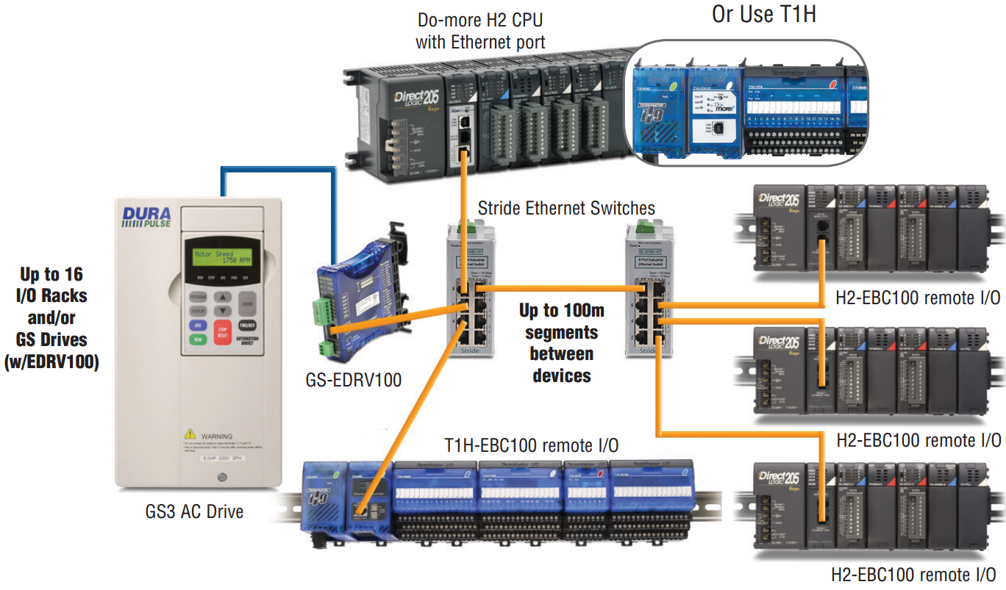
Communications – Ethernet I/O

Slide 3
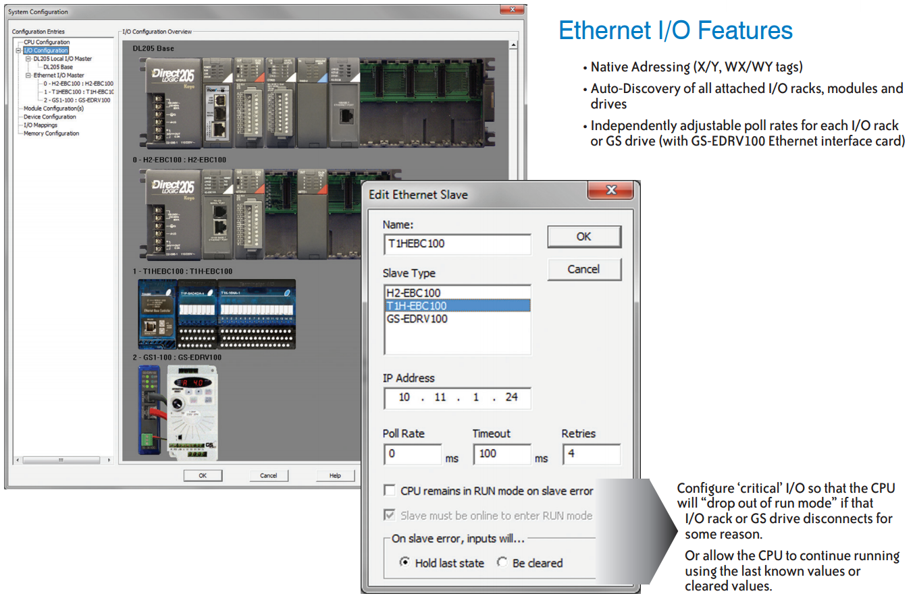
Communications – Ethernet I/O

Slide 4
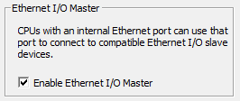
Communications – Ethernet I/O
System Configuration → CPU Configuration
Check “Enable Ethernet I/O Master”
Under I/O Configuration, click on the new “Ethernet I/O Master” that showed up

Slide 5
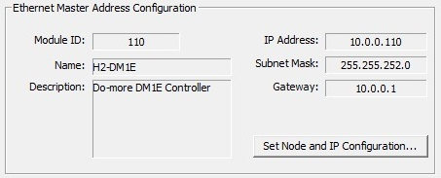
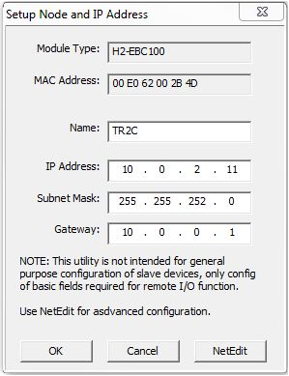
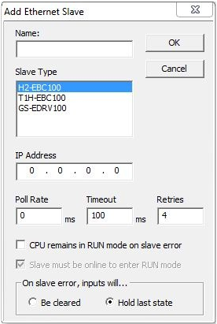
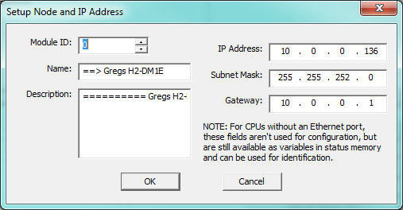
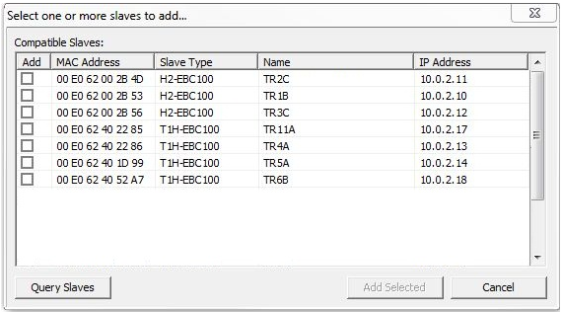
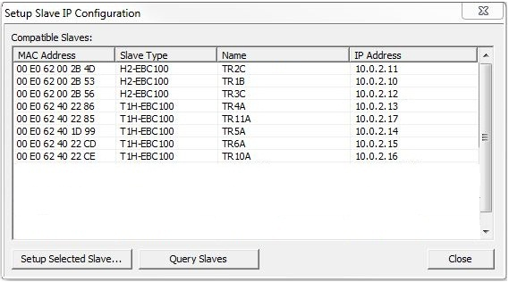
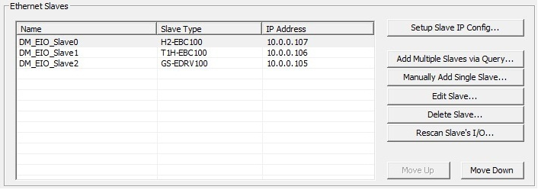
Communications – Ethernet I/O
I/O Configuration
Ethernet I/O Master
Ethernet Master Address Configuration
Set Node and IP Configuration
Ethernet Slaves
Set Slave IP Config…
Setup Selected Slave
Query Slaves
Add Multiple Slaves via Query…
Manually Add Single Slave…
Edit Slave…
Delete Slave…
Rescan Slave’s I/O…
Move Up
Move Down
Notes:
Configure Ethernet I/O with your EBC100 slave

