Slide 1
Do-more Technical Training
Communications
(Email)

Slide 2
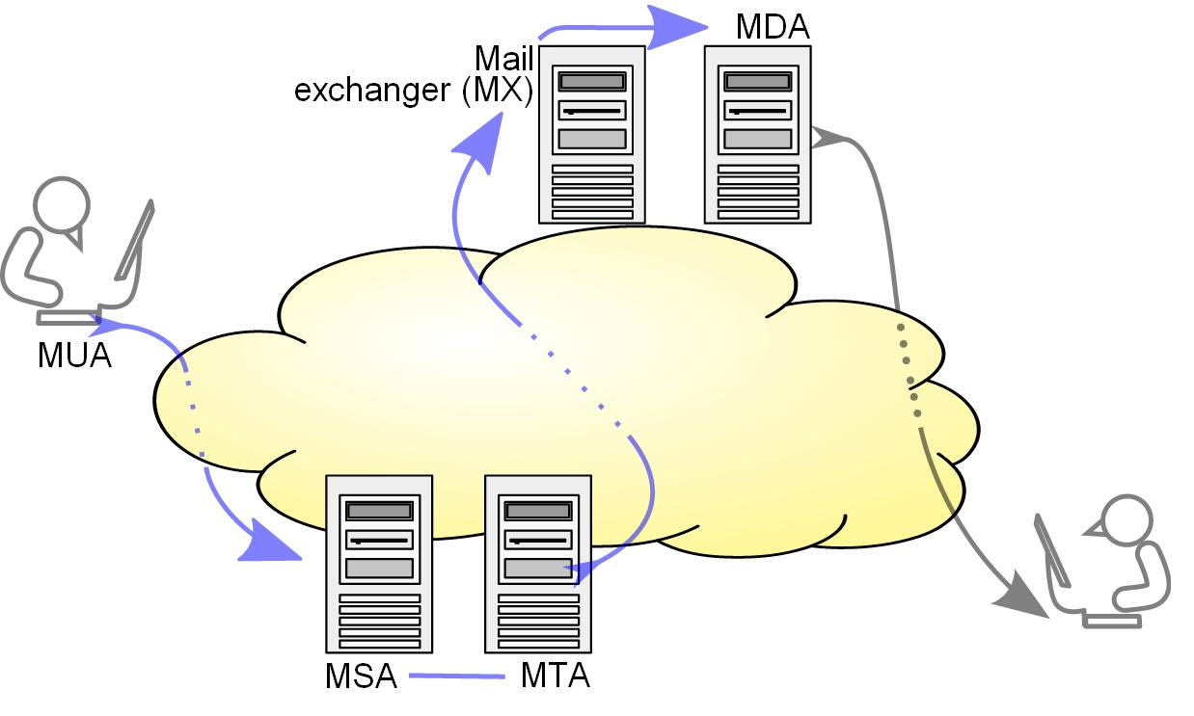
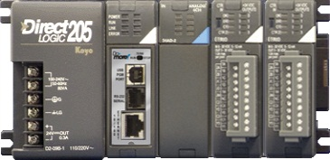
Communications – Email
Built-in Ethernet Port
Supports sending SMTP Email requests to a known SMTP server (MSA/MTA) via the EMAIL instruction
MUA – Mail User Agent MX – Mail Exchanger
MSA – Mail Submission Agent MDA – Mail Delivery Agent
MTA – Mail Transfer Agent
POP / IMAP
Internet
SMTP

Slide 3
Communications – Email (Connect)
@MyEmailClient (MUA)
TCP Protocol
Email Server (MSA/MTA)
SYN
TCP Connection Established
SYN, ACK
TCP Connection Established
ACK

Slide 4
Communications – Email (Authorize)
@MyEmailClient (MUA)
SMTP Protocol
Email Server (MSA/MTA)
220 “Ready”
TCP Connection Established
EHLO
TCP Connection Established
250-Hello
250-SIZE
Connection Authenticated
Connection Authenticated
250-AUTH LOGIN
AUTH LOGIN
Server asks Client for Password using BASE64 encoding
Server tells Client maximum size
334 VXNlcm5hbWU6
Server tells Client what Authorizations are available for use (e.g. LOGIN, PLAIN, CRAM-MD5)
Client tells Server which Authorization he chooses
adlxdkej
BASE64 Encoding
334 UGFzc3dvcmQ6
Server asks Client for Username using BASE64 encoding
lkujsefxlj
235 “Successful”

Slide 5
Communications – Email (Exchange)
SMTP Protocol
@MyEmailClient (MUA)
MAIL FROM:<bob>
Email Server (MSA/MTA)
250-OK
TCP Connection Established
RCPT TO:<alice>
TCP Connection Established
250-OK
DATA
Connection Authenticated
Connection Authenticated
354 “End with .”
Email Sent
“From: <bob>”
Email Received
Client tells Server a data stream is to follow
[body of email]
Server tells Client to end data stream with a period “.” on a line by itself
“.”
Client sends Server all of the email body text (could be several telegrams)
250-OK
QUIT
Client sends Server the period “.” (end of data)
221-Bye

Slide 6
Communications – Email (Disconnect)
@MyEmailClient (MUA)
TCP Protocol
Email Server (MSA/MTA)
FIN, ACK
TCP Connection Established
TCP Connection Established
FIN, ACK
ACK
Connection Authenticated
Connection Authenticated
Email Sent
Email Received

Slide 7
Communications – Email
CPU’s Built-in Ethernet Port must have IP address
CPU must have a properly configured SMTP Client Device
Must know SMTP Server’s (MSA/MTA) IP address or the DNS Lookup name
Some SMTP Servers have IP addresses that periodically change for security reasons. In this case, the DNSLOOKUP instruction can be used with DEVWRITE instruction to read the IP address dynamically and write it to the CPU’s SMTP Client Device just before doing the EMAIL instruction
SMTP Server (MSA/MTA) must either use no Authentication (Disabled) or one of the following types:
AUTH LOGIN
AUTH PLAIN
POP before SMTP
If Authentication is used, the Username & Password must be known for the email account
Must use EMAIL instruction to send

Slide 8
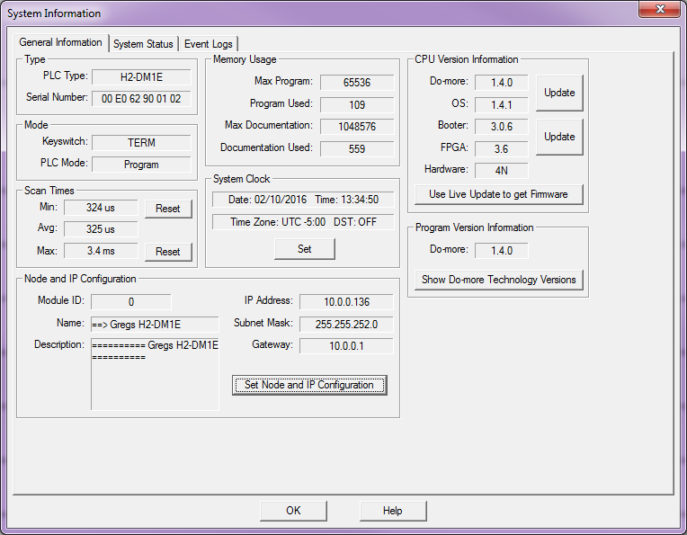
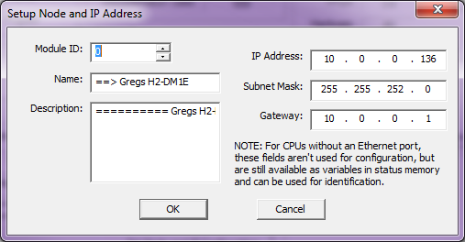
Communications – Email
CPU’s Built-in Ethernet Port must have IP address:
Manual config:

Slide 9
Communications – Email
CPU’s Built-in Ethernet Port must have IP address:
Programmatic configuration:
SETUPIP – “Setup TCP/IP Parameters”
SETUPNOD – “Setup Ethernet Node Parameters”

Slide 10
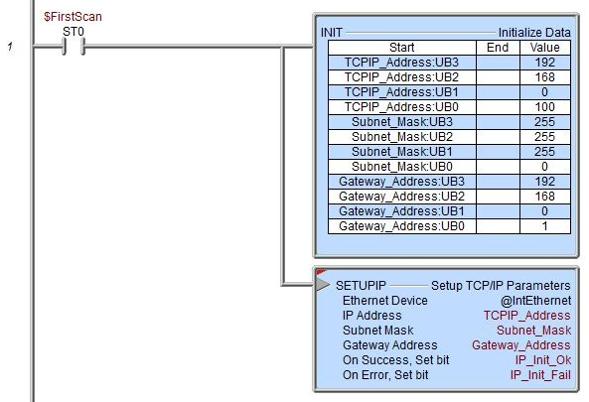
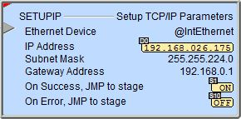
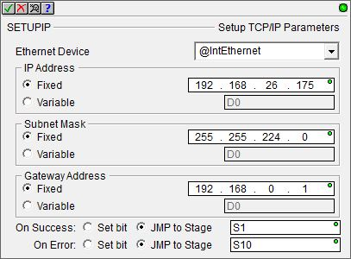
Instruction Set (Ethernet)
SETUPIP “Setup TCP/IP Parameters”
Configures TCP/IP networking parameters for onboard Ethernet port
Fully asynchronous instruction (red triangle)
Parameters:
Ethernet Device: @IntEthernet
IP Address
Fixed: Regular IP address format
Variable: D-memory format (double-word)
Subnet Mask: (Fixed / Variable)
Gateway Address: (Fixed / Variable
On Success: (Set bit / JMP to Stage)
On Error: (Set bit / JMP to Stage)
Input leg leading-edge-triggered
System data words reflect current settings:
$IPAddress (DST18)
$NetMask (DST19)
$Gateway (DST20)
NOTE: Writes to ROM. Could take several seconds to complete. Use sparingly due to ROM’s limited writes (≈100K).
Double-words are used with “unsigned byte” casting to make the line containing the IP address octet in the INIT instruction more readable

Slide 11
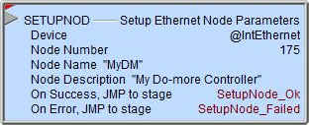
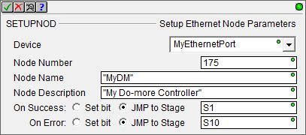
Instruction Set (Ethernet)
SETUPNOD “Setup Ethernet Node Parameters”
Configures node parameters for onboard Ethernet port
Fully asynchronous instruction (red triangle)
Parameters:
Ethernet Device: @IntEthernet
Node Number: 32-bit signed (0 to 2,147,483,647)
Node Name: 0 to 256 alphanumeric characters
Also stored in system parameter string SysName
Node Description: 0 to 256 alphanumeric characters
Also stored in system parameter string SysDesc
On Success: (Set bit / JMP to Stage)
On Error: (Set bit / JMP to Stage)
Input leg leading-edge-triggered
NOTE: Writes to ROM. Could take several seconds to complete. Use sparingly due to ROM’s limited writes (≈100K).

Slide 12
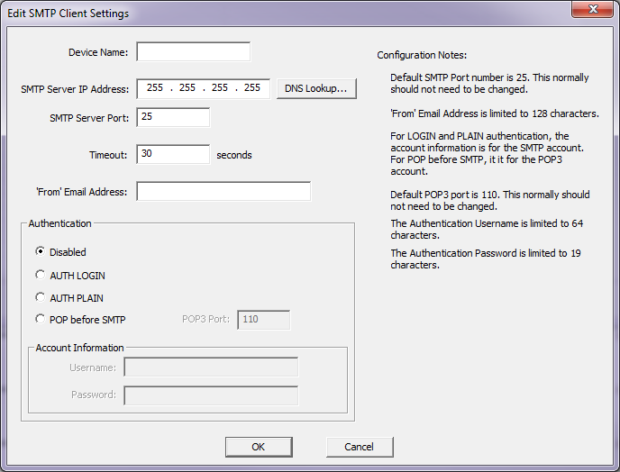
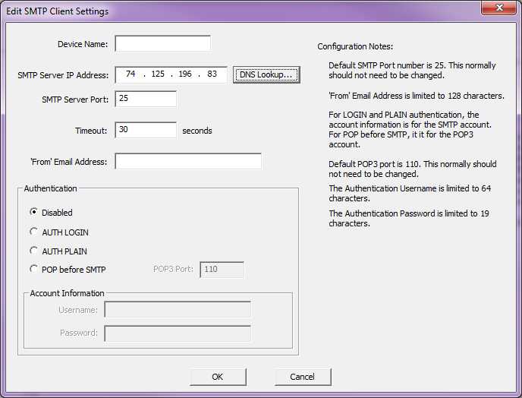
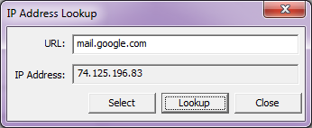
Communications – Email
Built-in Ethernet Port
To send Email requires an SMTP Client Device
Use Device Configuration to create
Follow Configuration Notes
DNS Lookup button

Slide 13
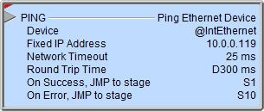
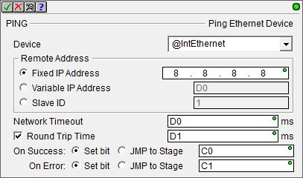
Instruction Set (Ethernet)
PING “Ping Ethernet Device”
Sends an ICMP ping to see if a particular IP Address is reachable from the Do-more PLC
Fully asynchronous instruction (red triangle)
Parameters:
Device: @IntEthernet
Remote Address:
Fixed IP Address
Variable IP Address – D-memory double-word
Slave ID – (Module ID)
Network Timeout: How long to wait in ms (0-65,535)
Round Trip Time (optional): Time in ms the response took
On Success: (Set bit / JMP to Stage)
On Error: (Set bit / JMP to Stage)
Input leg leading-edge-triggered

Slide 14
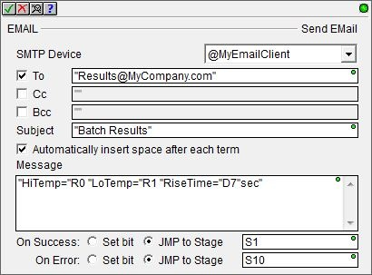
Instruction Set (Ethernet)
EMAIL “Send EMail”
Sends email
Fully asynchronous instruction (red triangle)
Parameters:
SMTP Device: @MyEmailClient
To / Cc / Bcc: pertinent email addresses (max 1024 characters)
Subject: text for the subject line (max 1024 characters)
Automatically insert space after each term (optional): for use if sending embedded terms in email message
Message: text body of the email with optional embedded fields (text, control characters, strings, elements, formatting & string selection functions, raw data) – See next slide→
On Success: (Set bit / JMP to Stage)
On Error: (Set bit / JMP to Stage)
Input leg leading-edge-triggered

Slide 15
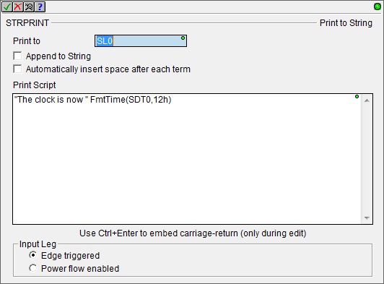
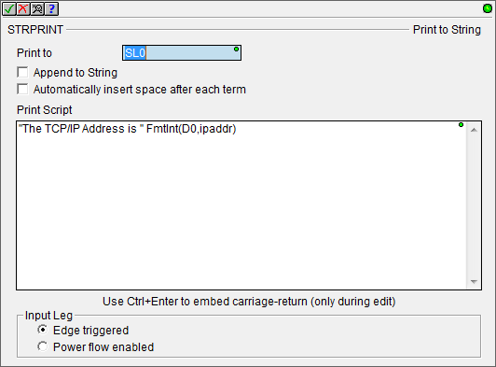
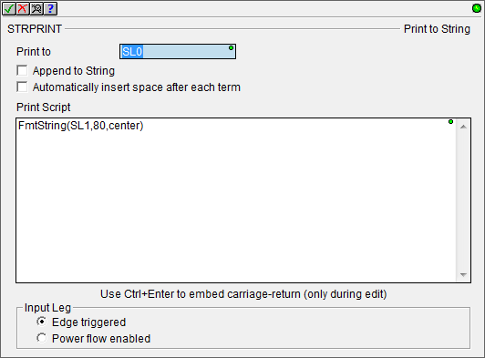
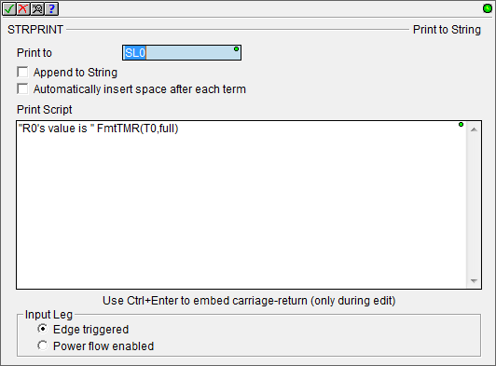
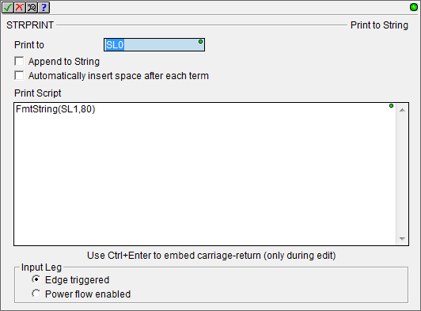
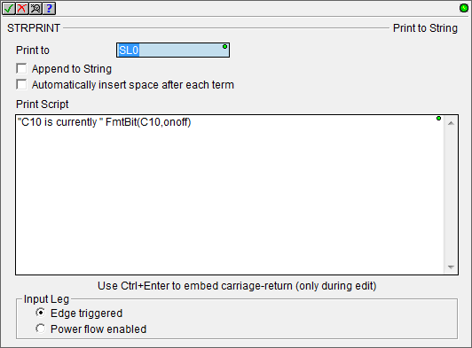
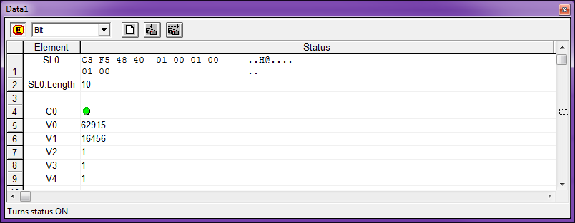
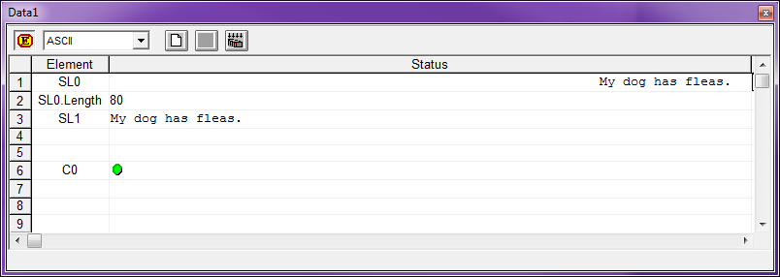
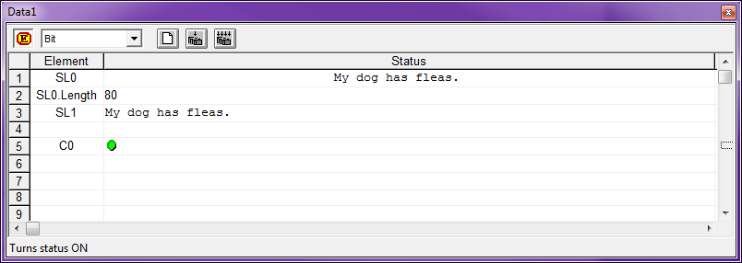
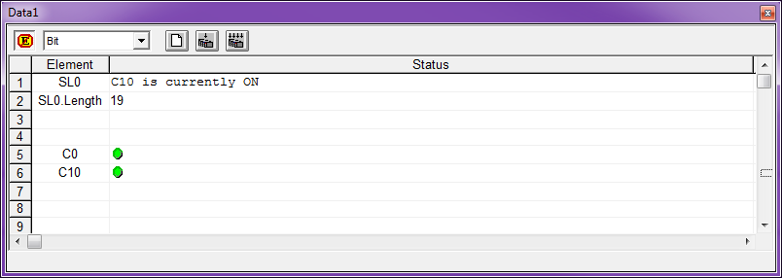
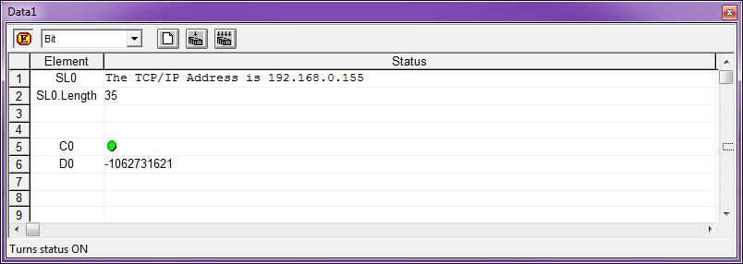
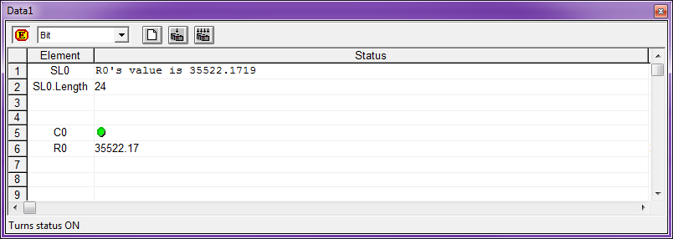
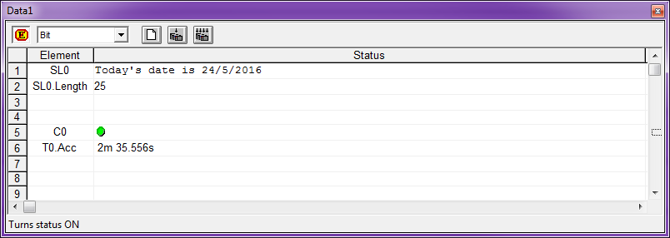
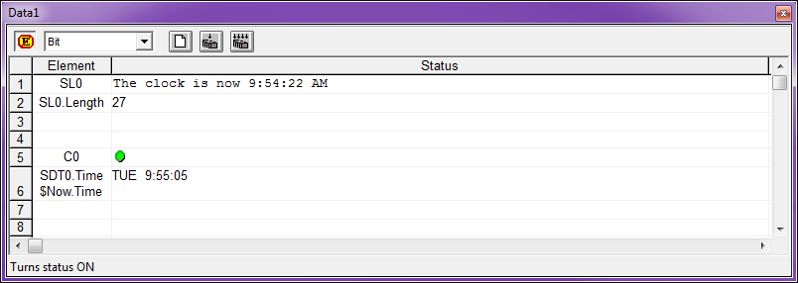
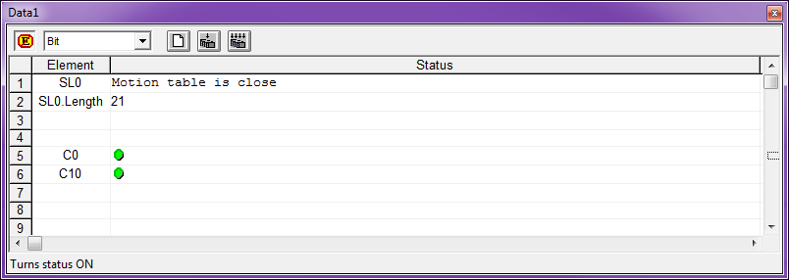
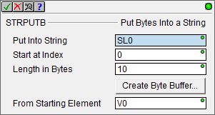
Instruction Set (Ethernet)
EMAIL “Send EMail”
Parameters:
Message: text body of the email
String Literals – ASCII text in double quotes (e.g. “Hi!”)
Data Elements – (e.g. “The current count is” CT0.Acc)
Control Characters
$$ → $
$” → “
$L → <LF> (line feed)
$N → <CR><LF> (carriage return, line feed)
$P → <FF> (form feed)
$R → <CR> (carriage return)
$T → <TAB> (tab)
$hh → hh (any one-byte hex value)
Formatting Functions [see Do-more Designer Help Topic DMD0168]
FmtString – Sets length and/or justifies text within a string
FmtBit – Formats bits’ values as a text instead of just 0 or 1
FmtInt – Formats how an integer is represented in a string
FmtReal – Formats how real numbers are represented in a string
FmtTMR – Formats how Timer Accumulator values are represented in a string
FmtDate – Formats how a Date stamp is represented in a string
FmtTime – Formats how a Time stamp is represented in a string
Lookup – Selects a string in a list to represent a value
Raw – Places bytes of data from a data block into a string

Slide 16
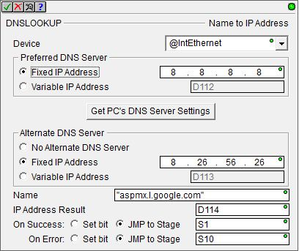
Instruction Set (Ethernet)
DNSLOOKUP “Name to IP Address”
Finds IP address assigned to a device using DNS protocol.
Fully asynchronous instruction (red triangle)
Parameters:
Device: @IntEthernet
Preferred DNS Server (Fixed / Variable): IP address to contact for resolving the name. Default is 8.8.8.8 (Google’s public DNS Server)
Alternate DNS Server (No / Fixed / Variable): IP address to contact if the preferred one fails. Default is the secondary DNS Server IP address from the network setup on the PC running Do-more Designer
Name: the name that is to be resolved to an IP address (e.g. mail.google.com)
IP Address Result: where to store the result
On Success: (Set bit / JMP to Stage)
On Error: (Set bit / JMP to Stage)
Input leg leading-edge-triggered

Slide 17
Instruction Set (Ethernet)
DEVWRITE “Write Device Register”
Writes a configuration value to a register in a Device
Parameters:
Device: @MySMTPClient
Write Register (pull-down selection): valid registers for chosen Device
Value: valid value for the register chosen

Slide 18
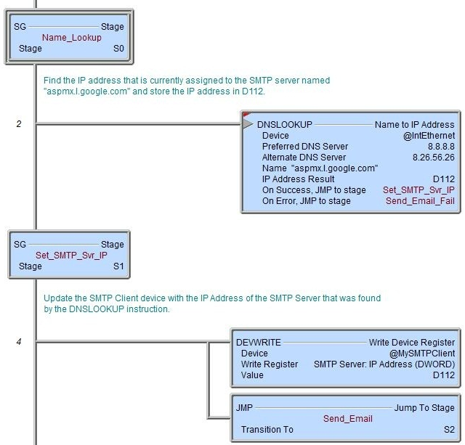
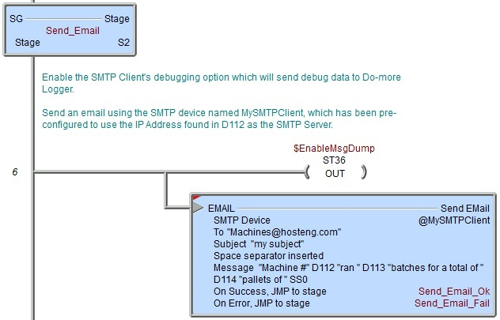
Communications – Email
DNSLOOKUP → DEVWRITE → EMAIL
Stage0 uses a DNSLOOKUP instruction to query the DNS server for Gmail’s IP address.
Google’s email server changes IP addresses for security purposes but their domain name doesn’t.
The new IP address is stored in D112, and Stage1 is jumped to
Stage2 sends the email
The new IP address is written to the SMTP Client’s IP Address parameter
Stage2 is jumped to

Slide 19
Training Station Communication
Serial Comms
PLC: 10.1.1.110
EC: 10.1.1.111
EBC: 10.1.1.112
Stepper, encoder, 2 limit switches
Comm PLC: 10.1.1.200
TCP, UDP &
Serial Comms
PLC: 10.1.1.120
EC: 10.1.1.121
EBC: 10.1.1.122
Ethernet Switch
PLC: 10.1.1.130
EC: 10.1.1.131
EBC: 10.1.1.132
PLC: 10.1.1.140
EC: 10.1.1.141
EBC: 10.1.1.142
Raspberry Pi: 10.1.1.8
SNTP, DNS,
Email & DHCP
PLC: 10.1.1.150
EC: 10.1.1.151
EBC: 10.1.1.152
SNTP, DNS, Email…
To laptops’ Ethernet Switch

Slide 20
Communications – Email
Email (SNTP) & DNS Server:
Raspberry Pi → 10.1.1.8
Valid emails:
test0@adcsmiley.tld
test1@adcsmiley.tld
test2@adcsmiley.tld
test3@adcsmiley.tld
test4@adcsmiley.tld
test5@adcsmiley.tld
Web Email Client:
http://adcsmiley.tld
Login Name: test0, test1, test2, test3, test4, test5
Password: test

