Slide 1
Do-more Technical Training
Communications
(Do-more)

Slide 2
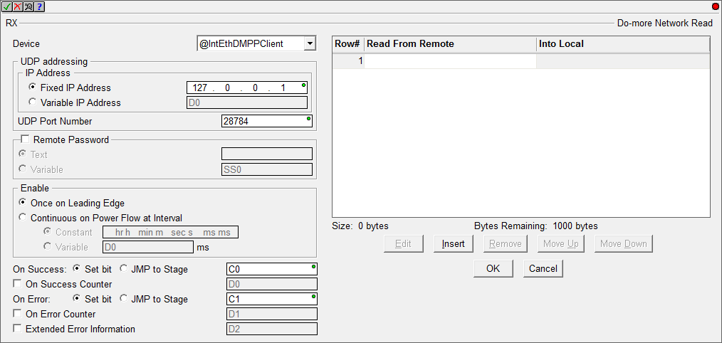
Communications – Do-more
RX “Do-more Network Read”
Reads data from another Do-more PLC
Fully asynchronous instruction (red triangle)

Slide 3
Communications – Do-more
RX “Do-more Network Read”
Parameters
Device - @IntEthDMPPClient
UDP Addressing → IP Address
Fixed IP Address / Variable IP Address
UDP Port Number
Remote Password (optional)
Text / Variable
Enable
Once on Leading Edge
Continuous on Power Flow at Interval
Constant / Variable
On Success
Set bit / JMP to Stage
On Success Counter (optional)
On Error
Set bit / JMP to Stage
On Error Counter (optional)
Extended Error Information (optional)

Slide 4
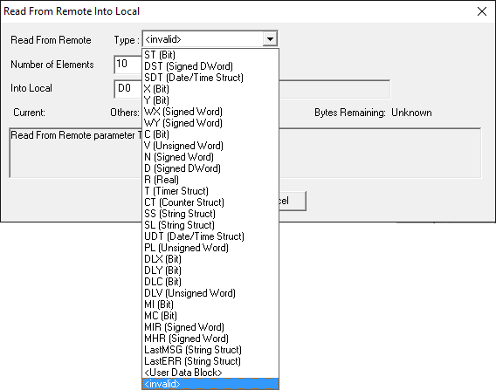
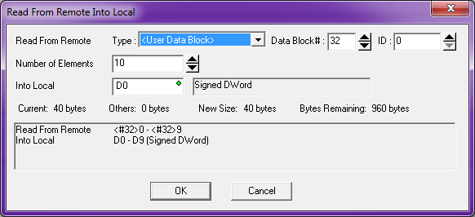
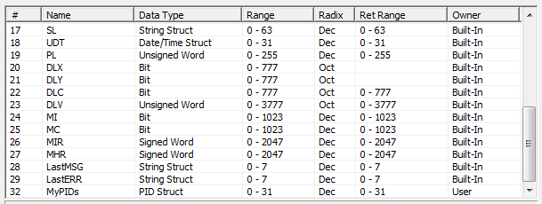
Communications – Do-more
RX “Do-more Network Read”
Parameters
Will not allow incorrect parameters
Allows User Data Blocks!
NOTE: Cannot read Heap Items
The “Data Block #” is found in the other PLC via PLC → System Configuration → Memory Configuration
If User Data Block is chosen, then the “Data Block #” must be used to point to the block in the other Do-more PLC

Slide 5
Communications – Do-more
WX “Do-more Network Write”
Writes data to another Do-more PLC
Fully asynchronous instruction (red triangle)
Parameters are exactly the same as the RX instruction

Slide 6
Communications – Do-more
Do-more Peer-to-peer
Do-more Peer-to-peer
Do-more CPU
Do-more CPU
RX
WX
Memory Blocks
(no Heap)
@IntEthDMPPClient
UDP
DMPP Server

