Slide 1
Do-more Technical Training
Communications
(DirectLOGIC)

Slide 2
Communications – DirectLOGIC
DL Server (Slave)
(1) Do-more built-in Ethernet port
(2) Do-more w/ECOM100
DL Client (Master)
(1) Do-more built-in Ethernet port
(2) Do-more w/ECOM100
Client (Master)
Server (Slave) #1

Slide 3
Communications – DirectLOGIC
DL Server (Slave)
(1) Do-more’s DL Server Device exists & is enabled by default but is invisible & not configurable
(2) ECOM100’s DL Server is also not configurable
Both have a Module ID parameter so both broadcasting & peer-to-peer comms function the same
Both serve up DL-memory to the DL Client
C-bits (C) 0-177777 → DLC0-177777*
Inputs (X) 0-177777 → DLX0-177777*
Outputs (Y) 0-177777 → DLY0-177777*
V-memory (V) 0-177777 → DLV0-177777*
*Range is expandable in Do-more via Memory Configuration

Slide 4
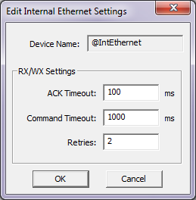
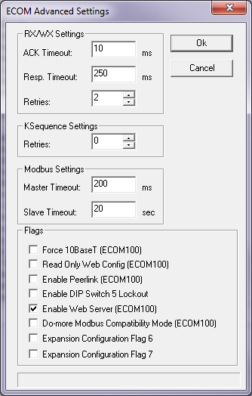
Communications – DirectLOGIC
DL Client (Master)
(1) Do-more’s DL Client Device exists (@IntEthernet) & is enabled by default
Use Device Configuration to change parameters as desired:
ACK Timeout: how long to wait for an ACK from partner
Command Timeout: how long to wait for partner to respond to a data request
Retries
(2) ECOM100’s DL Client
Use NetEdit3’s Advanced Settings or the ECOM100’s web interface to change parameters as desired:
ACK Timeout: (same as above)
Resp. Timeout: (same as Command Timeout above)
Retries
Both use DLRX (Read) & DLWX (Write) instructions
Both can use Broadcasting to Module ID, or peer-to-peer via IP address
Both use UDP/IP (connectionless comms)
Client (Master)
Server (Slave) #1

Slide 5
Communications – DirectLOGIC
DL & ECOM History Lesson
Objective: Establish Ethernet communications between DL-CPUs
Stipulation: “Take the Ethernet-ness out of the equation”
Enter ECOM/ECOM100 modules
Actually the first ones were called “ENET” modules
DL-PLC
Ethernet
Switch
DL-PLC
Data Exchange
IP Addr: 10.1.1.150
IP Addr: 10.1.1.155

Slide 6
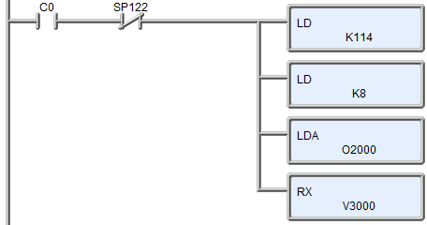
Communications – DirectLOGIC
DL & ECOM History Lesson
Requirements:
Ethernet requires IP Addresses (double-word)
Can communication be established without them?
Yes, via broadcasting & raw Ethernet II packets
DL-PLC has limited instructions to communicate over backplane to intelligent modules
SP-Busy bit for the slot (SP122)
1st LD:
Base #: 0
Slot #: 1
Partner’s Module ID: 14
2nd LD: number of bytes to read: 8 (4 words)
LDA: storing of the data after the read (V2000-2003)
RX: what to read from the partner (V3000-3003)
Module ID (a number from 0-90) is the only means to address the communication partner

Slide 7
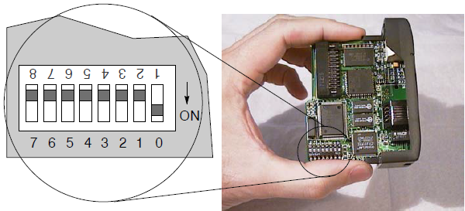
Communications – DirectLOGIC
DL & ECOM History Lesson
ECOM Design:
Module must have Module ID address
To “remove Ethernet-ness” the Module ID must be settable via a dipswitch
ECOMs must be able to “find” one another without IP Addresses
Broadcasting will be utilized for this

Slide 8
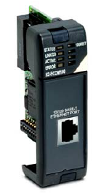
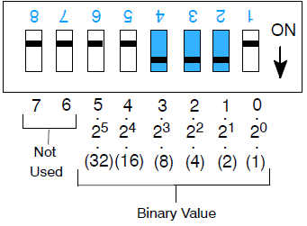
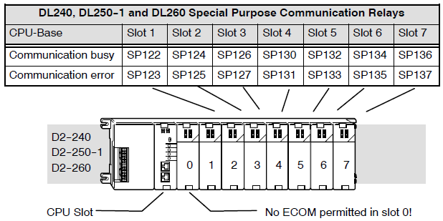
Communications – DirectLOGIC
DL & ECOM History Lesson
Solution:
Customer removes new ECOMs from box
Customer sets dipswitches to preferred Module IDs
Customer plugs ECOMs into desired slots
Customer figures out SP-Busy (& SP-Error) bit for the slot of the “master” (or “initiator”)
Customer writes LD, LD, LDA, RX/WX rung in ladder logic in the “master”
Master ECOM uses Ethernet II Broadcast with embedded HAP (Host Application Protocol) to ask who has Module ID
Slave ECOM responds: “That’s my Module ID”
Response telegram has slave ECOM’s MAC address
Master ECOM utilizes the slave’s MAC address & uses regular Ethernet II telegrams with embedded HAP data to communicate
NOTE:
No “Ethernet-ness” knowledge required
No configuration software required (i.e. NetEdit)

Slide 9
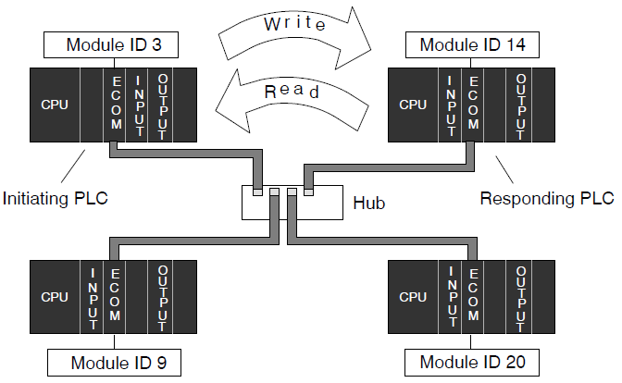
Communications – DirectLOGIC
DL & ECOM History Lesson
Problem:
Network administrators don’t like broadcast telegrams on their network
ECOMs won’t communicate across bridges, routers and some managed switches because broadcasting is blocked
How to get rid of broadcasting?
Module ID (the only means to address the partner) must be translated to an IP address
No way to do this without putting the “Ethernet-ness” back into the ECOM
ECOMs must now have IP addresses
A tool is needed to give ECOMs an IP address

Slide 10
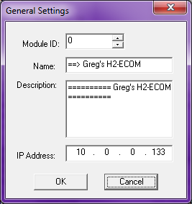
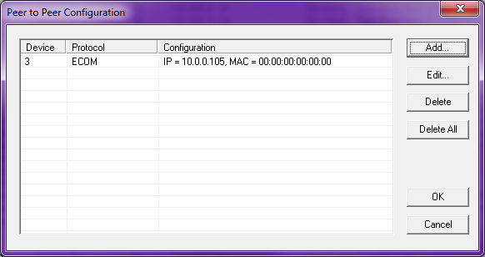
Communications – DirectLOGIC
DL & ECOM History Lesson
The “No-broadcast” Solution:
Customer removes new ECOMs from box
Customer plugs ECOMs into desired slots (dipswitches are left at zero)
Customer uses NetEdit to give ECOMs IP addresses
Customer uses NetEdit to create Peer-to-peer table
Customer figures out SP-Busy (& SP-Error) bit for the slot of the “master” (or “initiator”)
Customer writes LD, LD, LDA, RX/WX rung in ladder logic in the “master”
“Master” ECOM translates the Module ID in the 1st LD instruction into the IP address of the Partner ECOM
“Master” ECOM generates a standard UDP telegram with embedded HAP data to communicate
NOTE:
“Ethernet-ness” knowledge required
Configuration software required (i.e. NetEdit)
However, problem solved: No broadcast telegrams
Notice in the old ECOM there is no Subnet Mask, nor Gateway Address
Translates a Module ID (3) to an IP Address (10.0.0.105)

Slide 11
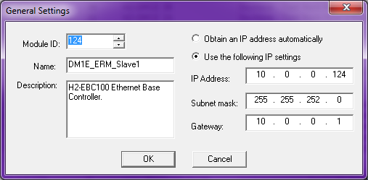
Communications – DirectLOGIC
DL & ECOM History Lesson
New Advancements:
ECOM100 invented
Runs at 100Mbps
Supports Modbus TCP (Client & Server)
A 3rd-party TCP/IP stack is utilized to keep from “reinventing the wheel”
TCP/IP requires Subnet Mask, and Gateway Address

Slide 12
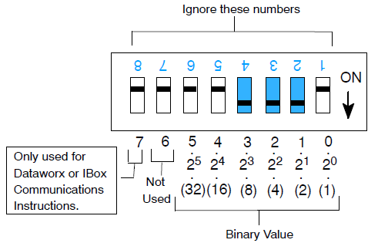
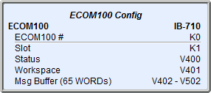
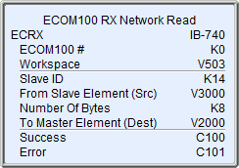
Communications – DirectLOGIC
DL & ECOM History Lesson
New Advancements:
DirectSOFT IBoxes invented
Requires DipSwitch #7 on ECOM100s to be ON
No need to figure out the correct SP bits because the ECOM100 IBox does that for you
No need to figure out the LD, LD, LDA & RX/WX parameters because the ECRX/ECWX IBoxes do that for you

Slide 13
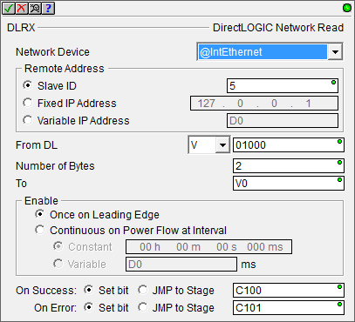
Communications – DirectLOGIC
@IntEthernet DL Client (Master) Module ID: 1 IP Addr: 10.0.0.101
DO-MORE PLC
DLRX/DLWX to Slave ID: 5
DL Server (Slave) Module ID: 5 IP Addr: 10.0.0.105
DO-MORE PLC
or
DL-PLC
Eth II Broadcast
Eth II HAP-ACK
Eth II HAP-Data
This is a “Directed” Broadcast looking for Module ID: 5
Broadcasts are heard by every device on network. Routers & some switches block broadcasts

Slide 14
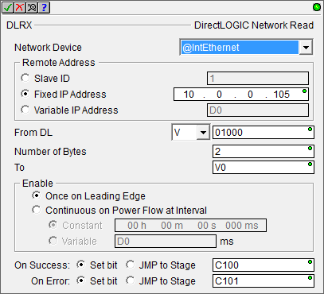
Communications – DirectLOGIC
@IntEthernet DL Client (Master) Module ID: 1 IP Addr: 10.0.0.101
DO-MORE PLC
DLRX/DLWX to IP Addr: 10.0.0.105
DL Server (Slave) Module ID: 5 IP Addr: 10.0.0.105
DO-MORE PLC
Or
DL-PLC
UDP HAP-Request
UDP HAP-ACK
UDP HAP-Data

Slide 15
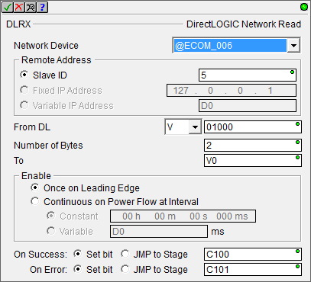
Communications – DirectLOGIC
ECOM100 DL Client (Master) Module ID: 1 IP Addr: 10.0.0.101
(no Peer-to-peer)
DO-MORE
w/ECOM100
DLRX/DLWX to Slave ID: 5
DL Server (Slave) Module ID: 5 IP Addr: 10.0.0.105
DO-MORE PLC
or
DL-PLC
Eth II Broadcast
Eth II HAP-ACK
Eth II HAP-Data
This is a “Directed” Broadcast looking for Module ID: 5
Broadcasts are heard by every device on network. Routers & some switches block broadcasts
Notice when the Network Device is an ECOM100 (“@ECOM_006”) the Fixed IP Address & Variable IP Address parameters are greyed out

Slide 16
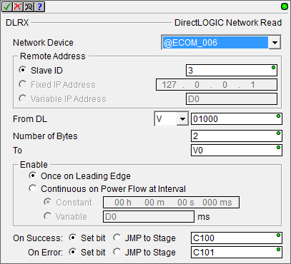
Communications – DirectLOGIC
ECOM100 DL Client (Master) Module ID: 1 IP Addr: 10.0.0.101
Peer-to-peer
Module ID 3 → IP Addr: 10.0.0.105
DO-MORE PLC
w/ECOM100
DLRX/DLWX to Slave ID: 3
DL Server (Slave) Module ID: 5 IP Addr: 10.0.0.105
DO-MORE PLC
or
DL-PLC
UDP HAP-Request
With ECOM100 as Network Device in DLRX/DLWX only Slave ID is available
UDP HAP-ACK
UDP HAP-Data
The DL Server’s (Slave) Module ID: 5 is irrelevant for this transaction
ECOM100’s Peer-to-peer Table translates the Slave ID of the DLRX/DLWX to an IP Address in a UDP telegram

Slide 17
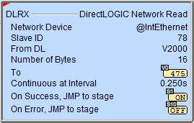
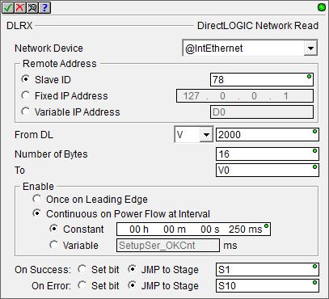
Communications – DirectLOGIC
DLRX “DirectLOGIC Network Read”
Reads data from a DL Server (Slave)
Fully asynchronous instruction (red triangle)
Parameters:
Network Device – e.g. @IntEthernet or @ECOM_003
Remote Address
Slave ID – corresponds to Module ID of DL Server (Slave) device
Fixed IP Address – only available for @IntEthernet
Variable IP Address – <ditto>
From DL – DirectLOGIC memory type & offset (octal)
Number of Bytes
To – where read data is stored

Slide 18
Communications – DirectLOGIC
DLRX “DirectLOGIC Network Read”
Parameters:
Enable
Once on Leading Edge
Continuous on Power Flow at Interval – executes multiple times based on the Interval configured
Constant
Variable
On Success: Set bit or JMP to Stage
On Error: Set bit or JMP to Stage

Slide 19
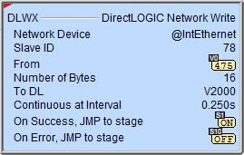
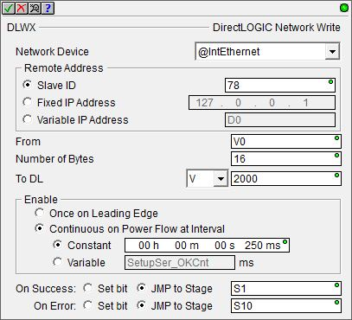
Communications – DirectLOGIC
DLWX “DirectLOGIC Network Write”
Writes data to a DL Server (Slave)
Fully asynchronous instruction (red triangle)
Parameters:
Network Device – e.g. @IntEthernet or @ECOM_003
Remote Address
Slave ID – corresponds to Module ID of DL Server (Slave) device
Fixed IP Address – only available for @IntEthernet
Variable IP Address – <ditto>
From – where data-to-be-written is located
Number of Bytes
To DL – DirectLOGIC memory where data is to be written

Slide 20
Communications – DirectLOGIC
DLWX “DirectLOGIC Network Write”
Parameters:
Enable
Once on Leading Edge
Continuous on Power Flow at Interval – executes multiple times based on the Interval configured
Constant
Variable
On Success: Set bit or JMP to Stage
On Error: Set bit or JMP to Stage

Slide 21
Communications – DirectLOGIC
DirectLOGIC Client (Master)
DirectLOGIC Server (Slave)
Do-more CPU
Do-more CPU
DLC
DLX
DLY
DLV
DLRX
DLWX
@IntEthernet
EthII
DL Server
Module ID
DirectLOGIC Client (Master)
DirectLOGIC Server (Slave)
Currently does not work, instead the Do-more NAKs the request
Do-more CPU
E
C
O
M
1
0
0
Do-more CPU
DLC
DLX
DLY
DLV
DLRX
DLWX
@IntEthernet
EthII
@ECOM_001
Module ID
DirectLOGIC Client (Master)
DirectLOGIC Server (Slave)
Do-more CPU
E
C
O
M
1
0
0
DL-CPU
V, X, Y, C, S, T, CT, GX, GY, SP
DLRX
DLWX
@IntEthernet
EthII
Module ID

Slide 22
Communications – DirectLOGIC
DirectLOGIC Client (Master)
DirectLOGIC Server (Slave)
Do-more CPU
Do-more CPU
DLC
DLX
DLY
DLV
DLRX
DLWX
@IntEthernet
UDP
DL Server
IP Address
DirectLOGIC Client (Master)
DirectLOGIC Server (Slave)
Do-more CPU
E
C
O
M
1
0
0
Do-more CPU
DLC
DLX
DLY
DLV
DLRX
DLWX
@IntEthernet
UDP
@ECOM_001
IP Address
DirectLOGIC Client (Master)
DirectLOGIC Server (Slave)
Do-more CPU
E
C
O
M
1
0
0
DL-CPU
V, X, Y, C, S, T, CT, GX, GY, SP
DLRX
DLWX
@IntEthernet
UDP
IP Address

Slide 23
Communications – DirectLOGIC
DirectLOGIC Client (Master)
DirectLOGIC Server (Slave)
Do-more CPU
E
C
O
M
1
0
0
Do-more CPU
DLC
DLX
DLY
DLV
DLRX
DLWX
@ECOM_001
EthII
DL Server
Module ID
DirectLOGIC Client (Master)
DirectLOGIC Server (Slave)
Currently does not work
Do-more CPU
E
C
O
M
1
0
0
E
C
O
M
1
0
0
Do-more CPU
DLC
DLX
DLY
DLV
DLRX
DLWX
@ECOM_001
EthII
@ECOM_001
Module ID
DirectLOGIC Client (Master)
DirectLOGIC Server (Slave)
Do-more CPU
E
C
O
M
1
0
0
E
C
O
M
1
0
0
DL-CPU
V, X, Y, C, S, T, CT, GX, GY, SP
DLRX
DLWX
@ECOM_001
EthII
Module ID

Slide 24
Communications – DirectLOGIC
DirectLOGIC Client (Master)
DirectLOGIC Server (Slave)
Do-more CPU
E
C
O
M
1
0
0
Do-more CPU
Peer
To
Peer Config
DLC
DLX
DLY
DLV
DLRX
DLWX
@ECOM_001
UDP
DL Server
Module ID
DirectLOGIC Client (Master)
DirectLOGIC Server (Slave)
Do-more CPU
E
C
O
M
1
0
0
E
C
O
M
1
0
0
Do-more CPU
Peer
To
Peer Config
DLC
DLX
DLY
DLV
DLRX
DLWX
@ECOM_001
UDP
@ECOM_001
Module ID
DirectLOGIC Client (Master)
DirectLOGIC Server (Slave)
Do-more CPU
E
C
O
M
1
0
0
E
C
O
M
1
0
0
DL-CPU
Peer
To
Peer Config
V, X, Y, C, S, T, CT, GX, GY, SP
DLRX
DLWX
@ECOM_001
UDP
Module ID

Slide 25
Communications – DirectLOGIC
DirectLOGIC Client (Master)
DirectLOGIC Server (Slave)
DL-CPU
E
C
O
M
1
0
0
Do-more CPU
DLC
DLX
DLY
DLV
ECRX
ECWX
EthII
DL Server
Module ID
DirectLOGIC Client (Master)
DirectLOGIC Server (Slave)
Currently does not work
DL-CPU
E
C
O
M
1
0
0
E
C
O
M
1
0
0
Do-more CPU
DLC
DLX
DLY
DLV
ECRX
ECWX
EthII
@ECOM_001
Module ID
DirectLOGIC Client (Master)
DirectLOGIC Server (Slave)
DL-CPU
E
C
O
M
1
0
0
E
C
O
M
1
0
0
DL-CPU
ECRX
ECWX
V, X, Y, C, S, T, CT, GX, GY, SP
EthII
Module ID

Slide 26
Communications – DirectLOGIC
DirectLOGIC Client (Master)
DirectLOGIC Server (Slave)
DL-CPU
E
C
O
M
1
0
0
Do-more CPU
Peer
To
Peer Config
DLC
DLX
DLY
DLV
ECRX
ECWX
UDP
DL Server
Module ID
DirectLOGIC Client (Master)
DirectLOGIC Server (Slave)
DL-CPU
E
C
O
M
1
0
0
E
C
O
M
1
0
0
Do-more CPU
Peer
To
Peer Config
DLC
DLX
DLY
DLV
ECRX
ECWX
UDP
@ECOM_001
Module ID
DirectLOGIC Client (Master)
DirectLOGIC Server (Slave)
DL-CPU
E
C
O
M
1
0
0
E
C
O
M
1
0
0
DL-CPU
Peer
To
Peer Config
V, X, Y, C, S, T, CT, GX, GY, SP
ECRX
ECWX
UDP
Module ID

Slide 27
Communications – DirectLOGIC
# | Master CPU | Ethernet Port | Instruction | Device | Protocol
1 | Do-more | Internal | DLRX/DLWX (Module ID) | @IntEthernet | Broadcast Ethernet II
2 |  |  | DLRX/DLWX (IP Address) |  | UDP
3 |  | ECOM100 | DLRX/DLWX (Module ID) | @ECOM_001 | Broadcast Ethernet II
4 |  | ECOM100 (Peer-to-Peer) |  |  | UDP
5 | DL-PLC | ECOM100 | ECRX/ECWX (Module ID) | n/a | Broadcast Ethernet II
6 |  | ECOM100 (Peer-to-Peer) |  |  | UDP

Slide 28
Communications – DirectLOGIC
# | Slave CPU | Ethernet Port | Protocol | Device | Memory Available
1 | Do-more | Internal | Broadcast Ethernet II* | @IntEthernet | DL-memory
2 |  |  | UDP
3 |  | ECOM100 | Broadcast Ethernet II | @ECOM_001
4 |  |  | UDP
5 | DL-PLC |  | Broadcast Ethernet II | n/a | V, X, Y, C, S, T, CT, GX, GY, SP
6 |  |  | UDP
* - Currently (as of May-2016) does not work

