Slide 1
Do-more Technical Training
Communications
(Custom UDP)

Slide 2
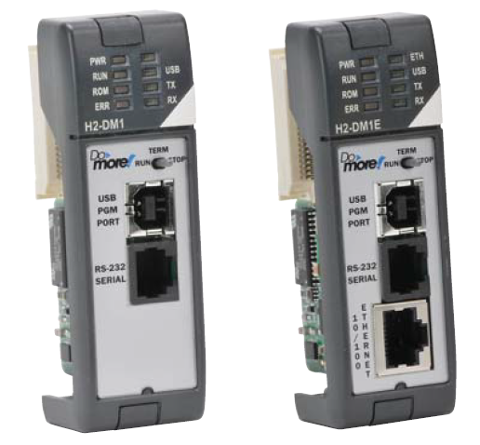
Communications – Custom UDP
Do-more built-in Ethernet

Slide 3
Communications – Custom UDP
Serial & TCP Protocols are streams of data
Serial medium is usually a private conversation
I’ll say ‘bye’.
OK. I will talk at this rate and only to you.
I’m only going to give you 5 data points.
I need to give you the latest data on the weather.
OK, but don’t talk too slow; I’ve got other things to do.
Stream of weather data…
How will I know when the conversation is complete?
OK, I’m listening…
Bye
Thanks.
IMPLIMENTATION: Partner listens.
IMPLIMENTATION: Transfer complete
ENGINEERING: What type of data will be sent?
IMPLIMENTATION: (Processes data)
ENGINEERING: How will the data end?
ENGINEERING: How is the data transmitted?

Slide 4
Communications – Custom UDP
TCP Protocol medium is a network
TCP is connection-based protocol
Dial
Ring
OK. I’ll call you later.
I’m sorry, but I’m pretty busy at the moment.
Can we talk?
Hello?
Dial
Ring
A “connection” must be established before a conversation can take place. The client (man) must call the server (woman). One is initiating and the other is listening.
<starts conversation>
Can we talk?
Hello?
Sure. What’s up?
The conversation is delimited because both parties will agree on when it is over and say, “Bye”, just like serial comms.

Slide 5
Communications – Custom UDP
UDP Protocol medium is also a network
UDP is connectionless protocol
Since no connection is needed, no resources (i.e. cellphone) are monopolized
A “connection” is not necessary. The client (man) simply sends a message to the server (woman).

Slide 6
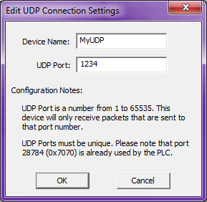
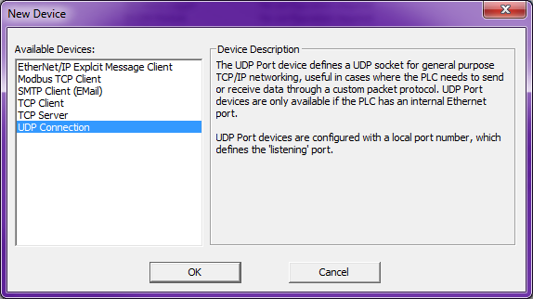
Communications – Custom UDP
UDP Connection (Initiator or Listener)
Do-more CPU with built-in Ethernet port
Must create a UDP Connection
Use Device Configuration & <New Device> button → “UDP Connection”, press <OK> button
Give it a Device Name
Give it a UDP Port number – this Device will only receive packets that are sent to this port number
Use PACKETOUT / PACKETIN instructions to send/receive data to/from partner

Slide 7
Communications – Custom UDP
Custom Protocol | Type | Data Size | Client Instruction | Server Instruction | Server Member
Serial | Stream | Unlimited | STREAMOUT | STREAMIN | InQueue (# of bytes)
 |  |  | STREAMIN | STREAMOUT
TCP |  |  | OPENTCP | TCPLISTEN
 |  |  | STREAMOUT | STREAMIN
 |  |  | STREAMIN | STREAMOUT
UDP | Packet | 1 packet | PACKETOUT | PACKETIN | PacketAvailable (bit)

Slide 8
Communications – Custom UDP
@MyUDP (Initiator)
@MyUDP (Listener)
Output Buffer
“TIME”<CR><LF>
Input Buffer
“TIME”<CR><LF>
“TIME” <CR><LF>
The logic for the PACKETIN can be set to monitor the PacketAvailable bit & when it is executed, will read the data out of the Input Buffer
PacketAvailable = ON
PacketAvailable = OFF
When the @MyUDP Device “gets around to it”, it sends the data in its Output Buffer out on the wire
PACKETOUT
“TIME”<CR><LF>
The data goes into the @MyUDP Device’s Input Buffer where it will stay until a PACKETIN is executed to get the data out
PACKETOUT does not send data out on the wire; it merely writes the data to the @MyUDP Device’s Output Buffer
@MyUDP Device’s structure member, PacketAvailable, is set ON indicate one or more packets are currently in the Input Buffer
PACKETIN
Memory
“TIME”<CR><LF>

Slide 9
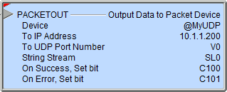
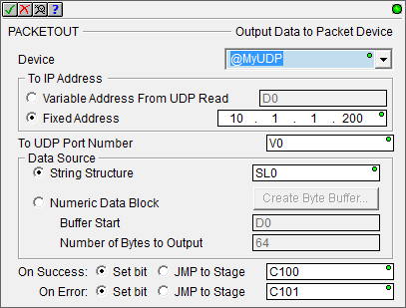
Communications – Custom UDP
PACKETOUT “Output Data to Packet Device”
Writes data to UDP Device’s output buffer
Fully asynchronous instruction (red triangle)
Parameters:
Device – UDP Connection Device
To IP Address:
Variable Address From UDP Read – uses IP address read from the last PACKETIN instruction execution
Fixed Address
To UDP Port Number
Data Source:
String Structure – string to send
Numeric Data Block
Buffer Start – location of start of data buffer to send
Number of Bytes to Output
On Success: Set bit, JMP to Stage
On Error: Set bit, JMP to Stage

Slide 10
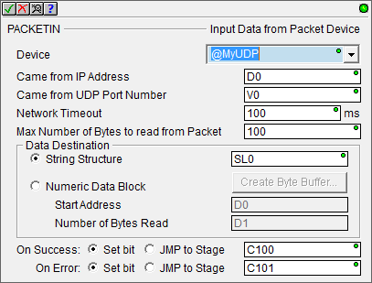
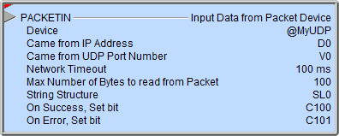
Communications – Custom UDP
PACKETIN “Input Data from Packet Device”
Retrieves data from UDP Device’s input buffer
Structure member PacketAvailable comes ON when there is one or more packets in the input buffer to receive
Fully asynchronous instruction (red triangle)
Parameters:
Device – UDP Connection Device
Came from IP Address – where to put the sender’s IP address from which the packet came from
Came from UDP Port Number – where to put the packet’s sending port number value
Network Timeout
Max Number of Bytes to read from Packet
Data Destination:
String Structure
Numeric Data Block:
Start Address
Number of Bytes Read
On Success: Set bit, JMP to Stage
On Error: Set bit, JMP to Stage
The Came from IP Address & Came from UDP Port Number parameters are NOT something you provide, but instead are something the PACKETIN instruction provides you
When attempting to get a PACKETIN to work the first time, the importance of Network Timeout cannot be overstressed because without it the PACKETIN has potential to lock the UDP Device

Slide 11
Communications – Custom UDP
UDP Connection (Initiator)
UDP Connection (Listener)
Do-more CPU
Do-more CPU
Memory
Memory
PACKETOUT
@MyUDP
UDP
@MyUDP
PACKETIN

Slide 12
Communications – Custom UDP
Communications Test
IP Address: 10.1.1.200
UDP Port #: 1234
Commands delimited by <CR><LF>:
TIME
Response: “Current PLC Time is: 04:02:14 PM”
DATE
Response: “Current PLC Date is: 3/11/2016”
SCANTIME
Response: “Current PLC Scan Time is: 561us”
FIRMWARE
Response: “Current PLC Firmware is: 176201”
IPADDRESS
Response: “Current PLC IP Address is: 10.1.1.200”

