Slide 1
Do-more Technical Training
Communications
(Custom Serial)

Slide 2
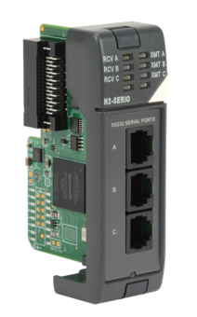
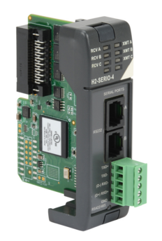
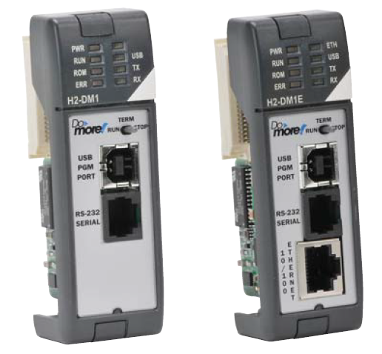
Communications – Custom Serial
Do-more built-in serial port
Do-more with SERIO/SERIO4

Slide 3
Communications – Custom Serial
Serial & TCP Protocols are streams of data
Serial medium is usually a private conversation
I’ll say ‘bye’.
OK. I will talk at this rate and only to you.
I’m only going to give you 5 data points.
I need to give you the latest data on the weather.
OK, but don’t talk too slow; I’ve got other things to do.
Stream of weather data…
How will I know when the conversation is complete?
OK, I’m listening…
Bye
Thanks.
IMPLIMENTATION: Partner listens.
IMPLIMENTATION: Transfer complete
ENGINEERING: What type of data will be sent?
IMPLIMENTATION: (Processes data)
ENGINEERING: How will the data end?
ENGINEERING: How is the data transmitted?

Slide 4
Communications – Custom Serial
TCP Protocol medium is a network
TCP is connection-based protocol
Dial
Ring
OK. I’ll call you later.
I’m sorry, but I’m pretty busy at the moment.
Can we talk?
Hello?
Dial
Ring
A “connection” must be established before a conversation can take place. The client (man) must call the server (woman). One is initiating and the other is listening.
<starts conversation>
Can we talk?
Hello?
Sure. What’s up?
The conversation is delimited because both parties will agree on when it is over and say, “Bye”, just like serial comms.

Slide 5
Communications – Custom Serial
UDP Protocol medium is also a network
UDP is connectionless protocol
Since no connection is needed, no resources (i.e. cellphone) are monopolized
A “connection” is not necessary. The client (man) simply sends a message to the server (woman).

Slide 6
Communications – Custom Serial
Custom Protocol | Type | Data Size | Client Instruction | Server Instruction | Server Member
Serial | Stream | Unlimited | STREAMOUT | STREAMIN | InQueue (# of bytes)
 |  |  | STREAMIN | STREAMOUT
TCP |  |  | OPENTCP | TCPLISTEN
 |  |  | STREAMOUT | STREAMIN
 |  |  | STREAMIN | STREAMOUT
UDP | Packet | 1 packet | PACKETOUT | PACKETIN | PacketAvailable (bit)

Slide 7
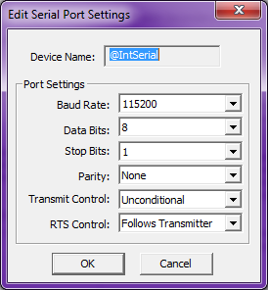
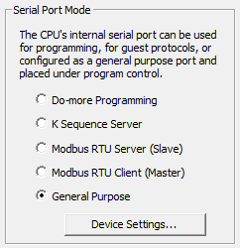
Communications – Custom Serial
General Purpose comms (Initiator/Listener)
Do-more CPU with built-in serial port or SERIO/SERIO4
Serial Port Mode must be configured
Use CPU Configuration for built-in or Module Configuration for SERIO/SERIO4
Select “General Purpose”
Use <Device Settings> button to change port settings as desired
Use STREAMOUT (write) & STREAMIN (read) instructions

Slide 8
Communications – Custom Serial
@IntSerial (Initiator)
@IntSerial (Listener)
Output Buffer
“TIME”<CR><LF>
Input Buffer
“TIME”<CR><LF>
“TIME” <CR><LF>
The logic for the STREAMIN can be set to monitor the InQueue value & when it is executed, will read the data out of the Input Buffer
InQueue = 6
InQueue = 0
When the @IntSerial Device “gets around to it”, it sends the data in its Output Buffer out on the wire
STREAMOUT
“TIME”<CR><LF>
The data goes into the @IntSerial Device’s Input Buffer where it will stay until a STREAMIN is executed to get the data out
STREAMOUT does not send data out on the wire; it merely writes the data to the @IntSerial Device’s Output Buffer
@IntSerial Device’s structure member, InQueue, is set to indicate how many bytes are currently in the Input Buffer
STREAMIN
Memory
“TIME”<CR><LF>

Slide 9
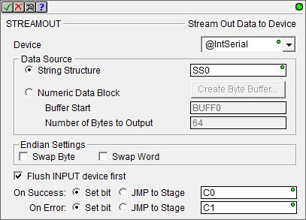
Communications – Custom Serial
STREAMOUT “Stream Out Data to Device”
Writes data from to stream-capable device
Fully asynchronous instruction (red triangle)
Parameters:
Device – stream-capable Device
Data Source:
String Structure – string to send
Numeric Data Block
Buffer Start – location of start of data buffer to send
Number of Bytes to Output
Endian Settings:
Swap Byte
Swap Word
Flush INPUT device first
On Success: Set bit, JMP to Stage
On Error: Set bit, JMP to Stage

Slide 10
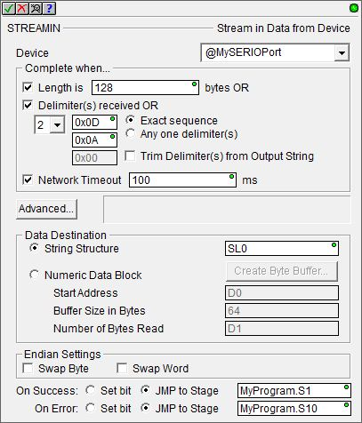
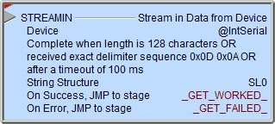
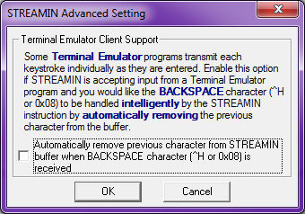
Communications – Custom Serial
STREAMIN “Stream in Data from Device”
Reads data from a stream-capable device
Fully asynchronous instruction (red triangle)
Parameters:
Device – stream-capable Device
Complete when…
Length is x bytes OR
Delimeter(s) received OR
Number of delimiters
Delimiter characters
Exact sequence
Any one delimiter(s)
Trim Delimiter(s) from Output String
Network Timeout
<Advanced…> button
Data Destination
String Structure
Numeric Data Block
Start Address
Buffer Size in Bytes
Number of Bytes Read
Endian Settings: Swap Byte, Swap Word
On Success/On Error: Set bit, JMP to Stage
When attempting to get a STREAMIN to work the first time, the importance of Network Timeout cannot be overstressed because without it the STREAMIN has potential to lock the streaming Device

Slide 11
Communications – Custom Serial
General Purpose (Initiator)
General Purpose (Listener)
Do-more CPU
Do-more CPU
Memory
Memory
STREAMOUT
@IntSerial
@IntSerial
STREAMIN

Slide 12
Communications – Custom Serial
Communications Test
Commands delimited by <CR><LF>:
TIME
Response: “Current PLC Time is: 04:02:14 PM”
DATE
Response: “Current PLC Date is: 3/11/2016”
SCANTIME
Response: “Current PLC Scan Time is: 561us”
FIRMWARE
Response: “Current PLC Firmware is: 176201”
IPADDRESS
Response: “Current PLC IP Address is: 10.1.1.200”

