Slide 1
Do-more Technical Training
CTRIO2
(Introduction)

Slide 2
Instruction Set
THE BASICS
181 instructions
Contact (14)
Coil/Bit Output (11)
Analog/Process (13)
Date/Time/Calendar (7)
Ethernet (5)
Hardware/Device (9)
High Speed/CTRIO (19)
Math (5)
Misc/Data Manipulation (23)
Program Control (20)
Program-Looping (8)
Protocol-Custom/ASCII (7)
Protocol-Standard (10)
String (14)
Timer/Counter/Drum (16)

Slide 3
Instruction Set
Box Instruction
Corner
THE BASICS
181 instructions
In-line (100) – no flag
Executes completely in-line on same scan
Fully Asynchronous (48) – Red
Dependent on shared Device’s availability
Locks Device when executed to make it exclusive
Unlocks Device after it is finished
Must not terminate before it is finished
Must wait for Success or Error indication
All CTRIO2 instructions are fully asynchronous
Multi-scan (20) – Yellow
Takes 2 or more scans to complete or function properly
Depend on the status of the instruction from previous scan
(Edge-triggering inputs normally take 2 also)
Yielding (5) – Blue
Can temporarily postpone operation until next scan
Skipping (6) – Green
Can skip forward or backward in code
Yielding/Skipping (2) - Blue Green
Can temporarily postpone operation until next scan and skip forward or backward in code

Slide 4
CTRIO2 – Introduction
High Speed/CTRIO (19)
CTAXCFG – CTRIO2 Axis Configuration
CTAXDYNP – CTRIO2 Axis Run Dynamic Position Mode
CTAXDYNV – CTRIO2 Axis Run Dynamic Velocity Mode
CTAXJOG – CTRIO2 Axis Jog Mode
CTAXLIMT – CTRIO2 Axis Run Trapezoid w/Limits
CTAXTRAP – CTRIO2 Axis Run Trapezoid
CTDYNPOS – CTRIO Run Dynamic Position Mode
CTDYNVEL – CTRIO Run Dynamic Velocity Mode
CTPLSADD – CTRIO2 Add Entry to PLS
CTPLSEDT – CTRIO2 Edit PLS Entry
CTREGRD – CTRIO Read Register
CTREGWR – CTRIO Write Register
CTRUNPOS – CTRIO Run Position Mode
CTRUNVEL – CTRIO Run Velocity Mode
CTTBLADD – CTRIO Add Entry to Preset Table
CTTBLCLR – CTRIO Clear Table
CTTBLEDT – CTRIO Edit Preset Table Entry
CTTBLLD – CTRIO Load Table
CTUPDLVL – CTRIO Update Level

Slide 5
CTRIO2 – Introduction

Slide 6
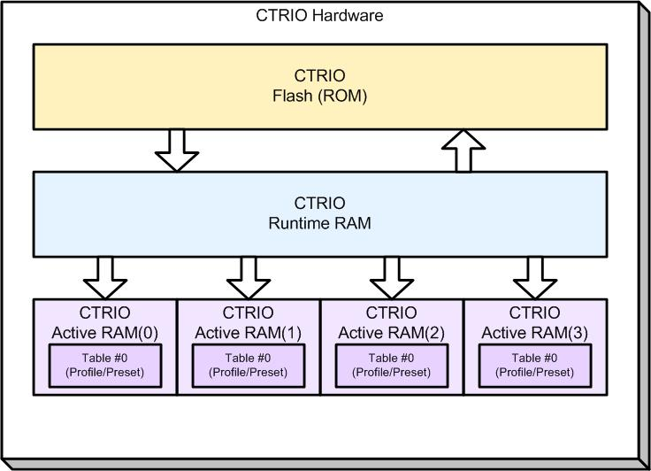
CTRIO2 – Introduction
Flash (ROM)
DL-PLC: memory where CTRIO Workbench configuration is stored
Do-more: irrelevant
Runtime RAM
DL-PLC: on power-up Flash (ROM) is copied to here
Do-more: overwrites whatever is here with the Module Configuration stored in the Do-more
Active RAM (0-3): memory where the active Table for each Pulse Output is stored
Table #0: Special Table that is always active

Slide 7
CTRIO2 – Introduction
DL-PLC
CTRIO2
ROM
CTRIO Workbench
RAM
CTRIO Configuration #1
CTRIO Configuration #1
CTRIO Configuration #1
A copy must also be stored in a CWB file in case the CTRIO2 ever needs replacement
CTRIO Configuration #1
The configuration is written to CTRIO RAM & then copied to ROM
CWB File
A CTRIO configuration is created in CTRIO Workbench software

Slide 8
CTRIO2 – Introduction
When everything is powered down, the configuration only exists in the CWB file (if saved!) and the ROM of the CTRIO2
DL-PLC
CTRIO2
ROM
CTRIO Workbench
CTRIO Configuration #1
RAM
CTRIO Configuration #1
CTRIO Configuration #1
If the CTRIO2 is replaced for any reason then the configuration would be lost if not previously saved in the CWB file
CWB File
If the configuration was previously saved in the CWB file, then it can be read up into CTRIO Workbench and written back to the new CTRIO2
CTRIO Configuration #1
CTRIO Configuration #1

Slide 9
CTRIO2 – Introduction
POWER = OFF
POWER = ON
DL-PLC
CTRIO2
ROM
CTRIO Configuration #1
CTRIO Workbench
CTRIO Configuration #1
RAM
On power up the CTRIO2 copies the configuration from ROM to RAM
CWB File
The DL-PLC works with the RAM copy because it is much faster, of course
CTRIO Configuration #1

Slide 10
CTRIO2 – Introduction
The configuration is never written to the CTRIO2’s ROM
Do-more
CTRIO2
ROM
Do-more Designer
System Config
CTRIO Configuration #2
RAM
CTRIO Configuration #2
CTRIO Configuration #2
CTRIO Configuration #2
The configuration is written to the System Configuration (Flash Memory)
Do-more Project
The configuration is also written to the CTRIO2’s RAM
A CTRIO configuration is created in Do-more Designer in the System Configuration → Module Configuration
A copy is also stored in the Do-more Project file

Slide 11
CTRIO2 – Introduction
POWER = OFF
POWER = ON
Do-more
CTRIO2
ROM
Do-more Designer
System Config
CTRIO Configuration #2
CTRIO Configuration #2
RAM
On power up the Do-more copies the configuration from System Configuration to CTRIO2 RAM
Do-more Project
CTRIO Configuration #2

Slide 12
CTRIO2 – Introduction
POWER = OFF
POWER = ON
Do-more
CTRIO2
ROM
CTRIO Configuration #1
Do-more Designer
System Config
CTRIO Configuration #1
CTRIO Configuration #2
CTRIO Configuration #2
RAM
Also, if the CTRIO2 was to be replaced there is no need to reconfigure it because on power up the Do-more writes the proper configuration down to the CTRIO2
Thus, if this same CTRIO2 was placed in a DL-PLC it would have configuration #1; if in a Do-more it would have configuration #2
However, that copy will get overwritten by the Do-more on power up
On power up the CTRIO2 copies the configuration from ROM to RAM
Do-more Project
CTRIO Configuration #2

Slide 13
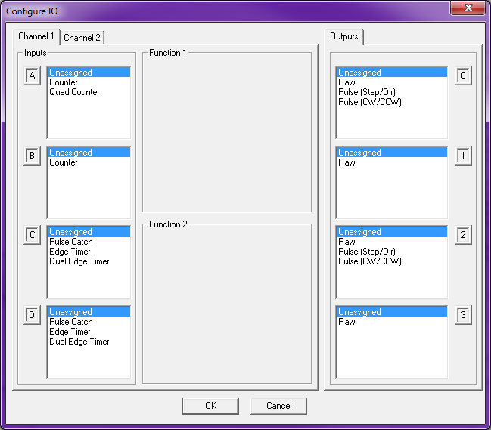
CTRIO2 – Introduction
CTRIO2
1A
0
I
N
P
U
T
S
1B
1
O
U
T
P
U
T
S
1C
Ch 1
2
1D
3
2A
2B
2C
Ch 2
2D

