Slide 1


Do-more Technical Training
Connecting C-more

Slide 2
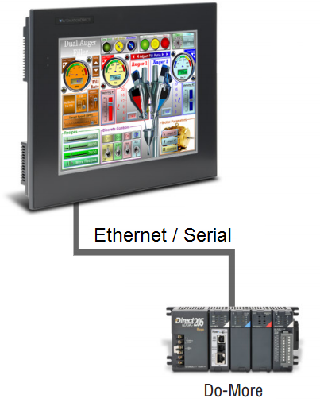
Connecting C-more
Two easy ways:
  Create TAGs manually
    …in C-more Programming
  Create TAGs automatically
    …by importing an exported
    Element Documentation file
    from Do-more Designer

Slide 3
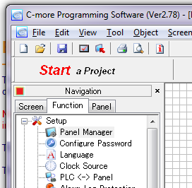
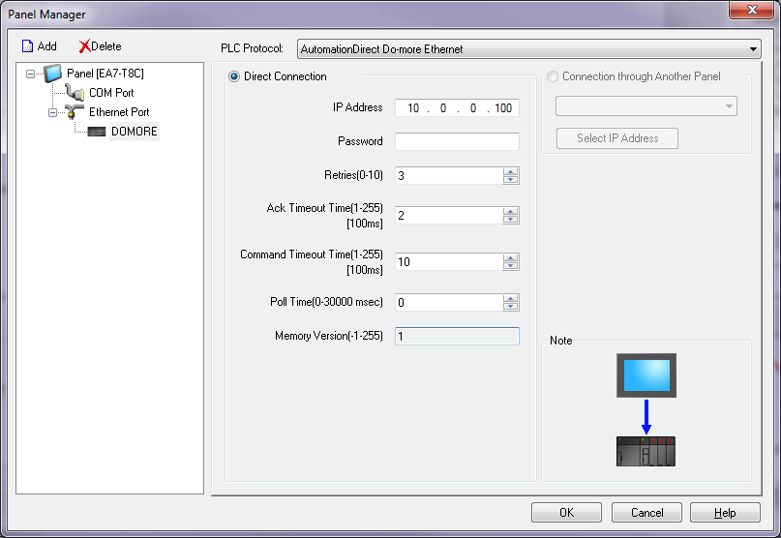
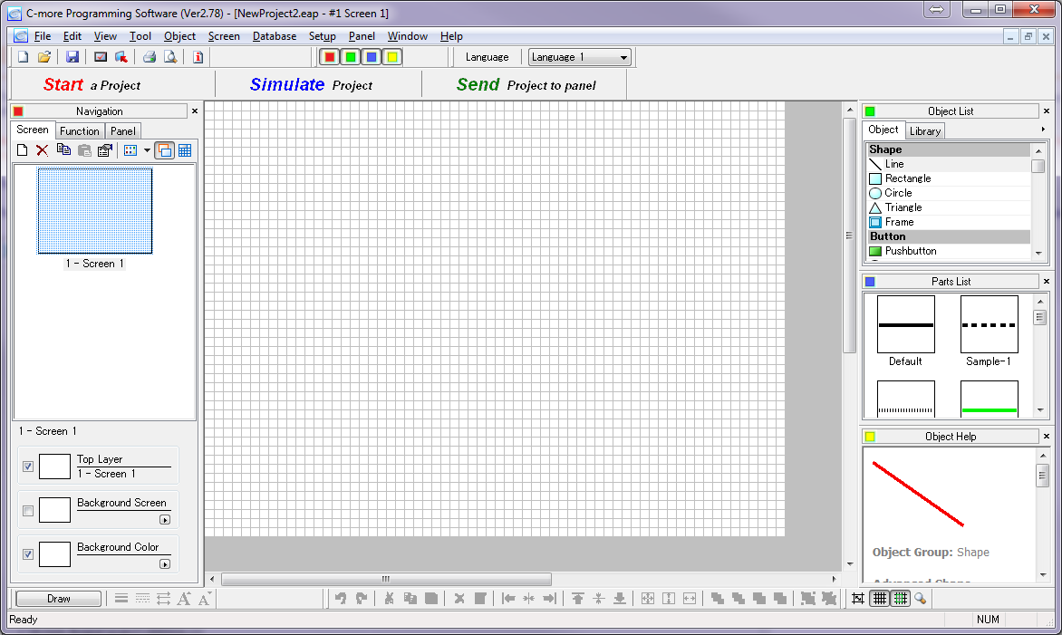
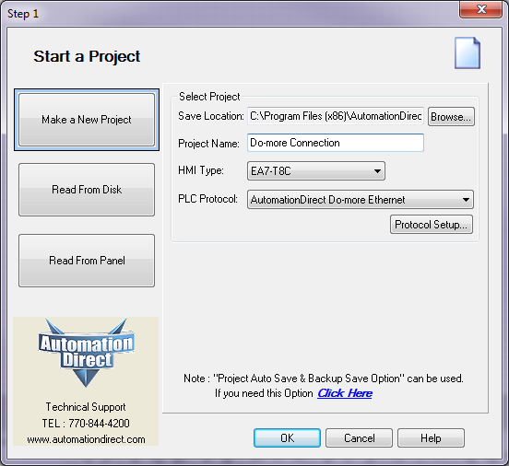
Connecting C-more
Create TAGs Manually:
  Start C-more Programming Software
  Press <Start a Project> button
  Enter Project Name
  Select panel
  Select Do-more Protocol
    AutomationDirect
    Do-more Ethernet
    AutomationDirect
    Do-more Serial
      NOTE: If this is picked make
      sure the Do-more port is set to
      “Do-more Programming”
  Press <OK> button
  Select Function tab, under Setup, double-click Panel Manager
  Name Device, enter connection parameters (e.g. IP Address or Serial parameters) & password (if needed)
  Press <OK> button

Slide 4
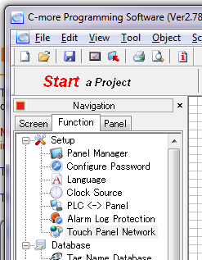
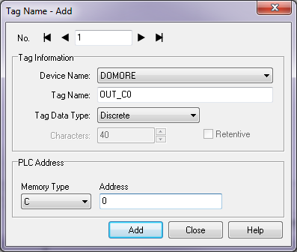
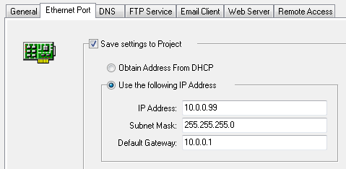

Connecting C-more
Create TAGs Manually:
  On Function tab, under Setup, double-click Touch Panel Network
  Select Ethernet Port tab & enter desired parameters
  Select Database → Tag Name Database…, then the <Add…> button
  Enter Device Name, a Tag
  Name, a Tag Data Type, then
  select the Memory Type &
  Address in the Do-more from
  the pull-down menus
  Enter all desired TAGs…
  Press <OK>, then <Close>
  Save Project & Send it to the
  panel

Slide 5
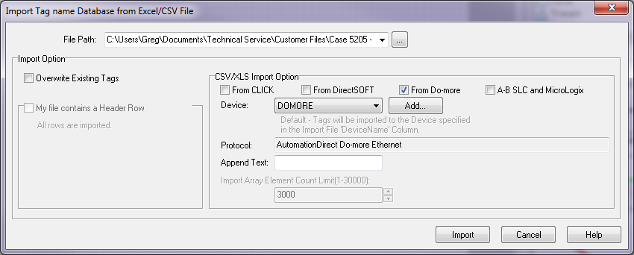
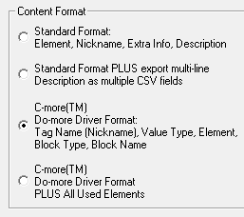
Connecting C-more
Use Do-more’s exported Element Documentation file
  In Do-more Designer (that has a documented project) select File → Export → Element Documentation
  Choose the C-more Format desired:
    Tag Name (Nickname), Value Type, Element, Block Type, Block Name
    … PLUS All Used Elements
  Name file & press <Save> button
  In C-more Programming, select File → Import → Tag Name Database…
  Check “From Do-more”, select File Path & Device, then press the <Import> button

Slide 6
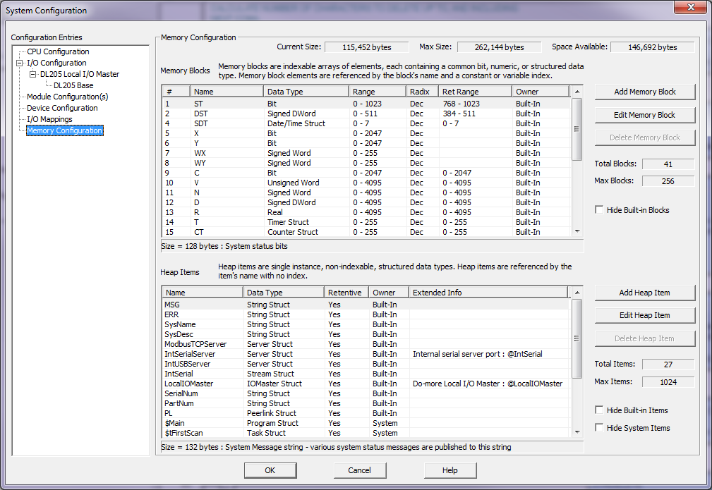



Connecting C-more
Limitations
  No Heap Items
  No user-created Memory Blocks

