Slide 1
Do-more Technical Training
System Configuration
(Device Configuration)

Slide 2
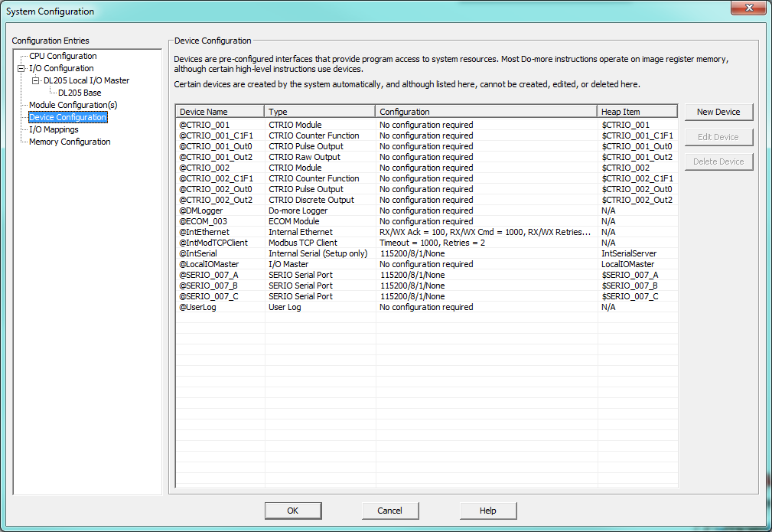
System Configuration
Device Configuration
Device Name: assigned name or name given to it in Module Configuration (cannot be changed here)
Type:
IntModTCPServer
IntEthernet
IntModTCPClient
IntSerial
LocalIOMaster
DMLogger
User Log
User Modbus TCP Client
User SMTP Client (EMail)
User TCP Client
User TCP Server
User UDP Connection
Etc…
Configuration: summary of the configuration
Heap Item: name of the Heap Item for the given Device
Notes:
Launchpad: nothing new here
Project Browser:
Buttons
Control Logic Filter – Display filter
New Code Block – Create new code blocks
Execution Order – Change execution order of blocks
Status – Shows which blocks are enabled to run
Sort Code Blocks – Change display order
Sort Memory – Change display order
Control Logic
Configuration
Tools
Debug View
NOTE: Message Dump – enables dump to Do-more Logger, $EnableMsgDump (ST36)
Data View
PID Overview

Slide 3
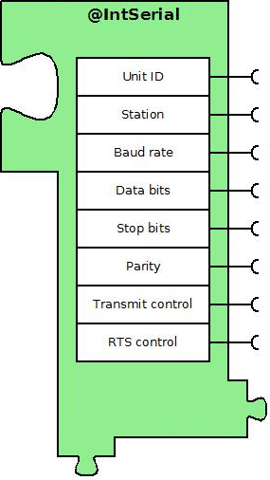
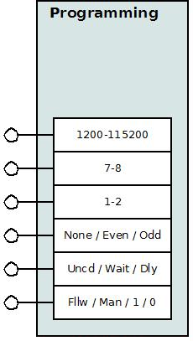
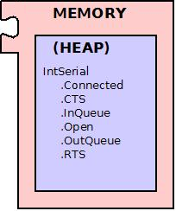
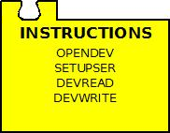
CPU Configuration
Manual
Configuration Interface
DEVICE
Driver Interface
Memory Interface
Instruction Interface

