Slide 1
Do-more Technical Training
Module Configuration

Slide 2
Module Configuration
Module Name: assigned logical name (can be changed)
Type:
CTRIO/CTRIO2
ECOM/ECOM100
ERM/ERM100
F2-8AD4DA-x
GS Drive
SERIO/SERIO4
Terminator Analog Output
Location: (I/O Master) -> (Base) -> (Slot) or “Disconnected”
“Disconnected”
- Module is missing
- Module type is incorrect If Module is being replaced, this could occur.
(1) Module goes bad
(2) Power down
(3) Remove bad Module
(4) Power up → “Disconnected”
- Allows Module configuration to be saved for replacement Module

Slide 3
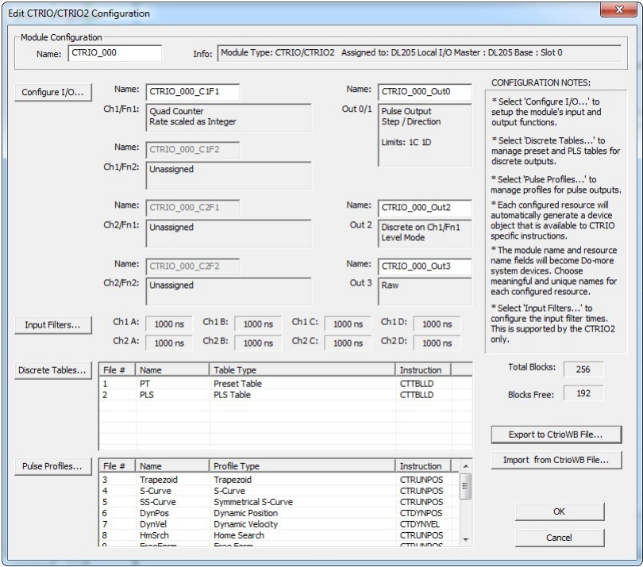
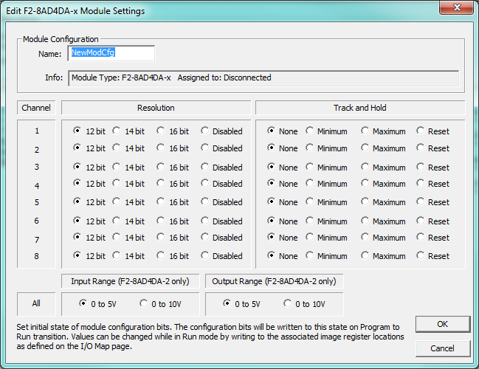
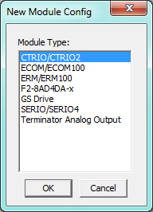
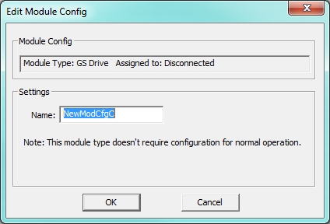
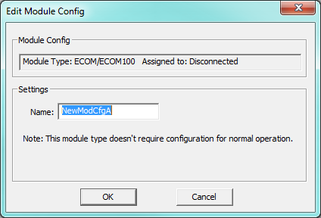
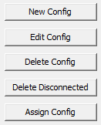
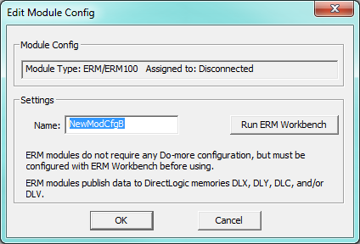
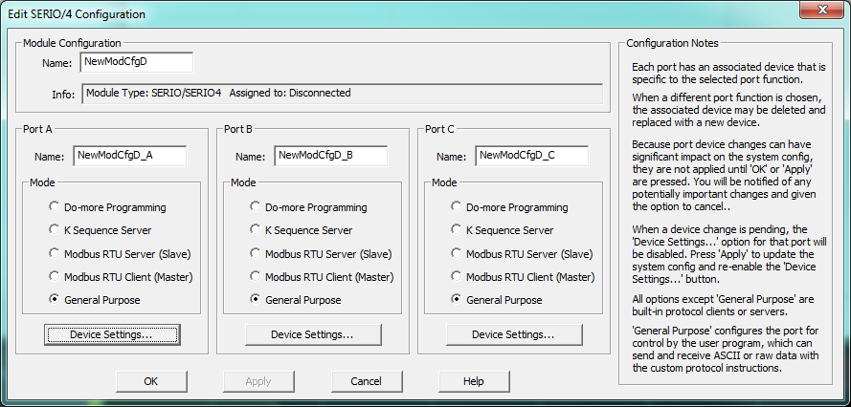
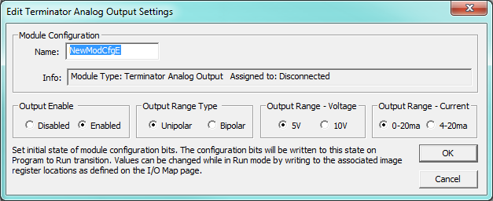
Module Configuration
New Config
CTRIO/CTRIO2
ECOM/ECOM100
ERM/ERM100
F2-8AD4DA-x
If 16-bit is chosen:
Must use WX0:U
GS Drive
SERIO/SERIO4
Terminator Analog Output

Slide 4
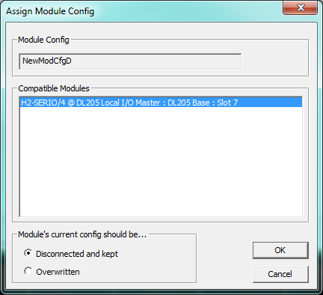
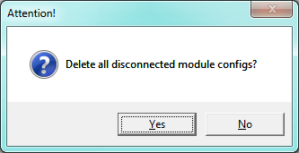
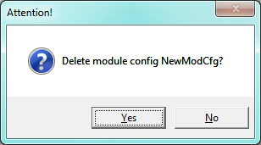
Module Configuration
New Config
Edit Config
Module type config is pulled up
Delete Config
Delete Disconnected
Assign Config
Disconnect and kept
Overwritten

Slide 5
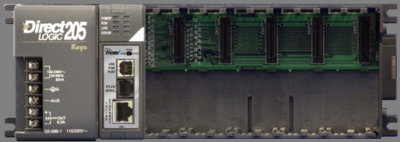
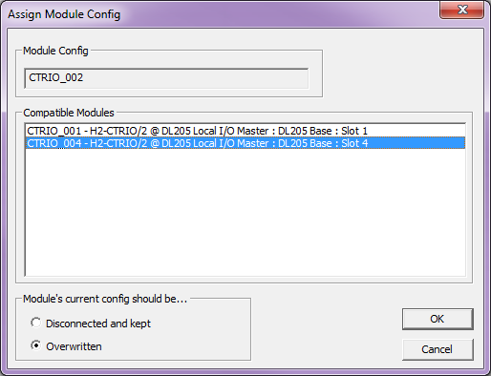
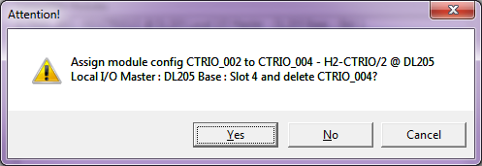
Module Configuration
Assign Config
Notes:
Configure the H2-CTRIO2 as a Counter and Pulse Out
Write program using CTRUNVEL
Confirm it works by Data View & Trend View
Power down
Move CTRIO2 to EBC100 rack
Power up
Configure Ethernet I/O for EBC100
Demonstrate the <Assign Config>, noting no changes were made to the program

