Slide 1
Do-more Technical Training
Hardware

Slide 2
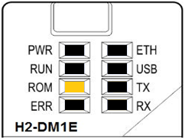
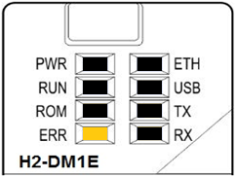
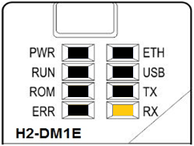
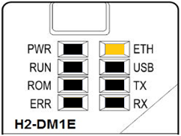
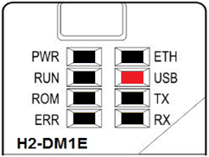
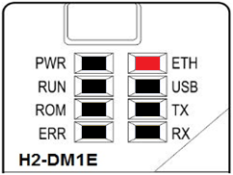
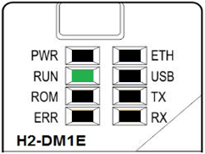
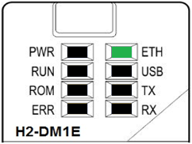
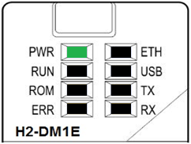
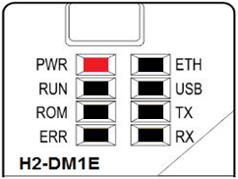
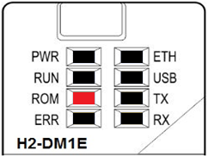
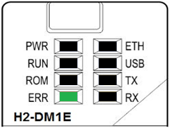
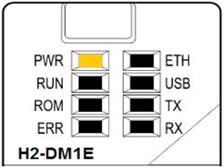
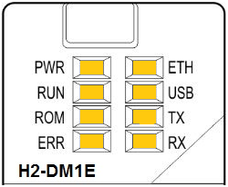
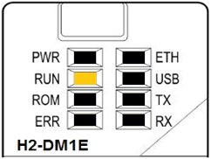
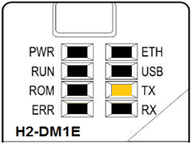
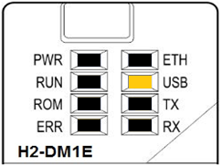
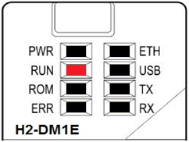
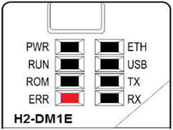
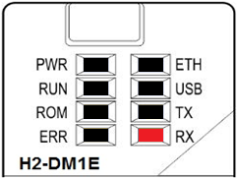
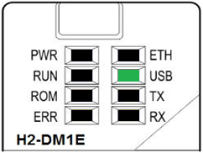
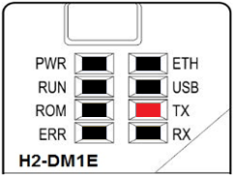
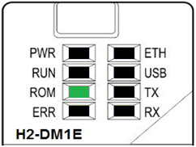
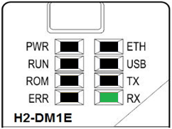
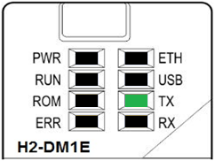
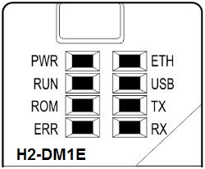
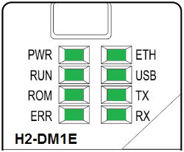
CPU Hardware
LEDs
Powered OFF
All YELLOW: Booter started
All GREEN: OS started
YELLOW-RED-GREEN Chase: OS initializing
Notes:
- Do power up demonstration

Slide 3
CPU Hardware
LEDs
PWR: Power
OFF – No base power
GREEN – Base power, battery good
YELLOW – Base power, battery low

Slide 4
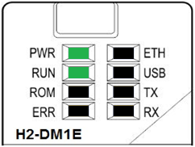
CPU Hardware
LEDs
RUN: Run mode
OFF – Stop (Program) mode
GREEN – Run mode

Slide 5
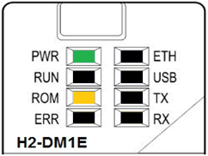
CPU Hardware
LEDs
ROM: Non-volatile read-only memory (ROM)
OFF – ROM not being updated
YELLOW – ROM being updated
Notes:
Connect with Do-more Designer
Goto Edit mode in $Main
Add a simple rung
Click <Write PLC> button
Observe ROM light
Make change in Ladder
Press <Write PLC> again
Observe Status bar in Do-more Designer

Slide 6
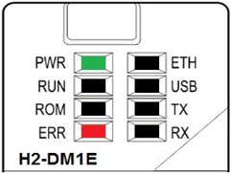
CPU Hardware
LEDs
ERR: Error
OFF – Normal
RED
(1) Fatal error: (e.g. I/O)

Slide 7
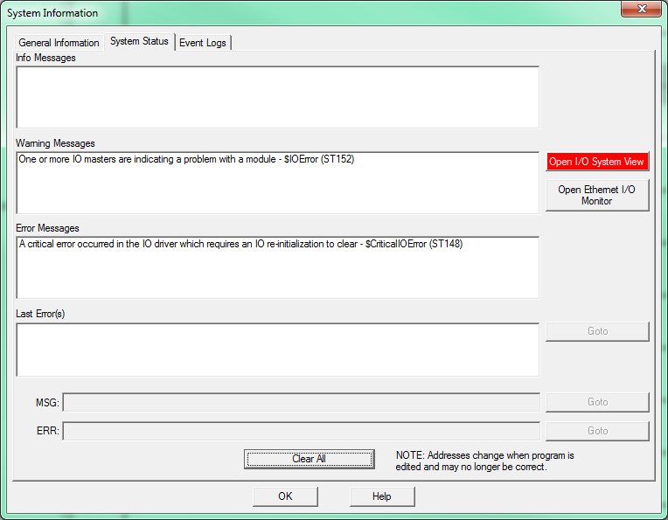
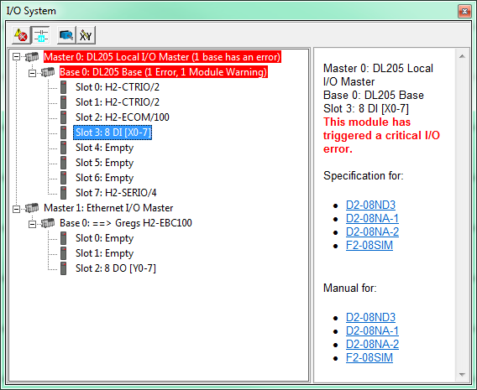
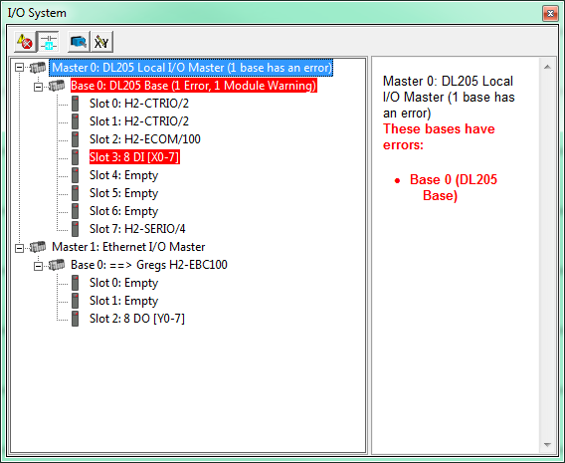
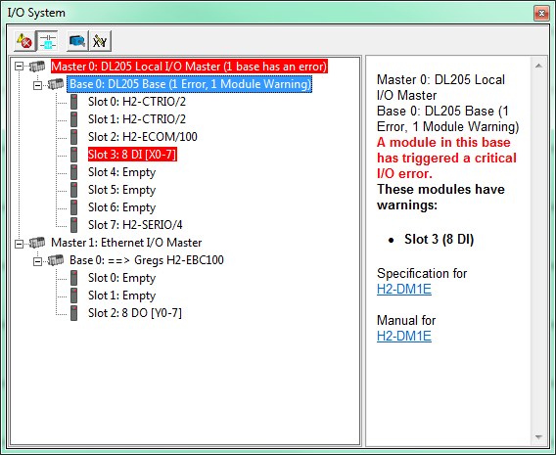
CPU Hardware (ERR LED lit)
Click on Error
Click on Open I/O System View
Notes:
While powered up, pull the output module out of the base
Click on the “Error” in the Status Bar
Click on the <Open I/O System View> button
Show progressive detail
Plug module back in
Use PLC → Re-initialize PLC I/O…

Slide 8
CPU Hardware
LEDs
ERR: Error
OFF – Normal
RED
Fatal error: (e.g. I/O)
$IOError (ST152)
$IOMasterErrors (DST28)
LocalIOMaster.Slot0_31

Slide 9
CPU Hardware
LEDs
ERR: Error
OFF – Normal
RED
(1) Fatal error: (e.g. I/O)
(2) Software watchdog: PLC scantime greater than $WatchdogTimeVal (DST23)

Slide 10
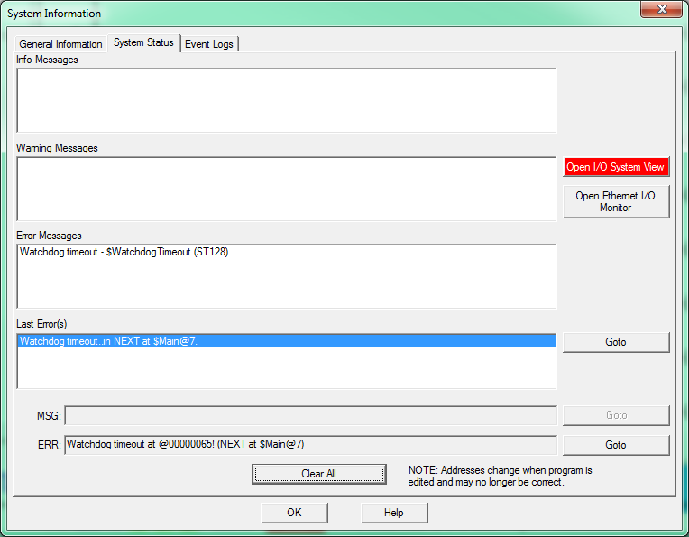
CPU Hardware (ERR LED lit)
Click on Error

Slide 11
CPU Hardware
LEDs
ERR: Error
OFF – Normal
RED
(1) Fatal error: (e.g. I/O)
(2) Software watchdog: PLC scantime greater than $WatchdogTimeVal (DST23)
$WatchdogTimeout (ST128)
Notes:
Make a simple C0 to WATCHDOG instruction in $Main selecting “Fire Software Watchdog” as the parameter
Create a Data View with $ScanTime, C0, $WatchdogTimeVal, $WatchdogTimeout in them
Discuss the values & make sure C0 is OFF (use Data View’s Edit mode)
Download to PLC
Put in RUN mode
Turn C0 ON and note response
Turn C0 OFF, clear error and go back to RUN mode

Slide 12
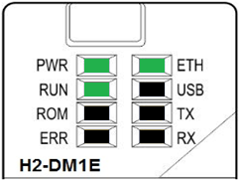
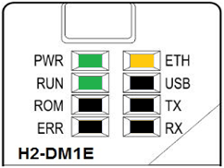
CPU Hardware
LEDs
ETH: Ethernet network
OFF – No connection
GREEN – Link good
YELLOW – Activity
Notes:
Unplug the Ethernet cable from the built-in port and plug it back in to notice the activity
Notice activity while a link is working

Slide 13
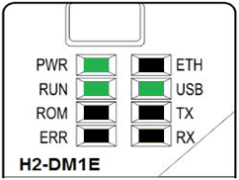
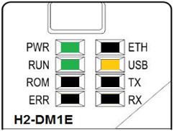
CPU Hardware
LEDs
USB: USB activity
OFF – No activity
GREEN – Receiving data
YELLOW – Transmitting data
Notes:
Make a USB link with USB cable
Notice activity light

Slide 14
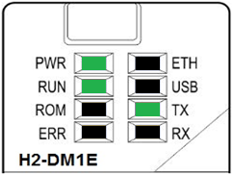
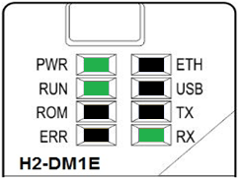
CPU Hardware
LEDs
TX: Serial port transmit
OFF – No activity
GREEN – Transmitting data
RX: Serial port receive
OFF – No activity
GREEN – Receiving data

Slide 15
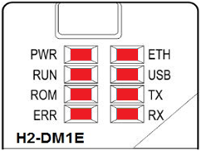
CPU Hardware
LEDs
All RED: Hardware Watchdog
Fires if OS stops working for >2 seconds
$DisableHwWdog (ST25)
OFF: Enabled
ON: Disabled
Disables H/W Watchdog
Prevents WATCHDOG instruction from working
Prevents Designer’s Debug Mode from firing H/W Watchdog
$HwWatchdogMode (ST24)
OFF: Reboot Mode
Attempts warm reboot
Makes entry in System Log
Sets $WatchdogReboot (ST13)
Increments $WatchdogReboots (DST385)
If ≥ 10, CPU stays in Stop (Program) mode
ON: Shutdown Mode
No reboots attempted
Stays in shutdown state

Slide 16
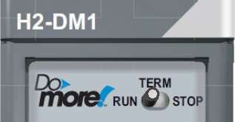
CPU Hardware
Mode Switch
RUN: Run
On power-up, goes to Run mode
TERM: Terminal; allows Designer to control mode
On power-up, returns to last mode
STOP: Stop; Program mode
On power-up, stays in Stop mode
Designer shows mode switch position
Notes:
Flip it and watch the Status Bar

Slide 17
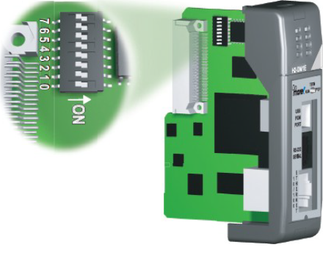
CPU Hardware
DIP Switches
0: Load oldest OS
1: Stay in booter
2: Disable H/W Watchdog
3: Disable update (OS/FPGA)
4: <reserved>
5: <reserved>
6: <reserved>
7: Reset TCP/IP network settings

Slide 18
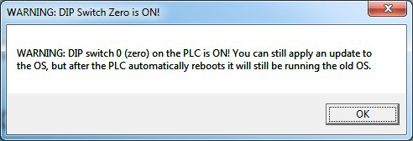
CPU Hardware
DIP Switches
0: Load oldest OS – In case the latest OS failed or features are not wanted, allows reverting to previous version
(1) Power down
(2) Remove CPU
(3) Set DIP #0 ON
(4) Reinstall CPU
(5) Power up
Set DIP #0 OFF to revert to latest OS

Slide 19
CPU Hardware
DIP Switches
0: Load oldest OS
Current OS 1.0 (Running)
Old OS 1.0 (not running)
New OS 1.1
New OS 1.1 (Running)
Newer OS 1.2 (Running)
Old OS 1.0 (not running)
Newer OS 1.2 (not running)
Old OS 1.0 (Running)
New OS 1.1 (not running)
FW Update

Slide 20
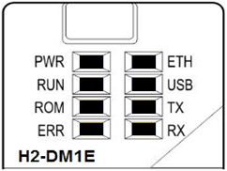
CPU Hardware
DIP Switches
1: Stay in booter – Causes CPU to power up, stay in booter & not run OS
(1) Power down
(2) Remove CPU
(3) Set DIP #1 ON
(4) Reinstall CPU
(5) Power up
Set DIP #1 OFF to power up normally

Slide 21
CPU Hardware
DIP Switches
2: Disable H/W Watchdog
Disables H/W Watchdog
Prevents WATCHDOG instruction from working
Prevents Designer’s Debug Mode from firing H/W Watchdog
(1) Power down
(2) Remove CPU
(3) Set DIP #2 ON
(4) Reinstall CPU
(5) Power up
CAUTION: Not recommended!

Slide 22
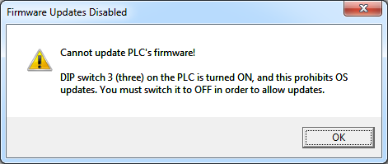
CPU Hardware
DIP Switches
3: Disable update (OS/FPGA): Prevents Designer from being able to update either the OS or the FPGA
(1) Power down
(2) Remove CPU
(3) Set DIP #3 ON
(4) Reinstall CPU
(5) Power up

Slide 23
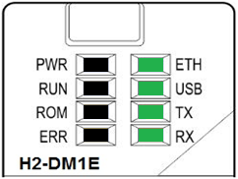
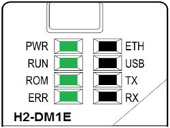
CPU Hardware
DIP Switches
7: Reset TCP/IP network settings: Resets back to factory defaults:
Module ID, Module Name, Module Description, IP Address, Subnet Mask, Gateway Address
Must be used in conjunction with DIP #1 (Stay in booter)
(1) Power down
(2) Remove CPU
(3) Set DIP #1 & #7 ON
(4) Reinstall CPU
(5) Set Mode Switch to TERM
(6) Power up
(7) Mode switch: RUN, TERM, RUN, TERM, STOP, TERM, STOP, TERM
(8) Power down
(9) Remove CPU
(10) Set DIP #1 & #7 OFF
(11) Reinstall CPU
(12) Power up

Slide 24
CPU Hardware
DIP Switches
0-7: Clear All: Clears everything!
TCP/IP network settings, System Configuration, Memory Configuration, Ladders, Documentation, User Accounts, Passwords
(1) Power down
(2) Remove CPU
(3) Set all DIPs ON
(4) Reinstall CPU
(5) Set Mode Switch to TERM
(6) Power up
(7) Mode switch: RUN, TERM, RUN, TERM, STOP, TERM, STOP, TERM
(8) Power down
(9) Remove CPU
(10) Set all DIPs OFF
(11) Reinstall CPU
(12) Power up

Slide 25
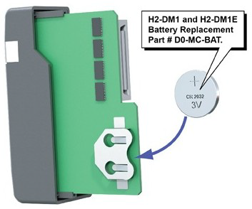
CPU Hardware
Battery Backup
3-year life
CR2032 (P/N: D0-MC-BAT)
2-hour capacitor
Holds up memory while replacing battery
Battery low indications
PWR light is YELLOW
$BatteryLow (ST149) = ON
Notes:
Power down
Remove battery
Power up & note the color of the PWR light
Create Data View and look at ST149

