Slide 1
BRX Technical Training
High-Speed I/O (Axis & Pulse Outputs)

Slide 2
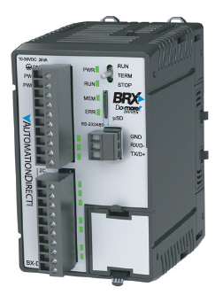
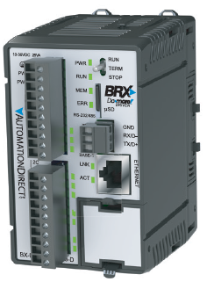
High-Speed I/O
BX10
6 discrete IN (all high-speed)
4 discrete OUT (2 high-speed)
No analog IN
No analog OUT
No Ethernet port
BX10E
6 discrete IN (all high-speed)
4 discrete OUT (2 high-speed)
1 analog IN
1 analog OUT
Ethernet port

Slide 3
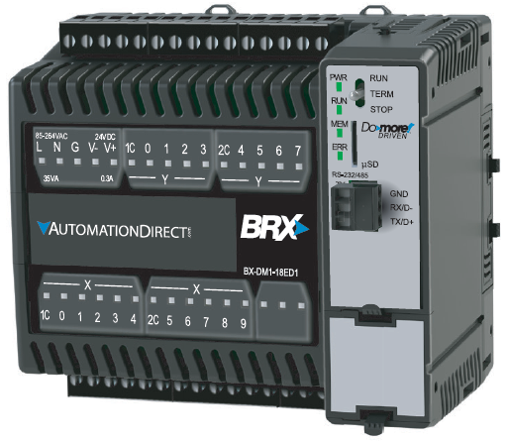
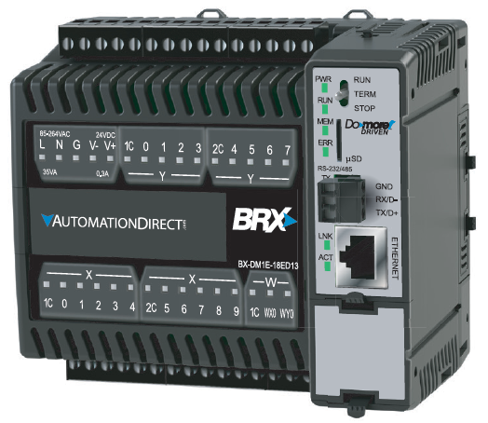
High-Speed I/O
BX18
10 discrete IN (all high-speed)
8 discrete OUT (4 high-speed)
No analog IN
No analog OUT
No Ethernet port
BX18E
10 discrete IN (all high-speed)
8 discrete OUT (4 high-speed)
1 analog IN
1 analog OUT
Ethernet port

Slide 4
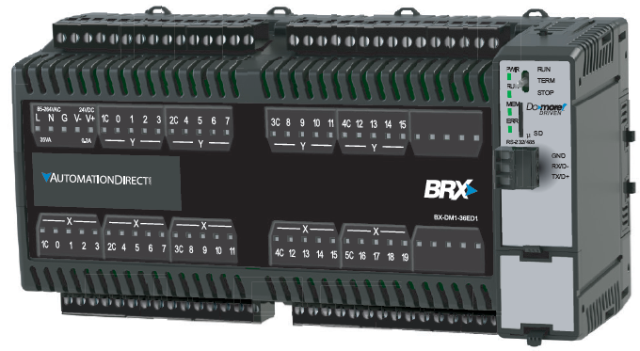
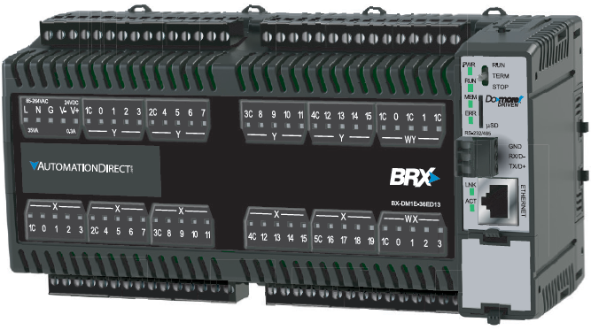
High-Speed I/O
BX36
20 discrete IN (10 high-speed)
16 discrete OUT (8 high-speed)
No analog IN
No analog OUT
No Ethernet port
BX36E
20 discrete IN (10 high-speed)
16 discrete OUT (8 high-speed)
4 analog IN
2 analog OUT
Ethernet port

Slide 5
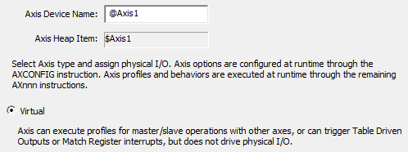
High-Speed Outputs (Axis)
Default Device Name: @Axis0, 1, 2 & 3
Default Structure: $Axis0, 1, 2 & 3
Virtual – configured only with AXCONFIG instruction; no actual physical I/O is used
@Axis0 is only a virtual axis
@Axis1-3 can be virtual (by default) but can also be configured to drive physical high-speed outputs

Slide 6
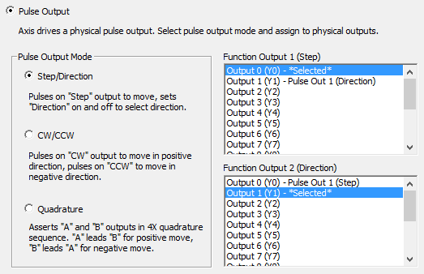
High-Speed Outputs (Axis)
Pulse Output Configuration
Step/Direction (2 outputs)
1 for step pulses
1 for selecting direction
CW/CCW (2 outputs)
1 for clockwise pulses
1 for counter-clockwise pulses
Quadrature (2 outputs)
1 for A output
1 for B output

Slide 7
High-Speed Outputs (Axis)
Instructions:
AXCONFIG “Axis Configuration”
AXJOG “Axis Jog Mode”
AXVEL “Axis Set Velocity Mode”
AXHOME “Axis Perform Home Search”
AXPOSTRAP “Axis Move to Position Using Trapezoid”
AXPOSSCRV “Axis Move to Position Using S-Curve”
AXGEAR “Axis Electronic Gearing”
AXFOLLOW “Axis Position Following with Offset”
AXCAM “Axis Electronic Camming”
AXRSTFAULT “Reset Axis Limit Fault”
AXSETPROP “Set Axis Properties”

Slide 8
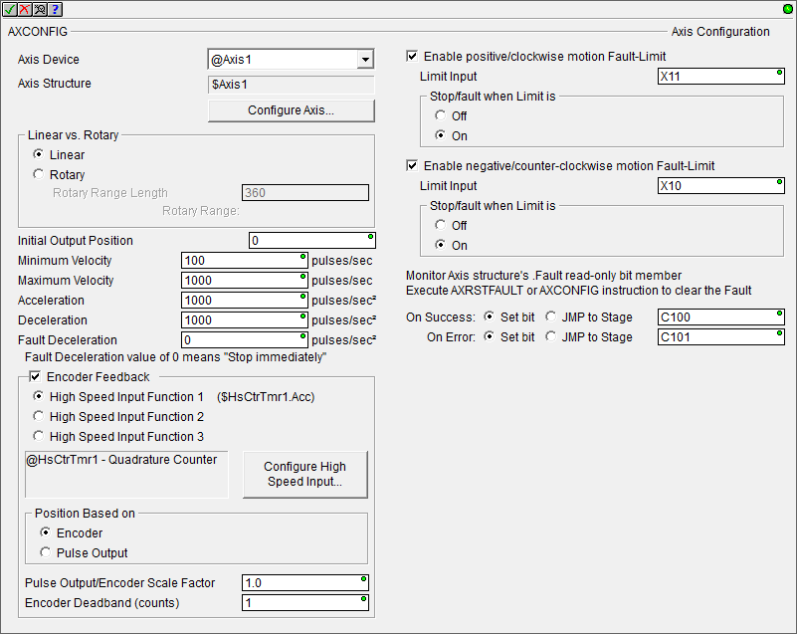
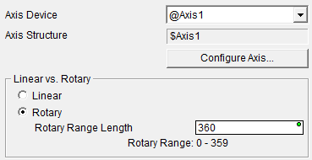
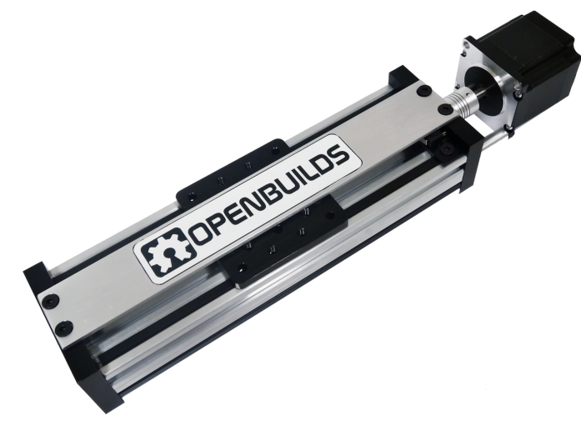
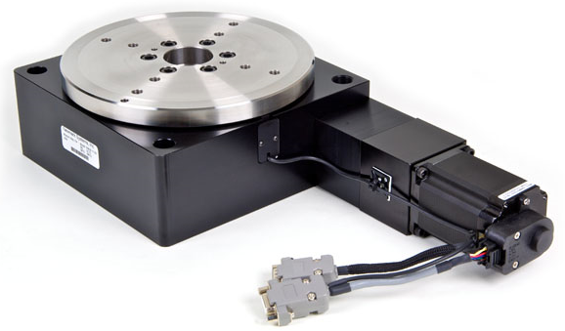
High-Speed Outputs (Axis)
AXCONFIG “Axis Configuration”
Pick Device Name
Can configure axis directly from the instruction using the <Configure Axis…> button
Linear vs Rotary
Linear moves forward or backward along a linear path
Rotary revolves so the position stays within a defined range; usually related to 360° of motion
Position: 0° (home)
Position: 270°
Position: 90°
Position: 0 (home)
Position: +100,000
Position: 180°

Slide 9
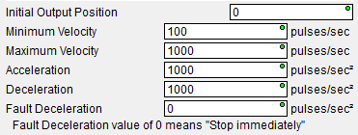
High-Speed Outputs (Axis)
AXCONFIG “Axis Configuration” (continued)
These are the main parameters
Initial Output Position – when the Axis is first enabled, this will be the current position value
Minimum Velocity – slowest frequency of output
Maximum Velocity – fastest frequency of output
Acceleration – rate of acceleration
Deceleration – rate of deceleration
Fault Deceleration – any time a Fault Limit is reached or the Axis’ Master Enable is manually turned OFF, the Axis will decelerate to stop using this rate; if 0 (zero), then pulses will stop immediately

Slide 10
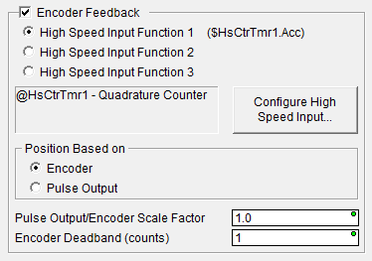
High-Speed Outputs (Axis)
AXCONFIG “Axis Configuration” (continued)
Enable this if using an encoder for feedback
If used for position feedback the Axis’ .FollowingError = difference between the output pulse count (.TargetPosition) and the encoder input value (.CurrentPosition)
If this number keeps increasing there is a problem
Pick the encoder: High Speed Input Function 1 ($HsCtrTmr1.Acc), etc.
Can configure the counter from the instruction using the <Configure High Speed Input…> button
Position Based on
Encoder – uses the encoder’s current value for Axis position
Pulse Output – uses output pulse count for Axis position
Pulse Output/Encoder Scale Factor – enter scaling factor for the application (e.g. motor’s ppr / encoder ppr; or there could be mechanical gearing, etc.)
Encoder Deadband (counts) – value that is applied above and below the encoder value; helps prevent “seeking”

Slide 11
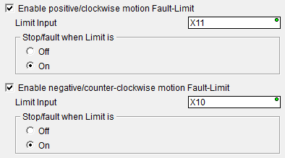
High-Speed Outputs (Axis)
AXCONFIG “Axis Configuration” (continued)
Enable these if you have a limit switch/sensor for this purpose
When these inputs are activated it will cause the Axis to go into a fault and decelerate to a stop
Monitor .Fault
To reset the fault:
Use AXRSTFAULT instruction, or…
Use AXCONFIG instruction to reconfigure Axis

Slide 12
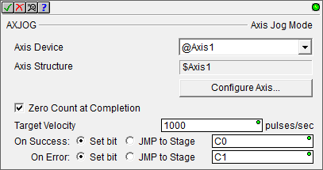
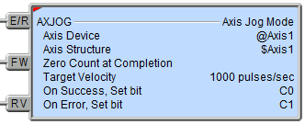
High-Speed Outputs (Axis)
AXJOG “Axis Jog Mode”
Allows the manual adjustment of an Axis’ position
Uses the acceleration and deceleration parameters setup in the AXCONFIG instruction
Maximum velocity is determined by either the Maximum Velocity specified here or in the AXCONFIG instruction; whichever is lower
Can zero the count after adjustment (e.g. a manual homing)
Input legs:
E/R – Enable/Reset; when ON Axis is in jog mode
FW – Forward; move Axis forward
RV – Reverse; move Axis in reverse
If both FW & RV are ON, Axis decelerates to stop
Success or Error on come on when E/R goes OFF

Slide 13
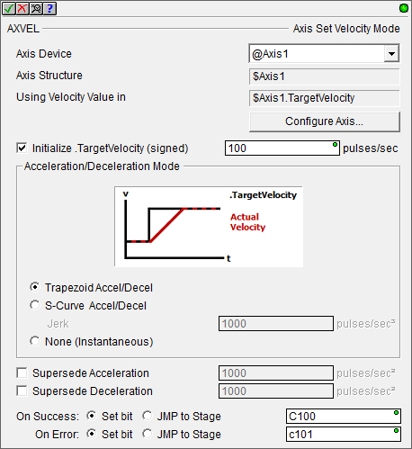
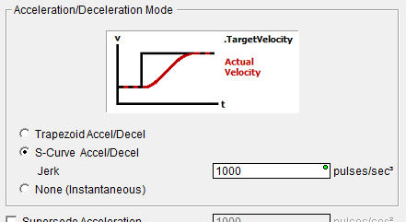
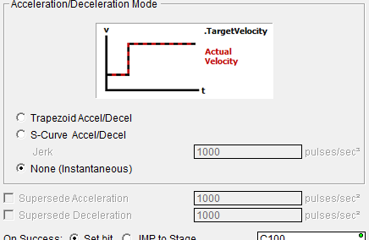
High-Speed Outputs (Axis)
AXVEL “Axis Set Velocity Mode”
Allows Axis to be put in velocity mode where movement is controlled by velocity (vs position)
.TargetVelocity can be changed on-the-fly
Uses AXCONFIG parameters unless otherwise selected
Can use an initial velocity when the instruction is enabled
Can select acceleration / deceleration mode:
Trapezoid
S-Curve
Jerk parameter
Instantaneous
Can use different acceleration / deceleration than AXCONFIG
Success or Error only come on when E/R leg goes OFF

Slide 14
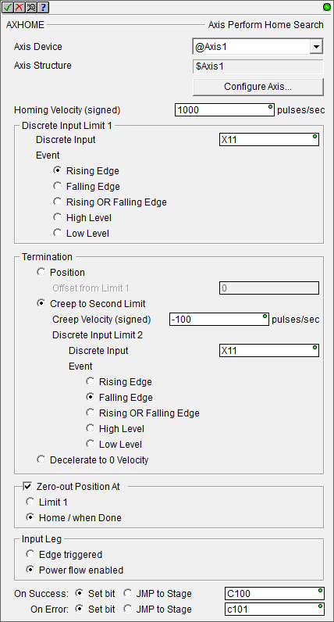
High-Speed Outputs (Axis)
AXHOME “Axis Perform Home Search”
Performs homing function to move Axis to physical starting position
Homing Velocity – sign determines direction
Choose input for home switch (Limit 1)
Choose termination
Position – an offset from the home switch (sign determines direction)
Creep to Second Limit – can be the same input; Creep Velocity’s sign determines direction
Decelerate to 0 Velocity
Choose where zero position is
Input leg can be Edge triggered or Power flow enabled
Use Power Flow if you might want to abort the operation with the input leg logic
Success or Error only occurs after homing is complete

Slide 15
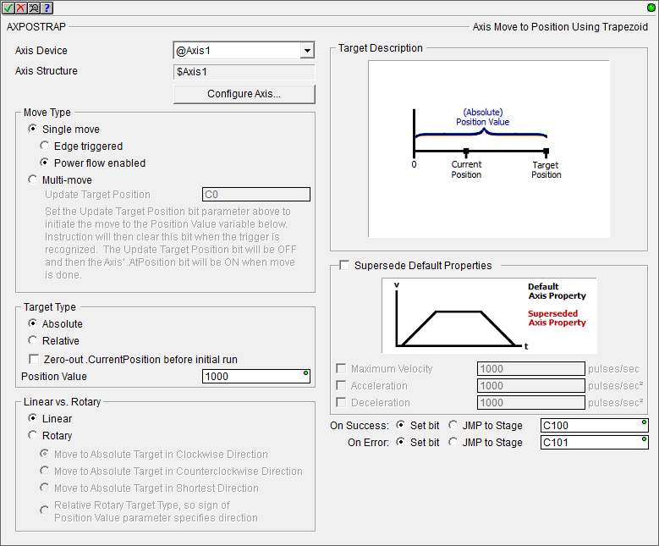
High-Speed Outputs (Axis)
AXPOSTRAP “Axis Move to Position Using Trapezoid”
Causes Axis to move to a Position Value via an absolute or relative position value
Uses AXCONFIG parameters unless superseded here
Works with linear or rotary axes
Can also be a multi- move instruction using the Update Target Position bit

Slide 16
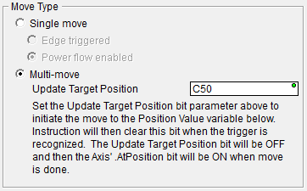
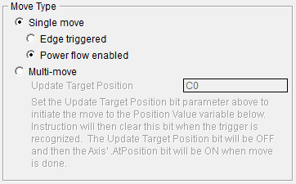
High-Speed Outputs (Axis)
AXPOSTRAP “Axis Move to Position Using Trapezoid” (continued)
Move Type
Single move – one move is executed when input leg is either:
Edge triggered, or…
Power flow enabled – use this if you want to abort (causing a fault) during the move using the input leg logic
Multi-move – multiple moves are possible using the following bit and the Position Value (variable)
Update Target Position bit
Write new position to Position Value variable
Set Update Target Position bit ON
AXPOSTRAP will reset Update Target Position bit OFF when new position is recognized
Wait for .AtPosition bit to come ON

Slide 17
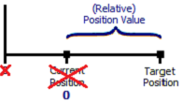
High-Speed Outputs (Axis)
AXPOSTRAP “Axis Move to Position Using Trapezoid” (continued)
Target Type
Absolute – Position Value is measured from the Axis’ zero position
Relative – Position Value is measured from the Axis’ .CurrentPosition
Zero out .CurrentPosition before initial run
If Single Move Type, zeroed out before the move
If Multi-move Type, zeroed on the first move only

Slide 18
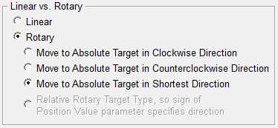
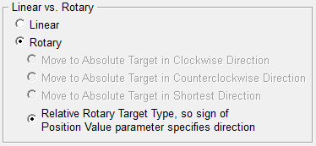
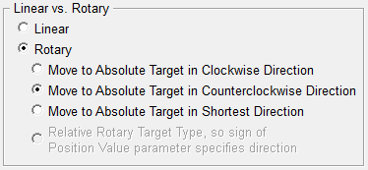
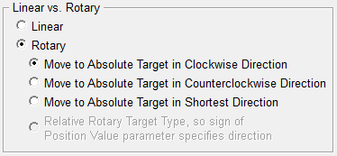
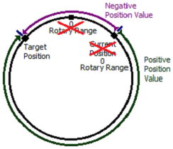
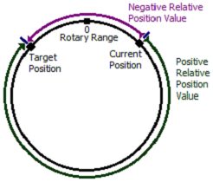
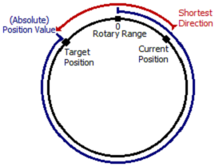
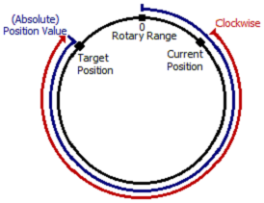
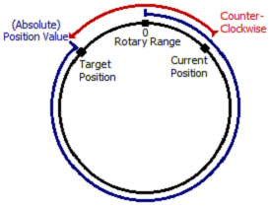
High-Speed Outputs (Axis)
AXPOSTRAP “Axis Move to Position Using Trapezoid” (continued)
Rotary (Absolute)
Clockwise only
Counterclockwise only
Shortest Direction
Rotary (Relative)
Sign of Position Value is direction
Zero-out .Current Position before initial run

Slide 19
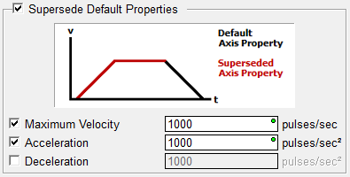
High-Speed Outputs (Axis)
AXPOSTRAP “Axis Move to Position Using Trapezoid” (continuted)
Supersede Default Properties – pick which ones to use; indicated by red graphic color
Maximum Velocity
Acceleration
Deceleration
Success or Error come on:
After a Single Move is complete
If a Multi-Move Type; after the input leg loses power flow

Slide 20
High-Speed Outputs (Axis)
AXPOSSCRV “Axis Move to Position Using S-Curve”
Almost identical to AXPOSTRAP except:
No multi-moves are allowed
Jerk parameter required (rate of change of acceleration / deceleration)

Slide 21
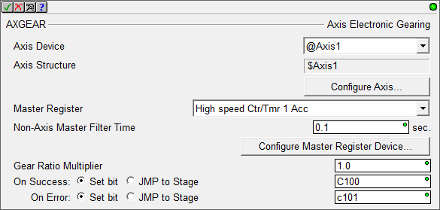
High-Speed Outputs (Axis)
AXGEAR “Axis Electronic Gearing”
Creates a Master / Slave connection that will synchronized the movement of one Axis to another Axis or a High-Speed Counter / Timer.
If velocity-centric:
Slave's velocity is derived from the Master's velocity (adjusted by gear ratio)
Gear Ratio and the Master's Target Velocity can be changed on-the-fly
If position-centric:
Slave's position is derived from the Master position (modified by Gear Ratio)
Changes to Gear Ratio and the Master's Target Position on-the-fly are ignored
Use .MstSlvCoordError to monitor the difference between the Master Axis' position and the Slave Axis' position

Slide 22
High-Speed Outputs (Axis)
AXGEAR “Axis Electronic Gearing” (continued)
Maser Register
Axis0-3 Position
High-Speed Counter / Timer 1-3 Acc
Non-Axis Master Filter Time – only for Counter / Timer inputs; how often Slave’s position is calculated
Gear Ratio Multiplier - multiplier applied to Slave's position or velocity; 0 (zero) means stop; negative values cause opposite motion

Slide 23
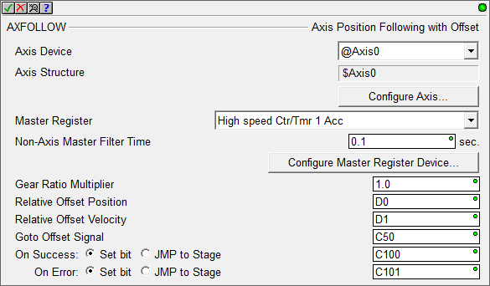
High-Speed Outputs (Axis)
AXFOLLOW “Axis Position Following with Offset”
Similar to AXGEAR except:
Can go to an offset relative position
Can use an offset relative velocity
Causes an Axis to follow a Master’s movement (another Axis or a High- Speed Counter / Timer
Follower Axis needs to overtake the Master Axis if a Goto Relative Offset is commanded so Follower’s Maximum Velocity and Acceleration & Deceleration parameters need to be larger than the Master’s
Use .MstSlvCoordError to monitor the difference between the Master Axis' position and the Slave Axis' position

Slide 24
High-Speed Outputs (Axis)
AXFOLLOW “Axis Position Following with Offset” (continued)
Relative Offset Position – Follower's position will be adjusted by this pulse count value each time the Goto Offset Signal turns ON
Relative Offset Velocity – additional velocity (relative to the Master’s velocity) the Follower will use when moving to the Relative Offset Position
Goto Offset Signal - each time this bit comes ON the Follower will attempt to move to the Relative Offset Position using the Relative Offset Velocity
When Follower reaches Relative Offset Position this bit is turned OFF
If it stays ON then the Follower can’t catch up to the Master
Adjust for higher maximum velocity and/or faster acceleration / deceleration

Slide 25
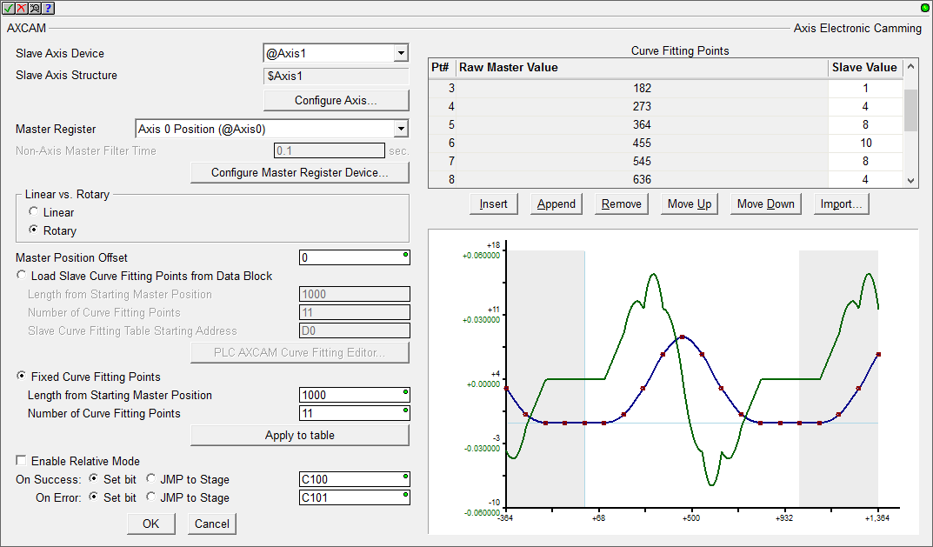
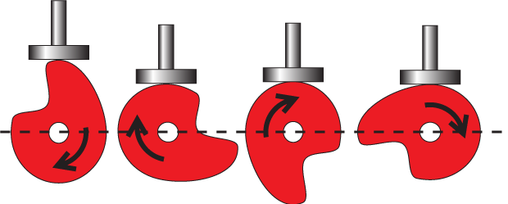
High-Speed Outputs (Axis)
AXCAM “Axis Electronic Camming”
Causes an Axis to synchronize its movement to a Master Axis so that its position corresponds to values in the cam table
Cam Tables can be located right in the instruction, or in PLC memory
There is a configurator dialog to aid in creating Cam Tables in memory
Cam Tables can have up to 64 points
Uses “Cubic Interpolation” to generate a trajectory between each pair of entries in the table
The CPU will fit a smooth curve to the data which will pass through every point in the table

Slide 26
High-Speed Outputs (Axis)
AXCAM “Axis Electronic Camming” (continued)
Master Position Offset – added to the Master Axis position before the associated Slave position value is calculated (cam table can start at an offset)
Table graph will display the value
Load Slave Curve Fitting Points from Data Block – choose this if the cam table is located in PLC memory
Length from Starting Master Position - total number of pulse counts the Master will move
Number of Curve Fitting Points - number of equal-length segments the Length from Master Position will be divided into; 3-64
Slave Curve Fitting Table Starting Address - PLC memory address
Use the <PLC AXCAM Curve Fitting Editor...> button if online to the PLC to generation the table in memory

Slide 27
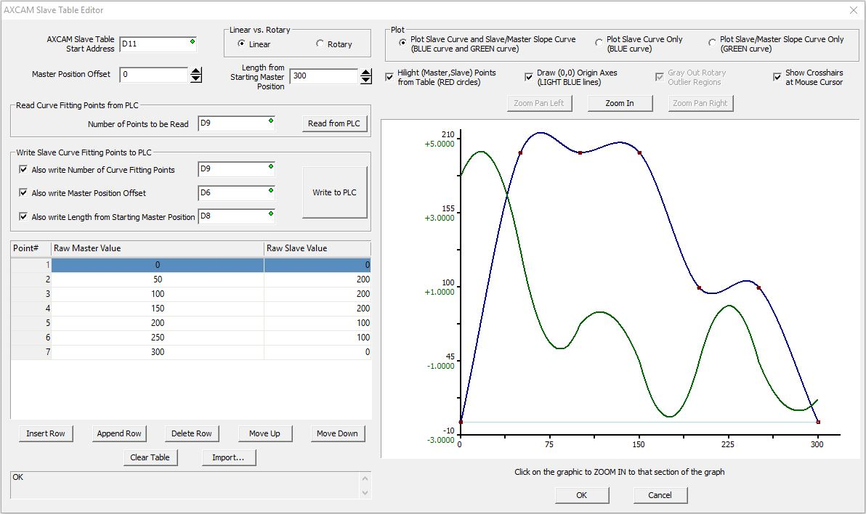
High-Speed Outputs (Axis)
AXCAM “Axis Electronic Camming” (continued)

Slide 28
High-Speed Outputs (Axis)
AXCAM “Axis Electronic Camming” (continued)
Fixed Curve Fitting Points – choose this if the cam table is located in the instruction itself
Length from Starting Master Position
Number of Curve Fitting Points
Use the <Apply to table> button to graph the changes
Enable Relative Mode – if enabled then when the instruction is enabled, the Slave Axis' current position is stored internally and becomes the new 0 (zero) for the Slave Axis

Slide 29
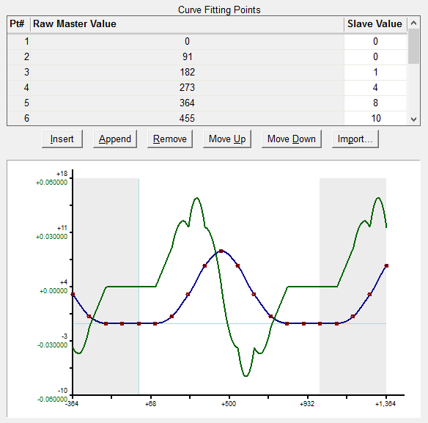
High-Speed Outputs (Axis)
AXCAM “Axis Electronic Camming” (continued)
Green – velocity offset
Blue – position offset
Red – data points from table

Slide 30
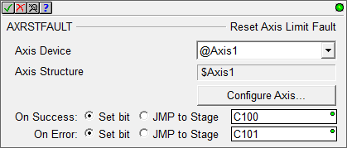
High-Speed Outputs (Axis)
AXRSTFAULT “Reset Axis Limit Fault”
Clears the fault of an Axis that has either:
Triggered one of its Fault Limits, or…
Has had its .MasterEnable manually turned OFF
After clearing the fault any move in the same direction that caused the fault will immediately generate another fault condition
AXCONFIG instruction will also reset an Axis that is in a fault state

Slide 31
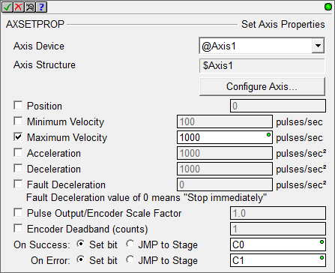
High-Speed Outputs (Axis)
AXSETPROP “Set Axis Properties”
Used to make changes to some of the configured parameters of an Axis without having to re-run an AXCONFIG
Changes made are reflected in all subsequent instructions that reference this Axis
Changes will not affect any Axis instructions that are currently running

Slide 32
High-Speed Outputs (Axis)
Axis ($Axis0, 1, 2 & 3) Structure members:
.TargetVelocity (signed DW; R/W) – velocity (pps) the Axis is accelerating / decelerating toward
.CurRateOfChg (signed DW; R/W) – current velocity (pps) being used during acceleration / deceleration
.TargetPosition (signed DW; RO) – pulse count the Axis is moving toward
.CurrentVelocity (signed DW; RO) – current velocity (pps) of the Axis
.CurrentPosition (signed DW; RO) – current position (pulse count) of the Axis
.FollowingError (signed DW; RO) – when using encoder feedback as Axis position, this value (in pulse counts; not encoder counts) is the difference between the output pulse count (.TargetPosition) and the encoder input value (.CurrentPosition)
Large increasing value could indicate:
Motor stalled
Mechanical slippage
Filter Time Constant is too large
Resolution of encoder is too small

Slide 33
High-Speed Outputs (Axis)
Axis ($Axis0, 1, 2 & 3) Structure members (continued):
.MstSlvCoordError (signed DW; RO) – when a slave axis in AXGEAR, a follower in AXFOLLOW mode, or a slave in AXCAM mode, value (pulse counts, not encoder counts) is difference between the position of the master axis and the projected location of the slave axis; negative value means it is behind; positive value means it is ahead
.Suspend (bit; R/W) – set ON to cause axis to decelerate to stop using the Axis’ deceleration rate; reset OFF to cause axis to acceleration back to .TargetVelocity
.MasterEnable (bit; R/W) – automatically set ON when axis is properly configured; reset OFF to cause axis to decelerate to stop using the axis’ Fault Deceleration Rate; use AXRSTFAULT or AXCONFIG to clear the fault
.EnableOutput (bit; R/W) – automatically set ON when the Axis is properly configured; reset OFF to cause axis to immediately stop (no deceleration rate)
.Configured (bit; RO) - ON if an AXCONFIG has successfully executed
.Active (bit; RO) - ON any time the Axis is enabled and in any mode other than idle
.AtVelocity (bit; RO) - ON when .TargetVelocity = .CurrentVelocity
.AtPosition (bit; RO) - ON when .TargetPosition = .CurrentPosition
.ScriptBusy (bit; RO) - ON when the Axis is running a script (reserved)

Slide 34
High-Speed Outputs (Axis)
Axis ($Axis0, 1, 2 & 3) Structure members (continued):
.Fault (bit; RO) - ON when:
Fault Limit has been triggered, or…
If Axis' .MasterEnable has been manually turned OFF
AXRSTFAULT or an AXCONFIG must be executed to reset OFF
.Mode (unsigned byte; RO) - execution mode
00 (Unconfigured) 130 (Smart Position)
01 (Idle) 131 (Electronic Gearing)
65 (Positive Limit Fault) 132 (Follower)
66 (Negative Limit Fault) 133 (Cam)
67 (Fault Both Limits) 134 (Terminate)
68 (Fault Master Enable) 135 (S-Curve Velocity)
128 (Velocity) 136 (S-Curve-Terminate)
129 (Smart Velocity)

