Slide 1
BRX Technical Training
Onboard Input Digital Filtering

Slide 2
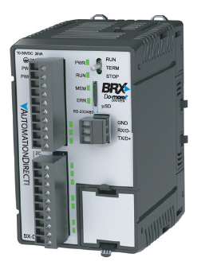
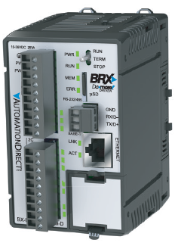
Onboard Input Filters
BX10
6 discrete IN (all high-speed)
Digitally filtered
4 discrete OUT (2 high-speed)
No analog IN
No analog OUT
No Ethernet port
BX10E
6 discrete IN (all high-speed)
Digitally filtered
4 discrete OUT (2 high-speed)
1 analog IN
1 analog OUT
Ethernet port

Slide 3
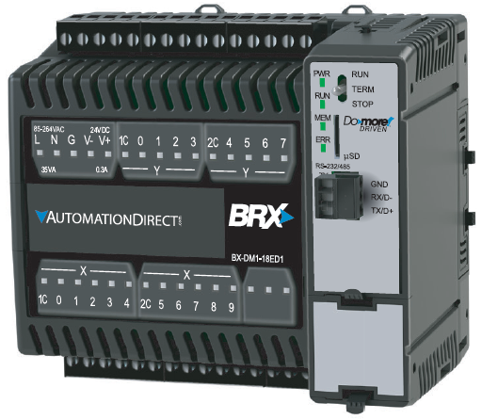
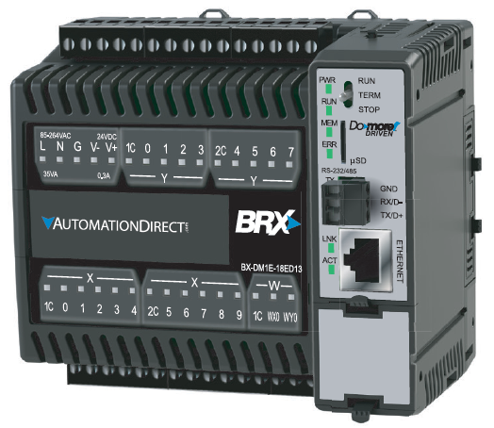
Onboard Input Filters
BX18
10 discrete IN (all high-speed)
Digitally filtered
8 discrete OUT (4 high-speed)
No analog IN
No analog OUT
No Ethernet port
BX18E
10 discrete IN (all high-speed)
Digitally filtered
8 discrete OUT (4 high-speed)
1 analog IN
1 analog OUT
Ethernet port

Slide 4
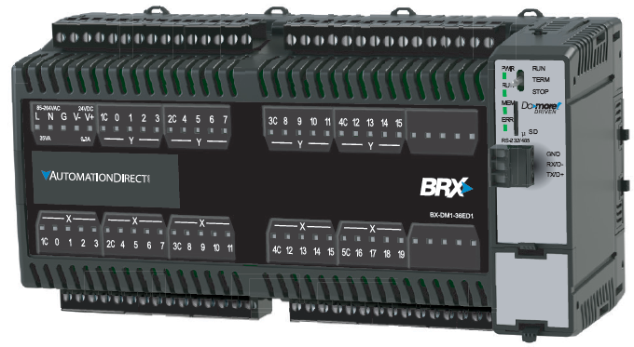
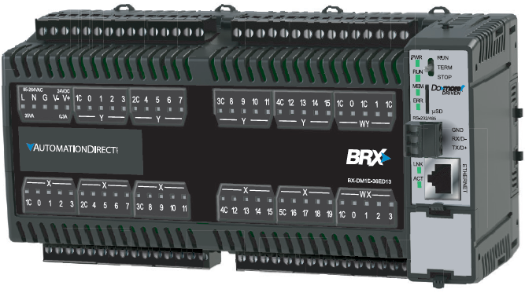
Onboard Input Filters
BX36
20 discrete IN (10 high-speed)
Digitally filtered
16 discrete OUT (8 high-speed)
No analog IN
No analog OUT
No Ethernet port
BX36E
20 discrete IN (10 high-speed)
Digitally filtered
16 discrete OUT (8 high-speed)
4 analog IN
2 analog OUT
Ethernet port

Slide 5
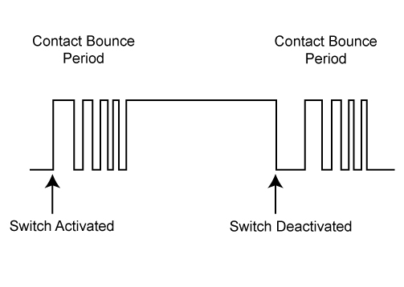
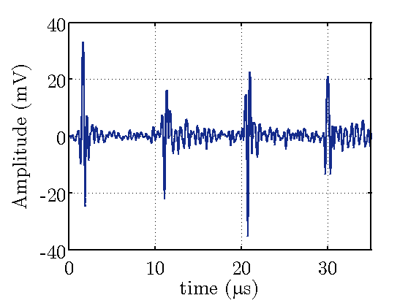
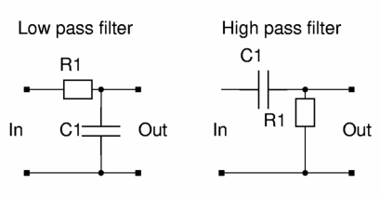
Onboard Input Filters
Purpose
Switch bounce
Electrical noise
Solution
Low-pass filter
Cleaner solution:
Digital low-pass filter

Slide 6
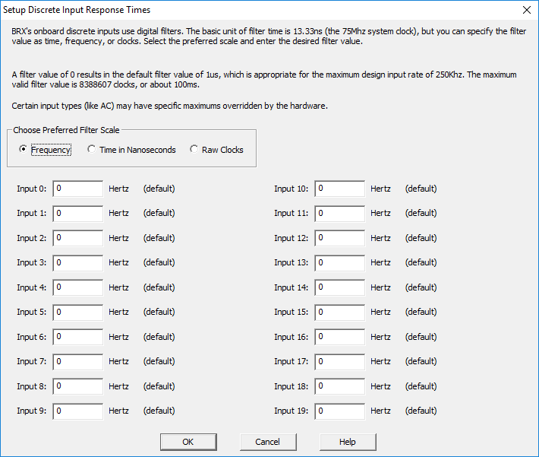
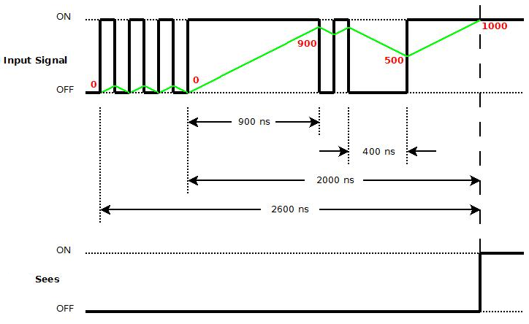
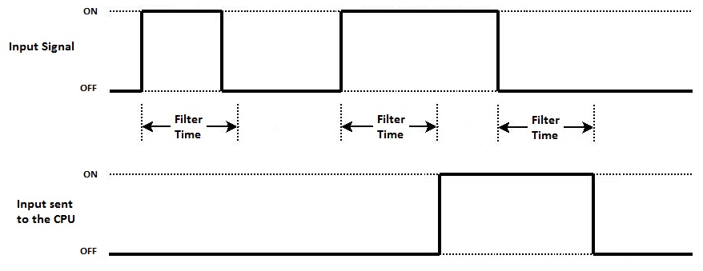
Onboard Input Filters
Digital Filtering
Input state determined every clock tick
System clock is 75MHz thus every 1/75MHz = 13.33ns
Digital filtering is just a counter
If the hardware circuitry sees the input as ON, counter increments by 1
If the hardware circuitry sees the input as OFF, counter decrements by 1
When counter reaches number of raw clock counts preset in filter value, the input is seen as ON
3 ways to enter the filter value

