Slide 1
Do-more Technical Training
Communications
(Custom TCP)

Slide 2
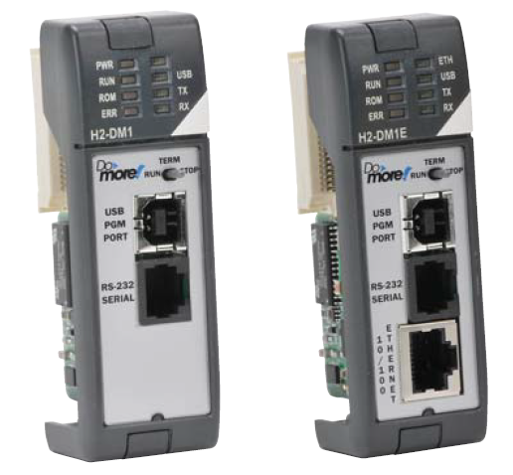
Communications – Custom TCP
Do-more built-in Ethernet

Slide 3
Communications – Custom TCP
Serial & TCP Protocols are streams of data
Serial medium is usually a private conversation
I’ll say ‘bye’.
OK. I will talk at this rate and only to you.
I’m only going to give you 5 data points.
I need to give you the latest data on the weather.
OK, but don’t talk too slow; I’ve got other things to do.
Stream of weather data…
How will I know when the conversation is complete?
OK, I’m listening…
Bye
Thanks.
IMPLIMENTATION: Partner listens.
IMPLIMENTATION: Transfer complete
ENGINEERING: What type of data will be sent?
IMPLIMENTATION: (Processes data)
ENGINEERING: How will the data end?
ENGINEERING: How is the data transmitted?

Slide 4
Communications – Custom TCP
TCP Protocol medium is a network
TCP is connection-based protocol
Dial
Ring
OK. I’ll call you later.
I’m sorry, but I’m pretty busy at the moment.
Can we talk?
Hello?
Dial
Ring
A “connection” must be established before a conversation can take place. The client (man) must call the server (woman). One is initiating and the other is listening.
<starts conversation>
Can we talk?
Hello?
Sure. What’s up?
The conversation is delimited because both parties will agree on when it is over and say, “Bye”, just like serial comms.

Slide 5
Communications – Custom TCP
UDP Protocol medium is also a network
UDP is connectionless protocol
Since no connection is needed, no resources (i.e. cellphone) are monopolized
A “connection” is not necessary. The client (man) simply sends a message to the server (woman).

Slide 6
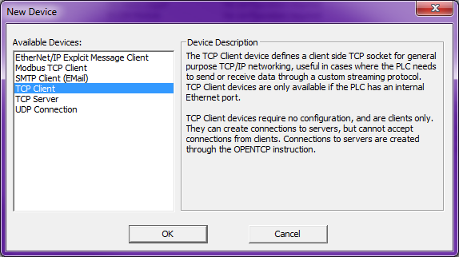
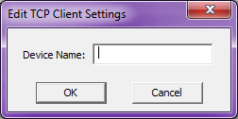
Communications – Custom TCP
TCP Client (Master/Initiator)
Do-more CPU with built-in Ethernet port
Must create a TCP Client Device
Use Device Configuration & <New Device> button → “TCP Client”, press <OK> button
Give it a Device Name
Use the OPENTCP instruction to establish connection to partner (Server/Slave)
Use STREAMOUT/STREAMIN instructions to send/receive data to/from partner (Server/Slave)

Slide 7
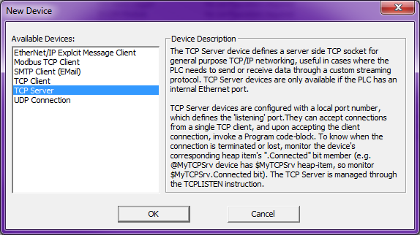
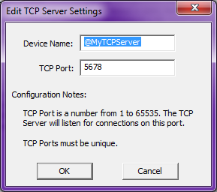
Communications – Custom TCP
TCP Server (Slave/Listener)
Do-more CPU with built-in Ethernet port
Must create a TCP Server Device
Use Device Configuration & <New Device> button → “TCP Server”, press <OK> button
Give it a Device Name & TCP Port number
Use the TCPLISTEN instruction to listen for connection request from partner (Client/Master)
Use STREAMIN/STREAMOUT instructions to send/receive data to/from partner (Client/Master)

Slide 8
Communications – Custom TCP
Custom Protocol | Type | Data Size | Client Instruction | Server Instruction | Server Member
Serial | Stream | Unlimited | STREAMOUT | STREAMIN | InQueue (# of bytes)
 |  |  | STREAMIN | STREAMOUT
TCP |  |  | OPENTCP | TCPLISTEN
 |  |  | STREAMOUT | STREAMIN
 |  |  | STREAMIN | STREAMOUT
UDP | Packet | 1 packet | PACKETOUT | PACKETIN | PacketAvailable (bit)

Slide 9
Communications – Custom TCP
@MyTCPClient (Master)
TCP/IP
@MyTCPServer (Slave)
SYN
TCP Connection Established
TCP Connection
Established
Establish TCP Connection
SYN, ACK
ACK
If Server does not respond in 15 seconds (not configurable) the OPENTCP instruction errors out
Output Buffer
“TIME”<CR><LF>
Input Buffer
“TIME”<CR><LF>
The logic for the STREAMIN can be set to monitor the InQueue value & when it is executed, will read the data out of the Input Buffer
“TIME” <CR><LF>
InQueue = 0
InQueue = 6
OPENTCP must be enabled in order for the connection request to be sent to the Server/Slave
TCPLISTEN must be enabled in order for the Server (Slave) to listen for the connection request
The data goes into the @MyTCPServer Device’s Input Buffer where it will stay until a STREAMIN is executed to get the data out
When the @MyTCPClient Device “gets around to it”, it sends the data in its Output Buffer out on the wire
STREAMOUT
“TIME”<CR><LF>
STREAMIN
@MyTCPServer Device’s structure member, InQueue, is set to indicate how many bytes are currently in the Input Buffer
STREAMOUT does not send data out on the wire; it merely writes the data to the @MyTCPClient Device’s Output Buffer
Memory
“TIME”<CR><LF>
OPENTCP
TCPLISTEN

Slide 10
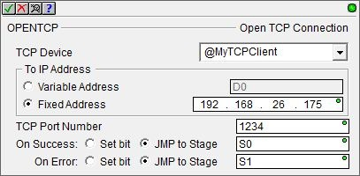
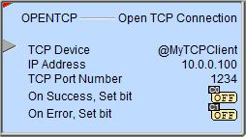
Communications – Custom TCP
OPENTCP “Open TCP Connection”
Opens TCP Client Device & attempts to establish a TCP connection to a TCP server device
Structure member Open comes ON when the TCP Client is opened
Structure member Connected comes ON when the TCP Server responds with a connection acknowledgement
Fully asynchronous instruction (red triangle)
Parameters:
TCP Device – TCP client Device
To IP Address: TCP server’s IP address
Variable Address or Fixed Address
TCP Port Number
On Success: Set bit, JMP to Stage
On Error: Set bit, JMP to Stage

Slide 11
Communications – Custom TCP
TCPLISTEN “Start Listening on TCP Port”
Listens for a TCP Client connection request & then runs a Program
Structure member Connected comes ON when a connection request is acknowledged
Fully asynchronous instruction (red triangle)
Parameters:
Device – TCP Server Device
On connect, run Program: name of the Program that will run whenever a TCP connection from a TCP Client has been made successfully

Slide 12
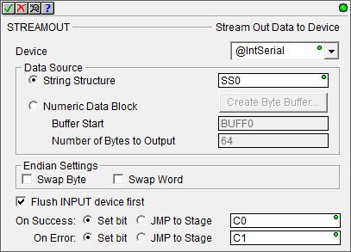
Communications – Custom TCP
STREAMOUT “Stream Out Data to Device”
Writes data from to stream-capable device
Fully asynchronous instruction (red triangle)
Parameters:
Device – stream-capable Device
Data Source:
String Structure – string to send
Numeric Data Block
Buffer Start – location of start of data buffer to send
Number of Bytes to Output
Endian Settings:
Swap Byte
Swap Word
Flush INPUT device first
On Success: Set bit, JMP to Stage
On Error: Set bit, JMP to Stage

Slide 13
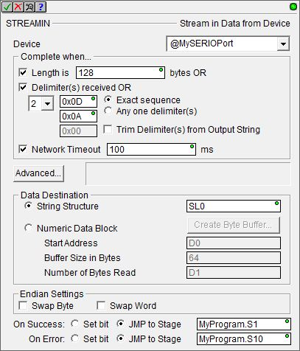
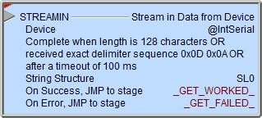
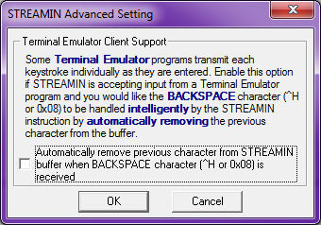
Communications – Custom TCP
STREAMIN “Stream in Data from Device”
Reads data from a stream-capable device
Fully asynchronous instruction (red triangle)
Parameters:
Device – stream-capable Device
Complete when…
Length is x bytes OR
Delimeter(s) received OR
Number of delimiters
Delimiter characters
Exact sequence
Any one delimiter(s)
Trim Delimiter(s) from Output String
Network Timeout
<Advanced…> button
Data Destination
String Structure
Numeric Data Block
Start Address
Buffer Size in Bytes
Number of Bytes Read
Endian Settings: Swap Byte, Swap Word
On Success/On Error: Set bit, JMP to Stage
When attempting to get a STREAMIN to work the first time, the importance of Network Timeout cannot be overstressed because without it the STREAMIN has potential to lock the streaming Device

Slide 14
Communications – Custom TCP
TCP Client (Initiator)
TCP Server (Listener)
Do-more CPU
Do-more CPU
Memory
Memory
OPENTCP
TCPLISTEN
STREAMOUT
@TCPClnt
TCP/IP
@TCPSrv
STREAMIN

Slide 15
Communications – Custom TCP
Communications Test
IP Address: 10.1.1.200
TCP/IP Port #: 5678
Commands delimited by <CR><LF>:
TIME
Response: “Current PLC Time is: 04:02:14 PM”
DATE
Response: “Current PLC Date is: 3/11/2016”
SCANTIME
Response: “Current PLC Scan Time is: 561us”
FIRMWARE
Response: “Current PLC Firmware is: 176201”
IPADDRESS
Response: “Current PLC IP Address is: 10.1.1.200”

