Slide 1
BRX Technical Training
High-Speed I/O (PWM Outputs)

Slide 2
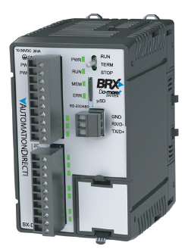
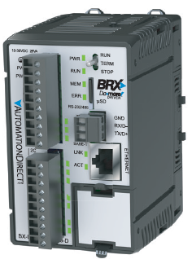
High-Speed I/O
BX10
6 discrete IN (all high-speed)
4 discrete OUT (2 high-speed)
No analog IN
No analog OUT
No Ethernet port
BX10E
6 discrete IN (all high-speed)
4 discrete OUT (2 high-speed)
1 analog IN
1 analog OUT
Ethernet port

Slide 3
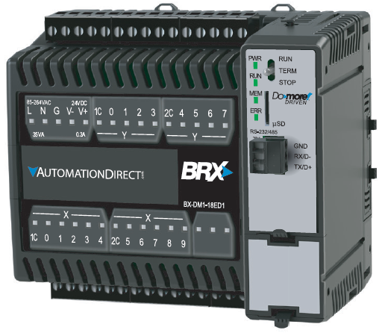
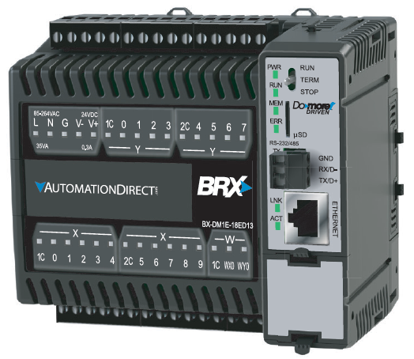
High-Speed I/O
BX18
10 discrete IN (all high-speed)
8 discrete OUT (4 high-speed)
No analog IN
No analog OUT
No Ethernet port
BX18E
10 discrete IN (all high-speed)
8 discrete OUT (4 high-speed)
1 analog IN
1 analog OUT
Ethernet port

Slide 4
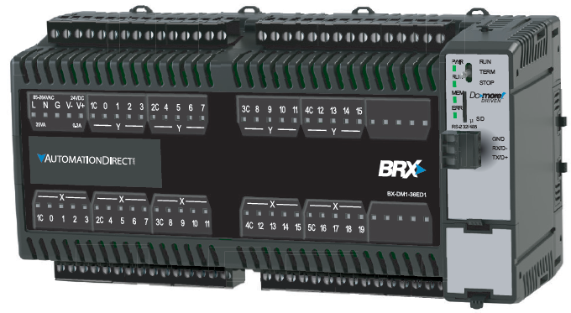
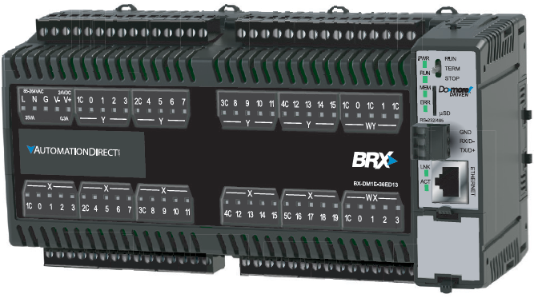
High-Speed I/O
BX36
20 discrete IN (10 high-speed)
16 discrete OUT (8 high-speed)
No analog IN
No analog OUT
No Ethernet port
BX36E
20 discrete IN (10 high-speed)
16 discrete OUT (8 high-speed)
4 analog IN
2 analog OUT
Ethernet port

Slide 5
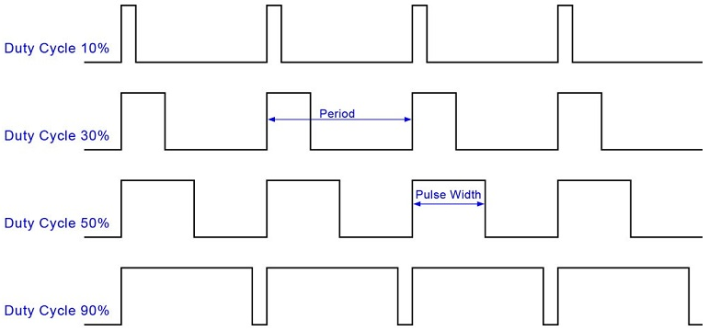
High-Speed Outputs (PWM Outputs)
PWM = Pulse Width Modulation

Slide 6
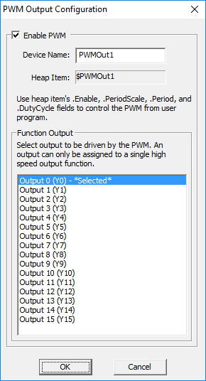
High-Speed Outputs (PWM Outputs)
Select Device Name & Output
Use Structure Members to control the PWM Output
.EnableOutput (bit; R/W) – set ON to generate pulses; OFF to stop
.PeriodScale (bit; R/W) – if OFF the .Period is in microseconds; if ON, milliseconds
.Period (unsigned word; R/W) – 0 to 65,535 micro- or milliseconds
.DutyCycle (real; R/W) – percentage of the .Period the pulse will be ON; 0.0 to 100.0%

