Slide 1
BRX Technical Training
File System

Slide 2
File System
Do-more Technology Version 2.0 added:
RAM Drive File System (@RamFS)
All Do-mores can support the FILE instructions with a firmware upgrade
BRX supports this by default
1 MB available system RAM
Contents lost:
If CPU is powered down
If REBOOT instruction is executed
Can have 512 entries (files and folders) in root folder
Can have 3000 entries in each sub-folder
Long file names supported but use up entry memory

Slide 3
File System
Do-more Technology Version 2.0 added:
SD Card File System (@SDCardFS)
Only BRX supports
Automatically created and mounted when the SD card is inserted
The $SDCardFS.MediaInstalled and $SDCardFS.MediaMounted bits will be ON if there is a functional file system available
Uses FAT32 formatted media
Micro-SD card must be formatted in a PC before it can be used in a Do-more CPU
This limits the size of SD card to 32GB
Any media larger must be reformatted to FAT32
SD cards formatted as NTFS or exFAT will not mount properly (MEM LED remains red)
Same entry spec as @RamFS
Use utility program called Browse PLC File Systems manage the contents of the two file systems
Browse contents of the folders
Copy files between PLC & PC
Delete files on the PLC
New EMAIL parameter allows the attachment of files from PLC’s file systems

Slide 4
File System
Structure members
.FolderEntryNum (unsigned word; RO) – number of file & subfolders found after scanning contents of folder; use with FILEQUERY
.StartFolderScan (bit; R/W) – set ON to initiate a folder scan operation; use with FILEQUERY
.FolderScanDone (bit; R/W) – ON at the completion of a folder scan operation; use with FILEQUERY
.RemovableMedia (bit; RO) – ON if file system has a slot for removable media (e.g. micro SD slot)
.MediaInstalled (bit; RO) – ON if media is installed (e.g. micro SD is plugged in)
.MediaMounted (bit; RO) – ON if media is installed & mounted (e.g. micro SD card is installed & formatted)
.FreeSpaceKB (signed doubleword; RO) – remaining number of KB of storage left on the file system
.TotalSpaceKB (signed doubleword; RO) – number of KB of total usable storage

Slide 5
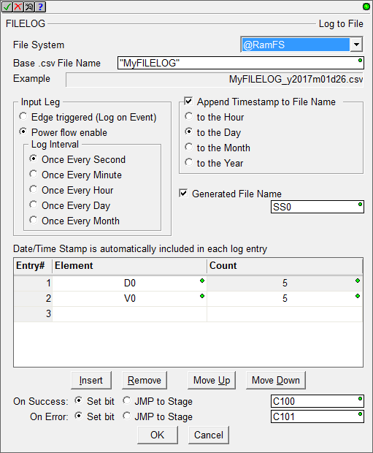
File System
FILELOG “Log To File”
Pick File System
Input Leg
Edge triggered
Power flow enable
Log Interval
Append Timestamp to File Name – since this names the file, if “to the Day” is picked then when the day changes a new file is created with the new name
Generate File Name – stores the current file name in a string for use with other instructions
Entries:
Up to 50 entries
Count must be <= 10
Date/Time prefixes every entry automatically
Store the current File Name in SS0 for convenience

Slide 6
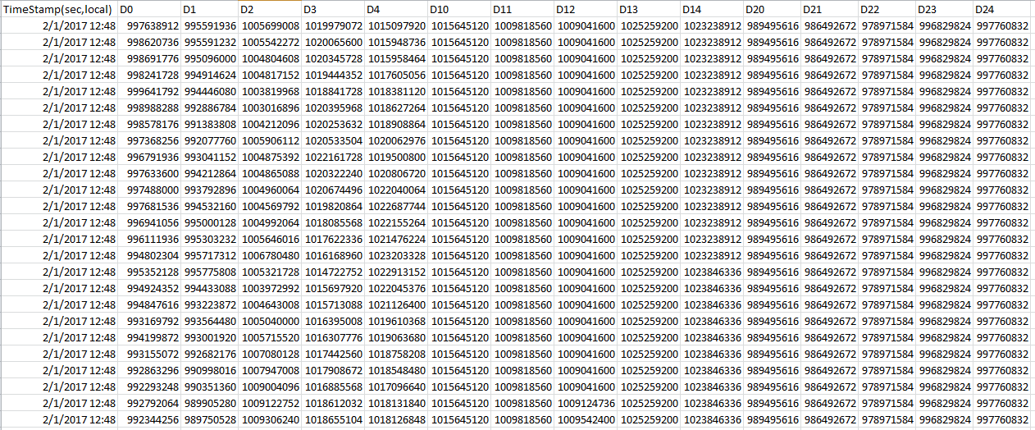
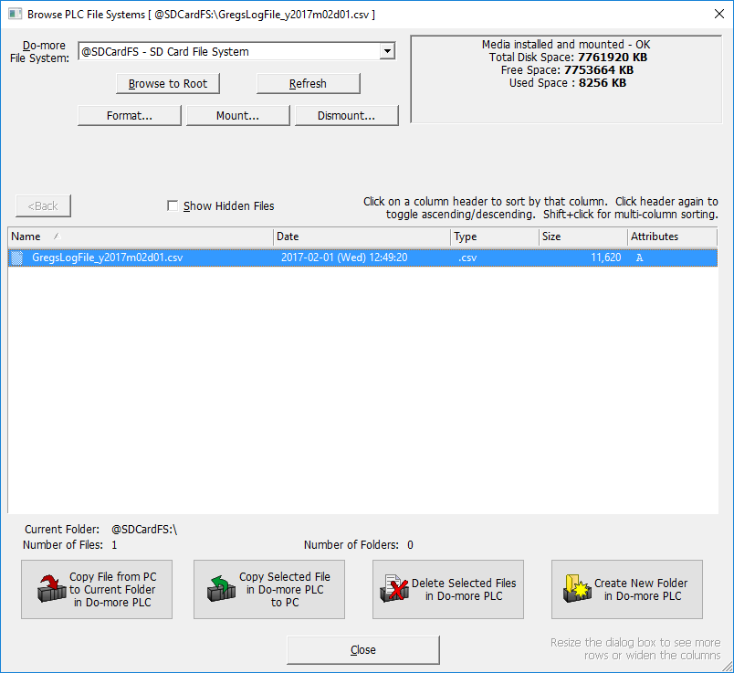
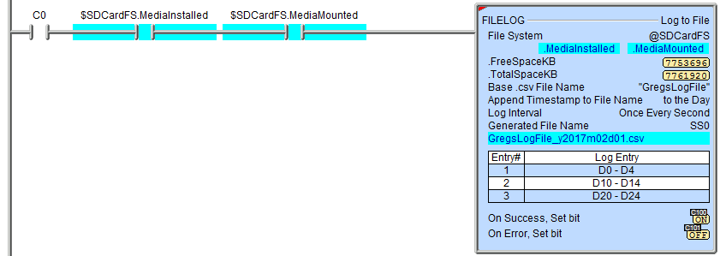
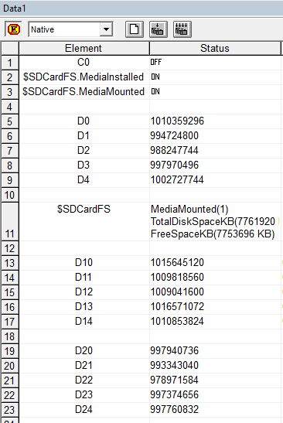
File System
FILELOG “Log To File” example

Slide 7
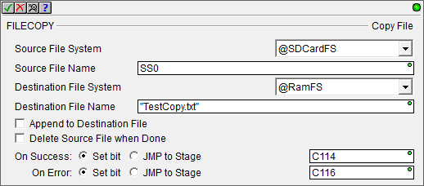
File System
FILECOPY “Copy File”
Simply copies a file
This is where the Generate File Name parameter of the FILELOG instruction can come in handy

Slide 8
File System
FILEDEL “Delete File”
Simply deletes a file
This is where the Generate File Name parameter of the FILELOG instruction can come in handy

Slide 9
File System
FILENEWFLDR “Make New Folder”
Creates a new folder

Slide 10
File System
FILESYSCMD “Perform File System Command”
Pick Command:
Format – removes all files & folders on selected File System (only valid for @RamFS File System)
Dismount – prepares the @SDCardFS File System media for extraction
All open files will be closed
Any outstanding file operations will complete
MEM light on BRX CPU will turn red
Mount – prepares the @SDCardFS File System for use
MEM light on BRX CPU will turn green

Slide 11
File System
FILEOPEN “Open File”
Uses a File Handle Structure (e.g. FILE_0) which will be created if it doesn’t already exist, with the following members:
.DeviceID (unsigned word; RO) – IDs this file handle
.Open (bit; RO) – ON if file is open
.Success (bit; RO) – (not used)
.Error (bit; RO) – (not used)
.EndOfFile (bit; RO) – ON if .FilePointer is at the end of the file
.FileSize (signed Dword; RO) – number of bytes in file
.FilePointer (signed Dword; RO) – current location being pointed to in the file
Where FILEREAD, FILEWRITE & FILETRUNC operations will be executed

Slide 12
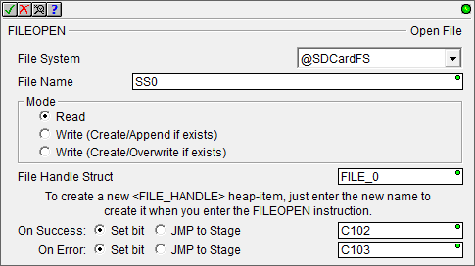
File System
FILEOPEN “Open File” example
Use the File Name that was stored in SS0 from the previous example instead of having to type in the name manually

Slide 13
File System
FILEREAD “Read from File”
References a File Handle Structure (e.g. FILE_0)
Exactly like a STREAMIN instruction
Define delimiters
If a FILELOG was used to create the lines in the file, then the delimiters will be:
0x0D (carriage return)
0x0A (line feed)
Store the data in a string or numeric data block

Slide 14
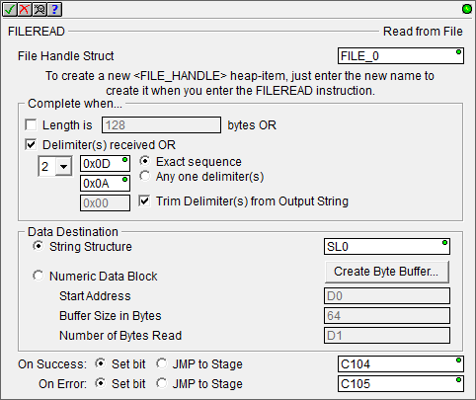
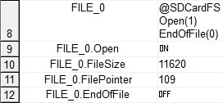
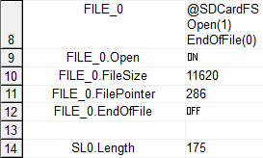
File System
FILEREAD “Read from File” example

Slide 15
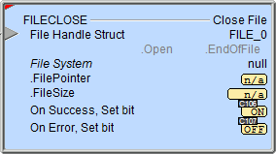
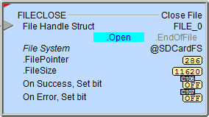
File System
FILECLOSE “Close File”
References a File Handle Structure (e.g. FILE_0)
Simply closes the file

Slide 16
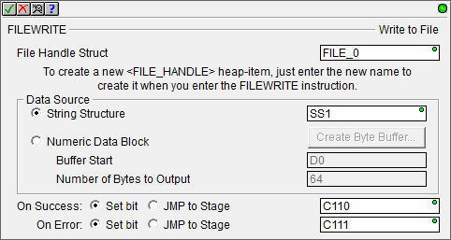
File System
FILEWRITE “Write to File”
References a File Handle Structure (e.g. FILE_0)
Exactly like a STREAMOUT instruction

Slide 17
File System
FILEWRITE “Write to File” example
I want to append a statement to the end of an already-existing file:
“This is the end of file:” and then use the name of the file itself
Use a STRPRINT with “This is the end of file:” SS0
The key is to use FILEOPEN and open it as “Write (Create/Append if exists)”
This will open the existing file and set the .FilePointer to the end of the file
Thus .EndOfFile bit will be ON as well

Slide 18
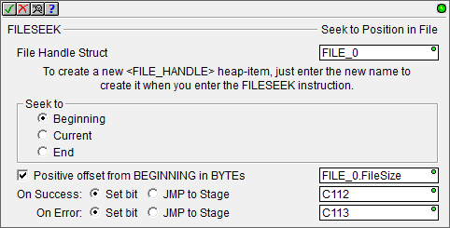
File System
FILESEEK “Seek to Position in File”
References a File Handle Structure (e.g. FILE_0)
File referenced must be already open
To open to the end of a file, for example:
Set Seek to = Beginning
Set Positive offset from BEGINNING = FILE_0.FileSize
Use this to point anywhere in a file

Slide 19
File System
FILETRUNC “Truncate File”
References a File Handle structure (e.g. FILE_0)
Truncates an open file at the .FilePointer location
Typical use:
Open a file using FILEOPEN
Use FILESEEK to set .FilePointer to the location in the file where the truncation is to happen
Execute the FILETRUNC

Slide 20
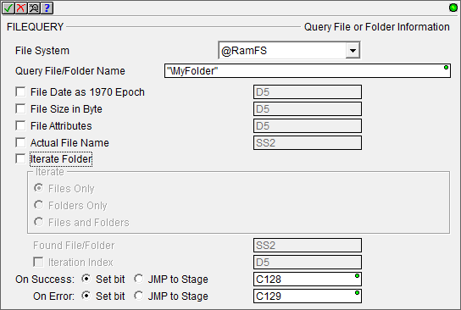
File System
FILEQUERY “Query File or Folder Information”
Used for 3 main functions:
Existence – check for the existence of a particular filename
Information – gather any or all of 4 characteristics of a file or folder in a particular folder:
Date
Size
Attributes
Actual Name
Iteration – gather any or all of the above 4 characteristics of all the files and folders in a particular folder

Slide 21
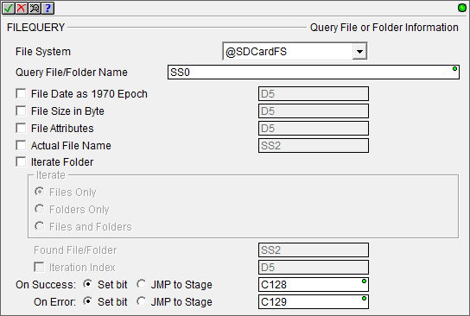
File System
FILEQUERY “Query File or Folder Information”
Existence
Checking for the existence of this File Name (SS0)
These parameters are not used when just checking for the existence of a file
If the File Name exists C128 will be ON
If the File Name does not exist C129 will be ON

Slide 22
File System
FILEQUERY “Query File or Folder Information”
Information (4 characteristics can be queried)
File Date – when the file was last written to, in 1970 Epoch format (number of seconds since January 1, 1970)
File Size in Bytes
File Attributes – double word defined as:
Bit0 – ON = read only (cannot be modified)
Bit1 – ON = hidden (cannot be seen)
Bit2 – ON = system file (cannot be modified)
Bit3 – ON = volume label (name of the file is the file system’s volume name created when the file system was formatted)
Bit4 – ON = directory (folder; the Query File/Folder Name entry is a folder, not a file)
Bit5 – ON = archive (bit is set ON when the file is created or when it is modified)
Bits 6-31 – Not used
Actual File Name – string, fully qualified file name as stored in the file system
<Bits 6-31 not used>
5
4
3
2
1
0
Folder
System
Archive
Volume
Hidden
Read Only

Slide 23
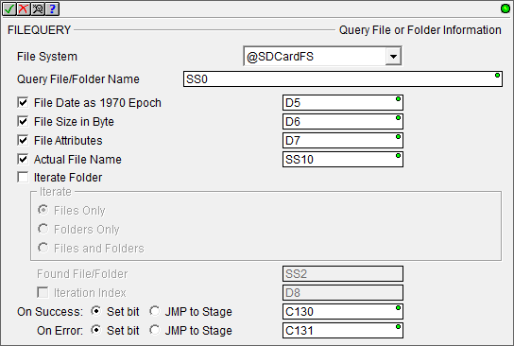
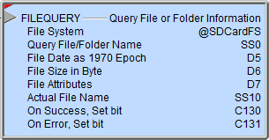
File System
FILEQUERY “Query File or Folder Information”
Information (4 characteristics can be queried)
All of these parameters are optional

Slide 24
File System
FILEQUERY “Query File or Folder Information”
Iteration (4 characteristics can be queried) – the iteration query is executed manually using structure members of the file system
For each characteristic queried, create a unique block of memory to store the information
e.g. Block of 256 strings to store the FileNames
e.g. Block of 256 signed DWords to store FileDates
e.g. Block of 256 signed DWords to store FileSizes
e.g. Block of 256 signed DWords to store FileAttributes
Clear those blocks (e.g. MEMCLEAR)
Set .StartFolderScan bit ON
Reset .FolderScanDone bit OFF
Zero out Iteration Index parameter chosen in the FILEQUERY instruction
Execute the FILEQUERY instruction
This will store the characteristics in the blocks above for ONE file/folder found and then increment the Iteration Index parameter in preparation for next query
If no more files/folders exist in the folder, then .FolderScanDone bit will be ON indicating FILEQUERY should not be executed again
If .FolderScanDone bit is still OFF, then the FILEQUERY can be executed again to get the next set of characteristics for the next file/folder
See Help file for excellent example of iteration using Stages

